Slide 1
School Librarians Advancing STEM Learning
Module #5: Student Work Wednesday, September 6, 2017, 7pm ET / 4pm PT
Institute for the Study of
KNOWLEDGE MANAGEMENT IN EDUCATION
ISKME 2016:

Slide 2
Project Team Introductions
Professional Learning Academy Team:
Amee Godwin, Director, Innovation, ISKME
Megan Simmons, Education Program Lead, ISKME
Joanna Schimizzi, Common Core and Science SME
Gail March, Londonderry
Susan Ballard, Granite State
Lauren Schultz, Independence
Notes:
7:00-7:02

Slide 3
Today’s agenda
Reflect on Advocacy
Our Goals in Examining Student Work
Draft Publishing
Peer Feedback
Final draft, SLASL survey and wrap-ups
Notes:
7:02-7:04

Slide 4
Shout it from the rooftops!
Planning for your advocacy
Why do you want to shout about SLASL from the rooftops?
Planning for your advocacy
Let’s make it SMART!
Notes:
Participants will discuss this in the chat box. (7:04-7:09)
Review checklist to make revisions to Advocacy goals (7:09-7:14)

Slide 5
What’s NEXT: Unit Template
1. Unit Title
2. Background on Teacher/LMS relationship
3. Unit Description
4. Standards addressed (assessed)
5. Unit Essential Question
6. Goals for Using Inquiry
7. Summative Assessment and Description
8. Prior Knowledge Needed
9. Student Objectives
10. Text Set Description
11. Lesson Breakdown/Pacing, Planning to Co-Teach
12. Student work samples
13. Teacher reflections

Slide 6
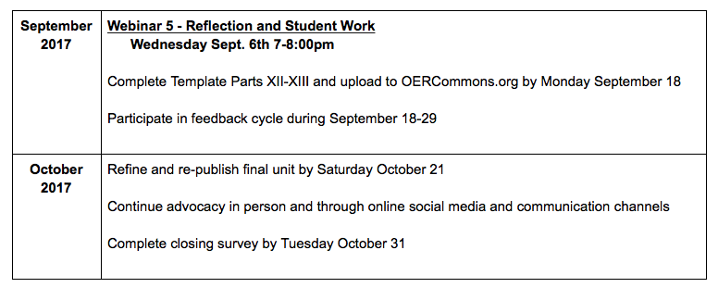
Final Work Flow

Slide 7
Part 12: Why do we reflect on student work?
Share out in the chat box...
Notes:
7:15-7:18

Slide 8
To accompany your student work samples, please reflect on:
Formative assessment opportunity
Where were your students successful?
Where did your students struggle?
Notes:
7:18-7:22

Slide 9
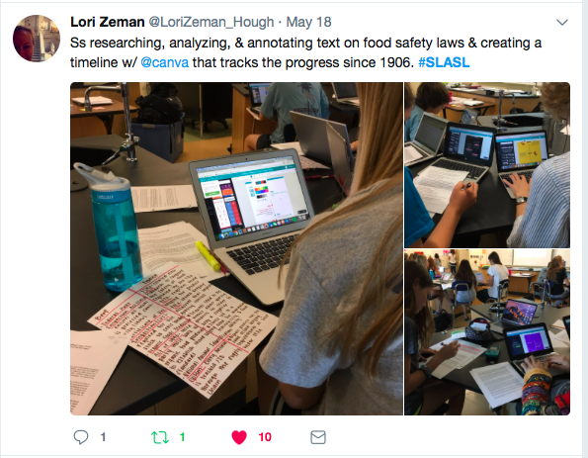
To accompany your student work samples, please reflect on:
2. Teacher reflection on the design of the lesson
How well did our design incorporate inquiry?
How well did our design incorporate literacy?
How well did our design incorporate open education practices?
Notes:
7:22-7:27 - Ask Lori question about OEP

Slide 10
To accompany your student work samples, please reflect on:
3. Teacher reflection on the implementation of the lesson
What were the strengths of our collaboration in teaching the unit?
How can collaboration continue to strengthen our unit?
Notes:
7:27-7:30

Slide 11
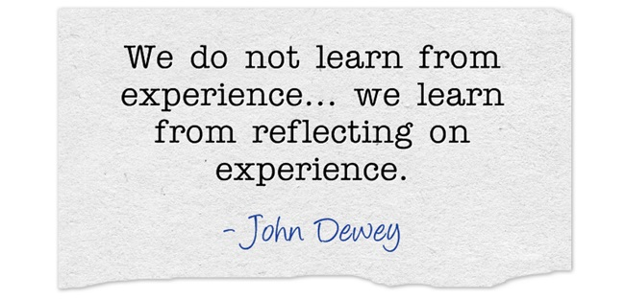
Part 13 - Final Reflection
Each member of the team should reflect on the SLASL process as a whole
Notes:
7:30-7:32

Slide 12
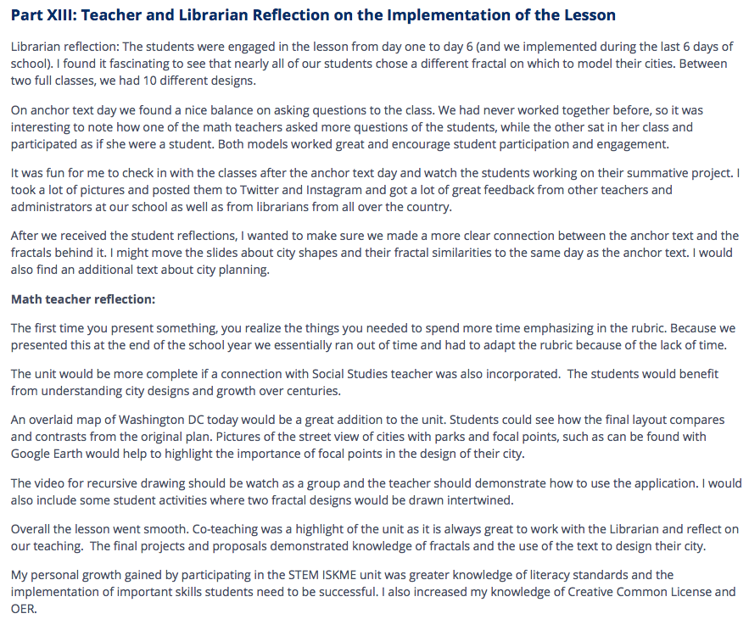
Part 13 - Final Reflection
Notes:
7:32-7:35

Slide 13
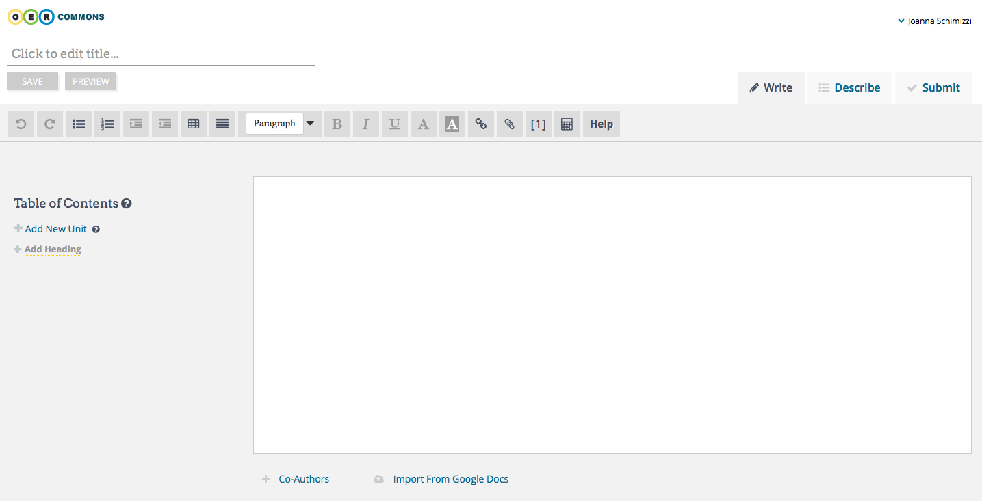
Uploading to OER (by Sept. 18th)
Notes:
7:40-7:50 - Walk through authoring process (Will send out guide to authoring as well)

Slide 14
Peer Feedback Best Practices
Be specific, helpful and kind
Something I like about this lesson is….
Something that can be improved about this lesson is…
Something I didn’t understand is…
One way this lesson can be used and shared across STEM is…
One new idea to consider in the design of this lesson is…
Notes:
7:50-7:53

Slide 15
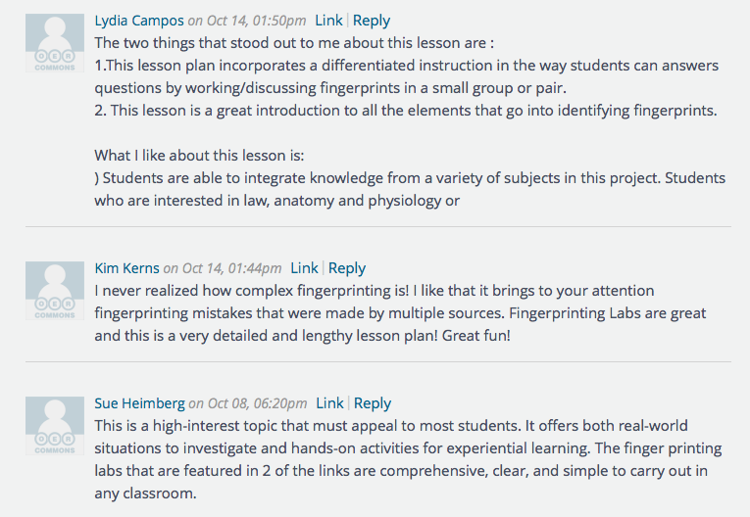
Let’s discuss this example from 2015
Notes:
7:53-7:57

Slide 16
Giving peer feedback:
Keep in mind:
The goals of the project (Inquiry, Literacy, OEP)
Specific, helpful, kind
Please read through two units and leave feedback by September 29th
Notes:
7:57-8:00

Slide 17
Final Work Flow
Notes:
8:00-8:01

Slide 18
amee@iskme.org
megan@iskme.org
jschimizzi@gmail.com
laurenr.schultz@cms.k12.nc.us

