Slide 1

Natural Language Processing using Big Data
Stephen Johnson, PhD, FACMI
Professor, Division of Health Informatics
Weill Cornell Medicine

Slide 2
Outline
Time | Topic
1:00-1:30 | Introduction
1:30-2:00 | Language
2:00-2:30 | Natural Language
2:30-3:00 | Natural Language Processing
3:00-3:30 | Break
3:30-4:00 | Natural Language Data
4:00-4:30 | Big Natural Language Data
4:30-5:00 | Using Big Data
5:00-5:30 | Questions and Discussion
processing
language
using
natural
data
big

Slide 3
Outline
Time | Topic
1:00-1:30 | Introduction
1:30-2:00 | Language
2:00-2:30 | Natural Language
2:30-3:00 | Natural Language Processing
3:00-3:30 | Break
3:30-4:00 | Natural Language Data
4:00-4:30 | Big Natural Language Data
4:30-5:00 | Using Big Data
5:00-5:30 | Questions and Discussion
processing
language
using
natural
data
big

Slide 4



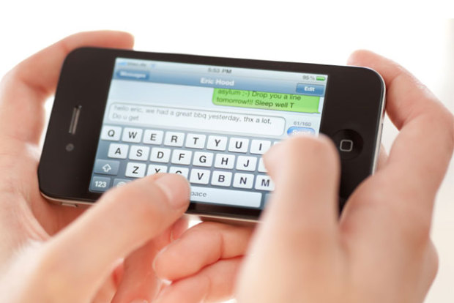
Sources of Medical Language

Slide 5
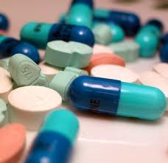



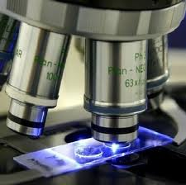
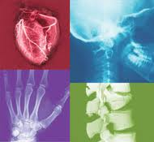


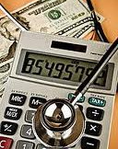




Clinical Structured Data
Pharmacy
Laboratory
Pathology
Radiology
Documentation
Administrative
5

Slide 6

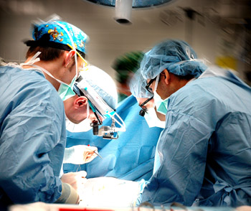
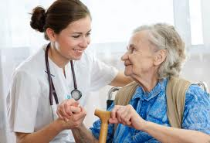
Clinical Unstructured Data
Pathology
Radiology
Progress
Nursing
Surgery
Discharge

Slide 7





Structured Data
Clinician
Researcher
Coder
Unstructured Data

Slide 8
Natural Language Processing
Unstructured Data (text)
Structured Data (codes)

Slide 9
The Science of Language
Medicine
Linguistics
Computer Science
Natural Language Processing
Medical Language Processing
Sublanguage
Artificial Language
Natural Language

Slide 10
Outline
Time | Topic
1:00-1:30 | Introduction
1:30-2:00 | Language
2:00-2:30 | Natural Language
2:30-3:00 | Natural Language Processing
3:00-3:30 | Break
3:30-4:00 | Natural Language Data
4:00-4:30 | Big Natural Language Data
4:30-5:00 | Using Big Data
5:00-5:30 | Questions and Discussion
processing
language
using
natural
data
big

Slide 11
Artificial (Formal) Language
A language is a set of strings over a given alphabet, as defined by a set of rules (grammar)
Alphabet Σ = {a, b}
Grammar G = a*b*
  Zero or more a’s followed by zero or more b’s
  L(G) = {Ø, a, aa, aaa, ab, aab, bbb, … }

Slide 12
Grammar Notation
Non-Terminal (Variable)
  Can be further expanded by other rules
  Grammar Rule
  X → YZ
Terminal (Constant)
  No further expansion
  Lexical Entry
  Y → b
Start Symbol
  Special non-terminal that describes whole sequence
  S
Null Symbol
  Special Terminal that represents empty (null) sequence
  Ø

Slide 13
Grammar Types
Unrestricted
Context Sensitive
Context Free
Regular
Regular
  X → aY
  X → a
Context Free
  X → YZ
  X → a
Context Sensitive
  XY → WZ
  X → YZ
  X → b
Unrestricted
  XY → WZ
  X → YZ
  X → b
  X → Ø

Slide 14
Example: Regular Grammar / Language
  S → A
  A → aA
  A → a
  A → B
  B → aB
  B → b
  What language does this grammar define?

Slide 15
Modeling Language Structure
Infinite number of potential sequences
Finite set of rules to describe them
Rules used in two ways:
Parsing:
  Begin with a sequence
  Apply right hand side of rules
  Continue until we derive start symbol
Generation:
  Begin with the start symbol
  Apply left hand side of rules
  Continue until we produce a sequence

Slide 16
Outline
Time | Topic
1:00-1:30 | Introduction
1:30-2:00 | Language
2:00-2:30 | Natural Language
2:30-3:00 | Natural Language Processing
3:00-3:30 | Break
3:30-4:00 | Natural Language Data
4:00-4:30 | Big Natural Language Data
4:30-5:00 | Using Big Data
5:00-5:30 | Questions and Discussion
processing
language
using
natural
data
big

Slide 17
Natural Language
Sequences of Sequences
Discourse
Basic unit of communication
Sentences
Complete unit of meaning
∞
Lexemes
Intermediate units of meaning
~10⁵
Morphemes
Smallest units of meaning
~10³
Phonemes
Elementary sounds
~10² (45 English)

Slide 18
Research Areas in Linguistics
Pragmatics
Context: Physical Exam
Semantics
Body Part: ear
Condition: normal
Syntax
Subject
Predicate
Lexicography
ears: noun,plural
normal: adj
Morphology
ear
-s
norm
-al
Phonetics
/i/
/r/
/z/
/norm/
/ l/
e

Slide 19
Morphology
Roots, prefixes, suffixes
Free: arm
Bound: arm-s, dis-arm
Inflectional: big, bigg-er, bigg-est
Derivationional: judg-ment, re-activate
Compounds: bio-medic-al
Variants: wolf, wolv-es

Slide 20
Lexicography
Parts of speech:
noun, adjective, verb, preposition, adverb, …
Subcategories:
  number (leg, legs)
  Person (I, you, he)
  Case (I, me, my)
  Tense, aspect, mood
Multiword lexemes:
ad hoc, along with, follow up, on and off

Slide 21
Syntax: Parts of Speech
POS | UMLS | Penn Tree Bank Tag | Example
Noun | noun | NN, NNS, NNP, NNPS | table
Adjective | adj | JJ, JJR, JJS | blue
Adverb | adv | RB, RBR, RBS, WRB, RP | quickly
Pronoun | pron | PRP, PRP$, WP, WP$ | she
Verb | verb | VB, VBD, VBG, VBN, VBP, VBZ | wrote
Determiner | det | DT, PDT, WDT | the
Preposition | prep | IN | with
Conjunction | conj | CC | and
Auxiliary | aux | VB, VBD, VBG, VBN, VBP, VBZ | does
Modal | modal | MD | could
Complement | compl | IN | that

Slide 22
Syntax: Context-Free Grammar (CFG)
X → A
X → B
X → A B
X → B
X → A X
X → A
X → A X
X → Ø
X → A | B alternative
X → [A] B optional
X → A⁺ one or more
X → A* zero or more

Slide 23
Syntax
Grammar
S → NP VP
NP → PRP | [DT] [VBN|VBG] (NN|NNS)
VP → (VBZ|VBP|VBD) [VBN|VBG] [NP]
Lexicon
DT → a | the
PRP → she | he | they
NN → patient | physician | attending
NNS → patients | physicians | attendings
VDB → visited | treated | were | was
VBN → visited | treated | attended
VBG → visiting | treating | attending
VBZ → is | has
VBP → are | have

Slide 24
Lexical Ambiguity
The physician is an attending
DT NN VBZ DT NN
The physician is attending
DT NN VBZ VBG

Slide 25
Syntactic Ambiguity
They are visiting physicians
PRP VBP VBG NNS
PRP VBP NP
PRP VP
They are visiting physicians
PRP VBP VBG NNS
PRP VBP VBG NP
PRP VP

Slide 26
Syntax: Representing Structure
S
S
NP
VP
Parse Tree
NP
VP
PRP
VBP
NP
PRP
VBP
VBG
NP
they
are
VBG
NNS
they
are
visiting
NNS
visiting
physicians
physicians
[S [NP [PRP they]]
[VP [VBP are]
[NP [VBG visiting] [NNS physicians]] ]]
[S [NP [PRP they]]
[VP [VBP are] [VBG visiting]
[NP [NNS physicians]] ]
Labeled Bracketing

Slide 27
Pragmatics
Contextual meaning
  Mass: mammography (breast mass), radiology (mass in lung)
  Drinks heavily: healthcare (alcohol)
Coherence (connectedness of sentences)
Referential expressions
  Pronouns (he, it), there, tomorrow
  An infiltrate was noted in right upper lobe;
  it was patchy
Discourse Structure
  Relation of events in time (narrative)
  Rhetorical relations of statements (argument)

Slide 28


Professional Language

Slide 29
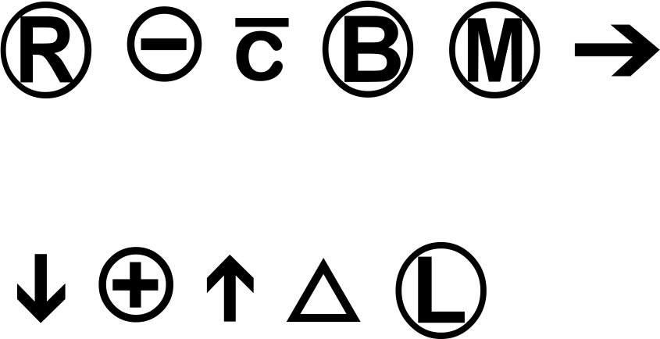
Medical Morphology
Rich Morphology (neoclassical compounds)
  Hydr-oxy-nitro-di-hydro-thym-ine
  Hepatico-cholangio-jejuno-stom-y
  Chole-docho-tom-y
Abbreviations
  ASA b.i.d. F/U
Symbols
Punctuation
  1./0.4 1-2+ 1.2x10(6) 0.25/day 72-year-old
  II-III/VI P&S $100-$200 ?ischemia

Slide 30
Medical Syntax
Abundance of nouns
Relatively few verbs
Multiword lexemes
  Congestive heart failure
  Diabetes mellitus
  ALL1-fused gene from chromsome 1q
Frequent use of passive and nominalizations
Telegraphic Syntax
  The cough worsened
  Cough worsened
  Cough

Slide 31
Medical Syntax: Annotation
We added Neurontin towards the end of her hospitalization (beginning 10/26) to help with mood instability and anxiety, which she tolerated despite some initial complaints of nausea.
We/PRP added/VBD Neurontin/NNP
towards/IN the/DT end/NN of/IN her/PRP$ hospitalization/NN
(/( beginning/VBG 10/CD //SYM 26/CD )/)
to/TO help/VB with/IN mood/NN instability/NN and/CC anxiety/NN
,/, which/WDT she/PRP tolerated/VBD
despite/IN some/DT initial/JJ complaints/NNS of/IN nausea/NN
./.

Slide 32
Medical Syntax: Phrases
Noun phrase some initial complaints of nausea
Verb phrase to help with instability
Adjective phrase somewhat unstable
Adverbial phrase more recently
Prepositional phrase towards the end of her hospitalization
Sentence We added Neurontin
Subordinate Clause although she complained of nausea
Relative clause which she tolerated

Slide 33
Medical Discourse
History of present illness: this is the second hospital admission for this one year, nine month old male with a history of asthma / bronchiolitis. Last hospitalized one year ago. Went to intensive care unit, was on c-pap, not intubated. On Albuterol nebulization at home status post Prednisone course given two weeks ago with improvement, then two days ago again developed increased coughing times three days, fever times three days up to 103, rhinorrhea times two days , post tussive emesis times five and decreased p.o. intake times one day.

Slide 34
Medical Discourse Representation
Event | Time before Now
Birth | 1 year, 9 months
asthma / bronchiolitis | > 1 year
admission to ICU | 1 year
Prednisone course | 2 weeks
Improved condition | < 2 weeks
Albuterol | < 2 weeks
post tussive emesis | 5 days
fever | 3 days
coughing | 2 days
decreased p.o. | 1 day

Slide 35
Medical Coreference
Patient was admitted to the surgery service under the care of Dr. Smythe for cellulitis of her left hand.
She remained inpatient on the surgery service for a period of 8 days.
During that time she received Kefzol therapy for her cellulitis.
She also received occupational therapy treatments QD and was treated with hand elevation.
She has increased mobility of her left hand and the induration is decreased.

Slide 36
Medical Semantics: Sublanguage
English
Standard English
Medical English
The patient treated
the physician.
The patient was treated
with penicillin.
Treated with
penicillin.

Slide 37
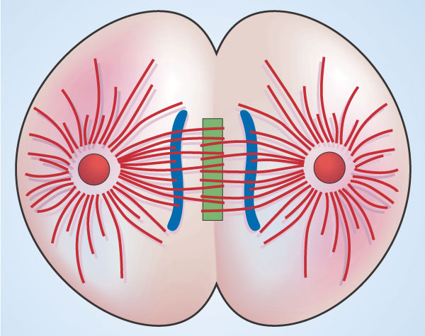
Medical Semantics: Determined by Usage
Mathematics
Biology
English
Divide
Multiply

Slide 38
Medical Semantics: Triples
Verb
Subject
Object
The USG showed multiple B cysts
Labs showed gross hematuria
Stereotactic biopsy showed DCIS
Notes:
The underlying mechanism of sublanguage is subject-verb-object patterns.
Note that subjects share certain properties, as do the objects. Might not have thought of these groupings in advance.
Other verbs make additional distinctions in groupings.
The sublanguage only makes distinctions that accomplish work.

Slide 39
Semantics: Unified Medical Language System
Abbreviations | Semantic Triples
DIAP DI FNDG | Diagnostic Procedure Diagnoses Finding
DSYN OC BPOC | Disease or Syndrome Occurs in Body Part or Organ Component
PHSU TS DSYN | Pharmacologic Substance Treats Disease or Syndrome
HCRO MN PODG | Health Care Related Organization Manages Patient or Disabled Group

Slide 40
UMLS Semantic Network
EVNT Event
  PHPR Phenomenon or Process
    NPOP Natural Phenomenon or Process
    INPO Injury or Poisoning
    HCPP Human-caused Phenomenon or Process
  ACTY Activity
  ENTY Entity
    PHOB Physical Object
    CNCE Conceptual Entity

Slide 41
NPOP Natural Phenomenon or Process
BIOF Biologic Function
  PHSF Physiologic Function
    OFUN Organism Function
      MENP Mental Process
    ORTF Organ or Tissue Function
    MOFT Molecular Function
      GENF Genetic Function
    CELF Cell Function
  PATF Pathologic Function
    EMOD Experimental Model of Disease
    DSYN Disease or Syndrome
      NEOP Neoplastic Process
      MOBD Mental or Behavioral Dysfunction
    COMD Cell or Molecular Dysfunction

Slide 42
ACTY Activity
OCAC Occupational Activity
  RESA Research Activity
    MBRT Molecular Biology Research Technique
  HLCA Health Care Activity
    TOPP Therapeutic or Preventive Procedure
    LBPR Laboratory Procedure
    DIAP Diagnostic Procedure
  GORA Governmental or Regulatory Activity
  EDAC Educational Activity
MCHA Machine Activity
DORA Daily or Recreational Activity
BHVR Behavior
  SOCB Social Behavior
  INBE Individual Behavior

Slide 43
PHOB Physical Object
SBST Substance
  FOOD Food
  CHEM Chemical
    CHVS Chemical Viewed Structurally
    CHVF Chemical Viewed Functionally
  BDSU Body Substance
ORGM Organism
MNOB Manufactured Object
  RESD Research Device
  MEDD Medical Device
    DRDD Drug Delivery Device
  CLND Clinical Drug
ANST Anatomical Structure

Slide 44
CHVS Chemical Viewed Structurally
ORCH Organic Chemical
  OPCO Organophosphorus Compound
  NNON Nucleic Acid, Nucleoside, or Nucleotide
  LIPD Lipid
    STRD Steroid
    EICO Eicosanoid
  CARB Carbohydrate
  AAPP Amino Acid, Peptide, or Protein
INCH Inorganic Chemical
ELII Element, Ion, or Isotope

Slide 45
CHVF Chemical Viewed Functionally
PHSU Pharmacologic Substance
  ANTB Antibiotic
IRDA Indicator, Reagent, or Diagnostic Aid
HOPS Hazardous or Poisonous Substance
BODM Biomedical or Dental Material
BACS Biologically Active Substance
  VITA Vitamin
  RCPT Receptor
  NSBA Neuroreactive Substance or Biogenic Amine
  IMFT Immunologic Factor
  HORM Hormone
  ENZY Enzyme

Slide 46
ORGM Organism
ANIM Animal
  VTBT Vertebrate
    REPT Reptile
    MAMM Mammal
      HUMN Human
    FISH Fish
    BIRD Bird
    AMPH Amphibian
VIRS Virus
PLNT Plant
  ALGA Alga
FNGS Fungus
BACT Bacterium
ARCH Archaeon

Slide 47
ASTR Anatomical Structure
FFAS Fully Formed Anatomical Structure
  TISU Tissue
  GNGM Gene or Genome
  CELC Cell Component
  CELL Cell
  BPOC Body Part, Organ, or Organ Component
EMST Embryonic Structure
ANAB Anatomical Abnormality
  CGAB Congenital Abnormality
  ACAB Acquired Abnormality

Slide 48
CNCE Conceptual Entity
ORGT Organization
GRUP Group
OCDI Occupation or Discipline
ORGA Organism Attribute
  CLNA Clinical Attribute
GRPA Group Attribute
LANG Language
INPR Intellectual Product
  RNLW Regulation or Law
  CLAS Classification
IDCN Idea or Concept
FNDG Finding
  SOSY Sign or Symptom
  LBTR Laboratory or Test Result

Slide 49
CNCE Conceptual Entity
OCDI Occupation or Discipline
  BMOD Biomedical Occupation or Discipline
ORGT Organization
  SHRO Self-help or Relief Organization
  PROS Professional Society
  HCRO Health Care Related Organization
GRUP Group
  PROG Professional or Occupational Group
  POPG Population Group
  PODG Patient or Disabled Group
  FAMG Family Group
  AGGP Age Group

Slide 50
IDEA Idea or Concept
TMCO Temporal Concept
SPCO Spatial Concept
  MOSQ Molecular Sequence
    NUSQ Nucleotide Sequence
    CRBS Carbohydrate Sequence
    AMAS Amino Acid Sequence
  GEOA Geographic Area
  BSOJ Body Space or Junction
  BLOR Body Location or Region
QNCO Quantitative Concept
QLCO Qualitative Concept
FNCO Functional Concept
  BDSY Body System

Slide 51
Medical Semantics: Annotation
The/DT neurological/BDSY examination/DIAP suggested/VBD cervical/BLOR neuralgia/SOSY
Breast/BPOC CA/NEOP status post/TMCO left/SPCO mastectomy/TOPP
EKG/DIAP :/& normal/FNDG sinus rhythm/LBTR with/IN paced/TMCO ventricular complex/LBTR
Skin/BPOC :/& surgical/FNCO wound/INPO clean/SOSY ,/, mild/QLCO drainage/BDSU ,/, staples/MEDD intact/QLCO

Slide 52
Semantic Annotation Issues
Some words lack semantics
  the, with, comma, suggested
Parse words or phrases?
  Neurological examination/DIAP
  Breast cancer/NEOP
Multiple choices for tags
  Drainage BDSU/TOPP
  Surgical FNCO/TOPP
Lack of specificity
  Mild/QLCO
  Intact/QLCO
  Surgical/FNCON

Slide 53
Semantic Relation: AW associated_with
TR temporally_related_to
  PC precedes
  CW co-occurs_with
SP spatially_related_to
  TV traverses
  SR surrounds
  LO location_of
  AD adjacent_to
PR physically_related_to
FR functionally_related_to
CR conceptually_related_to

Slide 54
PR physically_related_to
TB tributary_of
PT part_of
IC interconnects
IG ingredient_of
CT contains
CS consists_of
CN connected_to
BR branch_of

Slide 55
FR functionally_related_to
US uses
RO result_of
PE performs
  PA practices
  EX exhibits
  CO carries_out
OC occurs_in
  PO process_of
MF manifestation_of
IN indicates
BA brings_about
  PS produces
  CA causes
AF affects
  TS treats
  PV prevents
  MN manages
  IW interacts_with
  DS disrupts
  CM complicates

Slide 56
CR conceptually_related_to
PP property_of
MT method_of
MS measures
ME measurement_of
II issue_in
EV evaluation_of
DI diagnoses
DF developmental_form_of
DO derivative_of
DE degree_of
CP conceptual_part_of
AN analyzes
  AE assesses_effect_of

Slide 57
Semantic Relation Examples
cervical neuralgia/SOSY RO neurological examination/DIGN
normal sinus rhythm/LBTR RO EKG/DIAP
mastectomy/TOPP PC Breast CA/NEOP
Skin/BPOC LO surgical wound/INPO
Surgical wound/INPO AW clean/SOSY
Surgical wound/INPO CA mild drainage/BDSU
Staples/MEDD TS surgical wound/INPO

Slide 58
Semantic Grammar
S → [TMCO] (MN|OC|TS|PP)⁺ [TMCO]
S → S and S
MN → [PODG] MN [HCRO|PROG]
OC → [PODG] OC (PATF|FNDG)
TS → [PODG] TS (PHSU|TOPP)
PP → FNDG is QLCO

Slide 59
Semantic Lexicon
MN → was admitted to | under care of |remained inpatient on
OC → for | has
TS → received | was treated with
TMCO → for a period of 8 days | during that time | also | QD
HCRO → the surgery service
PROG → Dr. Smythe
PATF → cellulitis of her left hand | her cellulitis
FNDG → the induration | increased mobility of her left hand
QLCO → decreased
PHSU → Kevzol therapy
TOPP → occupational therapy treatments | hand elevation
PODG → she | patient

Slide 60
UMLS Semantic Annotation
[S [MN [PODG Patient]
[MN was admitted to]
[HCRO the surgery service]]
[MN [MN under the care of]
[PROG Dr. Smythe]]
[OC [OC for]
[PATF cellulitis of her left hand]] ]
[S [MN [PODG She]
[MN remained inpatient on]
[HCRO the surgery service] ]
[TMCO for a period of 8 days] ]
[S [TS [TMCO During that time]
[PODG she]
[TS received]
[PHSU Kefzol therapy] ]
[OC [OC for]
[PATF her cellulitis] ]
[S [S [TS
[PODG She]
[TMCO also]
[TS received]
[TOPP occupational therapy treatments] ]
[TMCO QD] ]
and [S [TS
[TS was treated with]
[TOPP hand elevation] ] ]
[S [S [OC
[PODG She]
[OC has]
[FNDG increased mobility of her left hand] ]
and [S [PP [FNDG the induration]
[PP is ]
[QLCO decreased] ] ]

Slide 61
Outline
Time | Topic
1:00-1:30 | Introduction
1:30-2:00 | Language
2:00-2:30 | Natural Language
2:30-3:00 | Natural Language Processing
3:00-3:30 | Break
3:30-4:00 | Natural Language Data
4:00-4:30 | Big Natural Language Data
4:30-5:00 | Using Big Data
5:00-5:30 | Questions and Discussion
processing
language
using
natural
data
big

Slide 62
Research Areas in NLP
Information Retrieval
Information Extraction
?
Question Answering

Slide 63
Conversational NLP
Transcription
Analysis
Speech
Structured
Data
Text
Synthesis
Generation

Slide 64
NLP Pipeline
Morphologic Analysis
Lexical Analysis
Lexicon
Syntactic Analysis
Grammar
Semantic Analysis
Pragmatic Analysis

Slide 65
Parsing
Determine whether given sequence is allowed by grammar
Bottom Up
  Reduce given sequence to start symbol
  Data-driven
  Forward Chaining
Top Down
  Generate given sequence from start symbol
  Goal-driven
  Backward Chaining

Slide 66
Top Down Derivation
S
NP VP
He VP
He VBZ NP
He is DT NN
He is a NN
He is a patient

Slide 67
Bottom Up Derivation
The physician treated the patient
DT NN VBD DT NN
NP VBD DT NN
NP VBD NP
NP VP
S

Slide 68
Syntax and Semantics
Need semantic constraints to obtain correct parse
  Denied pain in the ER
  Denied pain in the abdomen
  Pulmonary edema and effusion
  Pulmonary edema and anemia
  Pain in hands and feet
  Pain in hands and fever
Need syntactic constraints to construct correct semantic interpretation
  No edema, dyspnea, syncope
  No increased tenderness

Slide 69
NLP Paradigms
Corpus
Manual Extraction
Manual Grammar Induction
Manual Training Annotation
Automated Extraction
Automated Grammar
Induction
Extracted Information
Notes:
Manual: Symbolic, deep, brittle
Automated: Statistical, shallow, robust

Slide 70
Supervised Learning
TrainingCorpus
Learner
Linguist
Testing Corpus
Analyzer
Performance

Slide 71
Measuring Performance
 |  | ANALYZER
 |  | Yes | No
TESTING CORPUS | Yes | TP | FP | Precision
 | No | FN | TN
 |  | Recall
F_{β} = (1+β²)· (Precision · Recall)
(β² · Precision) + Recall
F₁ weighs precision and recall equally
F₂ weighs recall higher than precision
F_{0.5} weighs precision higher than recall

Slide 72
Unsupervised Learning
Corpus
Learner
Analyzer
Review Corpus
Linguist

Slide 73
NLP Tasks
Classify Document
Recognize
Named Entity
Identify Relationship
Detection Certainty
Resolve Co-reference
Structure Discourse

Slide 74
NLP Features (Independent Variables)
Structural Features
Specific words
Sequential order

Slide 75
NLP Annotation (Dependent Variable)
What type of document is given text?
What topic is a given paragraph about?
Which word sequences are medical terms?
Which sense is most likely for given term?
What kind of event is given sentence?

Slide 76
Features ➔ Annotation
 | Use only raw words | Use features as independent | Use features as Dependent
Ignore order of features | Bag of words | Naïve Bayes | Support Vector Machine
Consider order of features | N-gram | Hidden Markov Model | Conditional random fields

Slide 77
NLP Software
Tool | Institution | Focus
Waikato Environment for Knowledge Analysis (WEKA) | Waikato | Data mining
R | GNU | Statistics
OpenNLP | Apache | General language
Unstructured Information management Architecture (UIMA) | Apache | General language
General Architecture for Text Engineering (GATE) | Sheffield | General language
cTAKES | Mayo | Medical language
MetaMap | National Library of Medicine | Medical language

Slide 78
Outline
Time | Topic
1:00-1:30 | Introduction
1:30-2:00 | Language
2:00-2:30 | Natural Language
2:30-3:00 | Natural Language Processing
3:00-3:30 | Break
3:30-4:00 | Natural Language Data
4:00-4:30 | Big Natural Language Data
4:30-5:00 | Using Big Data
5:00-5:30 | Questions and Discussion
processing
language
using
natural
data
big

Slide 79
Data-driven NLP
Natural Language Processing
Text Mining
Small scale
Deep structure
Documents, handwriting, speech
Understanding
Large scale
Shallow structure
Documents, web
Discovery

Slide 80
Text Mining
Classification
Summarization
Sentiment Analysis
Information extraction

Slide 81
Text Analysis
Document
Representation
Comparison
Clustering
Classification
…
Document
Representation
Word frequency vector
N-gram frequency vector
Word ranking profile
N-gram ranking profile
Cosine
Multivariate Chi square
Wilcoxon rank sum test

Slide 82
Bag of words
Remove metadata (headers)
Remove markup (XML, HTML)
Remove punctuation
Remove numbers
Make lowercase
Remove “stop” words (the, a, is, …)
Reduce to “stem”
Count frequency
Order by rank

Slide 83
Bag of Words
Patient was admitted to the surgery service under the care of Dr. Smythe for cellulitis of her left hand.
She remained inpatient on the surgery service for a period of 8 days.
During that time she received Kefzol therapy for her cellulitis.
She also received occupational therapy treatments QD and was treated with hand elevation.
She has increased mobility of her left hand and the induration is decreased.

Slide 84
Bag of Words
patient was admitted to the surgery service under the care of dr smythe for cellulitis of her left hand
she remained inpatient on the surgery service for a period of days
during that time she received kefzol therapy for her cellulitis
she also received occupational therapy treatments qd and was treated with hand elevation
she has increased mobility of her left hand and the induration is decreased

Slide 85
Bag of Words
patient admitted surgery service care dr smythe cellulitis her left hand
she remained inpatient surgery service period days
during time she received kefzol therapy her cellulitis
she received occupational therapy treatments qd treated hand elevation
she increased mobility her left hand induration decreased

Slide 86
Bag of Words
4 she
3 hand
3 her
2 surgery
2 service
2 left
2 received
2 therapy
2 cellulitis
1 patient
1 admitted
1 care
1 remained
1 inpatient
1 period
1 days
1 she
0 hand
1 her
0 surgery
1 service
1 left
0 received
2 therapy
2 cellulitis
5 patient
2 admitted
0 care
1 remained
0 inpatient
0 period
3 days

Slide 87
N-grams
Preserves information about ordering
For each character (or word) in document
Examine following characters (or words), up to given limit (e.g. 5)
  T TH THE THES THESE
  H HE HES HESE
  E ES ESE
  …
Keep count of each unique combination (in hash table)
Bag of words = 1-gram

Slide 88
N-grams
2 surgery service
2 left hand
2 her left
2 the surgery
1 patient was
1 was admitted
…

Slide 89
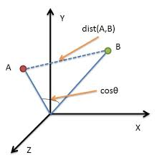

Cosine Similarity

Slide 90
Comparing Linguistic Objects
Object | Purpose
Document | Information retrieval
Sentence | Information extraction
Phrase | Named entity recognition
Word | Semantics

Slide 91
N-gram Ranking
High frequency items identify language
(e.g. top 300)
Middle frequency items identify topic
Low frequency items unique to document

Slide 92
Outline
Time | Topic
1:00-1:30 | Introduction
1:30-2:00 | Language
2:00-2:30 | Natural Language
2:30-3:00 | Natural Language Processing
3:00-3:30 | Break
3:30-4:00 | Natural Language Data
4:00-4:30 | Big Natural Language Data
4:30-5:00 | Using Big Data
5:00-5:30 | Questions and Discussion
processing
language
using
natural
data
big

Slide 93
Zipf Distribution
Frequency: number of tokens (occurrences) for each unique type (word)
Rank: ordering of the unique types by frequency
Frequency times rank is a constant
Rank | Frequency
1 | M
2 | M/2
3 | M/3
4 | M/4
…
N-2 | 1
N-1 | 1
N | 1
A few of the types account for most of the tokens
Many of the types have only one token (singletons)
Large numbers of rare events (LNRE)

Slide 94
Good-Turing Estimation
Frequency of singletons in current sample estimates frequency of singletons not yet seen
Sample | Types | Singletons | Estimate | Next 100K | Actual
100000 | 5978 | 2748 | 0.027 | 2510 | 0.025
200000 | 8488 | 3663 | 0.018 | 1943 | 0.019
300000 | 10341 | 4282 | 0.014 | 1572 | 0.016

Slide 95
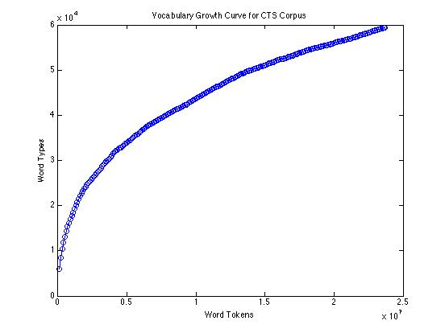
Vocabulary Growth

Slide 96
NLP Scalability
Model-driven
Data-driven
Dictionary listing known words and phrases
Pre-determined labels for semantics
Strength: deep representation of meaning
Weakness: many missing words; hard to adapt to new corpora
Words and phrases derived from corpus
Labels determined based on distribution of words in corpus
Strength: easy to adapt to new corpora
Weakness: shallow representation of meaning

Slide 97
Dimensionality Reduction
Dimensions of vectors are very high (~10⁴)
Reduce number of dimensions (~10²)
Hashing
  Function(Word) = number
  Uniform distribution (equal chance for each bin)
Principle component analysis (matrix algebra)
  Compute eigenvectors of matrix
  Select those with largest eigenvalues
Word embedding (neural net)

Slide 98
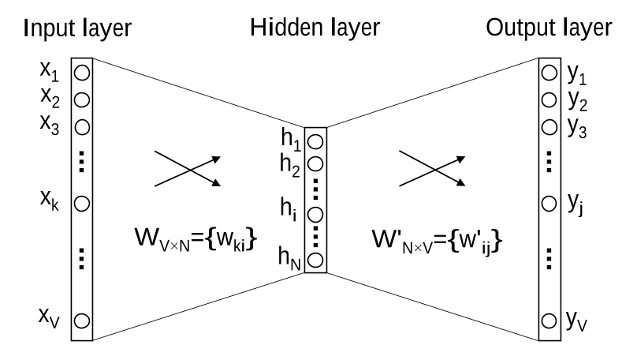
Word2vec (Google)

Slide 99
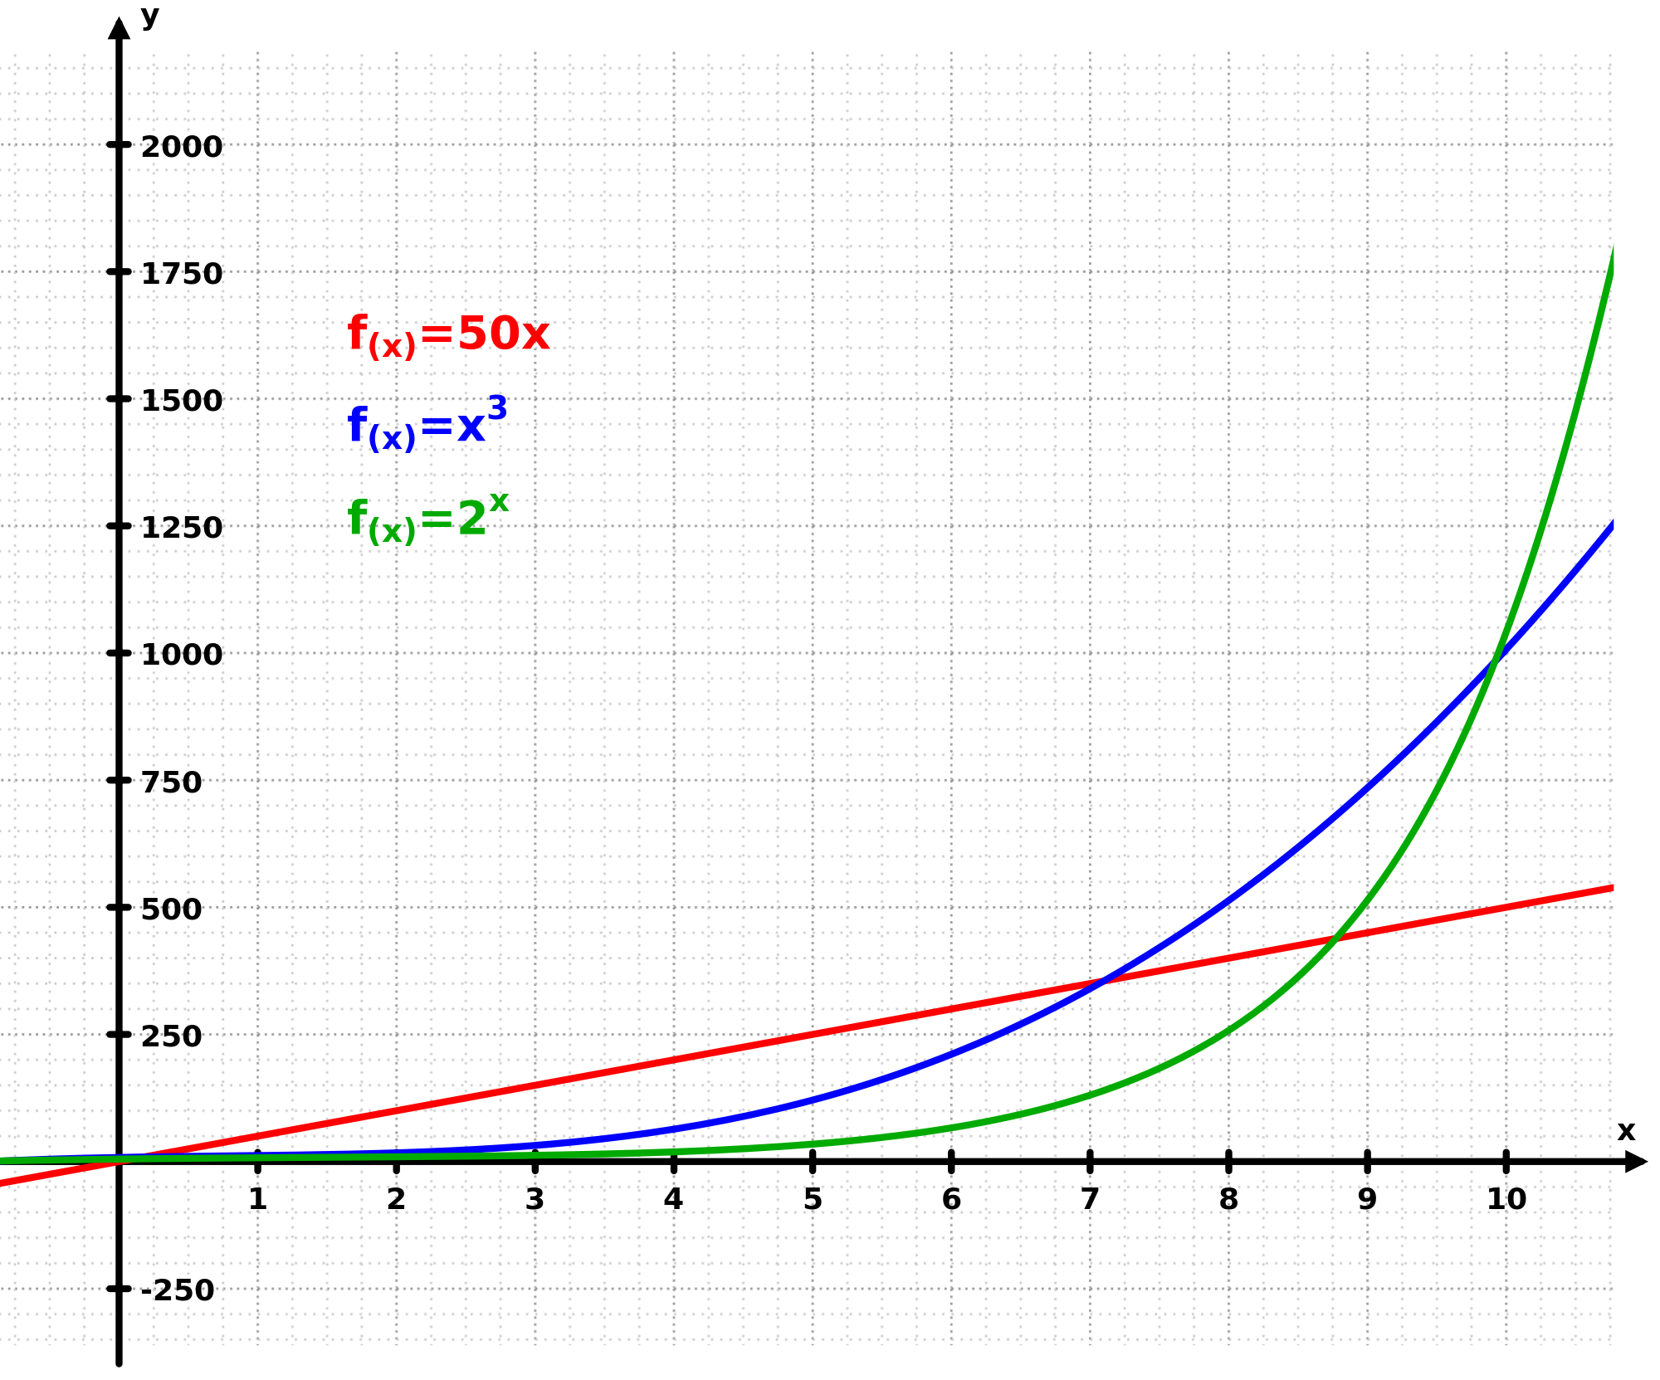
Computational Cost
Parsing complexity:
n words in sentence require time proportional to n³
Long sentences
+ Many sentences per document
+ Many documents
= High computation cost

Slide 100
Improving Processing
Distributed Architectures
  Duplicate the NLP pipeline on multiple virtual machines
  Enables use of current algorithms
Parallel Processing
  Redesign algorithms to exploit high performance computing
Deep learning
  Develop new algorithms using neural nets (word2vec)
  Area of intensive research

Slide 101
Outline
Time | Topic
1:00-1:30 | Introduction
1:30-2:00 | Language
2:00-2:30 | Natural Language
2:30-3:00 | Natural Language Processing
3:00-3:30 | Break
3:30-4:00 | Natural Language Data
4:00-4:30 | Big Natural Language Data
4:30-5:00 | Using Big Data
5:00-5:30 | Questions and Discussion
processing
language
using
natural
data
big

Slide 102
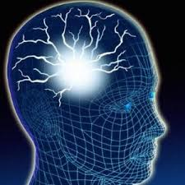
Example 1: Rare Epilepsies
Problem: How can we conduct epidemiology and surveillance of rare forms of epilepsy?
Challenge: large number of terms that occur very rarely
Approach
  Top-down: ask clinicians to suggest patterns
  Bottom-up: identify contexts where unknown patterns may occur

Slide 103
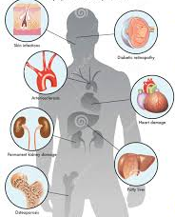
Example 2: Diabetes Outcomes
Problem: Can patient outcomes be detected in progress notes rather than conducting surveys?
Challenge: small number of terms (hypoglycemia, neuropathy) but large number of variations
Approach:
  Search for central terms
  Iteratively discover modifiers on left and right
  Identify negation phrases

Slide 104

Example 3: Clinical Trial Screening
Problem: How do we identify patients who may be eligible for certain clinical trials?
Challenge: large number of terms, complex eligibility criteria
Approach:
  Identify all terms in multiple types of clinical documents
  Identify negation phrases
  Identify temporal expressions
  Map terms onto timeline

Slide 105
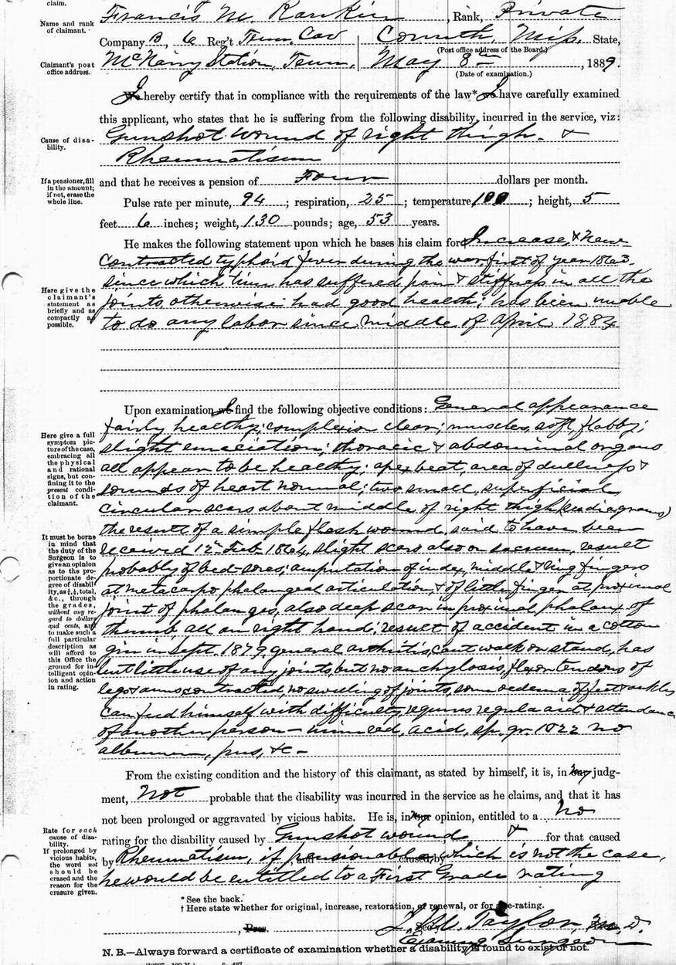
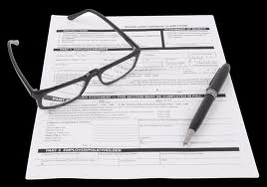
Using language data: Then and Now

Slide 106
Medicine has a long history using natural language
Disciplines
Institutions
Education
Records
Notes:
Usage varies enormously across settings. We are often unaware of differences. Individuals negotiate differences as needed.

Slide 107
Artificial languages (codes) are still evolving
?
Clinicians
Billers
Developers
Terminologists
Notes:
Clinicians know natural usage, but not artificial usage in dictionary or clinical systems.
Terminologists know usage in terminology, but not in clinical systems.
Billers must translate natural to artificial usage, so need to know something about both.
Developers of NLP may not know full natural usage, and must map to codes that may not match well.

Slide 108





Clinicians are caught between two worlds
Medical Dictionary
Controlled Terminology
Words
Codes
Electronic Document
Clinician
Electronic Form
Medical Literature
Patient Database

Slide 109
Which data represent the truth?
Structured Data
Unstructured Data
Structured Data
Coder
Structured Data
Clinician

Slide 110

Summary
Unstructured data contains important data for research
Natural language processing is based on rigorous scientific theory
Natural language processing methods can exploit current methods in machine learning
Complexity and validity are major challenges

Slide 111
Outline
Time | Topic
1:00-1:30 | Introduction
1:30-2:00 | Language
2:00-2:30 | Natural Language
2:30-3:00 | Natural Language Processing
3:00-3:30 | Break
3:30-4:00 | Natural Language Data
4:00-4:30 | Big Natural Language Data
4:30-5:00 | Using Big Data
5:00-5:30 | Questions and Discussion
processing
language
using
natural
data
big

