Slide 1
Lesson description:
This PowerPoint is aimed at teaching learners how to install google slides and find the shared slides.
For the interview basic lesson, learners will learn how to answer the question “tell me about yourself” by themselves with the slides provided. The instruction will take only about 10-15 minutes. After learners finish the instructions, a face-to-face discussion session with the instructor will be provided. In the discussion session, learners will present their own answer to the interview questions and receive feedback from other learners and instructors.

Slide 2
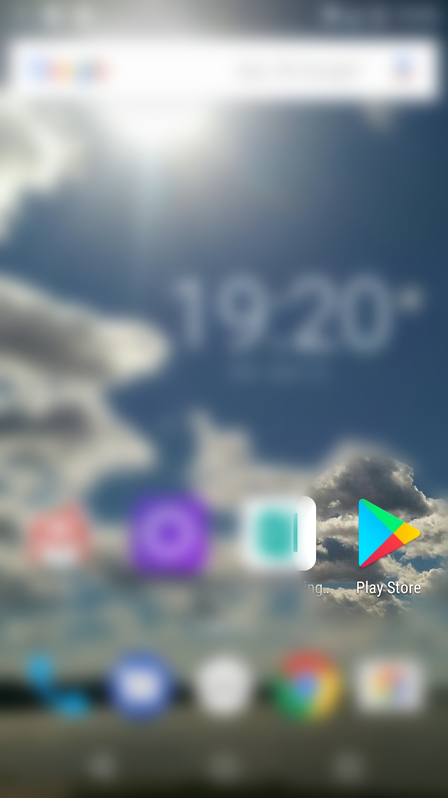
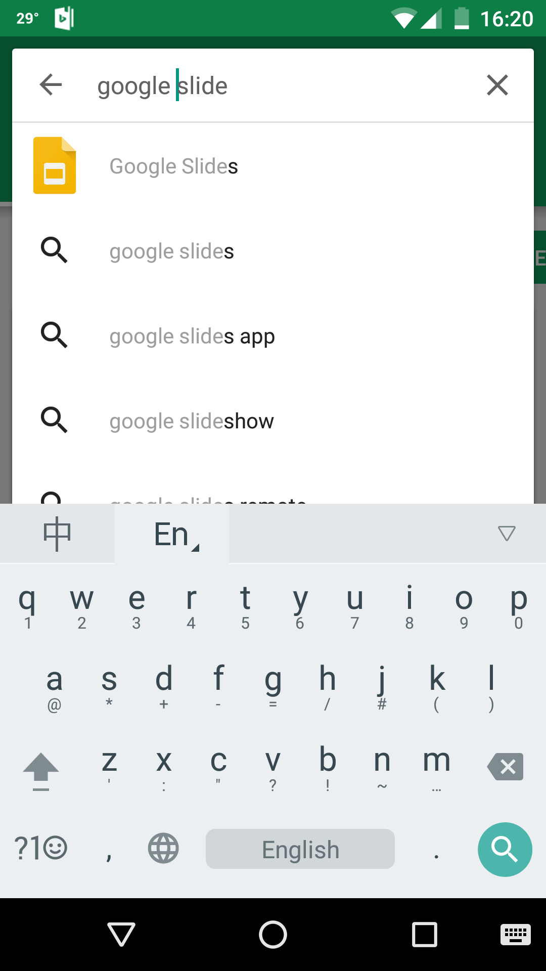
Go to app store and search “google slide”.

Slide 3
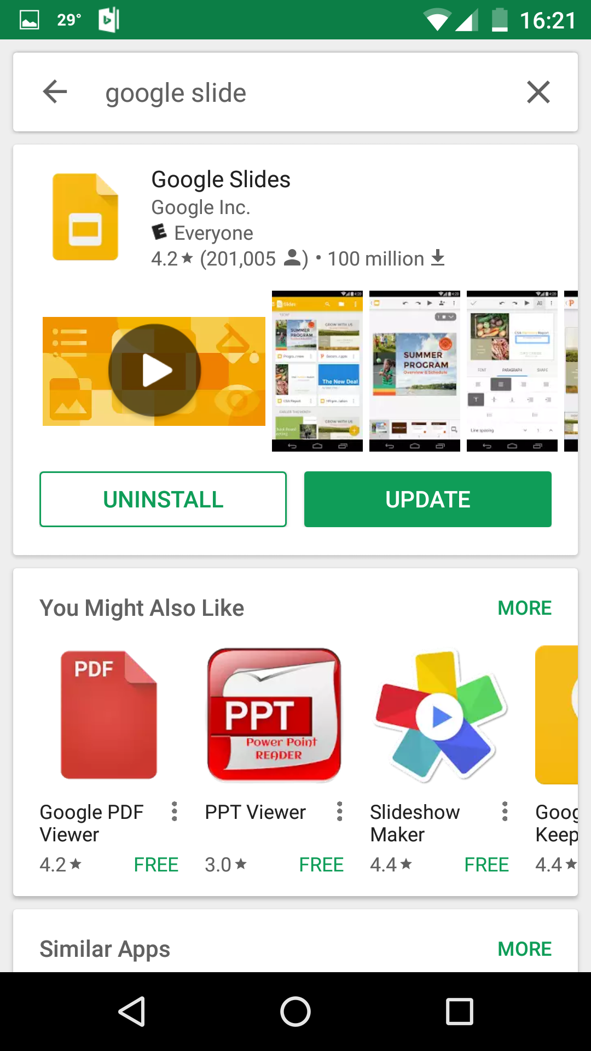
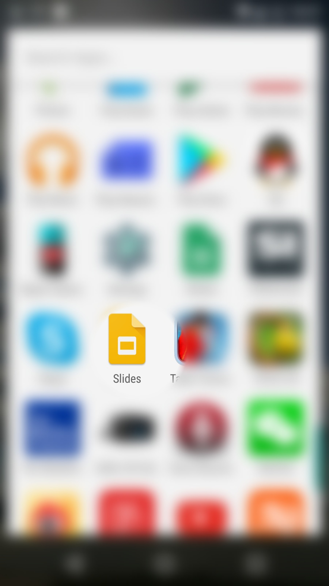
Click “google slide” you can go to the app page. And there you can click “install”. But because I have installed the app on my mobile phone, it only shows “update”. But in a phone which doesn’t have the app, it will show “install.”

Slide 4
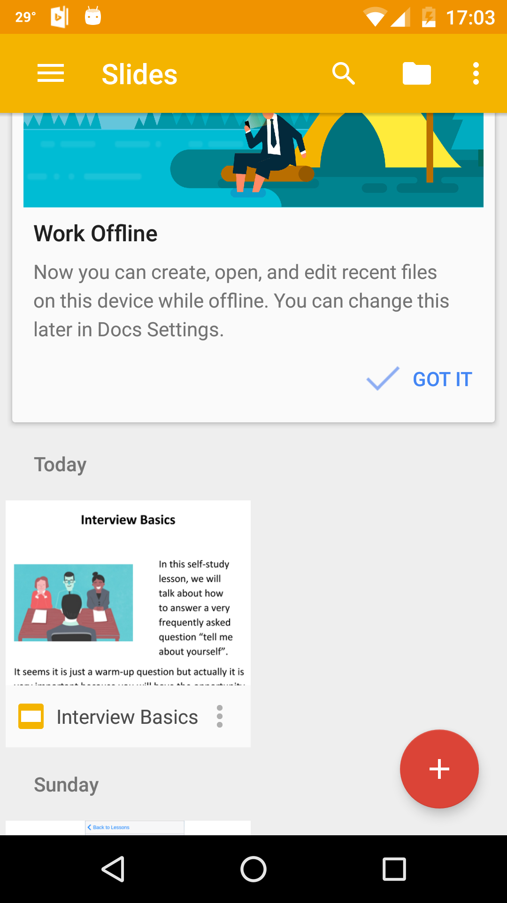
After you open google slides, you should see a slide with the name “interview basics” because the instructor should have shared the link with your email. Even if you cannot see this slide, you can also go to your email and click the share link in your email to open it.

Slide 5
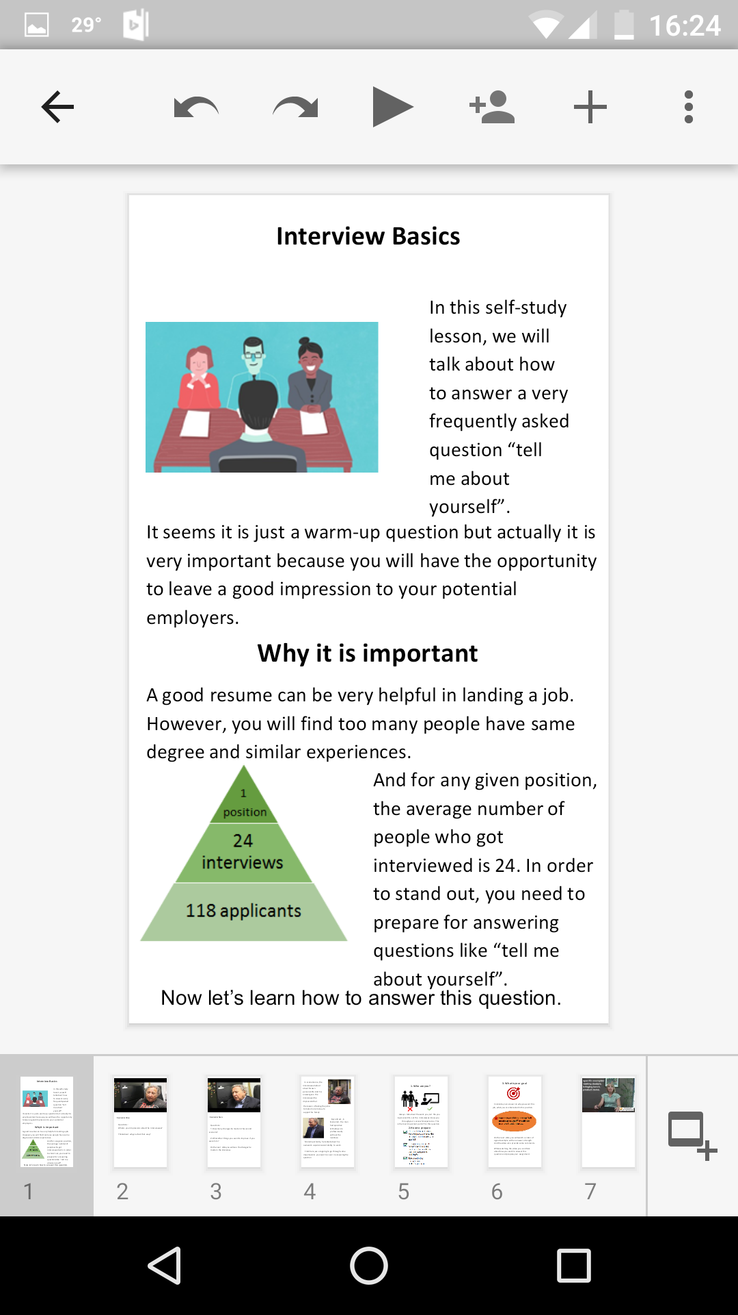
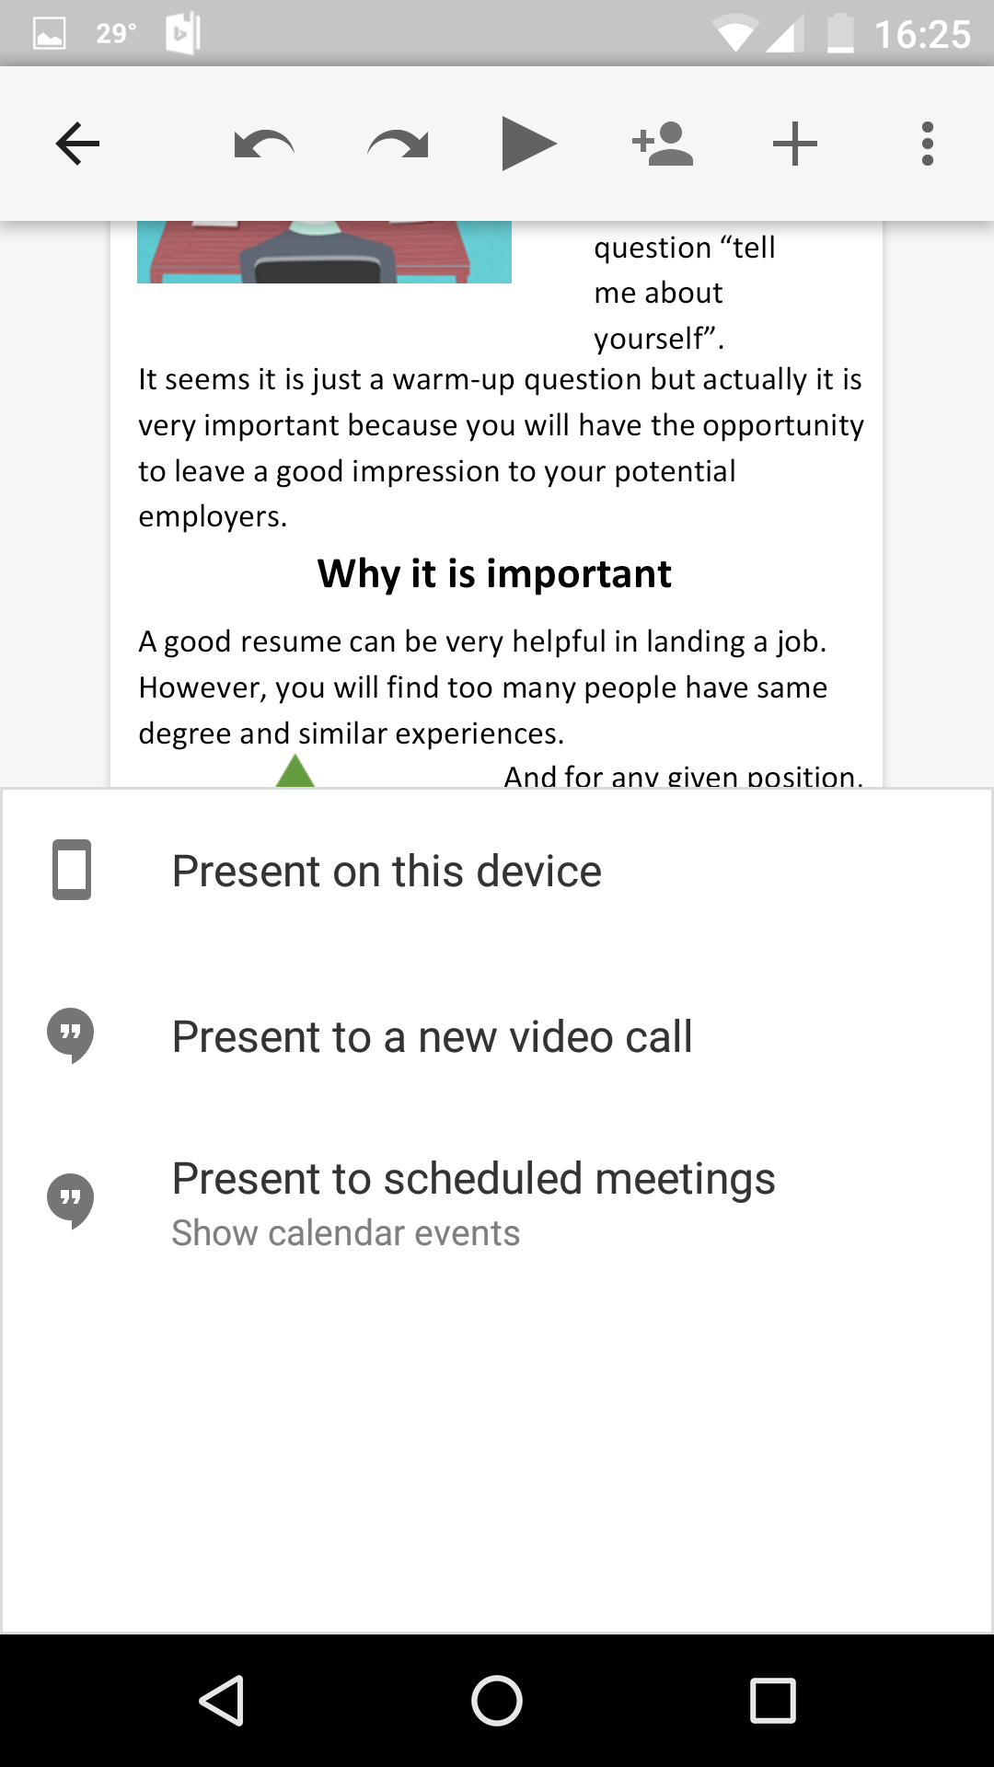
After you open the slide, click the play button on the top and press “present on this device”. Then you can view the self-learn lesson with your mobile phone.

Slide 6
Share-link: https://docs.google.com/a/umail.iu.edu/presentation/d/1PrX2yEhLVbjesdOZHOjbCq3sh0VdwEkVZLB1WDkZJSw/edit?usp=sharing

