Slide 1
Learn fractions with graphs
Using hours of the day

Slide 2
Graphs can be created using technology. Let’s create a bar graph that is similar to the one I presented in our lesson

Slide 3
Move to you laptop computer and open an browser by clicking on the Chrome icon. Search “online chart tool”. The following address should be one of your choices. Select Bar graph.
https://www.onlinecharttool.com/
SCROLL

Slide 4
Unless you want to make major changes, we can leave the next page just as it is. Notice the options that are chosen. They have a bullet in the circles.
Where there is a
You may click and make choices such as making your graph 3D rather than 2D
Once you have made your decisions, click at the bottom of the page
NEXT >>

Slide 5
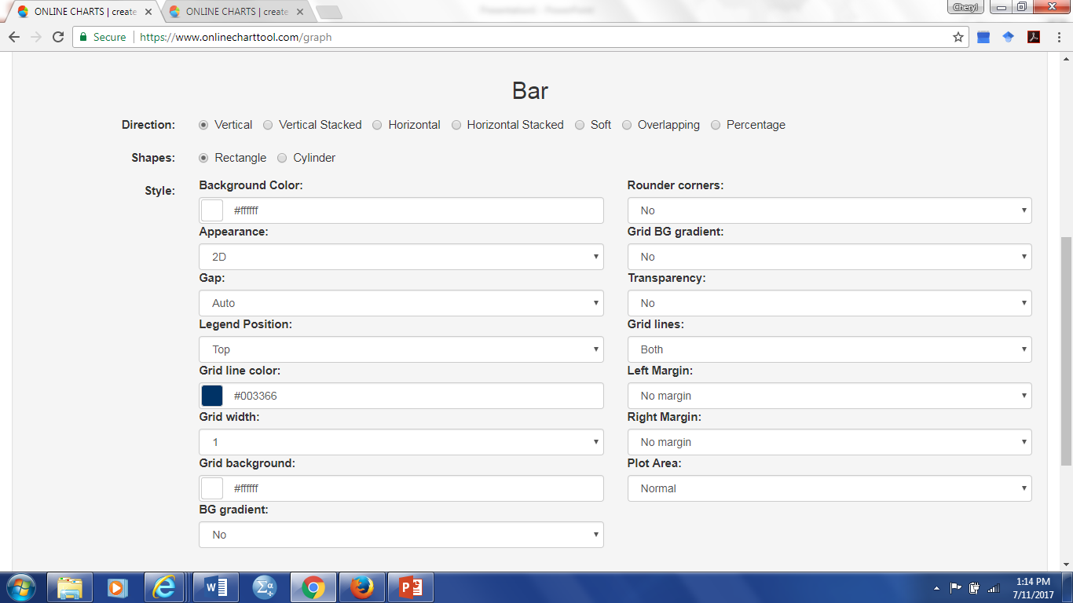

Slide 6
Now fill in the name of your graph IN Graph Title such as
“Hours Spent Each Day” and the labels for the x-axis (the bottom of your graph) such as “Activities” and for the
Y-axis (the horizontal label on the left) such as “Time Spent”
Select number of items to be 5 by clicking on the down arrow
Next, name your activities such sleep, exercise, work, relaxation, and miscellaneous.
The value is the amount of time you spend on each of those.
If you want to change the color of your bars on the graph click the colored bar and “hoover” over the color that you like and click. Noticed the following screen changed the color.
When happy, click
NEXT >>

Slide 7
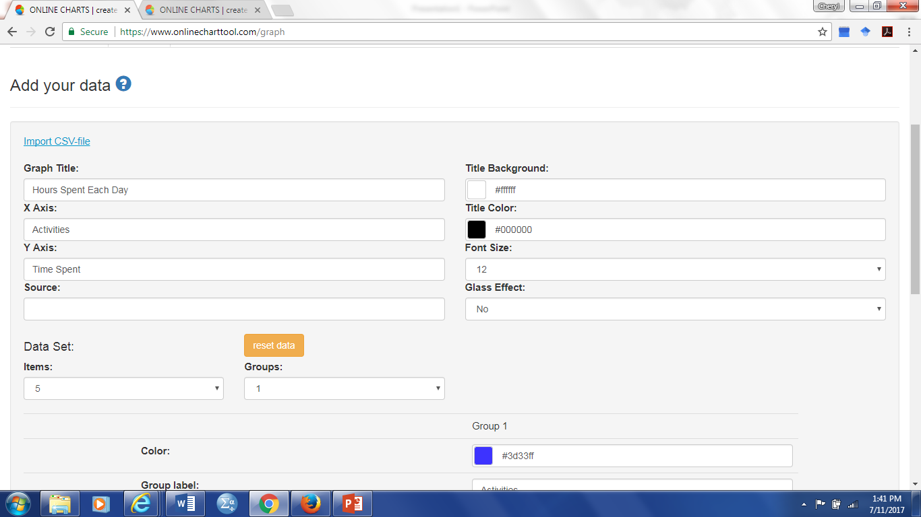

Slide 8
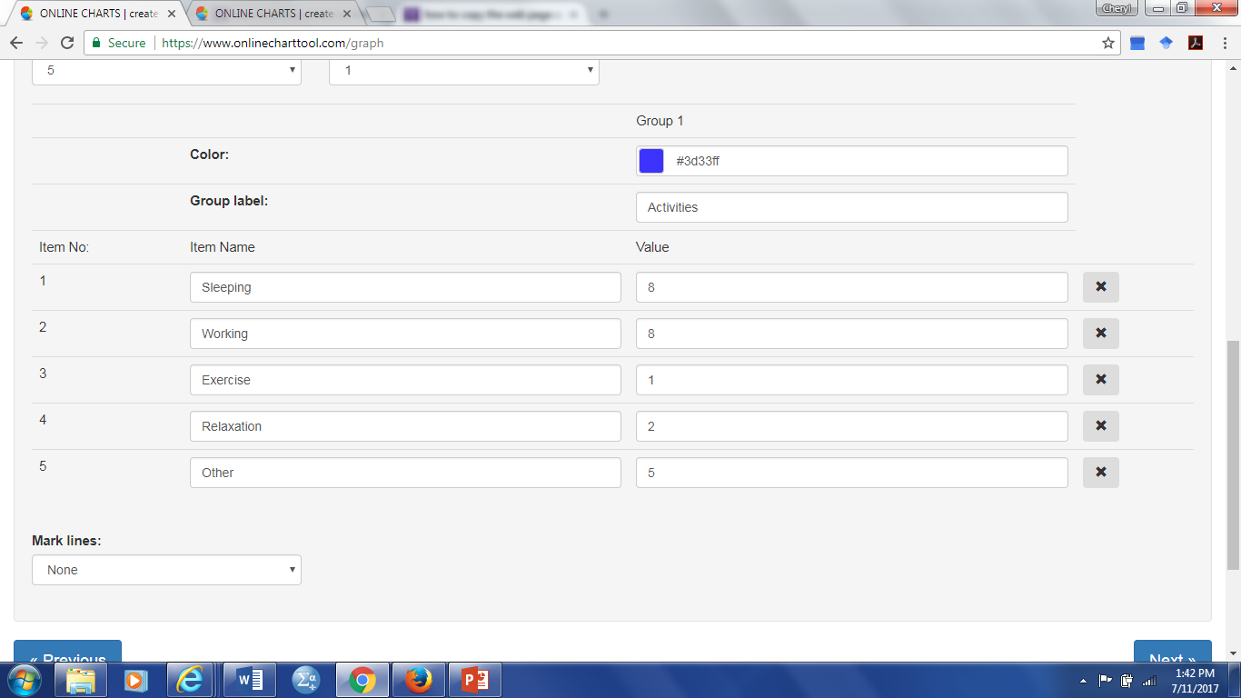

Slide 9
The next page allows you to chose your font. Click in the bullet to make changes. I suggest you leave the location of everything else the same for now.
When happy click
You now have your graph. The next page allows you to email your graph and the answers to questions to your instructor (or your friends).
NEXT >>

Slide 10
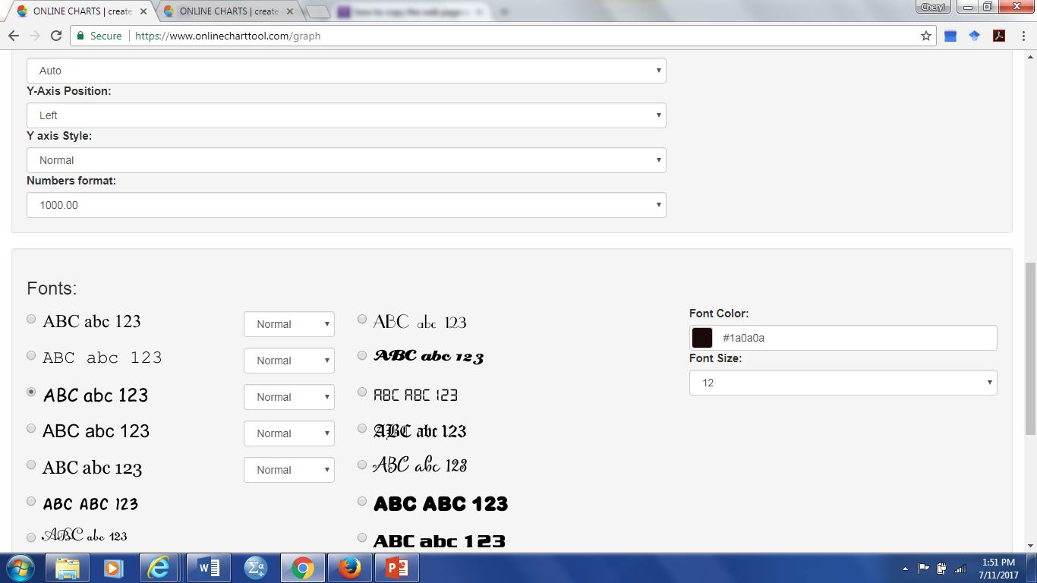
Choose your font

Slide 11
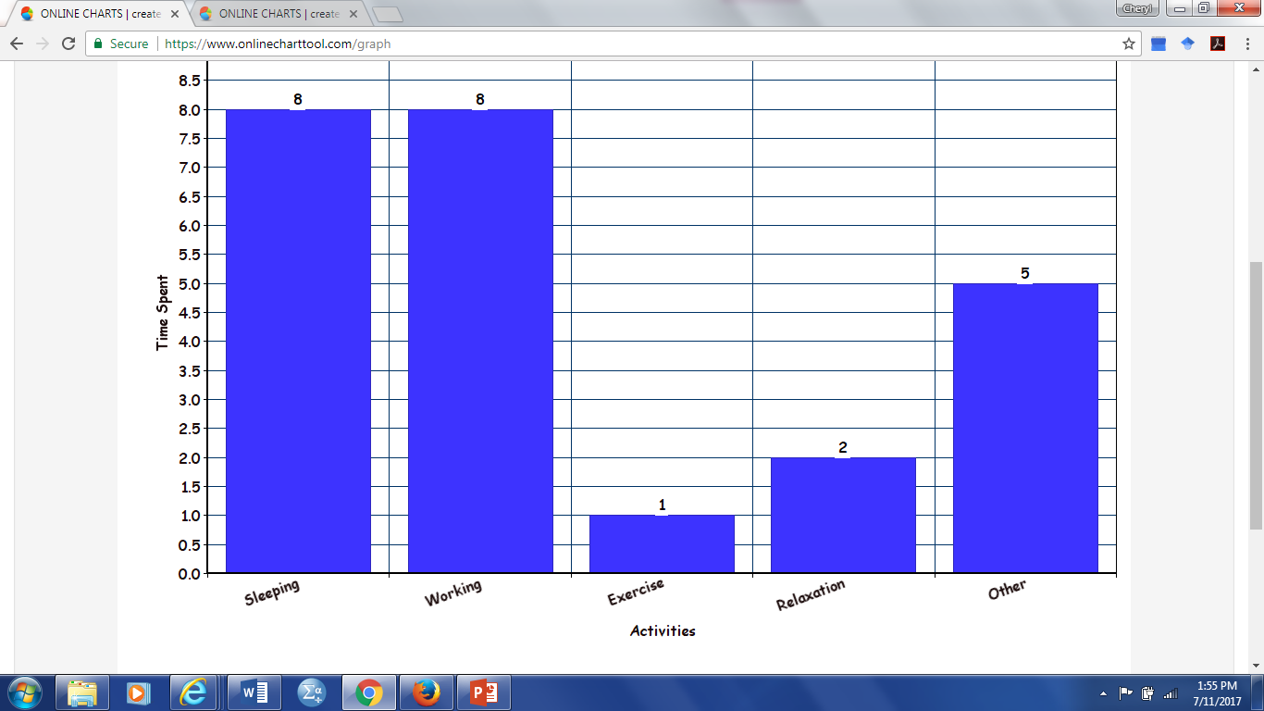

Slide 12
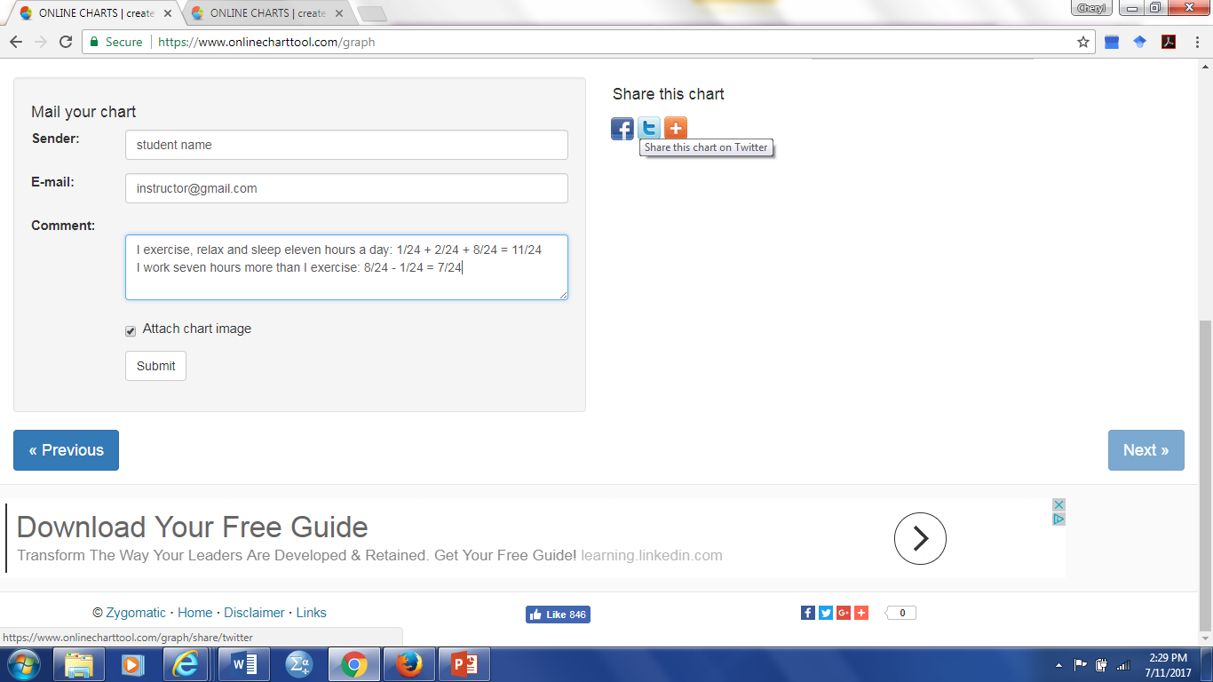
Share you work:

Slide 13
Use the graph you created on your computer to represent how you spend your time.
24 hours
Therefore the total number of hours in a day is 24 hours which represents our whole day divided into 24 parts. The whole is always represented in the denominator (bottom) of a fraction. The fraction representation of how long you exercise in a day would be $\frac{1}{24}$.
Calculate what fraction of your day that you use for sleep, exercise, and relaxation.

Slide 14
$\frac{8}{24}+\frac{1}{24}$ +$\frac{2}{24}=\frac{11}{24}$
If you changed the number of hours you spent, your answer will be different from this.

Slide 15
Calculate how many more hours you work than exercise.
$$\frac{8}{24}−\frac{1}{24}=\frac{7}{24}$$
I work 7 more hours than I exercise

Slide 16
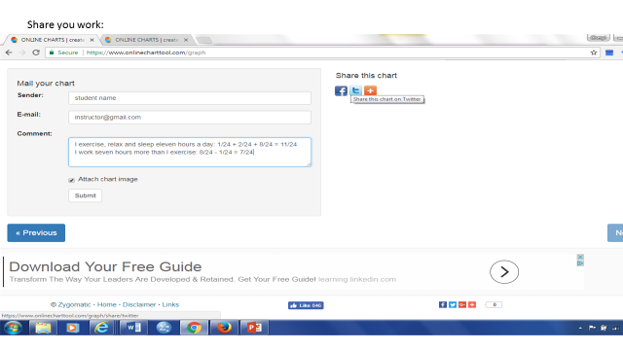

Slide 17
Happy Graphing!

