Slide 1
CHAPTER 07 TOOLING FOR CNC MACHINES

Slide 2
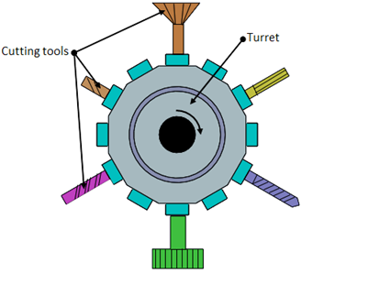
TOOL MAGAZINE
TOOL TURRET FOR CNC LATHE MACHINES

Slide 3
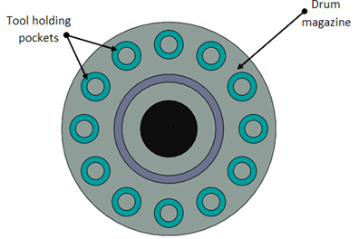
FOR CNC MILLING MACHINES
DRUM TYPE

Slide 4
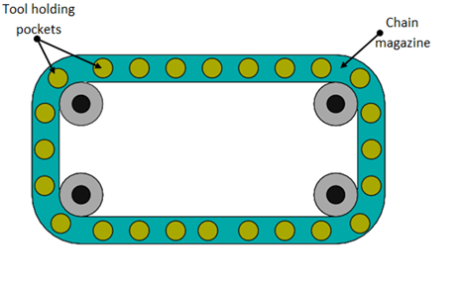
2. CHAIN TYPE

Slide 5
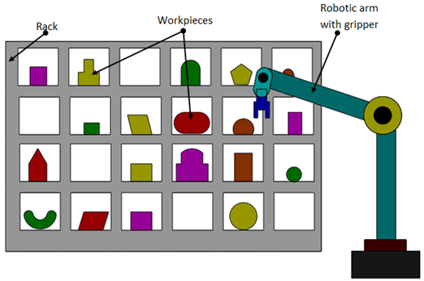
3. RACK TYPE

Slide 6
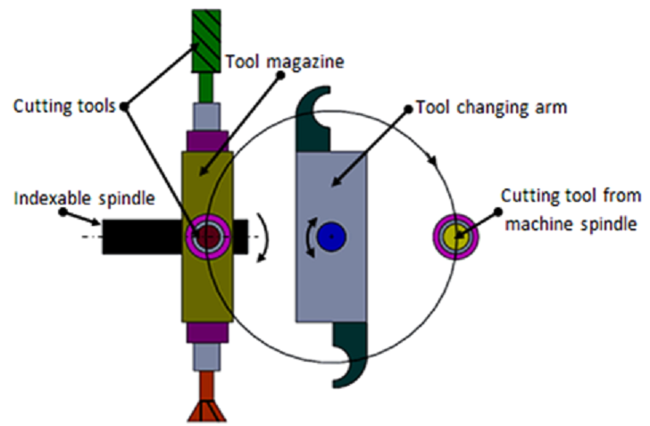
AUTOMATIC TOOL CHANGER

