Slide 1
Triangle Shirtwaist Fire
Fire Ladder Rescue

Slide 2
Act 1: Setting the Scene

Slide 3
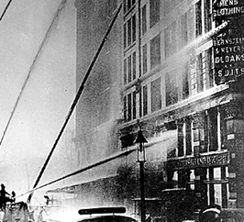
Ladder to the Rescue
What questions do you have?

Slide 4
At their full reach, how successful were the ladders in rescuing workers from the factory?
Exploration:

Slide 5
Act 2: Gathering Information
What questions do we need to have answered in order to tackle this exploration question?

Slide 6
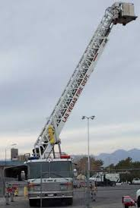
The Facts
Basic Floor to Floor Height
12 – 14 Feet
Maximal Ladder Angling
“…the longest ladder we had on a truck was 100 feet.”
-Fire Chief Hartley Brokenshaw

Slide 7
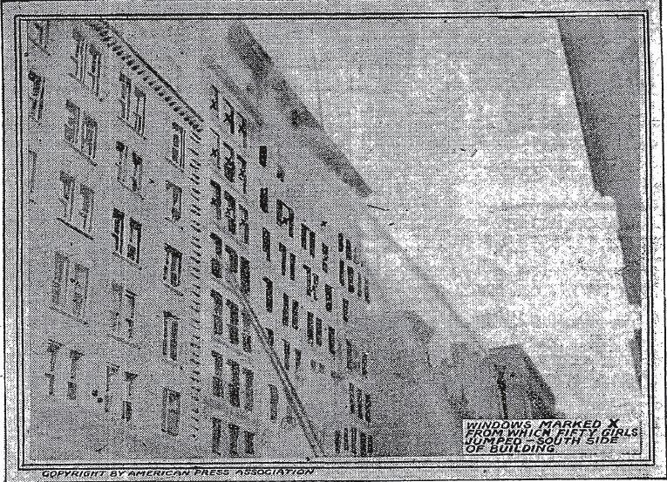
Act 3: The Rescue
Five girls who stood together at a window close to the Greene Street corner held their place while a fire ladder was worked toward them, but which stopped at its full length two stories lower down. They leaped together, clinging to each other, with fire streaming back from their hair and dresses. They struck a glass sidewalk cover and it to the basement. There was no time to aid them. With water pouring in upon them from a dozen hose nozzles the bodies lay for two hours where they struck, as did the many others who leaped to their deaths.
None waited for the firemen to attempt to reach them with the scaling ladders.

Slide 8
Extension:
1. Diagram and label your model, using appropriate units and explaining what each part means. Now create, diagram, and label a new model in our parallel universe which shows a ladder that was able to reach all of the factory workers. How can this mathematics be applied usefully in safety planning and building construction?
2. The angle created if the ladder reached the ground is between 60-72 degrees for stability. Use a model to approximate the ratio this creates between the distance from the ground to the desired height and the distance between the building and if the ladder reached the ground. How could this ratio used by fire fighters arriving at the scene of a fire?

