Slide 1
Triangle Shirtwaist Fire
Extinguishing the Fire

Slide 2
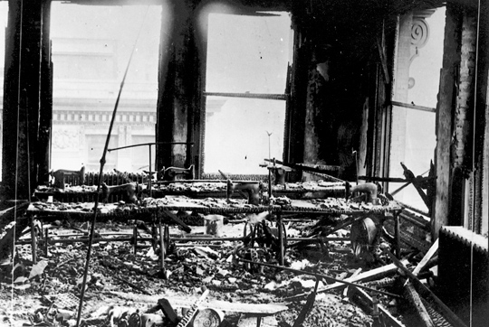
Act 1: Setting the Scene
Fire Marshall Account
Q. Were any attempts made in that case to extinguish the fire?
A. Yes, there were. They used fire pails there, and then attempted to use the fire hose.
Q. What happened to the fire hose?
A. Well, they claimed they could not get any water to it.
Q. How about the fire pail, why did not that put out the fire?

Slide 3
Why was it that the fire pail was not successful in extinguishing the fire in the factory?
Exploration:

Slide 4
Act 2: Gathering Information
Now we are going to complete a simulation and collect data to see if your hypotheses are supported.

Slide 5
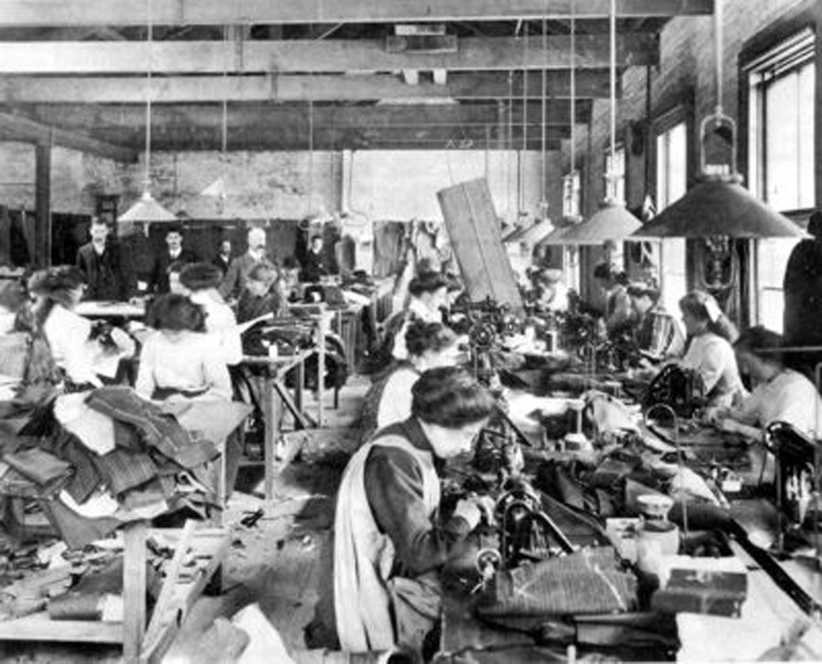
The Parameters
Working conditions are cramped
There is only one fire pail at the water source, so you may only carry one at a time.
Smoke rises, and dying of smoke inhalation is actually more rapid than burning in a fire. You may only crawl or walk on your knees back and forth between getting a pail of water and fighting back the fire.
…which means so is the space when you are trying to extinguish the fire.

Slide 6
Our Roles
#1 Water source: give one bucket to the student from your group attempting to put out the fire when they reach you; do not move.
#2 Fire: put the number of flames on the ground in front of you as directed each time your teacher indicates; do not move.
#3 Worker: get one bucket at a time to extinguish one flame at a time by crawling or walking on your knees between the fire and the water source.
#4-5 Data collector: as quickly and as much as possible, record inputs of time elapsed since the fire started and outputs of number of flames still on the ground that haven’t been extinguished; move as needed to best record data.

Slide 7
Ready, Set, Extinguish!
Each flame represents 1 ft² of fire.
Trial #1:
Fire starts at 2 ft² of fire. Teacher signals each 20 seconds for fire to increase by an additional 2 ft² of fire.

Slide 8
Ready, Set, Extinguish!
Switch roles.
Trial #2:
Fire starts with 4 ft² of fire. Teacher signals each 20 seconds for fire to increase by an additional 3 ft² of fire.

Slide 9
Ready, Set, Extinguish!
Switch roles.
Trial #3:
Fire starts with 3 ft² of fire. Teacher signals each 10 seconds for fire to increase by doubling the amount of square feet of fire that still has not been extinguished.

Slide 10
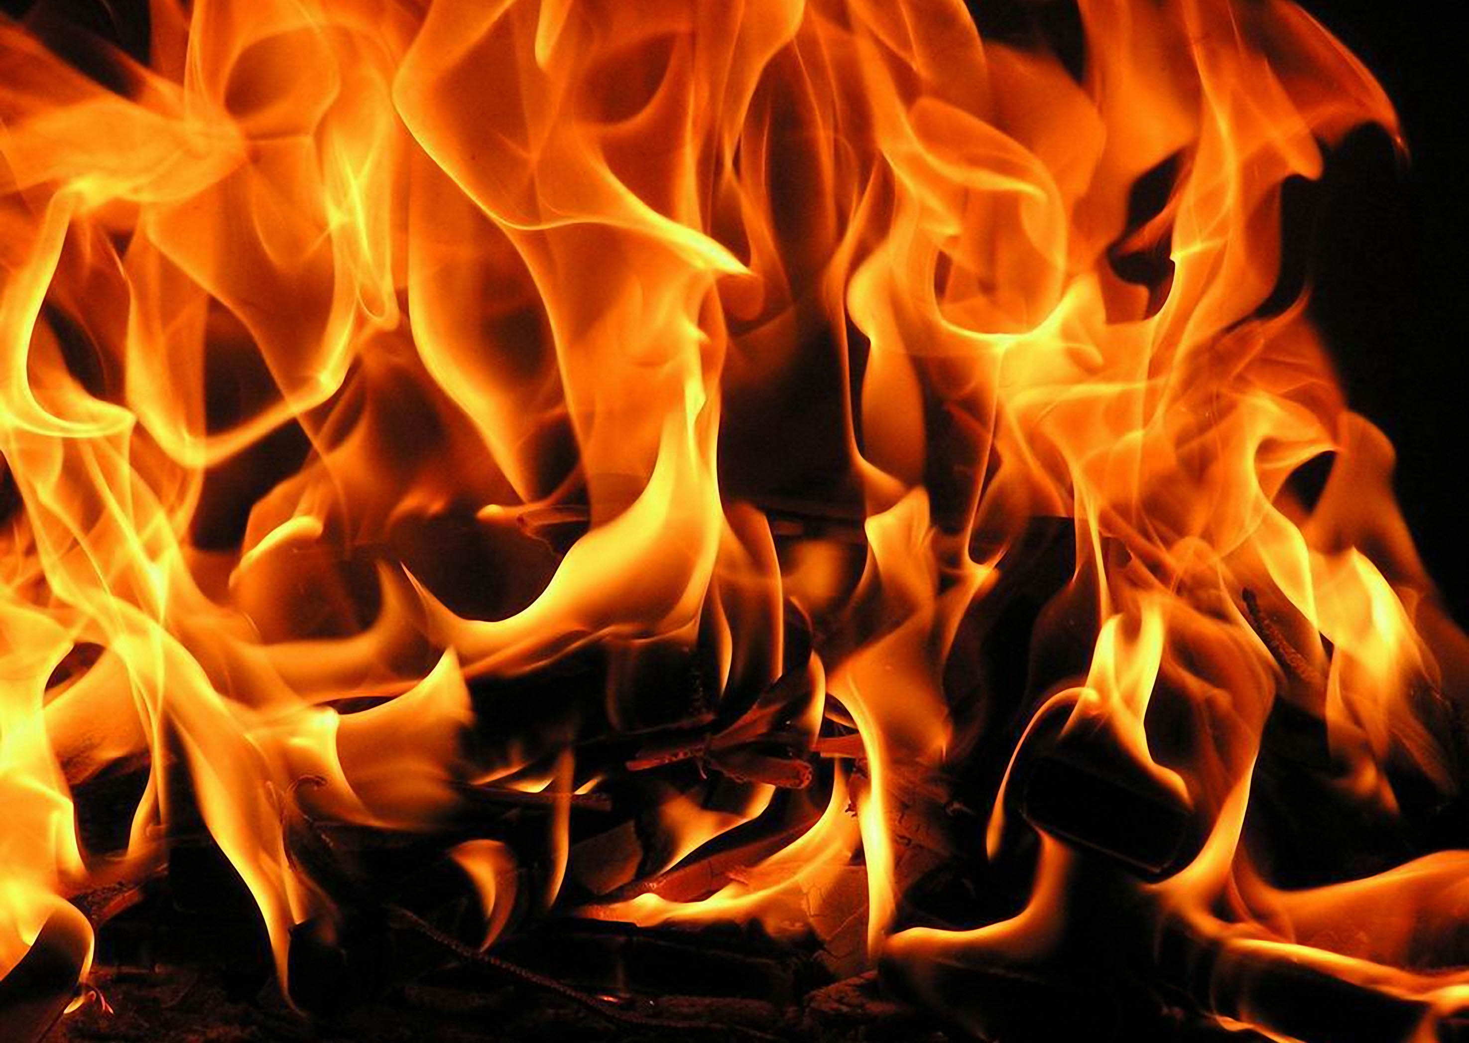
Representing Data:
Create scatterplots for the data sets your group has collected.
Describe the relationship you see between time and amount of fire.

Slide 11
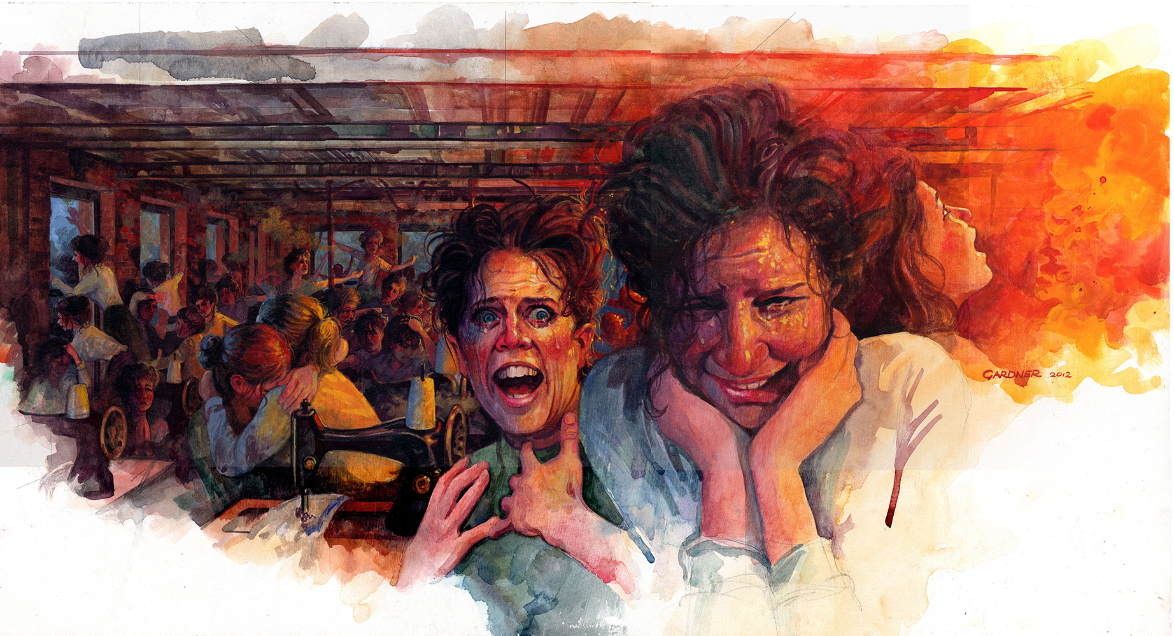
Act 3: Too great a rate of change
Fire Marshall Account
Q. How about the fire pail, why did not that put out the fire?
A. They did not get enough water to put it out. It spread very rapidly. The material is very inflammable, and it travels very fast, and the conditions were there, everything, to build a fire.
Mathematically, the negative rate of change from extinguishing the fire with only a small amount of water from a pail was far outweighed by the positive rate of change from the fire growth from contact with fabric and oxygen feeding it.

Slide 12
Extension:
1. Examining the graphs, justify which appear to be linear and which non-linear. For the linear associations, draw a trend line on top of your data points, and then write an equation to model the relationship between time and the area the fire covered.
2. Referring to the description of the three scenarios, create hypothetical input-output tables and a corresponding graph for each to represent the growth of the fire if no factory worker had attempted to extinguish the flames. Use this information to determine the rate at which each of your factory workers extinguished flames.

