Slide 1
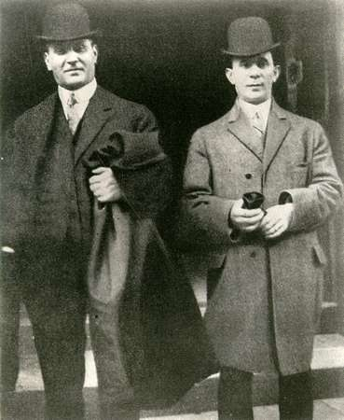
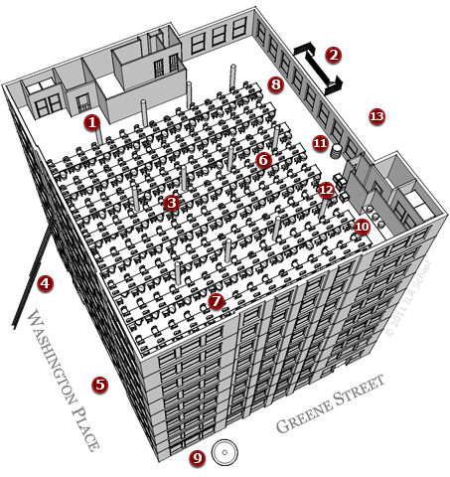
Triangle Shirtwaist Factory Fire
H.S.S. 8.12

Slide 2
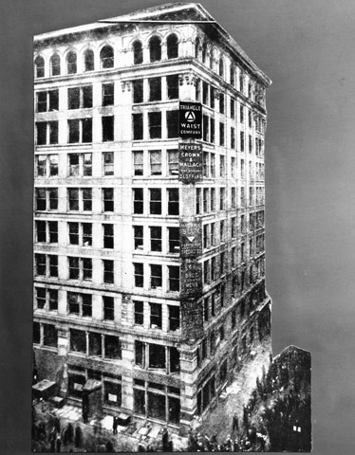
Background History
March 25, 1911 Manhattan, NY
Factory located on 8th, 9th and 10th floors (Asch Building)
600 young immigrants work in the factory
Why did the factory occupy the top floors?

Slide 3
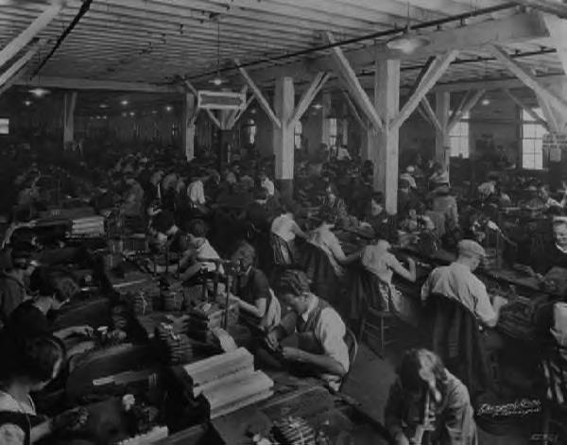
Labor conditions
14 hours a day, 6 days/wk.
$12 /wk. after paying for company needles, thread, and electricity.
Is this income sustainable?
What happens if you are sick or injured?

Slide 4
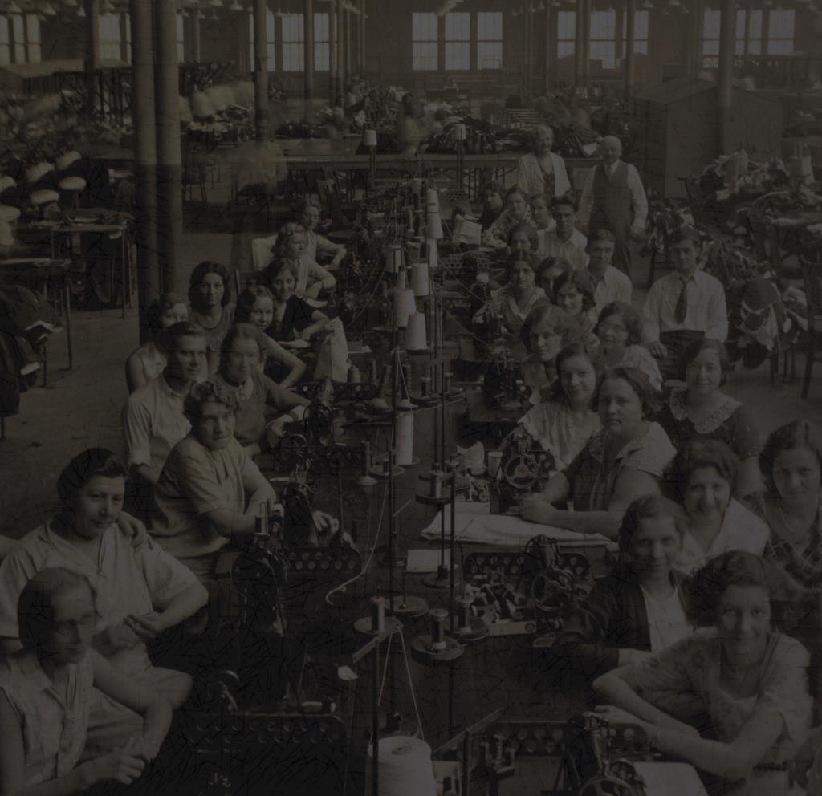
Working conditions
Each worker had to sew
3,000 stitches/ min. w/o a mistake.
Mistakes= no pay
No stopping the machines
No BR or meal breaks
Each person checked before leaving. (prevent theft)
What kind of work environment do these conditions create?

Slide 5
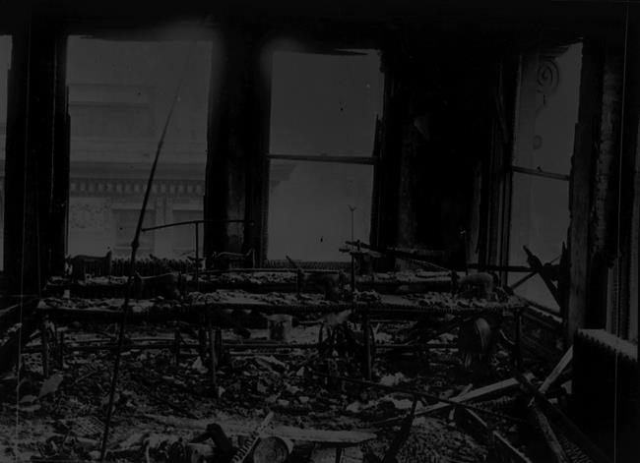
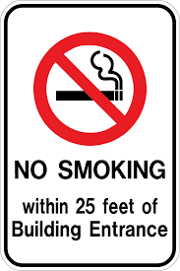
What started the fire?
At the end of the day a cigarette dropped onto the 8th floor in to a container of fabric scraps.
What do signs posted outside of buildings nowadays state?

Slide 6
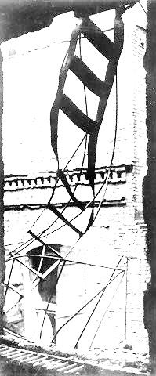
How did the people react?
People rushed to the fire escape, elevators, & stairs.
None of the 200 people on the 10th floor were notified.
Why do you think the other employees were not initially told of the below fire?

Slide 7
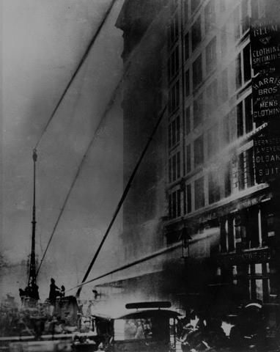
Emergency crew/ Reaction
Ladders could only reach the 6th floor.
The safety nets tore w/o survivors being saved.
53 women jumped off (the building)
19 fell down the elevator shaft
23 fell from the fire escape
1 woman initially survived but died (from her injuries.)

Slide 8
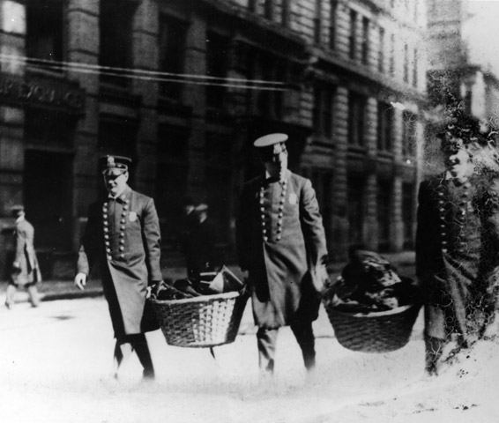
Results
146 killed: 123 women, 23 men
Youngest- 14 yrs. Old
They pay each survivor 1 weeks pay.
Weeks later they open another factory.
How could have this tragedy been prevented?

Slide 9
The Criminal Trial
Owners were found not guilty.
They did not know the doors were locked nor that the machines blocked the exits.
What does the verdict of the jury tell you about the people of the jury?
Civil Trial
Each victims family received $75.
(2014 RV- $1,800)
Though their insurance paid $400 per person (2014 RV $10,000)
Where did the rest of the money paid by the insurance go?

