Slide 1
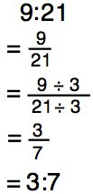
Ratios

Slide 2
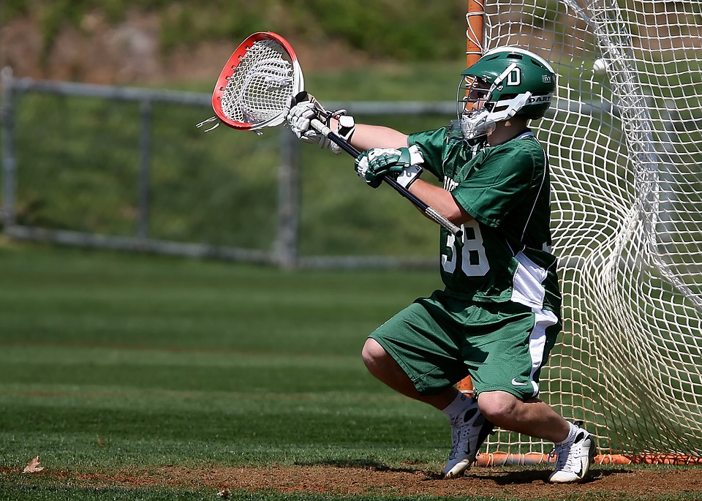
In Sports
I save 9 out of every 10 shots. That’s a 90% save percentage and a ratio of 9:10.
Save percentages
Season standings
Comparing wins and loses

Slide 3
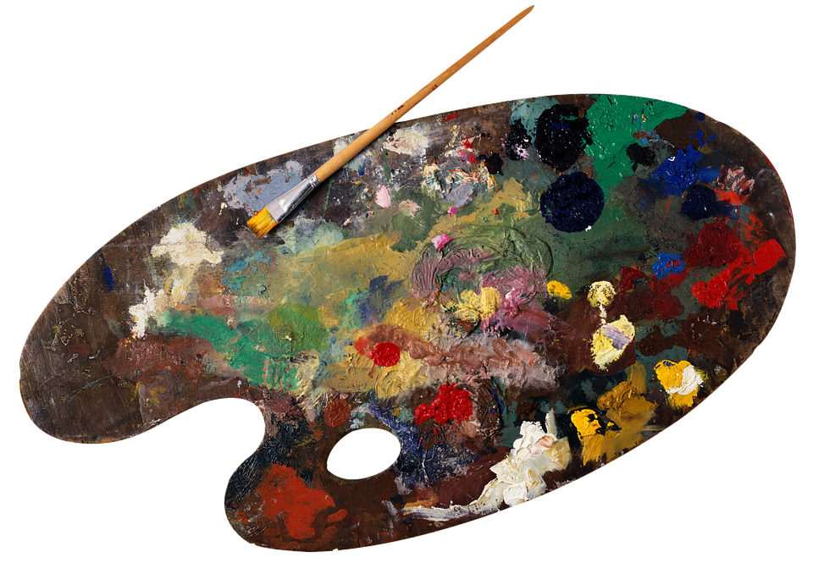
In Art
Paint mixing
Scaling images and photos
Dimensions
To make green, we can mix 1 part blue and 1 part yellow (a ratio of 1:1).

Slide 4
In Business
Banking and investments
Leverage ratios (debt-to-assets)
For every $100 you invest with me, you will get $300 in return. That’s a ratio of 100:300, or 1:3.

Slide 5
Food Servings

Slide 6
Ratios

