Slide 1
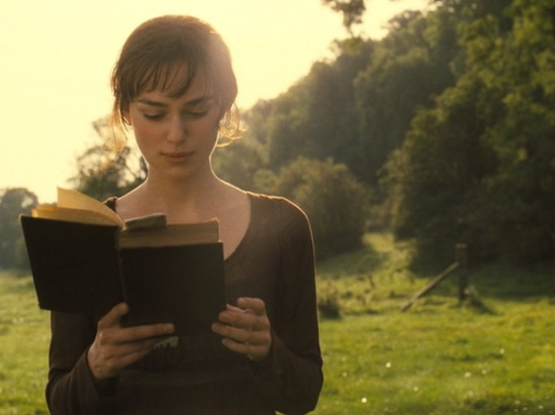
AN ANALYSIS OF FOIL CHARACTERS IN THE NOVEL ‘’PRIDE AND PREJUDICE’’
BY JANE AUSTEN

Slide 2
Literary term
Foil-:
A foil is another character in a story who contrasts with the main character, usually to highlight one of their attributes

Slide 3
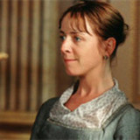
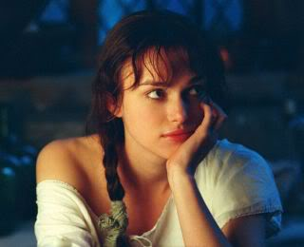
Lady charlotte lucas as a foil to Elizabeth Bennet
Minor details
Lady charlotte Elizabeth bennet
Age-27 Age-21
Plain girl(not so beautiful)
Realistic
Sensible
Intelligent
Practical
Cautious
Reserved and serious Peaceful and respectful
Rectitude
Beautiful
Romantic
Impractical
Witty
Unrealistic
Bold
Vivacious and assured
Good manners and virtue
Propriety

Slide 4
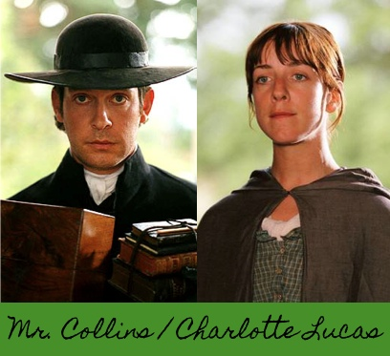
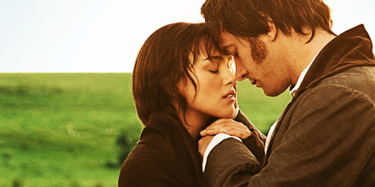
Nature of marriage they aspired and have in novel
Lady charlotte marriage to Mr. Collins is based on materialism and societal pressure
To pursue status of being married
Her motive for marriage is unemotional and pragmatic
Victorian type marriage
Elizabeth Bennet marriage to Mr. Darcy is based on
Spiritual values and individualism.
To pursue status of giving love and being loved back
Her motive for marriage is emotional and romantics
Modern type of marriage

Slide 5
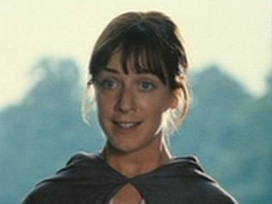
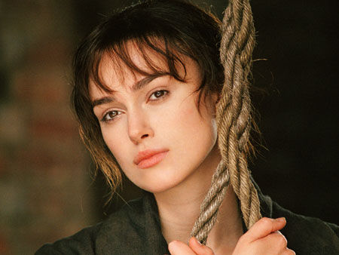
Quotation
to
Lady charlotte Lucas quotes-
‘‘I am not romantic you know .I never was. I ask only a comfortable home
; and considering to Mr.collins’s character ,connection, and situation in life, I am convinced that my chance of happiness with him is as fair ,as most people can boast on entering the marriage state ’’

Slide 6
High contrasity between their marriages
Help in portraying
Entailment policy
Self-esteem of characters
Feminist literary criticism
Elizabeth Bennet perfect feminist

Slide 7
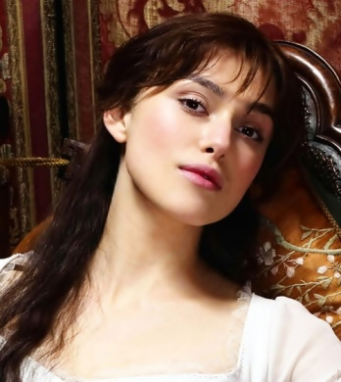
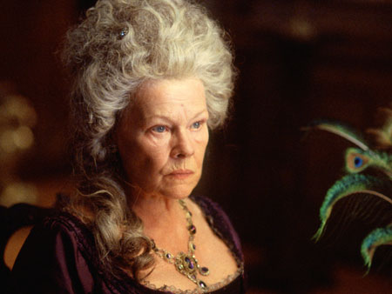
Quotation
to
Elizabeth quotes
‘‘yes, I am marrying your nephew I should not consider myself in quitting that sphere in which I have been brought up; he is a gentleman and I am gentleman’s daughter ,so for me we are equal’’.

Slide 8
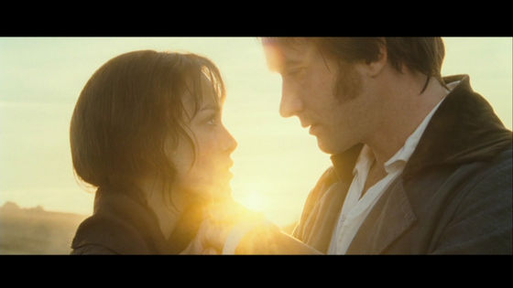
True love triumphs
True love triumphs at last.
HAPPY ENDING

