Slide 1
How a Utah State Bill Becomes a State Law

Slide 2
An Idea is Born
The process starts when a state representative or state senator sees an issue and thinks of an appropriate solution.
viZZual.com. It dawns on me. 2008. Flickr. Web. 14 April 2017.

Slide 3
Drafting Stage
Once a legislator has a solution, they must draft, or write, a bill to propose.
Lucas. pen and paper. 2009. Flickr. Web. 14 April 2017.

Slide 4
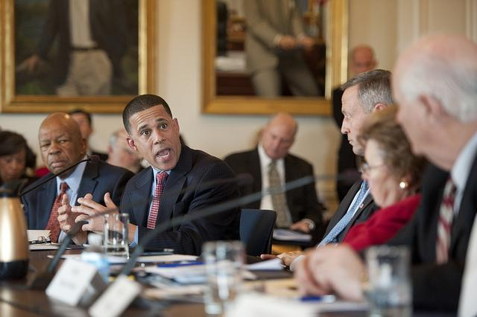
Introduction to the Rules Committee
Now, the legislator introduces the proposal to the Rules Committee. The Rules Committee reads the bill and tells the legislator which committee should review the bill in depth.
The House of Representatives and the Senate have many committees that handle bills on different subjects. Committees exist for anything from adoption and agriculture to weapons and wildlife.
Maryland GovPics. Maryland Congressional Delegation Meeting. 2012. Flickr. Web. 14 April 2017.

Slide 5
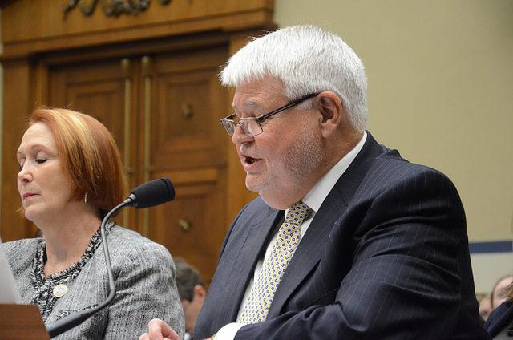
The Standing Committee
The “standing committee” is the subject-specific committee that the Rules Committee sent the bill to. This new committee holds public meetings and hears testimony from experts and people the potential law would affect.
Once the testimonies have finished, the committee recommends changes to the bill, postpones the bill, and/or sends the bill out for a vote.
AFGE. AFGE President Cox Testifies on Federal Workforce. 2014. Flickr. Web. 14 April 2017.

Slide 6
The Legislators Debate
At this point, the bill goes to all of the legislators. They will read the committee’s report and debate the bill. They have the chance to make changes to it.
Woodward, Tom. step up to the mic. 2009. Flickr. Web. 14 April 2017.

Slide 7
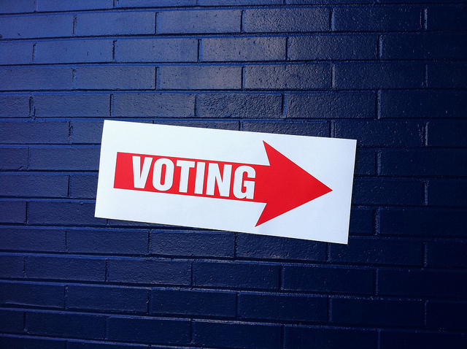
The Legislators Vote
The legislators vote in both the House of Representatives and the Senate. In order to become law, the bill must pass in both groups.
If the vote fails to pass the bill, legislators have the option to change the bill and start the whole process again.
Grimes, Justin. Voting. 2010. Flickr. Web. 14 April 2017.

Slide 8
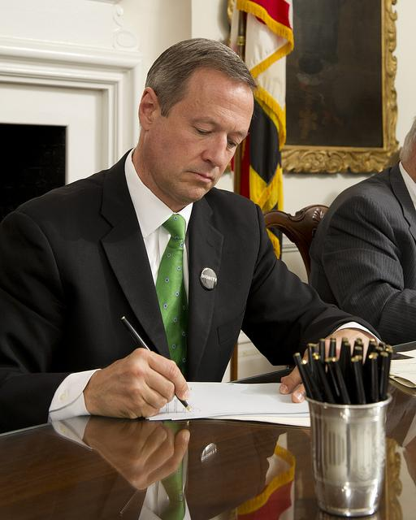
The Governor Makes a Choice
If the bill has passed the legislature, the governor has a choice to make. He can sign the bill to make it law or veto (reject) it. If he vetoes the bill, the legislature has the chance to vote again. If they gain 60% or more of the votes, the bill will still become law.
Maryland GovPic. Bill Signing. 2012. Flickr. Web. 14 April 2017.

Slide 9
The Law Goes into Effect
In Utah, laws usually go into effect 60 days after the governor signs the bill. However, if the bill has specific date contained inside, the law will only become effective on the date listed in the bill.
Once the law becomes effective, residents must obey the law, and the state government will enforce it.
Cholet, Dafne. Calendar*. 2011. Flickr. Web. 14 April 2017.

Slide 10
Resources
AFGE. AFGE President Cox Testifies on Federal Workforce. 2014. Flickr. Web. 14 April 2017.
Cholet, Dafne. Calendar*. 2011. Flickr. Web. 14 April 2017.
Grimes, Justin. Voting. 2010. Flickr. Web. 14 April 2017.
"How Ideas Become Bills, Then Law." Utah State Legislature. N.p., n.d. Web. 14 Apr. 2017.
Lucas. pen and paper. 2009. Flickr. Web. 14 April 2017.
Maryland GovPics. Maryland Congressional Delegation Meeting. 2012. Flickr. Web. 14 April 2017.
Maryland GovPic. Bill Signing. 2012. Flickr. Web. 14 April 2017.
viZZual.com. It dawns on me. 2008. Flickr. Web. 14 April 2017.
Woodward, Tom. step up to the mic. 2009. Flickr. Web. 14 April 2017.

