Slide 1
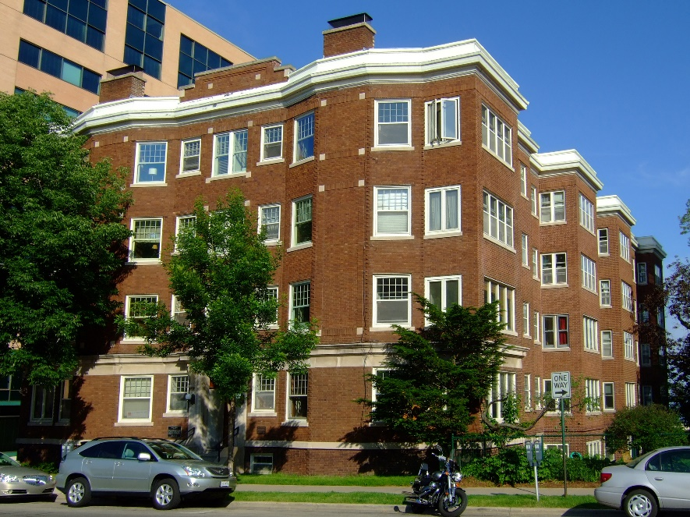
Adel is looking for an apartment.

Slide 2
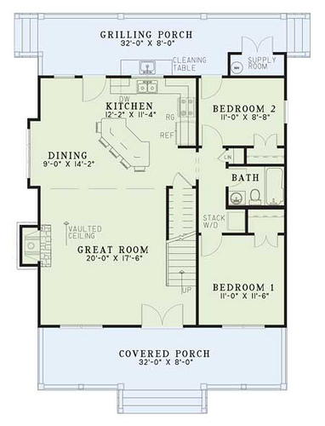
He wants a 2 bedroom apartment for his family.

Slide 3
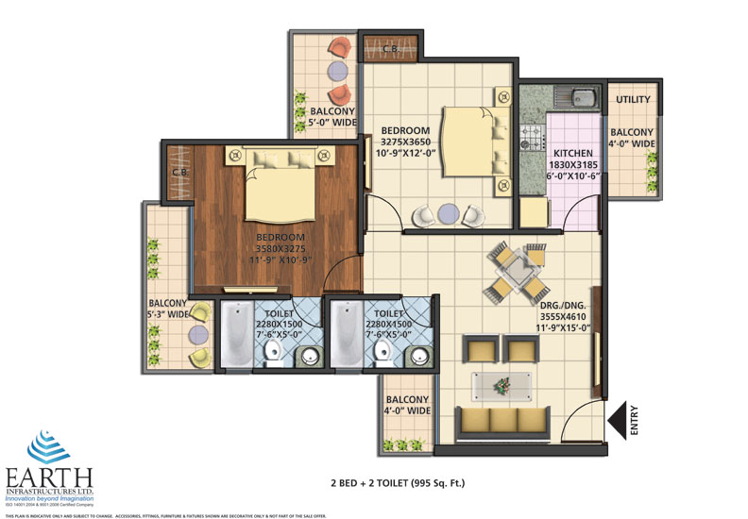
Adel looks on the computer. He finds a 2 bedroom, 2 bathroom for $825.

Slide 4
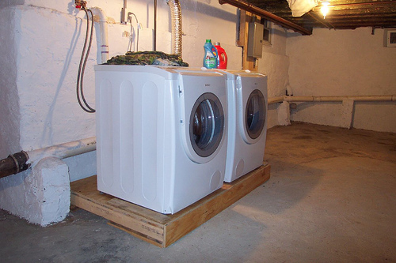
He calls and asks: “Is the apartment near a school?” “Is there a Washer and Dryer in the basement?”

Slide 5
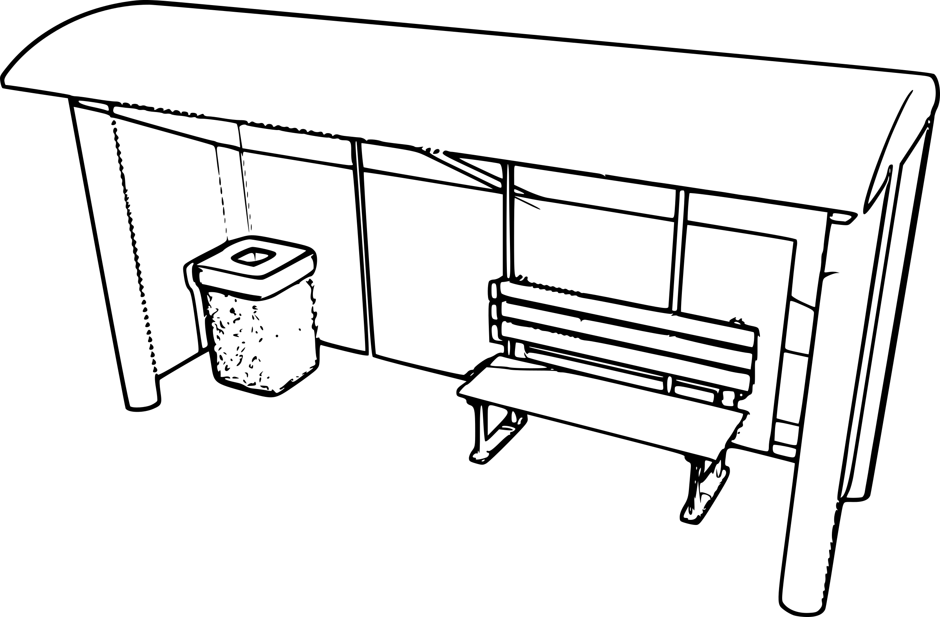
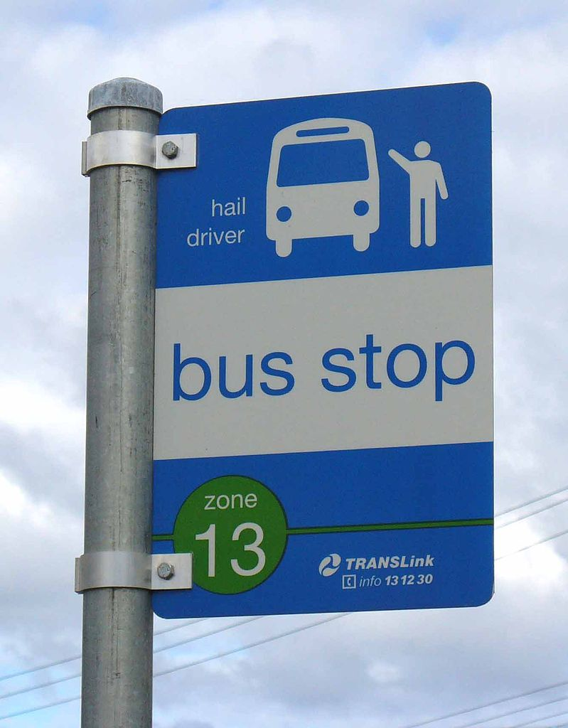
“Is it on a busline?” “When can we see the apartment?”

Slide 6
They see the apartment. It’s beautiful. It is near the bus stop, schools and supermarkets. It has a Refrigerator, stove and a dishwasher.

Slide 7
Adel says “Lets look at another one. Maybe we can find a cheaper apartment.”

Slide 8
They drive around the neighborhood and look for signs.

Slide 9
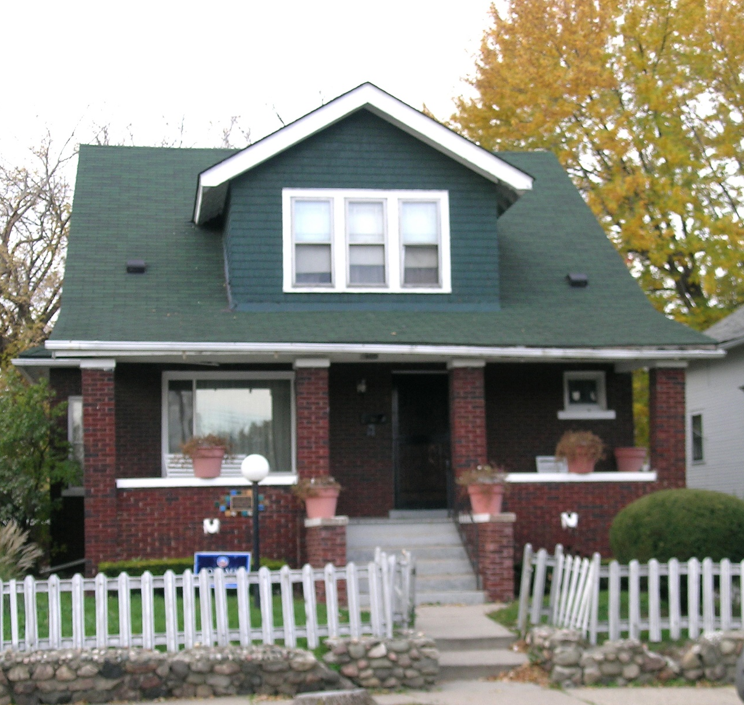
They find a small 3 bedroom house for $875. This is prefect because our children are getting older and they need their own rooms.

Slide 10
They sign a one year lease. They pay a $500 deposit.

Slide 11
They move in. They are happy.

Slide 12
Adel is looking for an apartment. He wants a 2 bedroom apartment for his family. Adel looks on the computer. He finds a 2 bedroom, 2 bathroom for $825. He calls and asks: “Is the apartment near a school?” “Is there a Washer and Dryer in the basement?” “Is it on a bus line?” “When can we see the apartment?” They see the apartment it’s beautiful. It is near the bus stop, schools and supermarkets. It has a Refrigerator, stove and a dishwasher. Adel says “Lets look at another one. Maybe we can find a cheaper apartment.” They drive around the neighborhood and look for signs. They find a small 3 bedroom house for $875. This is prefect because our children are getting older and they need their own rooms. They sign a one year lease. They pay a $500 deposit. They move in. They are happy.

Slide 13
Suggested Activities: Write the word twice Alphabetize Missing letter Scrambled word order WH questions True false and multi level dictation of TF Text only page Pictures without text. A dialogue Dictation of text (multi level) Concentration cards

Slide 14
Adel is looking for an __________. He wants a 2 bedroom apartment for his _______. Adel looks __ the computer. He finds a 2 bedroom, 2 bathroom for $825. He calls and asks: “Is the apartment _____ a school?” “Is there a Washer and Dryer in the ___________?” “Is it on a ___ line?” “____ can we ___ the apartment?” They see the apartment it’s _______. It is ____the bus stop, ______ and supermarkets. It has a Refrigerator, _____ and a dishwasher. Adel says “Lets look at _____ one. Maybe we can find a ____ apartment.” They drive around the ______ and look for _____. They find a small 3 bedroom ____ for $875. This is _____ because our children are getting older and they need their own rooms. They ____ a one year ____. They pay a $500 ______. They ____ in. They are ______.
CLOZE

Slide 26
WH Questions
Looking for Housing
1. WHAT is Adel looking for?____________________________________________
HOW MANY children are in Adel’s family?_______________________________
WHERE does Adel see a 2-bedroom house for $825.00?____________________
WHAT does Adel want in the basement? _________________________________________________________________
WHAT is a bus line? ______________________________________________
WHERE is the refrigerator, stove and dishwasher? _________________________
WHO is saying “Maybe we can find a cheaper apartment.” ___________________
WHERE are the family looking for signs? __________________________________
HOW MANY bedrooms are in the house for $875.00? _______________________
WHAT do they sign to get the house they like? _____________________________
WHEN the family moves in, are they happy? ______________________________

Slide 27
True or False?
Adel’s Search for Housing
1. ___ Adel is looking for a new car.
2. ___ He wants a 2 bedroom apartment.
3. ___ Adel looks at the community board in the grocery store.
4. ___ He finds a 3 bedroom, 2 bathroom for $825.
5. ___ He calls and asks, “Is there a washer and dryer in the yard?”
6. ___ Adel also asks if he can have a pet.
7. ___ The apartment is near the bus stop, schools and supermarkets.
8. ___ Adel wants to keep looking for a cheaper apartment.
9. ___ The family drives around with neighbors to look for signs.
10.___ They find a small 3 bedroom house for $875.
11.___ They sign a two year lease and pay $500. deposit.
12.___ The family moves in and they are happy!

Slide 28
Please copy the words two times. 1. Apartment _____________________ ________________________ 2. family _________________________ ________________________ 3. computer _____________________ ________________________ 4. calls and asks __________________ ________________________ 5. bus line _______________________ ________________________ when ________________________ ________________________ 6. see __________________________ ________________________ near __________________________ ________________________ 7. cheaper _______________________ ________________________ 8. neighborhood __________________ ________________________ signs __________________________ ________________________ 9. house _________________________ ________________________ 10. sign _________________________ ________________________ lease _________________________ ________________________ 11. move in ______________________ ________________________

Slide 29
Please arrange the words in alphabetical order.
apartment family computer calls bus line when see
near cheaper neighborhood house sign lease move in
_________________
_________________
_________________
_________________
_________________
_________________
_________________
____________________
____________________
____________________
____________________
____________________
____________________
____________________

Slide 30
What is the letter?
Ap____ent
__mily
c___uter
ca__s & __ks
bus ____
w__n?
s_e
____per
n____bor___d
____sit & l__se
s__ns & __gn

Slide 31
Describe the procedure for renting an apartment step by step
Go over the pictures. Introduce the title. “Adel is Looking for an Apartment”. Have students work in groups to draw out the meaning and establish the story.
Teach the vocabulary. Establish 12-15 active words. You can write the words on cue cards or on the board. Explain. Vocabulary: apartment, family, computer, calls and asks, bus line, wh/question words, see, cheaper, neighborhood, deposit/lease, signs/to sign.
Teach connectors/discourse words: because, as a result, so, finally.
Have students to connect the pictures and establish sequence.
- Adel is looking for a 2 bedroom apartment for his family - he looks on the computer - he calls and asks - make a list of wh/questions - they go and see, the rent is $825 - they decide to look at another one - they drive around and look for signs - they find a 3 bedroom house for $875 - they sign a one year lease - they pay $500 deposit - they move in
Listening dictation. Teacher reads. Students write missing words in blanks.
Have students write a story describing the steps.

