Slide 1
Traffic Signals Shapes and Descriptions
Application Preparation for “Preparing for a Driving Test in USA in Basic English” Lesson

Slide 2
Introduction
The following is based on the “Signs, Signals, Markings” section featured in the 2011 Georgia DMV Drivers Handbook.
(http://www.dds.ga.gov/docs/forms/fulldriversmanual.pdf )
Consult your state’s handbook for differences at: http://www.dmv.org/driver-handbook.php

Slide 3
Instructions
Select, modify, or create 5 to 10 of the following signals.
Print and cut out the chosen signal shapes and their descriptions.

Slide 4
Table of Contents
Road Signs - shapes
Octagon, Triangle, Round, Diamond, Pentagon, Horizontal rectangle, Vertical rectangle
Regulatory signs
No entry, wrong way, School Zone, Direction of traffic, speed restrictions
Construction signs
Construction signs, worker ahead, road closed- detour
Yellow Warning Signs
Sharp right, Narrow bridge, Hill, Merge, Reduced lanes, Pedestrian Xing, Deer Xing

Slide 5
Road signs

Slide 6
Octagon

Slide 7
STOP

Slide 8
Triangle

Slide 9
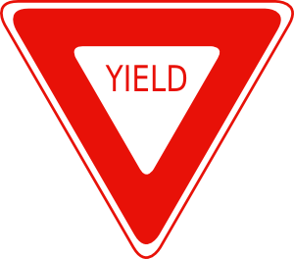
Yield

Slide 10
Round

Slide 11
Railroad Crossing

Slide 12
Diamond

Slide 13
Possible Hazards

Slide 14
Pentagon

Slide 15
School Zone

Slide 16
Horizontal rectangle

Slide 17
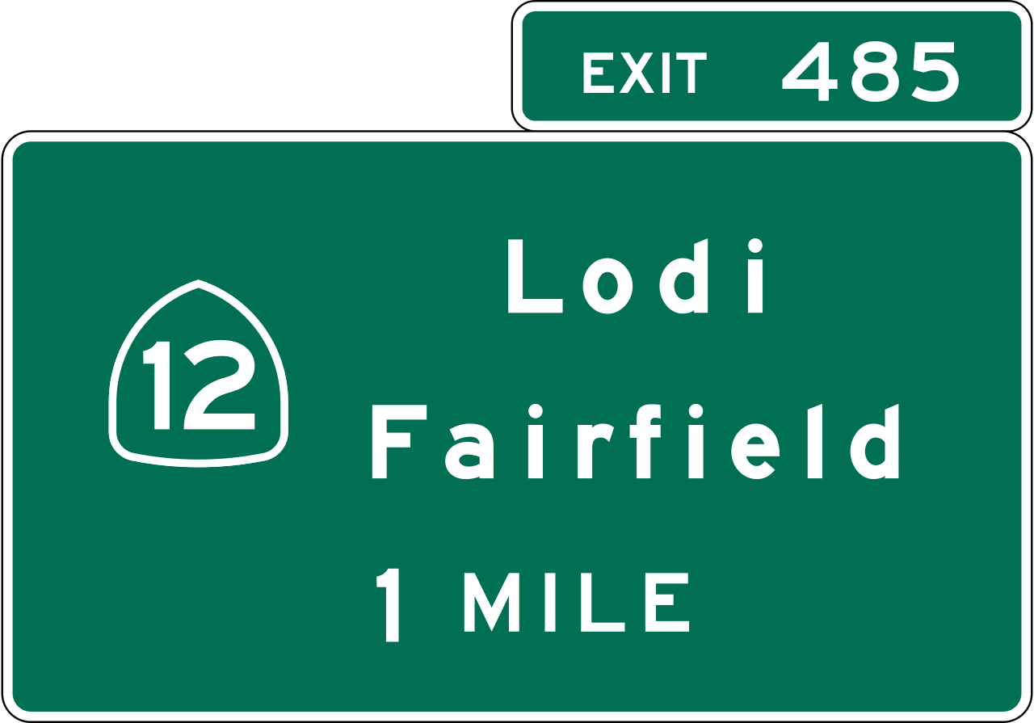
Guide Signs

Slide 18
Vertical rectangle

Slide 19
Regulatory signs that must be followed

Slide 20
Pedestrian Walking (White Outline)
Image Credit: Scott de Jonge

Slide 21
U-Turn

Slide 22
U-Turn Description
U-TURN
Turn around

Slide 23
Left Turn

Slide 24
Left Turn Description
LEFT TURN

Slide 25
Right Turn

Slide 26
Right Turn Description
RIGHT TURN

Slide 27
Yellow Warning Signs
(for the following signs, you can delete the background and use the shape only if necessary)

Slide 28
Reverse Turn Sign

Slide 29
Reverse Turn Description
CAUTION
Road Goes Left
(or Right)

Slide 30
Winding Road Sign
Arrow Credit: Freepik

Slide 31
Right Turn Description
CAUTION
Road is Windy

Slide 32
T-Intersection Sign

Slide 33
Right Turn Description
CAUTION
Side Intersection Ahead

Slide 34
Stop Ahead Sign

Slide 35
Stop Ahead Description
Stop Ahead

Slide 36
Yield Ahead Sign

Slide 37
Yield Ahead Description
Yield Ahead

Slide 38
Crossroad Sign

Slide 39
Crossroad Description
Crossroad Ahead

Slide 40
Pedestrian Crossing Sign
Pedestrian Icon Credit: Scott de Jonge

Slide 41
Pedestrian Crossing Description
CAUTION
Pedestrians Crossing

Slide 42
Lane Ends Sign

Slide 43
Lane Ends Ahead Description
Road Ends or Merges

Slide 44
Two Way Traffic Sign

Slide 45
Two Way Traffic Description
Two Way Traffic

Slide 46
Sharp Turn Sign

Slide 47
Sharp Turn Description
CAUTION
Sharp Turn Ahead

Slide 48
Divided Highway Sign
Arrow Credit: Freepik

Slide 49
Divided Highway Description
Divided Highway

Slide 50
End Divided Highway Sign
Arrow Credit: Freepik

Slide 51
Divided Highway Ends Description
Divided Highway Ends

Slide 52
Merging Traffic Sign

Slide 53
Merging Traffic Description
CAUTION
Traffic Merges

Slide 54
Slippery When Wet Sign
Car Icon Credit: Google

Slide 55
Lane Ends Ahead Description
CAUTION
When Road is Wet

