Slide 1
Name – Pushpa Yadav
CLASS-SYB.ED
Year -2015-2016
Project –ICT (EPC-3)
Roll no- 45

Slide 2
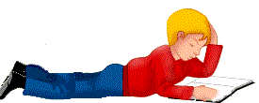


What is past tense
a verb tense used to express an action or state having already taken place or existed <The past tense of the verb “run” is “ran.”>

Slide 3

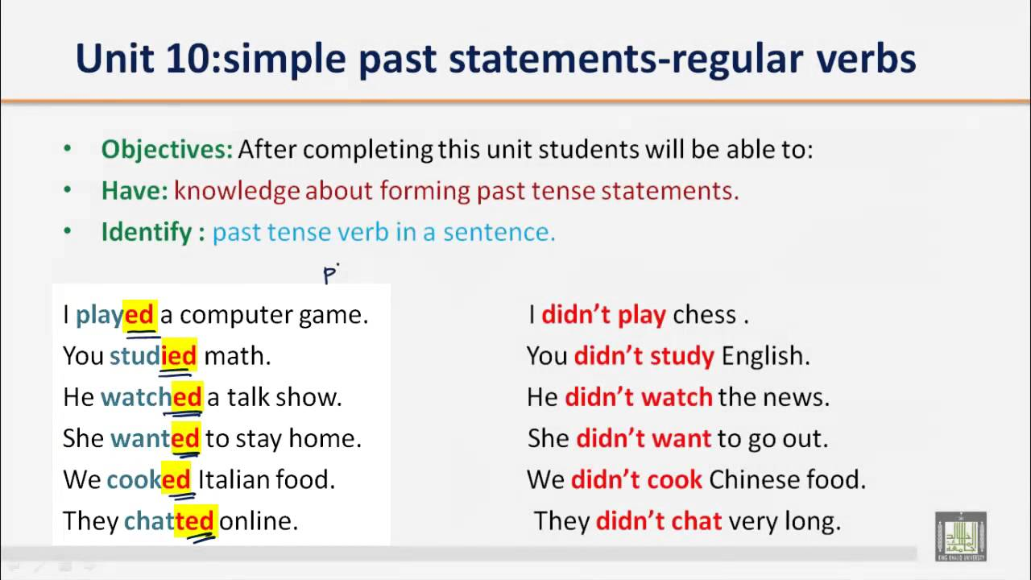

CONTENT ANALYSIS
SIMPLE PAST TENSE
Regular verbs with past tense

Slide 4


Slide 5

Regular verbs have reliable forms.
Infinitive | Simple Present | Simple Past | Past Participle | Present Participle
to laugh | laugh(s) | laughed | laughed | laughing
to start | start(s) | started | started | starting
to travel | travel(s) | traveled | traveled | traveling
Regular verbs are those whose past tense and past participles are formed by adding a -d or an -ed to the end of the verb. "To roll" is a good example of a regular verb: roll, rolled, rolled.

Slide 6


SPELLING RULES for adding ed
Verbs | Change into the past simple | Examples
Ending in e live die date | + d | live – lived die – died date - dated
Ending with consonant and y cry try study marry | Change y to i then + ed | cry – cried try – tried study – studied marry - married
Ending with A vowel and consonant clap trap sip (except w +y ) | Double the consonant then + ed | clap – clapped trap – trapped sip - sipped

Slide 7















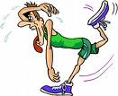












ANSWER
ANSWERED
ARREST
ARRESTED
BRUSH
CARRY
CARRIED
CLIMB
BRUSHED
CLIMBED
CLOSE
CLOSED
COMBED
COMB
COOK
COOKED
COUNT
COUNTED
CRY
CRIED
DANCE
DANCED
DROP
DROPPED
FINISH
FINISHED
HELP
HELPED
FRIGHTEN
FRIGHTENED

Slide 8
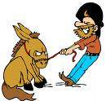










JUMPED
JUMP
LEARN
LEARNED
LISTEN
LIVE
LIVED
LOOK
LISTENED
LOOKED
OPEN
OPENED
PAINTED
PAINTED
PLANT
PLANTED
PLAY
PLAYED
PRAY
PRAYED
PULL
PULLED
PUSH
PUSHED
REMEMBER
REMEMBERED
RETURN
RETURNED
SAVE
SAVED

Slide 9

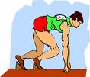

SCREAM
SCREAMED
SHOW
SHOWED
SMELL
SMELLED
SMILE
SMILED
START
STARTED
STAY
STOP
STAYED
STOPPED
STUDY
STUDIED
TALK
TALKED
TASTE
TASTED
TELEPHONED
TELEPHONE
TRAVELLED
TRAVEL
WALK
WALKED
WATCH
WATCHED
WORK
WORKED

Slide 10
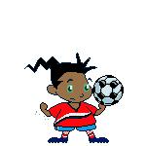
Quiz competition
for evaluation

Slide 11




bake
pack
brush
peel
collect
phone
cook
post
cry
smile
smiled
Kevin ______ at Pam when she saw him at
the corridor.
hug
snow
iron
wait
knit
watch

Slide 12
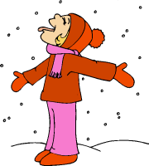
bake
pack
brush
peel
collect
phone
cook
post
cry
smile
hug
snow
snowed
It _______ a lot in my town last winter.
iron
wait
knit
watch

Slide 13
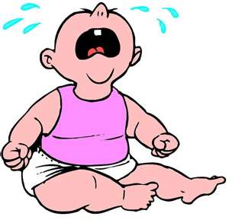
bake
pack
brush
peel
collect
phone
cook
post
cry
smile
Our neighbours’ baby ______ loudly last night.
hug
snow
cried
iron
wait
knit
watch

Slide 14

bake
pack
brush
peel
collect
phone
cook
post
cry
smile
hug
watched
snow
Thomas _______ the birds in the country.
iron
wait
knit
watch

Slide 15
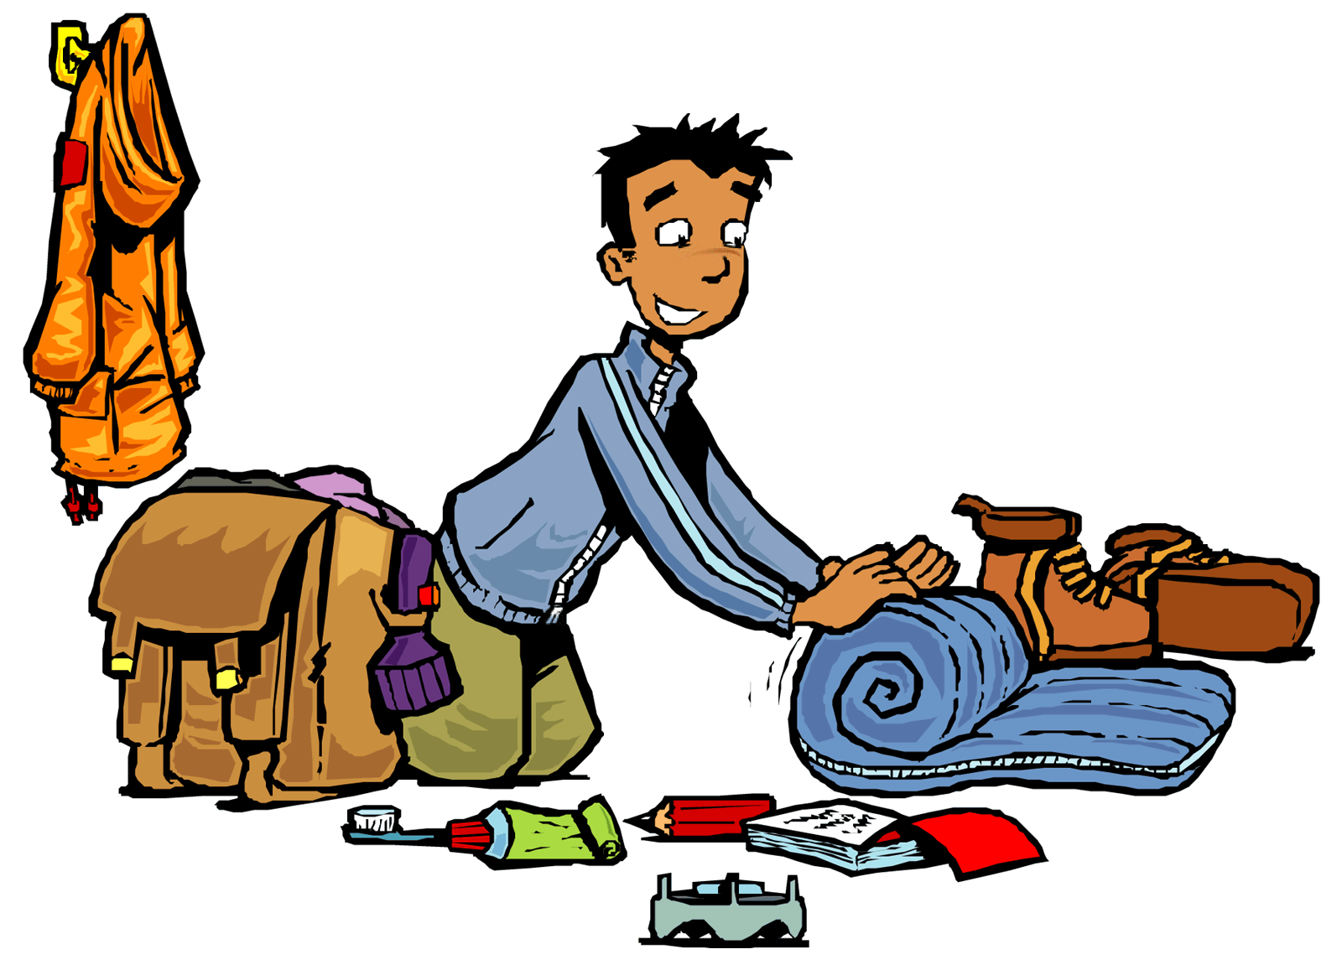

bake
pack
brush
peel
collect
phone
cook
post
cry
smile
packed
Peter ______ his sleeping bag in his rucksack.
hug
snow
iron
wait
knit
watch

Slide 16

bake
pack
brush
peel
collect
phone
cook
post
cry
smile
collected
My uncle ________ stamps at the age of ten.
hug
snow
iron
wait
knit
watch

Slide 17

bake
pack
brush
peel
collect
phone
cook
post
cry
smile
waited
John _______ quite long for his computer to boot.
hug
snow
iron
wait
knit
watch

