Slide 1
Puritanism – A Historical Background

Slide 2
The Puritan movement began in England in the middle of the sixteenth century (1500’s).
Puritanism moved into the New England colonies by way of settlers in the New World.
http://www.history.com/topics/puritanism
http://www.history.com/topics/puritanism/videos/pilgrims-in-america?m=528e394da93ae&s=undefined&f=1&free=false

Slide 3
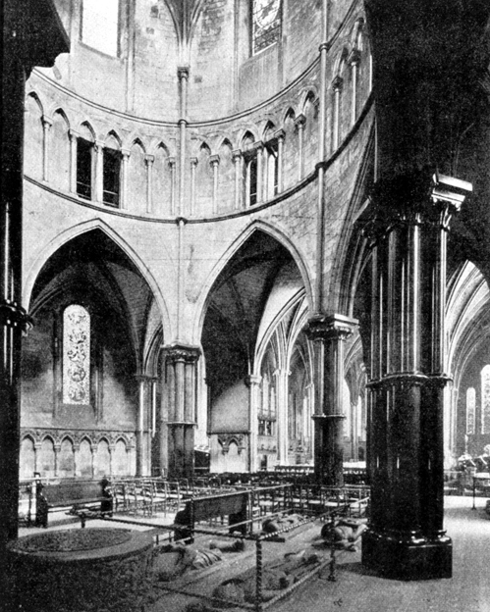
Christians in England felt the church was corrupt.
As a result, reformers suggested that scripture, NOT the clergy (religious leaders), should guide Christian life.
THE POPE’S AUTHORITY WAS
CHALLENGED!

Slide 4
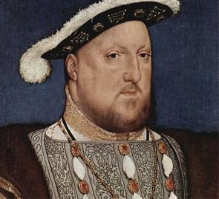
1543 – King Henry broke away from the Catholic Church to form the Church of England.
BY LAW, English citizens were forced to join the new church.
Many had a problem with a temporal or earthly authority dictating spiritual life.
http://www.history.com/topics/puritanism/videos/protestand-reformation-english-reformation?m=528e394da93ae&s=undefined&f=1&free=false

Slide 5
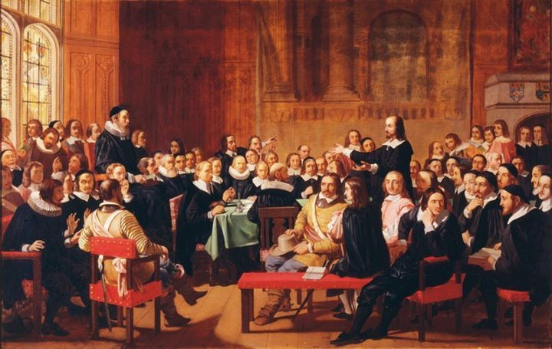
These non-conformists were called
PURITANS!

Slide 6
Several beliefs differentiated Puritans from other Christians:
PREDESTINATION: The belief that all features of salvation are determined by God’s sovereignty.
Including those who were to be saved
Belief in Jesus was not enough!
Participation in sacraments, important religious ceremonies, was not enough! (baptism, communion)
Neither a belief in Jesus nor participation in sacraments could earn someone salvation.

Slide 7
JUSTIFICATION: The gift of God’s grace to the elect (those “CHOSEN” for salvation).
SANCTIFICATION: The behavior that resulted in an individual when he or she had been saved.
The behavior was evidence of salvation, but did not cause salvation.

Slide 8
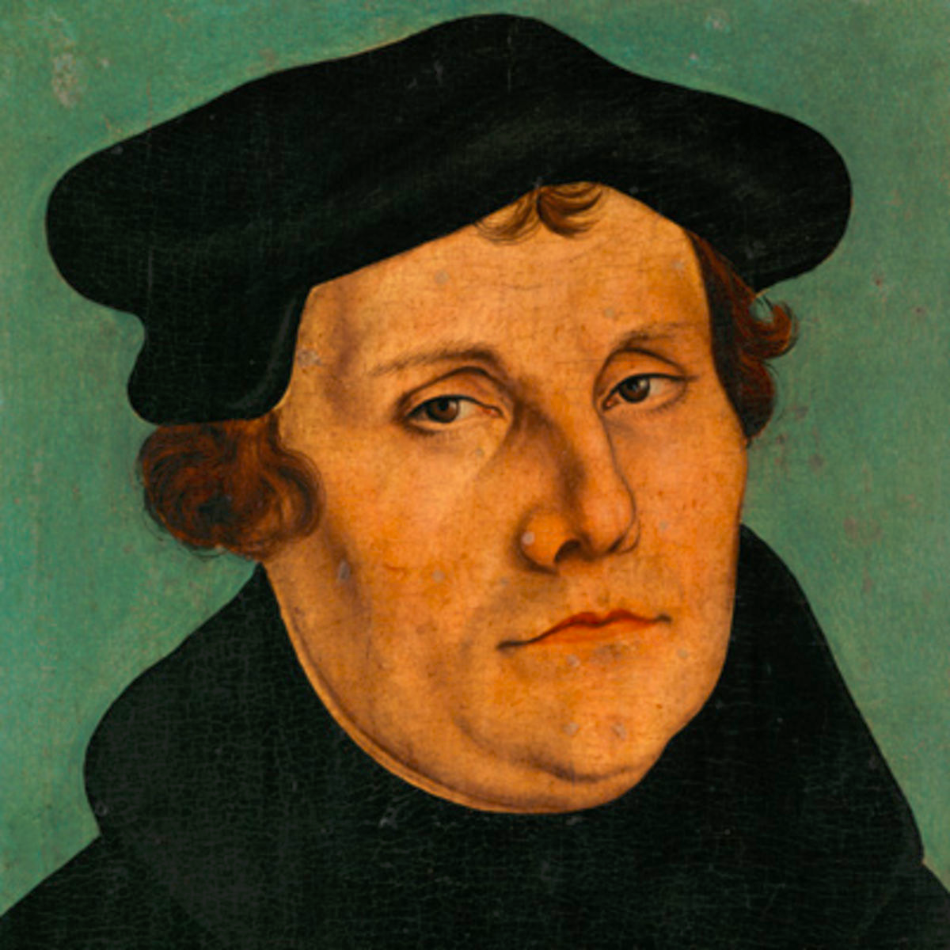
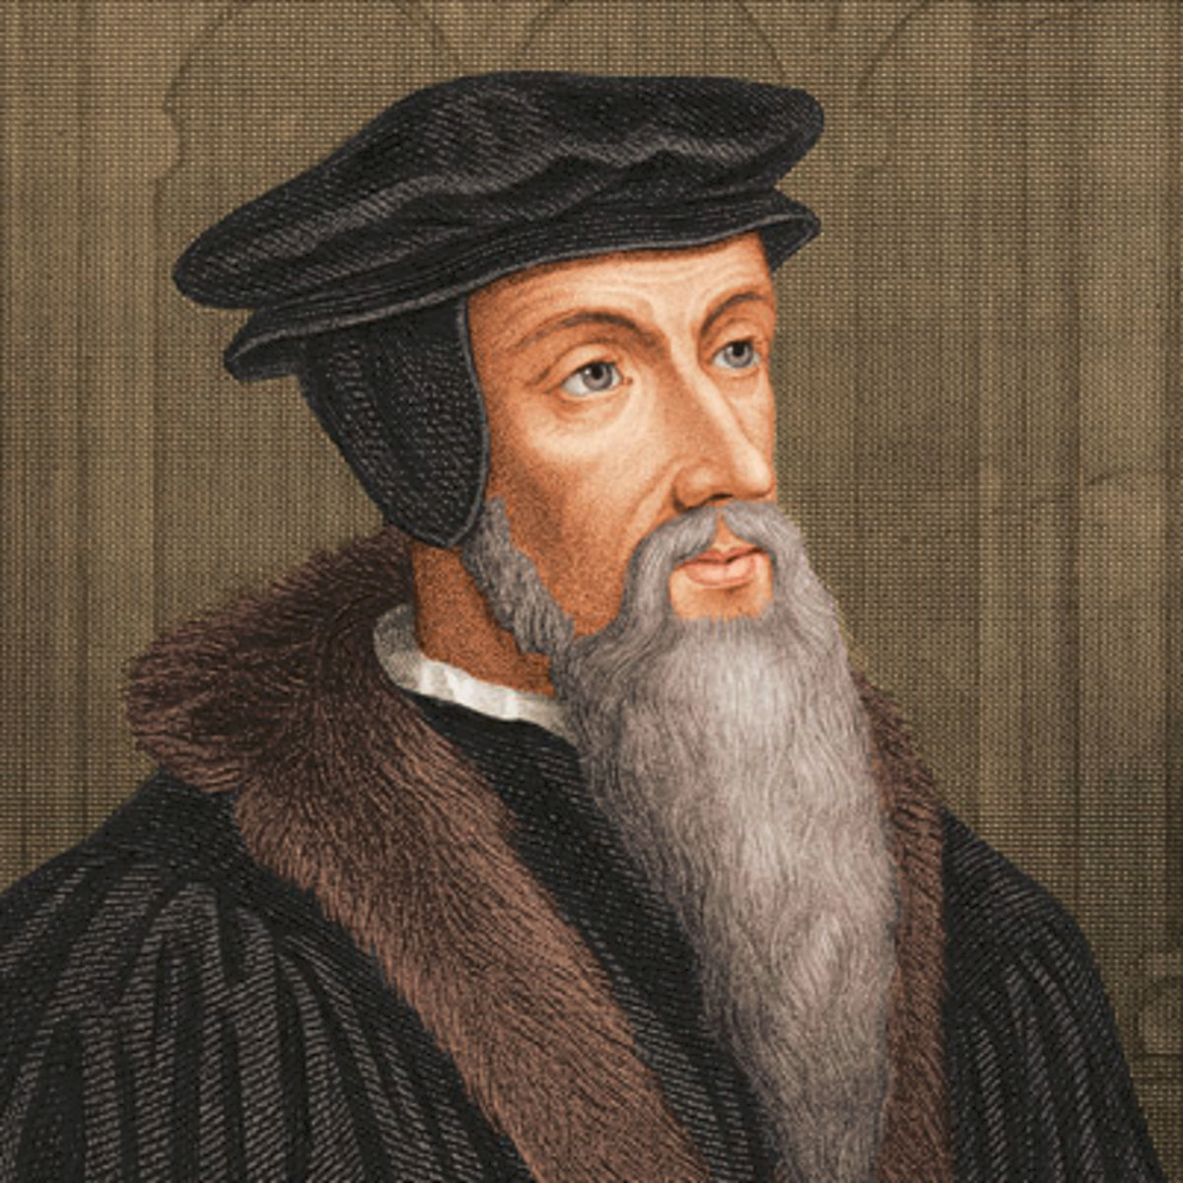
Primary Puritan Influences
Martin Luther
and
John Calvin
MARTIN LUTHER (1483-1546)
A German theologian who attacked the corruption in the Catholic Church with the publication of his 95 thesis.
Believed that all people were innately endowed with grace through God.
Argued that no pope or bishop had any God-given right over the souls of men.
http://www.history.com/topics/puritanism/videos/martin-luther-sparks-a-revolution?m=528e394da93ae&s=undefined&f=1&free=false

Slide 9
JOHN CALVIN (1509-1564)
Believed that the downfall of mankind was directly related to the corruption resulting from the fall of Adam and Eve.
Believed that God’s forgiveness is limited to a select group of followers (LIMITED ATONEMENT).
Believed THAT God’s forgiveness could neither be earned nor denied (IRRESTIBLE GRACE).
Felt that God’s chosen remain in a state of grace while on earth and are taken directly to heaven when dead (PERSEVERANCE OF SAINTS).
http://www.history.com/topics/puritanism/videos/the-origins-of-calvinism

Slide 10
Covenants of Puritan Thought
The Covenant of Works
God promised his followers eternal life if they obeyed moral law.
After Adam broke this covenant, God made a new covenant with Abraham.
Puritans believed they were direct descendants of Abraham.

Slide 11
The Covenant of Grace
This requires an active faith and softens the doctrine of predestination, the belief that everything that will happen has already been decided by God (Merriam-Webster).
God still chooses the elect but there is punishment for sin, a proper response to disobedience.

Slide 12
The Covenant of Redemption
The pre-existence of the covenant.
If Christ paid the price for the redemption of believers, his followers will be washed of their sins.

Slide 13
Puritanical Laws and Punishments
The laws and restrictions of the Puritans are known as some of the harshest in early American colonization and were administered through religion.
A person was fined, imprisoned, and whipped for non-attendance at church services!
People were dealt with more harshly if they spoke against religion or denied the divine origin of any book from the Bible.

Slide 14
Women were not allowed to wear lace or have clothes that showed skin!
Long hair worn by men, smoking in public, or showing affection was unacceptable!
Youths were not allowed to court one another in public and needed the consent of the girl’s parents to court period!
Children were often found crying in fear they would go to hell and not be chosen as the elect!
Crying was done privately as children were punished for doing so in public.

Slide 15
Puritan Literature (1650-1750)
The content was religious and included such themes:
Life is a test. Winners go to Heaven, and losers go to Hell!
Earth is a battlefield between God and Satan.
America is a holy “promised land” where Puritans will create Heaven on Earth, a Christian utopia!

Slide 16
Literary Genre:
sermons and religious tracts
diaries
histories
personal narratives
religious poems

Slide 17
There was very little, if any, imaginative literature produced.
If such literature was produced it was for personal satisfaction and not to be published.
Puritans were highly educated and literate (many had university degrees), mainly to understand scripture!

