Slide 1
Notes:
*
Mural showing stages of planting: sowing, ploughing and fertilising!

Slide 2
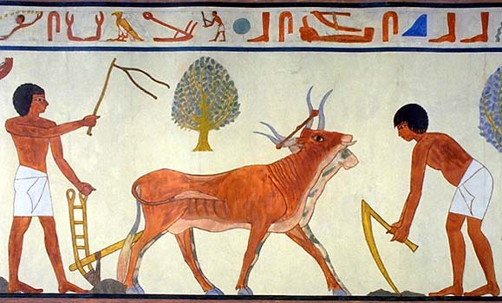
Notes:
*
Mural showing agriculture. Cattle were used for drawing ploughs. How many can you see here?

Slide 3
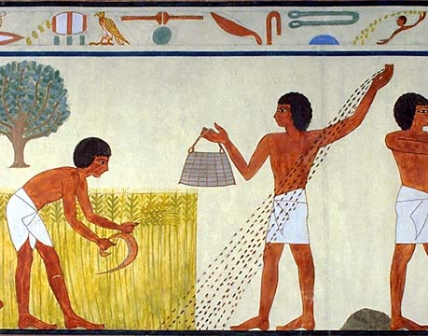
Notes:
*
Harvesting and sowing in one picture.

Slide 4
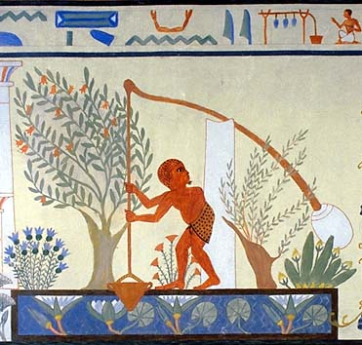
Notes:
*
Mural from a tomb showing a shaduf in use. These are still used today.

Slide 5
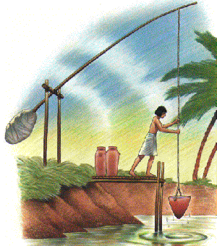
Notes:
*
A shaduf, used for raising water to the fields

Slide 6
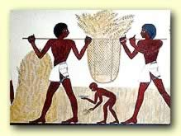
Notes:
*
Carrying the harvest prior to threshing.

Slide 7
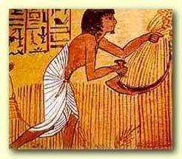
Notes:
*
Using a sickle to harvest the crop.

Slide 8
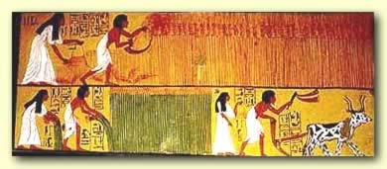
Notes:
*
Harvesting, done by men and women

Slide 9
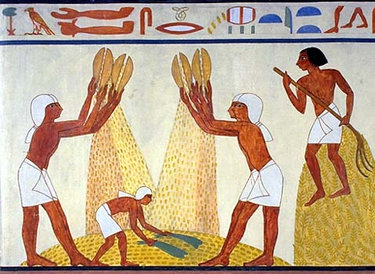
Notes:
*
Winnowing by dropping the grain and allowing the chaff to blow away.

Slide 10
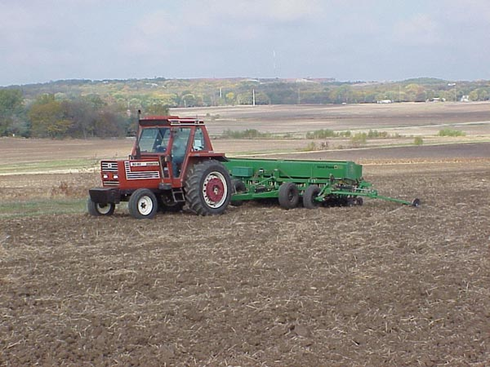
Notes:
*
This is a mechanical grain sower.

Slide 11
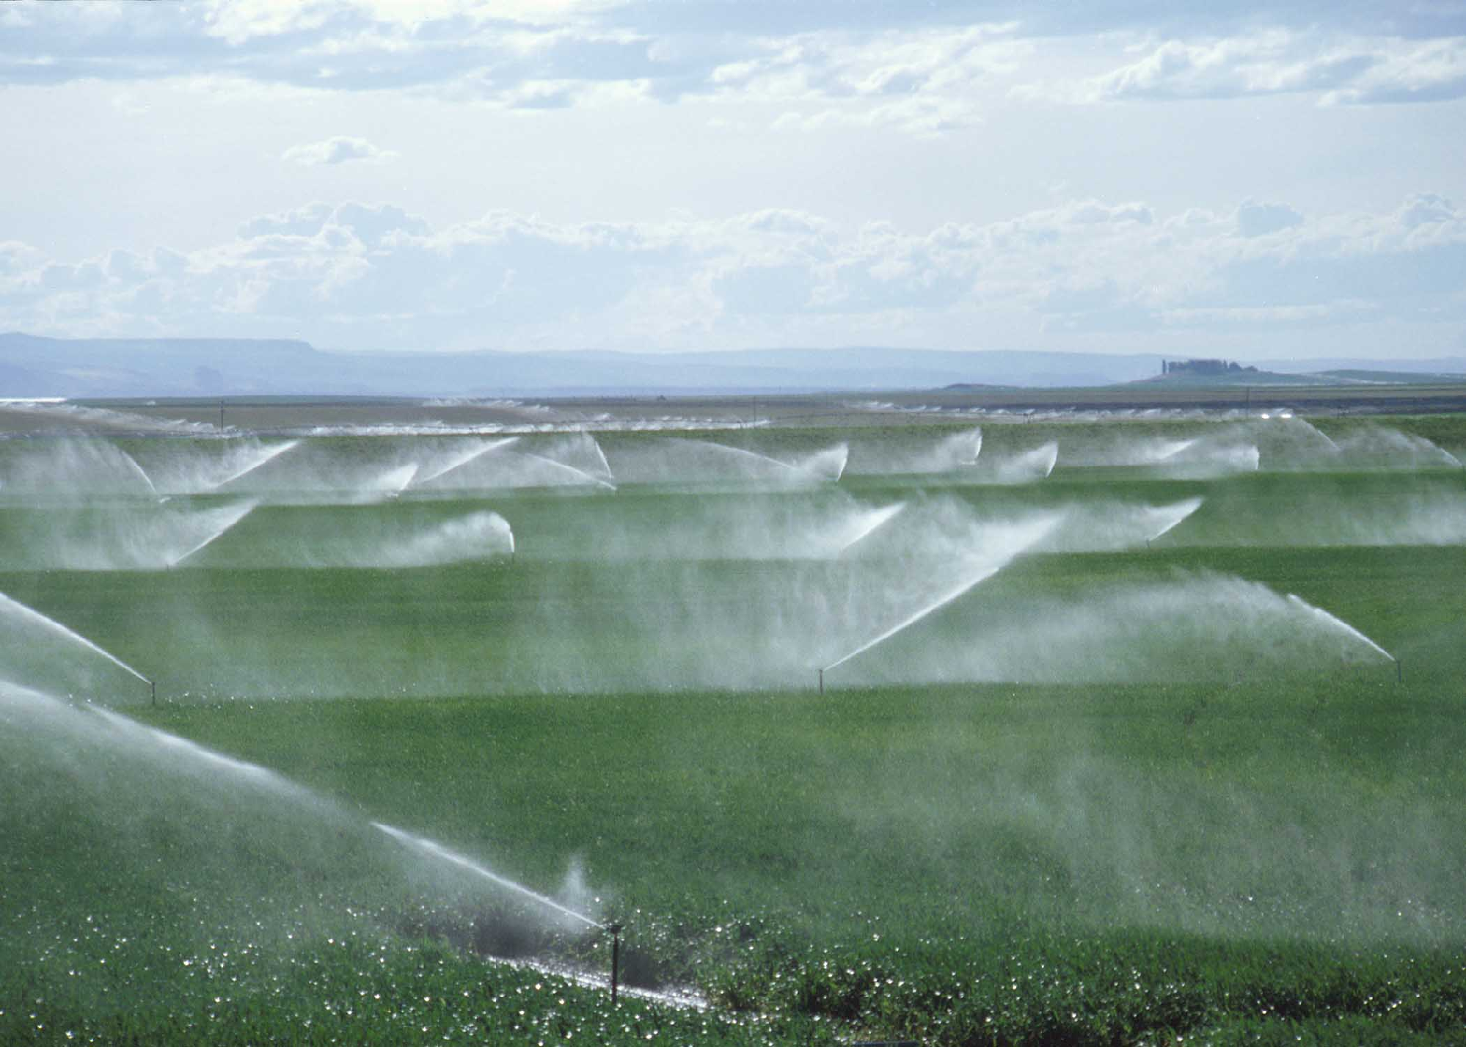
Notes:
*
High-pressure irrigation sprays in the middle east.

Slide 12
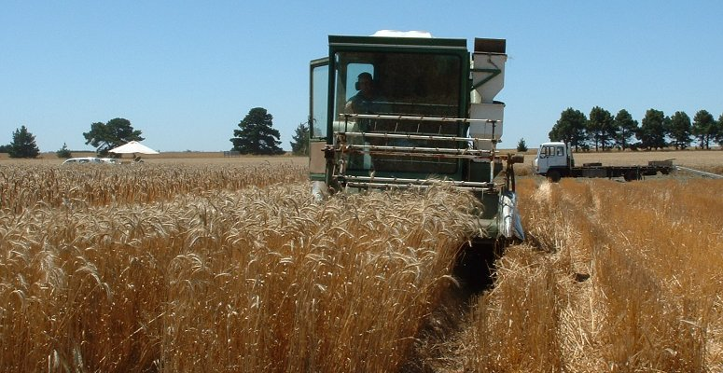
Notes:
*
Modern combine harvester. It combines harvesting, threshing and winnowing.

Slide 13
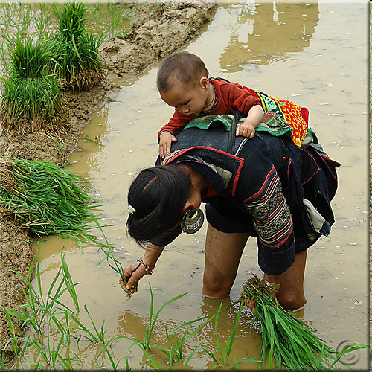
Notes:
*
In modern times not everyone uses machines in agriculture. Transplanting rice seedlings is done in most of Asia by hand. This is the Hmong tribe in Vietnam.

Slide 14
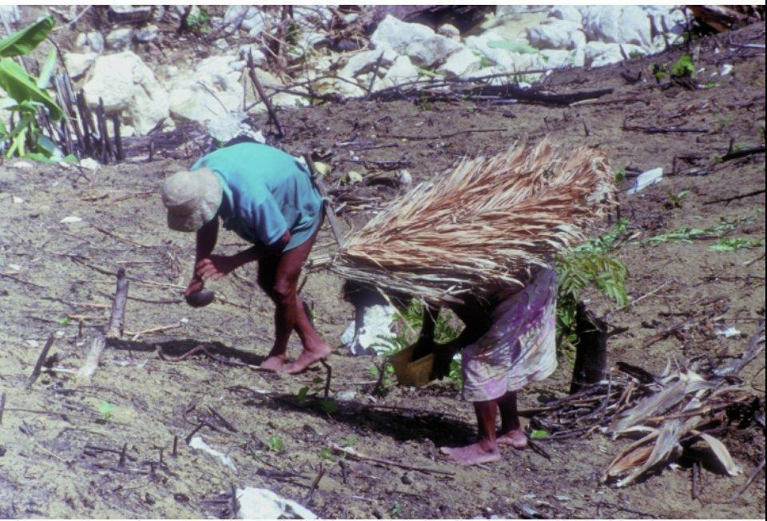
Notes:
*
Planting rice in a slash-and-burn field, in a hill tribe area of Mindoro island, Philippines. The man holds half a coconut shell with his rice seeds in. The palm-leaves on the woman’s back is a traditional sunshade.

Slide 15
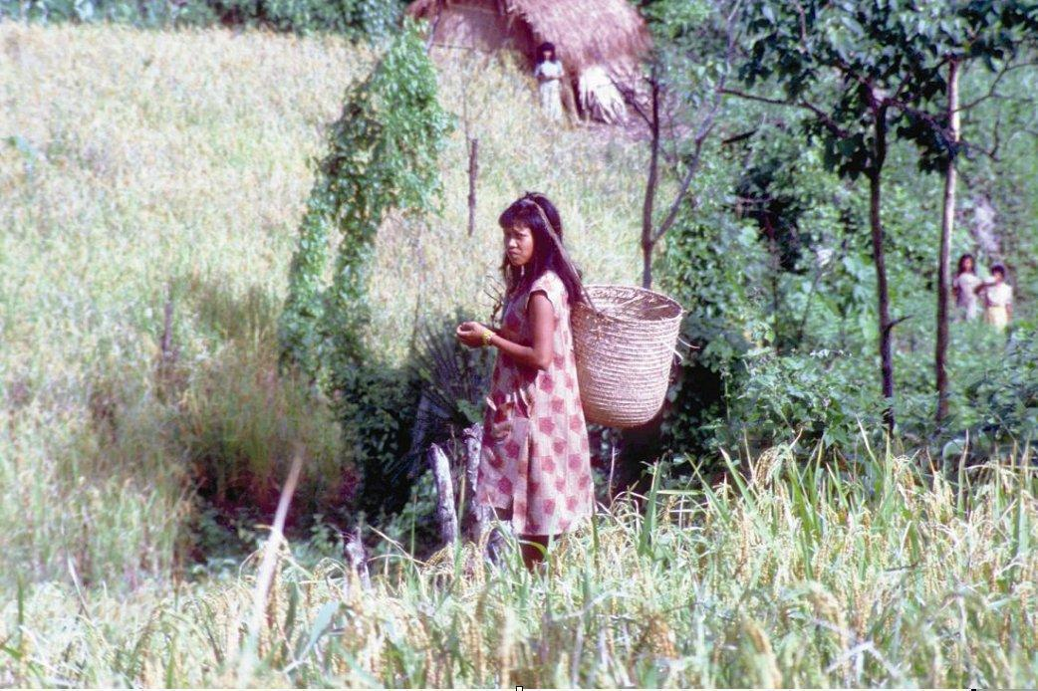
Notes:
*
Upland rice grown in a tribal area of Mindoro island. Planting and harvesting are all done by hand.

Slide 16
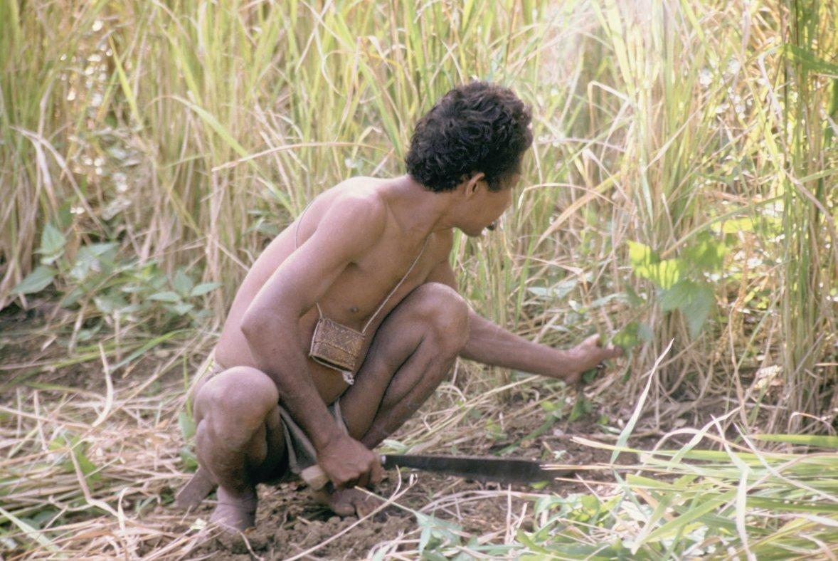
Notes:
*
Cutting the rice stalks with a bush knife. Mindoro, Philippines.

Slide 17
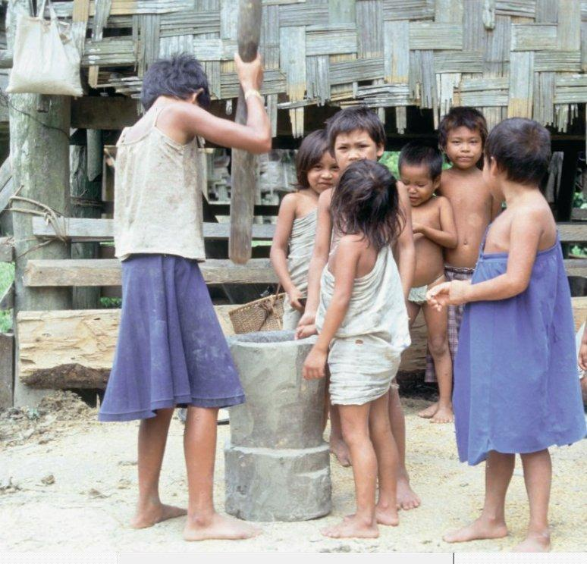
Notes:
*
Children in the tribe also play their part. Here they are milling the rice in a large mortar. When it is done, the rice can be cooked.

