Slide 1
So you’ve been reading (or trying to read) Arabic words for a couple of weeks now – and none of it makes sense…Relax ya Akhi, the time has come to make it real…

Slide 16
Is this starting to make sense? هل كل هذه واضح ؟

Slide 17
Now, Ladies and Gentlemen, for THE CHALLENGE ROUND!

Slide 38
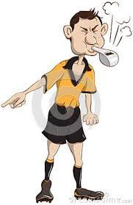
A Few Ground Rules for Language Classes

Slide 39
Be prepared to be an active language learner.
This means getting ready to become an actor. Your new role involves putting on the costume of a new language and pretending that you are comfortable in it.

Slide 40
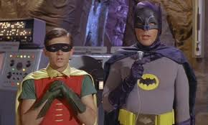
It also means realizing that you have to listen closely and not get hung up on words you don’t understand. Guess and try to follow other signals (like visuals) to help you make sense of what’s going on.

Slide 41
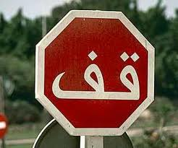
Respect the language space.
Except for beginners, in the language classroom, we will mostly be using the language we’re learning. You will be asked to hold to this agreement. When you don’t understand something, instead of asking about it in English, ask your questions in the second language.

Slide 42
Learning a language is a lot like learning to play a sport.
The idea is to have fun while building skills. You are going to feel tired at times, but this is a good sign – it means you are building up your language ‘muscles!’

Slide 43
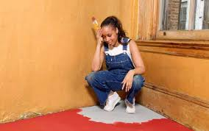
Feel free to make mistakes – it’s how we learn.
This is one of the few places where you are able to make mistakes and not have it cost you much. Try to use your language whenever possible, both in and out of the classroom. You’ll be surprised by how far a few words will take you.

Slide 44
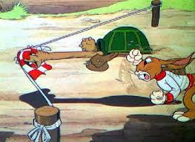
Respect your classmates and expect the same in return.
We all learn at different paces, but we’re going to be working together a lot – more than in most classes. You should encourage your classmates when they’re doing the right thing, be patient with them as they try on their new costume and expect them to do the same for you.

Slide 45
Be Kind
Respect and encourage your classmates.
Respect and encourage your teacher.
Be punctual and use your time wisely.

Slide 46
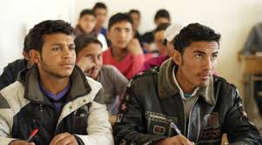
Work Hard
Bring all necessary materials to class.
Focus, concentrate, and complete work.
Contribute positively to the conversation.
Follow instructions.
Speak in Arabic.

Slide 47
Get Smart
Ask questions.
Try new things.
Practice, practice, practice.
Try your hardest at all times.
Make mistakes and learn from them.
Use all the resources at your disposal.

Slide 48
لا أفهم

Slide 49
ما معانى ____ ؟

Slide 50
لا أعرف

Slide 51
مرة ثانية، مِن فض لك؟

Slide 52
عندي سؤال

Slide 53
ما هذا؟

Slide 54
الأبجدية العربية

Slide 56
How Many Alifs Can You Spot Here?
كان يا ما كان في قديم الزمان كان تاجر كثير المال والأعمال...

Slide 57
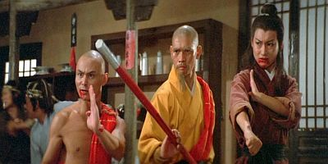
“So… You Think You’re Pretty Tough, Huh?! We’ll See How Well Your Ninja Arabic Skills Hold Up Against This One: ص + ب + ا + ح =_____________ ا + ل + خ + ي + ر = ________

