Slide 1
Law and Algebra: SVU (Special Visual Unit)
Presenter: Heidi Schuler
Heidi.Schuler@ChattahoocheeTech.edu
2015 COABE Conference
Friday, April 24, 2015
10:45 am – 12:00 pm

Slide 2
Greetings from Georgia!
Who am I?
Heidi Schuler
Lead Adult Education Instructor
LINCS National Trainer
Avid reader of mystery and detective novels
What do I do for a living?
Teach primarily math and science to about 260 students annually (Full-time)
Conduct trainings and workshops when I’m not teaching (Part-time)
When did I get started in Adult Education?
I was first introduced to AE in November 2006, and I’ve been here ever since despite my long-time belief that I would never be a teacher.
(This is what happens when both of your parents are school teachers.)
Came into teaching by chance (they needed a teacher; I needed a job) and am humbled by the individuals in my classroom each and every day.

Slide 3
Greetings from Georgia!
Where do I teach?
Chattahoochee Technical College’s Cherokee Learning Center in Canton, GA
Why did I name this workshop Law and Algebra: SVU (Special Visual Unit)?
I wanted the title to be memorable and to stand out in the midst of all the workshops you’d attend this week.
It represented what I think we’ve been missing in our approach to algebra (visuals).
I’m a HUGE fan of the TV show that inspired this workshop’s naming.
How will you use this information when you return to your classroom?
Handouts will be shared electronically through the COABE Online Repository; also feel free to email me if you need something
Resource list is provided at the end of this PowerPoint
Hands-on activities you’ll be doing can be reproduced easily with minimal prep work
Take pictures of you and your colleagues in action to remember what you did and to share with your students (visual aid and reminder to them that teachers take classes, too).

Slide 4
What we’ll be doing for the next hour
Algebra: The “A-Word” in math class (where did it all go wrong and why)
Finding algebraic patterns in the real world
Visual Real World Symbolic Notation
Practicing real world algebra (partnered work)
Seeing the pieces come together (group activity)
Concluding thoughts, resources for your classroom, Q & A

Slide 5
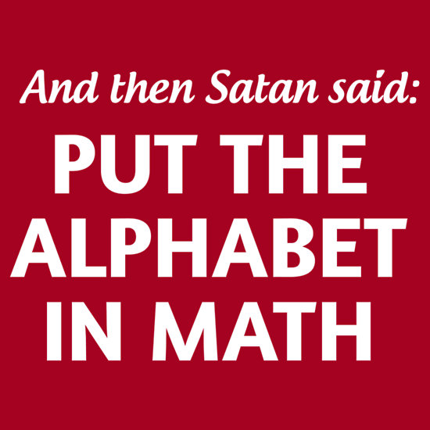
Algebra: The “A-Word” in Math Class
Taking OUR algebraic temperature
Taking our STUDENTS’ algebraic temperature
Research shows that mathematical proficiency also includes having a productive disposition. Attitude is everything.
www.RedRubble.com

Slide 6
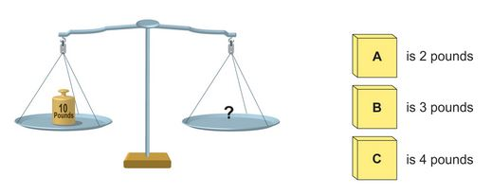
Algebraic reasoning in elementary school
Here’s a 2nd grade algebra problem:
What’s encouraged: exploration, investigation, hands-on learning, trial and error, explanation and reasoning

Slide 7
Algebraic reasoning for our adult learners
Most of our students have available to them either at home or in our classrooms the following algebra resources:
Videos demonstrating the steps to solve problems (Khan Academy, Algebra2go)
Worksheets or books with drill problems and similar solution steps demonstrated
What’s encouraged: repetition, solving problems according to a systematic approach that has been demonstrated vs discovered, process vs concept
Algebra2go Linear Equations
in One Variable

Slide 8
These resources work, but what would make them better?
Visuals
Stories
Real-world
Understanding

Slide 9
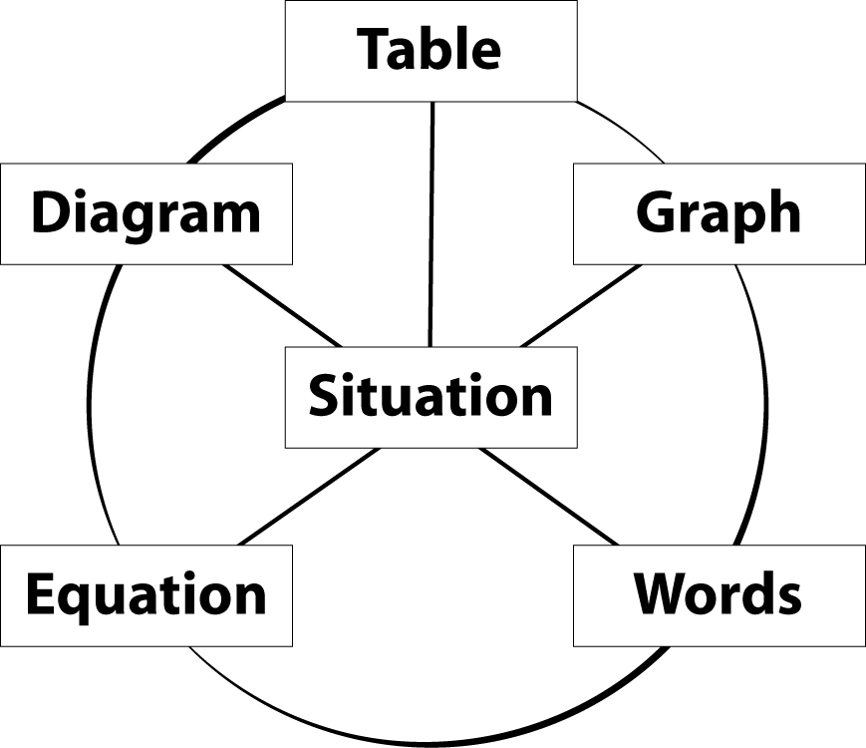
Keeping it real allows us to explore the various ways of seeing and solving the math
(From Seeking Patterns, Building Rules: Algebraic Thinking [EMPower series]. Teacher book, p. xxi.)

Slide 10
Patterning with stick figures
(From Seeking Patterns, Building Rules: Algebraic Thinking [EMPower series]. Teacher book, p. 203.)
Notes:
In the first lesson, students were asked to describe a pattern in their own lives in sentences and then show the same pattern using a diagram, table, graph, or some other representation. In the final lesson, we presented to the class some statements that students had made earlier about their personal patterns and again asked for multiple representations. Both times students were asked to think about using the representations to predict the future. These served as part of the pre- and post- assessments.

Slide 11
College Savings
One of your newest students shares that he has decided to start saving now for college. He doesn’t make much money, but he figures that he needs to save 25 cents out of every dollar he earns. He has created a small chart to help him get started.
He comes to you with his most recent pay stub in hand. It shows that he earned $80 last week.
Jot down some things you could show him so he’ll know what to put aside in his savings.
Earned (E) | Saved (S)
$1.00 | $0.25
$2.00 | $0.50
$3.00 | $0.75
$4.00 | $1.00

Slide 12
Some Possible Responses
Rule in Words
To get the amount saved (S), multiply the amount earned (E) by .25
Equation y = .25x (or in context: S = .25E)
We’re using the slope-intercept form (y = mx + b)
Table of Data
Note the use of patterns to make the values easier to find or calculate (added the first four entries to find the value for $10 earned and then doubled each subsequent entry to get to $80 earned)
Graph
y-intercept: shows us (visually) where the rate of change begins to take shape; also reminds us of what is (or is not) at the end of the equation
slope: helps to connect the “rise over run” model, especially to fractions and decimals; also connects the slope as the multiplier (mover) in the equation
Earned (E) | Saved (S)
$1.00 | $0.25
$2.00 | $0.50
$3.00 | $0.75
$4.00 | $1.00
$10.00 | $2.50
$20.00 | $5.00
$40.00 | $10.00
$80.00 | $20.00

Slide 13
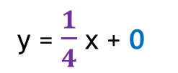
College Savings (Graphed)
y-intercept
slope
y = $\frac{1}{4}$ x + 0
same
slope
y-intercept

Slide 14
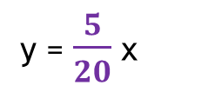
College Savings (Graphed)
y = $\frac{5}{20}$ x
same
slope

Slide 15
Did we see examples of these in our solutions?
(From Seeking Patterns, Building Rules: Algebraic Thinking [EMPower series]. Teacher book, p. xxi.)

Slide 16
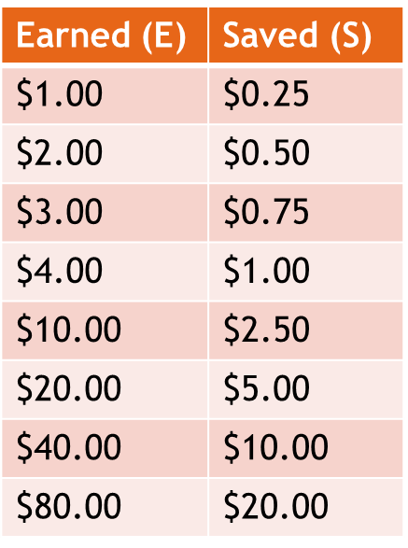
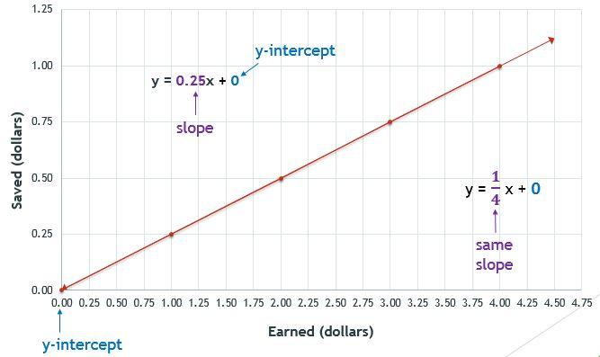
4-Part Harmony
We will spend the rest of our time together working on the skills we just saw with the previous example about the student needing to save money for college. In each of the problems you’ll do today, keep in mind the 4-part harmony we just explored and how each lends itself to deeper understanding:
Rule in Words
To get the amount saved (S), multiply the amount earned (E) by .25
Equation y = .25x (or in context: S = .25E)
Table of Data
Graph
y-intercept
slope

Slide 17
Practicing Real World Algebra
Take a look at the “Algebra in Our World” packet.
We will do the first problem together.
Find a partner at your table to do some of the other problems in the packet.
There are a couple of “challenge” problems at the end where you are given the equation and asked to create a real world story problem to match it.
An electronic copy of this packet is available for download on the COABE Online Repository, at OER Commons, or by emailing me directly. You are welcome to reuse, redistribute, remix, or revise this packet to make it your own.

Slide 18
Reflecting on the “Algebra in Our World” activity
How does this approach differ from the traditional ways we teach these topics?
What are some things we could do to this activity to make it more interesting for our students?

Slide 19
Seeing the pieces come together
Get into groups of 4 or 5 for this next activity.
You will be rotating around the room in your groups to visit as many of the algebra stations as you can in the time allotted for this activity.
Your group will need to take a stack of sticky notes and a pen or pencil with you to each station.
When you reach a station, take note of what information has been provided either by me or by a previous group. Look for anything not answered or completed.
With your group, determine the missing information and record it on your sticky note.
Place the sticky note on the correct section on the chart paper.
Move to a new station with a new problem and start the process again.

Slide 20
Reflecting on the Algebra Stations activity
What did you like most about this activity?
What did you like least about this activity?
How could you use this in your classroom?

Slide 21
Concluding thoughts, resources for your classroom, Q & A
You’ll find on the next few slides the following resources:
List of similar activities to what we did today and where to find them
List of free resources mentioned in today’s presentation
Note: The PowerPoint for today also has hyperlinks embedded on these items.
You’ll find all of today’s activities online at the COABE Online Repository or at OER Commons.
You’ll also find at your table (and again online) the Open Educational Resources (OER) Fact Sheet
Note: You are free to remix, tweak, and build upon my work non-commercially, as long as you credit me for the original work and license your new creations under the identical terms.
Any questions or comments not already addressed?

Slide 22
Heidi’s Resource Recommendations
EMPower Math Series – This 8-book series is one of the BEST adult education resources around! It was researched and written by adult ed folks for adult ed students and teachers. It has lesson plans, homework, and quizzes already designed for your use. You will need the Teacher Edition and Student Edition for each book. The best part is that the Student Edition comes with a copyright disclaimer granting you permission to reproduce the pages for students in your classes! [contact your McGraw-Hill rep for pricing]
Seeking Patterns, Building Rules is where you’ll find similar activities to those we did today. Here are some of my favorites:
Lesson 1: Guess My Rule (GREAT activity for patterning with in-out tables!)
Lesson 2: Banquet Table (Hands-on activity that really helps to emphasize the purpose of the y-intercept in a contextualized way.)
Lesson 6: Circle Patterns (AWESOME way to have students connect all those measurement formulas back to algebra, and see the relationship between circumference, diameter, and π.)
Lesson 7: What Is the Message? (Fun activity that connects the equation to a rule in words and graph.)
Lesson 8: Jobs Offers (Highly effective way for students to see how to use algebra when making important decisions.)
Lesson 9: Phone Plans (My students LOVE this activity! It really makes them see how/where algebra is used in the real world and gives them a chance to see how much their algebraic reasoning and skills have grown throughout the course.)

Slide 23
Heidi’s FREE Resource Recommendations
www.OERCommons.org – excellent resource for finding high quality math-specific Open Educational Resources
www.KhanAcademy.org – contains videos and procedural practice for just about every math topic out there
www.Algebra2go.com – contains videos, procedural practice with online worksheets, and quizzes on most math topics
www.ck12.org – contains lesson plans, interactive elements, practice, and a student or teacher platform
https://phet.colorado.edu/ - interactive simulations for science and math
http://nlvm.usu.edu/ - National Library of Virtual Manipulatives
www.mathplayground.com – games, manipulatives, activities for most math topics; great function machine manipulative for in/out tables and slope-intercept form equations

