Slide 1
Notes to Teachers:
Ensure that all students have an email account before class. Prior to class make sure that students know and have confirmed their email address and password. Maybe a class registration requirement should be an email from the student to the teacher.
You may want to give the NorthStar Social Media assessment before doing these lessons.
Certificates for assessments must be issued through an approved proctoring site/agency.
A vocabulary list is included on last slide. You may want to print this on 8.5 x 11 paper so you and students can refer to it during the lesson.

Slide 2
Social Media – Part 1
Your teachers are:

Slide 3
Today’s Goals
Assess your knowledge of social media
Understand differences between Facebook, Twitter, & LinkedIn
Creating an account
Importance of trust on social media
Privacy settings
Uploading photos
Appropriate photos

Slide 4
Social Media
Definition: Electronic communication (websites for social networking) where users create online communities to share information, ideas, personal messages, and other content.
Examples: photos, videos, etc.
Definition adapted from http://www.merriam-webster.com/dictionary/social%20media

Slide 5
Different Social Media Sites
Three of the most popular social media websites in the world:
?
?
The world’s largest social networking
site that connects “Friends”
A professional networking site used by many people for jobs and careers
?
A social network site where people communicate
through short updates called “Tweets”

Slide 6
Creating an Account
Setting up a social media account is free and requires you to enter some basic information like: email, password, and name
If you don’t have any social media accounts, please go to the
area of the classroom for the site you would like to join:
Go to the back of
the room to create an account on:
Go to the middle of
the room to create an account on:
Go to the front of
the room to create an account on:

Slide 7
Creating an Account
Video link for setting up a Facebook account:
https://www.youtube.com/watch?v=KR_xVgt9iZk
Video link for setting up a Twitter account:
https://www.youtube.com/watch?v=LeVeR7regTY
Video link for setting up a LinkedIn account:
https://www.youtube.com/watch?v=HSNVa_hYID0

Slide 8
Trust
Social Media websites are designed to try and help you connect with many people. Knowing which people to trust is probably
the most important part of using social media.
The following slide will list some people that have asked you to be their “Friend” on Facebook or to “Connect” on LinkedIn.
Let’s look at some examples and you decide if you should accept their request…

Slide 9
Trust
Raise your hand if you would accept a request from …
Your spouse
A person with the same last name, that you don’t know
Someone you don’t know, but is friendly looking
Your best friend
A very attractive person, in a swimsuit, that you don’t know
Someone you used to work with, but haven’t seen in years
What are some examples of why you would or wouldn’t want to
connect/friend this person?

Slide 10
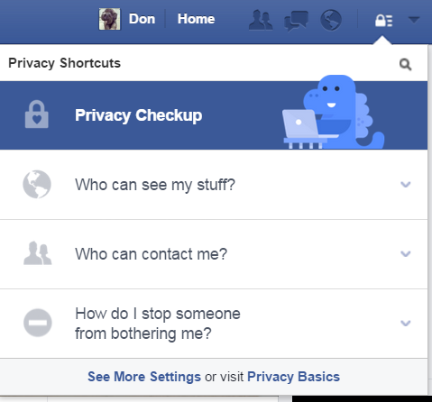
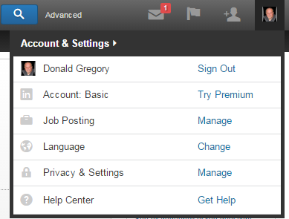
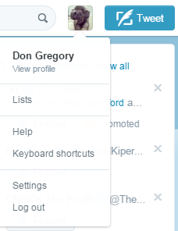
Privacy Settings
Facebook, LinkedIn, and Twitter privacy settings can be accessed in the following locations of each website:
First you click on the padlock icon,
Then click on the “Privacy Checkup”
First you click on your profile icon/photo,
Then click on the “Privacy & Settings”
First you click on your profile
photo, Then click on the “Settings”
Facebook
LinkedIn
Twitter

Slide 11
Privacy Settings
In Facebook, there are four settings that allow others to see or not see your information. These settings can be different for each item in your personal profile (Current City, Employer, etc.)
Public … Anyone on Facebook can see your information
Friends … Only people you have agreed to be friends with can see your information
Only Me … Only you can see your information
Custom … Allows you to customize your privacy settings
The following slide will ask you to set some privacy settings based on who you want to give access to your information:

Slide 12
Employer: Walmart Inc.
Which setting do you use if you only want yourself to be able to see this information:
⃝ Public ⃝ Friends ⃝ Only Me ⃝ Custom
Current City: Providence, RI
Which setting do you use if you want everyone on Facebook to see this information:
⃝ Public ⃝ Friends ⃝ Only Me ⃝ Custom
Relationship Status: Single
Which setting do you use if you want only people you have agreed to connect with on Facebook to see this information:
⃝ Public ⃝ Friends ⃝ Only Me ⃝ Custom

Slide 13
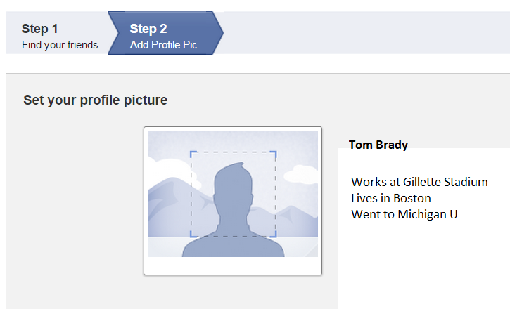
Uploading a Photo
All Social Media websites encourage you to use a Profile Picture on your page. Although optional, it is recommended that you do include a respectful and professional looking photo.
Where do you click to add a Profile Picture?

Slide 14
Appropriate Photos
Using professional/respectful photos on ALL of your Social Media sites is very important. If you are looking for a job than your LinkedIn profile picture should show you to be a clean, well groomed, responsible, and professional person.
Remember that your employer and other public agencies can view your Facebook and Twitter profile pictures, so don’t use any photo that could jeopardize your job or your personal reputation.
The following slide will show you several possible profile pictures, you decide which ones you would use on Facebook…

Slide 15
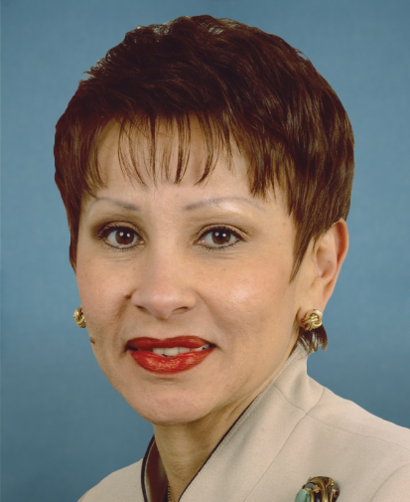
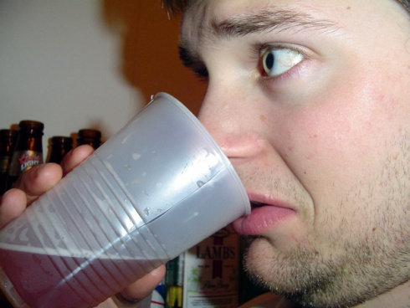
Appropriate Photos
Raise your hand if you would use this style of photo as your Facebook profile picture:

Slide 16
Questions?
1. Today’s lesson was:
Too easy
Too difficult
Just right
What was the most useful thing you learned today?
Comments, suggestions?
Notes:
Ask for a show of hands to assess needs based on today’s lesson.

Slide 17
Homework
Video Review:
Watch this short YouTube video about LinkedIn: http://youtu.be/ZVlUwwgOfKw
Watch this short YouTube video about Twitter:
http://youtu.be/D_4ZgGTJAJ8 (that is not a space, but an underscore “_”)
Watch this short YouTube video about Facebook Privacy:
http://youtu.be/emzaUABF2WU
Write down three things (one from each video) that you learned from watching the three videos

Slide 18
Vocabulary
Social Media – Electronic communication (websites for social networking) through which users create online communities to share information, ideas, personal messages, and other content
Facebook – The world’s largest social networking site that connects “Friends”
LinkedIn – A professional networking site used by many people for jobs and careers
Twitter – A networking site where people communicate through short updates called “Tweets”
Friend – A Facebook contact that both you and the other person have agreed to share information
Connection – A contact, that both you and the other person have agreed to connect. This includes 1st-degree connections on LinkedIn, contacts you've synced from other sources and LinkedIn profiles you've saved. You can contact these people through email or messages on LinkedIn. A 2nd-degree connection is a contact of one of your contacts
Following – A Twitter term to identify someone that you choose to follow their Tweets
Follower – A Twitter term to identify someone that has chosen to follow your Tweets
Hashtag – a word or phrase preceded by a hash or pound sign (#) and used to identify messages on a specific topic (mostly used on Twitter)
Trust – a measure of confidence that a person will behave in an expected manner, despite the lack of ability to monitor or control the environment in which he/she operates.
Privacy Settings – the part of a social networking website, internet browser, piece of software, etc. that allows you to control who sees information about you
Account Profile – Basic information about you on a social networking site
Profile Picture – A photo that is included in your social media profile that is visible to the public
Appropriate Photos – A photo posted on social media that reflects positively on you and would not jeopardize your employment or personal reputation
Notes:
This is a long list, but we decided to keep it and address words as they come up in the lesson.

