Slide 1
Notes to Teachers:
Bring sample flyers to class to help the students understand the homework assignment. See last slide.
Place the document: “Cape Cod vacation” on each student’s desktop.
You may want to give the Northstar MS Word assessment before doing these lessons.
Certificates for assessments must be issued through an approved proctoring site/agency.
A vocabulary list is included on last slide. You may want to print this on 8.5 x 11 paper so you and students can refer to it during the lesson.

Slide 2
Microsoft Word – Part 1
Your teachers are:

Slide 3
Review
Did you do your homework? Was it too easy, too difficult, or just right?
Turn to your partner and discuss something you learned about email from the homework.
Discuss the following with your partner:
Name 2-3 common email providers. Which one do you use?
What is your email address?
What are some actions that you can do with email?
What are some things you learned about email etiquette?
What is an attachment and how do you know there is an attachment in an email sent to you?
Notes:
This review is redundant, but we learned that students needed the reminders. You may want to change the questions.

Slide 4
Today’s Goals
Assess your knowledge of Microsoft Word
Open a document in Microsoft Word
Practice navigating around a document
Format a document
Insert a picture
Save your document
Email the document to yourself
Notes:
Bold words indicate the same words are found on their computer screen.

Slide 5
Open Microsoft Word
Where do you find the icon?
Click on the MS Word Icon
Click on ‘Blank document’.

Slide 6
Parts of Microsoft (MS) Word Screen
Title Bar
Quick Access Toolbar
Cursor
Ribbon
Status Bar (views and zoom)
Notes:
Ask students to Open Microsoft Word. We used Word 2013 in these lessons. You may see some differences if you are using a different version of Word.

Slide 7
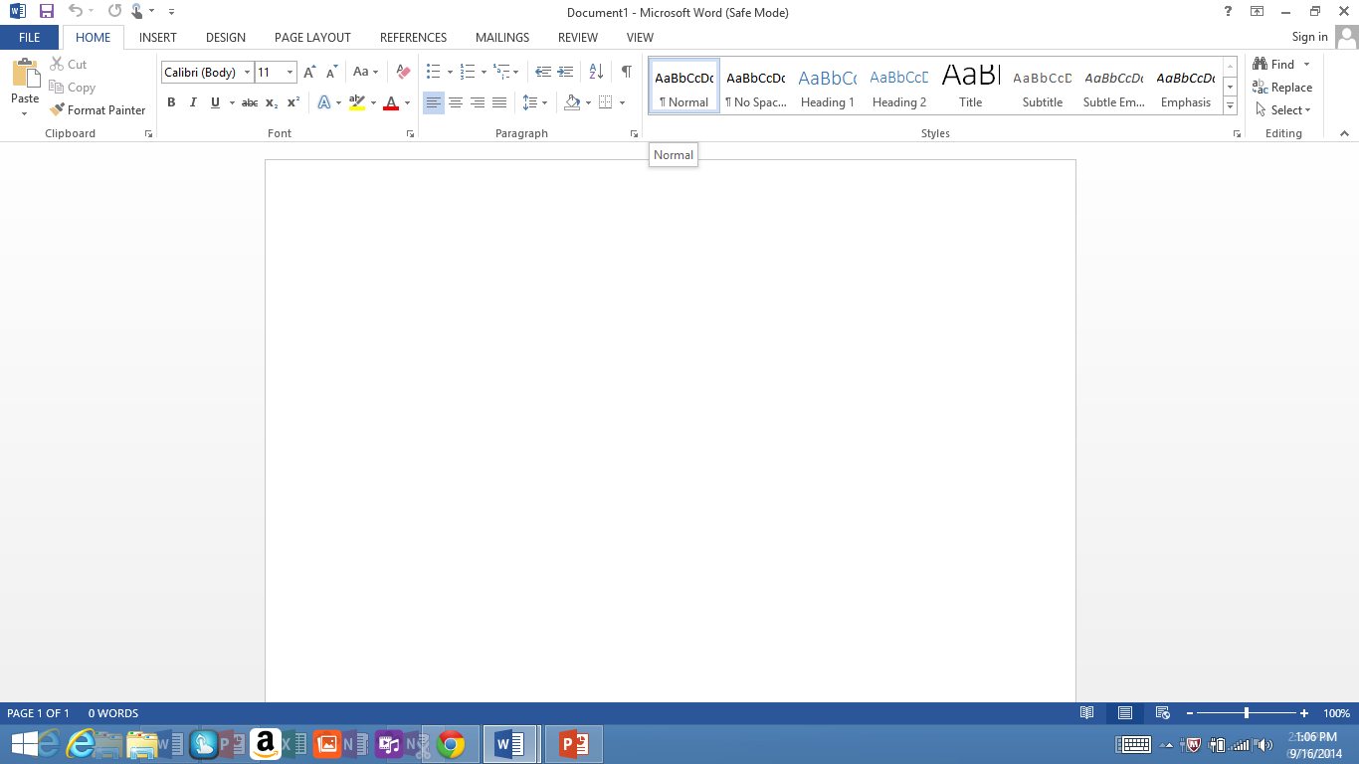
Parts of Microsoft (MS) Word Screen
Quick Access Toolbar
Title Bar
Ribbon
Cursor
Status Bar (views and zoom)

Slide 8
Navigating a Text
Open the Word document on your desktop named “ Cape Cod Vacation”
2. Ctrl Home - takes you to top of document
Ctrl End – takes you to end of document
Scroll Bar on right of screen
Notes:
Let students practice using these features to navigate a Word document.

Slide 9
Hover on the ribbon and find the following:
Font – Home tab, font
Default is Calibri size 11
Undo/Redo – on Quick Access Toolbar
Formatting Characters – Home tab, font
Bold (Ctrl +B)
Italic (Ctrl + I)
Underline (Ctrl +U)
Add a page: press “enter” until you have a new page

Slide 10
Text Alignment
Word Wrap – type to the margin and do not press enter. Press enter at the end of a paragraph
Alignment – on Home tab, paragraph
four types
Left (default)
Center
Right
justify
Notes:
Students type jibberish to demonstrate word wrap.
Students types their name and do alignments.

Slide 11
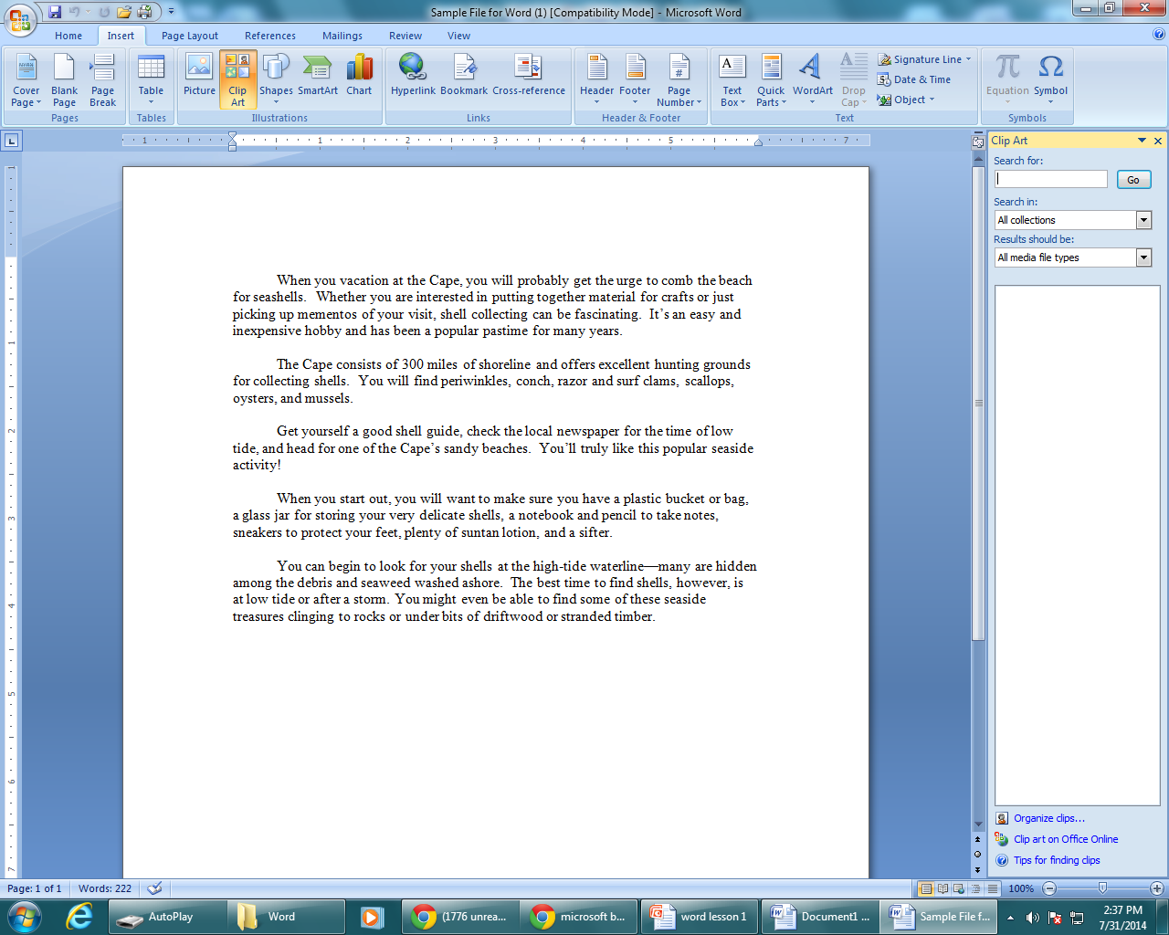
Insert a picture
Click on Insert
Click on clip art
Type a key word in the Search box to find a picture for the story
Select a picture by clicking on it.
Notes:
To the right is simply a screen shot of the Word document that students will be working with.

Slide 12
Format your picture
Click on the picture to activate it. You will see a broken line with circles on the corner.
Click on a corner and drag it to the size you want.
Click on one of the corners until the 4-sided arrows appear. Click, hold, and drag the picture to where you want it on the page.
Notes:
Ask students if they ever tried to enlarge a digital photo or image on a computer. What happened if they pulled out one of the sides? (the photo became too narrow or too long). Pulling out a corner allows the picture to stay in proportion.

Slide 13
Save your Document
Click on file.
Click on save as in the left hand menu.
Click on computer.
Click on desktop.
Give your document your name and type it in the file name box.
Click on save.

Slide 14
E-mail the document to yourself
Open your email.
Compose a message to someone in the class or a friend or family member.
Attach your document.
Send the message with the attachment.
Notes:
Elicit from students how to attach a document

Slide 15
Questions???
1. Today’s lesson was:
Too easy
Too difficult
Just right
What was the most useful thing you learned today?
Comments, suggestions???
Notes:
Ask for a show of hands to assess needs based on today’s lesson.

Slide 16
Homework
Write down ideas for a flyer you will create next class.
Examples: a party invitation, a notice, a service you could provide.
Go to:
digitallearn.org/learn/intro-microsoft-word Listen to and read along to the 5 Lessons
17 minutes - take notes to share in class

Slide 17
Vocabulary
Microsoft (MS) Word – create a document
Title Bar – shows the “title” of your document
Quick Access Toolbar – Save, Undo, Redo
Cursor – the insertion point on your screen
Ribbon – quick access to document editing
Status Bar (views and zoom) – your view of the document
Ctrl Home - takes you to top of document
Ctrl End – takes you to end of document
Scroll Bar on right of screen – move up and down within a document
Font – the printed “style” of your text
Undo/Redo – reverse a change to a document/repeat a previous change
Formatting Characters – change the appearance of text (Bold, Italic, etc.)
Word Wrap – when a sentence automatically continues to the next line
Alignment – when all of the text “lines up” the same (to left, right, center)
Insert – put a picture, chart, or art in your document
Clip Art – a library of pictures and art to “Insert”
Keyword – a word to help you find clipart or a picture in MS Word
Format – change the size, color or shape of something
Notes:
This is a long list, but we decided to keep it and address words as they come up in the lesson.

