Slide 1
Email - Part 2
Your teachers are:

Slide 2
Review
Did you do your homework? Was it difficult, easy, or just right?
Turn to your partner and tell them your email address.
Open your email account and identify the word to:
send an email
answer an email
find email addresses of your friends and family
Notes:
In Gmail, we’re looking for the words: compose, reply and contacts

Slide 3
Today’s Goals:
Review tasks from email lesson part 1 and practice using e-mail etiquette
Select messages to perform more tasks with email

Slide 4
What is email etiquette?
Begin your message with a greeting: Hi, Dear, Hello…
End your message with a closing: bye, talk to you soon, ….
Use punctuation and capitals to make reading easier.
Don’t type words in all capital letters.
Separate long messages into paragraphs.
Put an appropriate subject in the subject line.
Notes:
Elicit from class: What is etiquette in everyday life? What is cell phone etiquette? With more business being done online, it is becoming increasingly import to follow guidelines for Internet and email etiquette. Not doing so could cost you a job!

Slide 5
Use email etiquette and compose a message to me.
1. Sign in to your email account
Send me a message at __________________
I will respond to you with a question
Respond to my question and open the attachment I sent you.
Save the attachment to your desktop.
Insert another picture into my attachment and send it back to me or a classmate
Notes:
#2: Insert your email address.

Slide 6
Do a few more e-mail tasks:
Open up the contacts and type in my e-mail address.
Look in your spam folder for ‘junk’ mail and empty it.
Delete an email I sent you and then retrieve it from trash.
Create a folder and name it “computer class”
Move one of my messages to this folder.
Sign out.
Notes:
Words that are in Bold are the words they will see on the Gmail screen.

Slide 7
Selecting an email message.
You must first select a message before you can delete it or move it. Select a message by clicking in the little box to the left of the message.

Slide 8
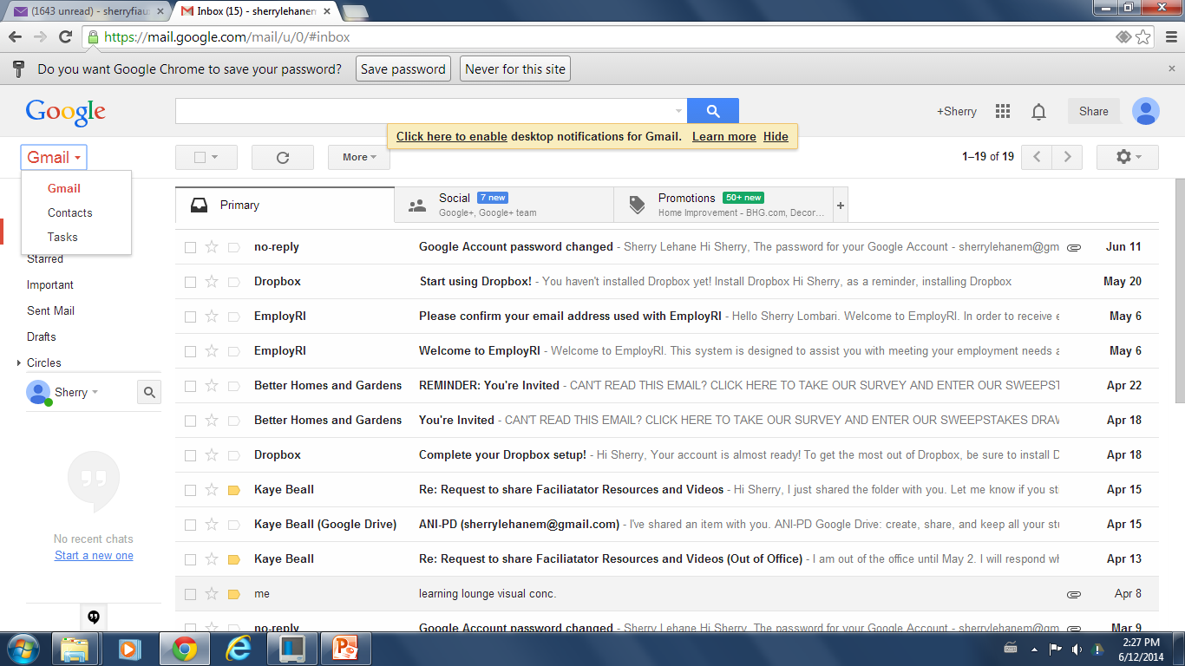
Insert contacts: email address of people, friends, family
Notes:
Open a Gmail account and guide students through inserting a contact.

Slide 9
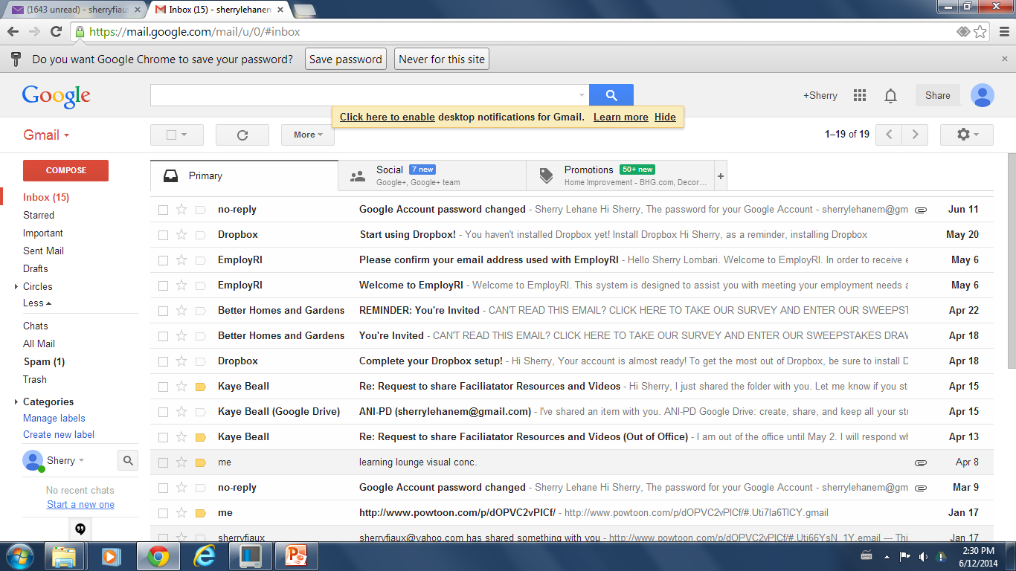
Look in your spam folder
Notes:
Guide students to select a message and move it to the spam folder. If they don’t have a message in their spam folder, they can move any message to spam and then move it back.

Slide 10
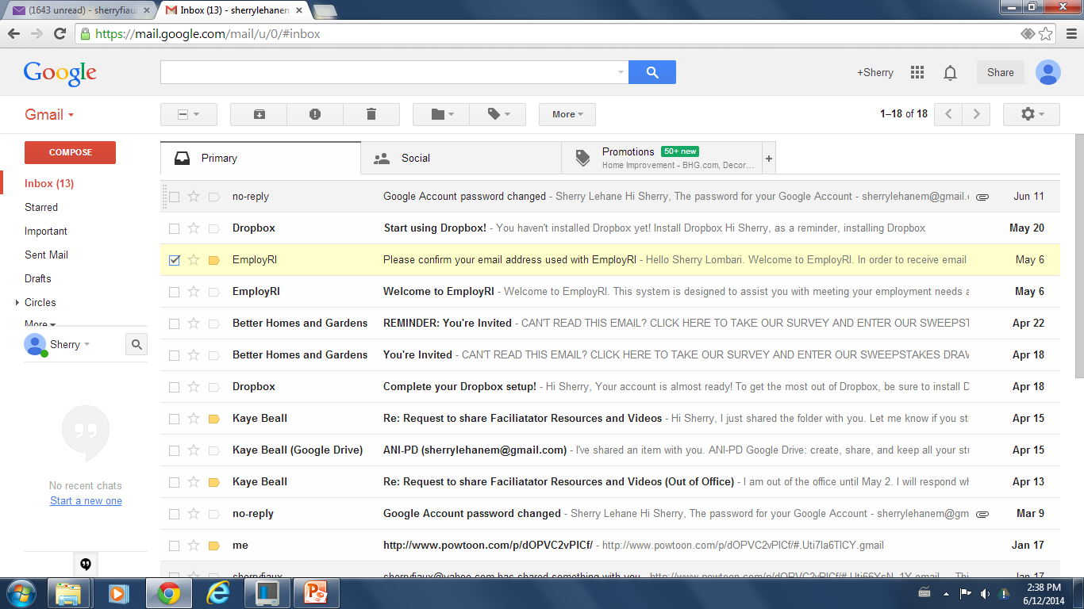
Gmail Tools
Report spam
Move to
Archive
Delete
Labels
Notes:
Show how to select a message to delete it and then retrieve it from trash.
Show students how to select a message and move it to a spam folder.

Slide 11
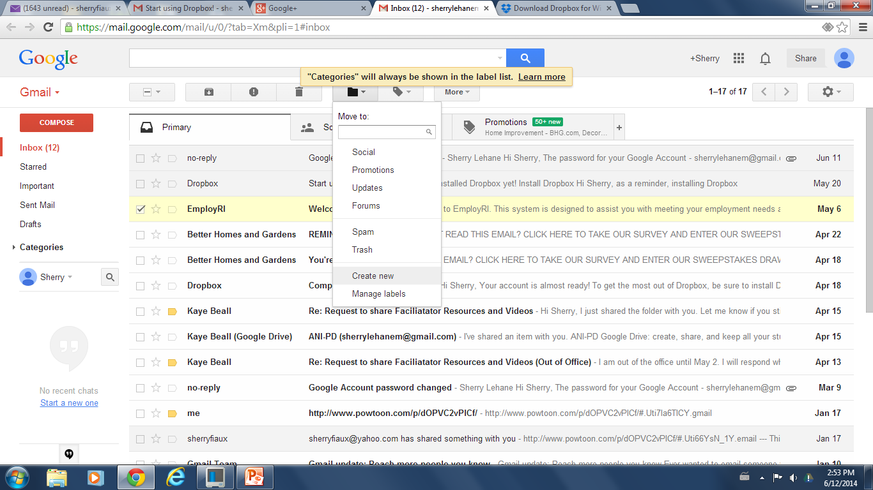
Create a folder to organize your mail. Name is “computer class”.

Slide 12
Questions??
The lesson today was:
too easy
too difficult
just right
What was the most useful thing you learned today?
Comments, suggestions???

Slide 13
Resources for Review
www.gcflearnfree.org/beyondemail
digitallearn.org/learn/intro-email-part-2
Notes:
Students need these resources for the homework assignment on the next page.

Slide 14
Homework
Open both of the resources.
Watch the videos and read the texts.
Make notes of things you want to remember and be prepared to share them with a classmate in the next class.
Notes:
Remind students that these videos and resources serve as a review and will help them remember some of that they learned and/or provide a better understanding. It’s always a good idea to watch them more than once – not necessarily in the same sitting though!

