Slide 1
Notes to Teachers
These lessons cover very basic computer information. Based on the pre-assessments for your students, you may be able to get through these slides rather quickly.
You can do the Northstar Computer Basics assessment. There is also a paper/pencil assessment that is time saving. It can be accessed through the proctor site of Northstar.
Certificates for assessments must be issued through an approved proctoring site/agency.

Slide 2
Introduction to Computer Basics Part 1
Your Teachers are:
Notes:
Introduce teachers, volunteer(s). Students introduce themselves if there are new students.

Slide 3
Today’s Goals:
Talk about the computer assessments
Identify computer parts: hardware and software
Learn and review words to talk about computers
Practice using the mouse and/or typing

Slide 4
Computer Parts – Can you show me…….
Keyboard
Screen or Monitor
Mouse
Mouse Pad
On/Off button
USB port
Headphone and Headphone port
Microphone and Microphone port
CD drive
Notes:
Matching words to computer parts. We put these words on pieces of paper and showed it to the students and asked them to show up the corresponding part on the computer in front of them.

Slide 5
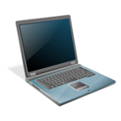
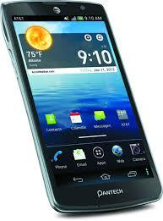
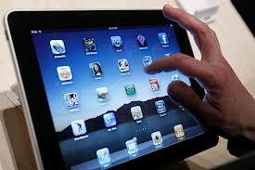
Computer
Many parts that work together to process and save information
Can be portable or stationary
Notes:
Elicit: What kind of computer do you have?

Slide 6
Desktop Computer
Stationary computer that sits on a desk or table
Must be plugged in for power
Monitor, keyboard and mouse are separate parts
Notes:
These are becoming less popular

Slide 7
Laptop Computer
Small, portable computer
Uses a rechargeable battery for power
Monitor, keyboard and mouse are combined

Slide 8
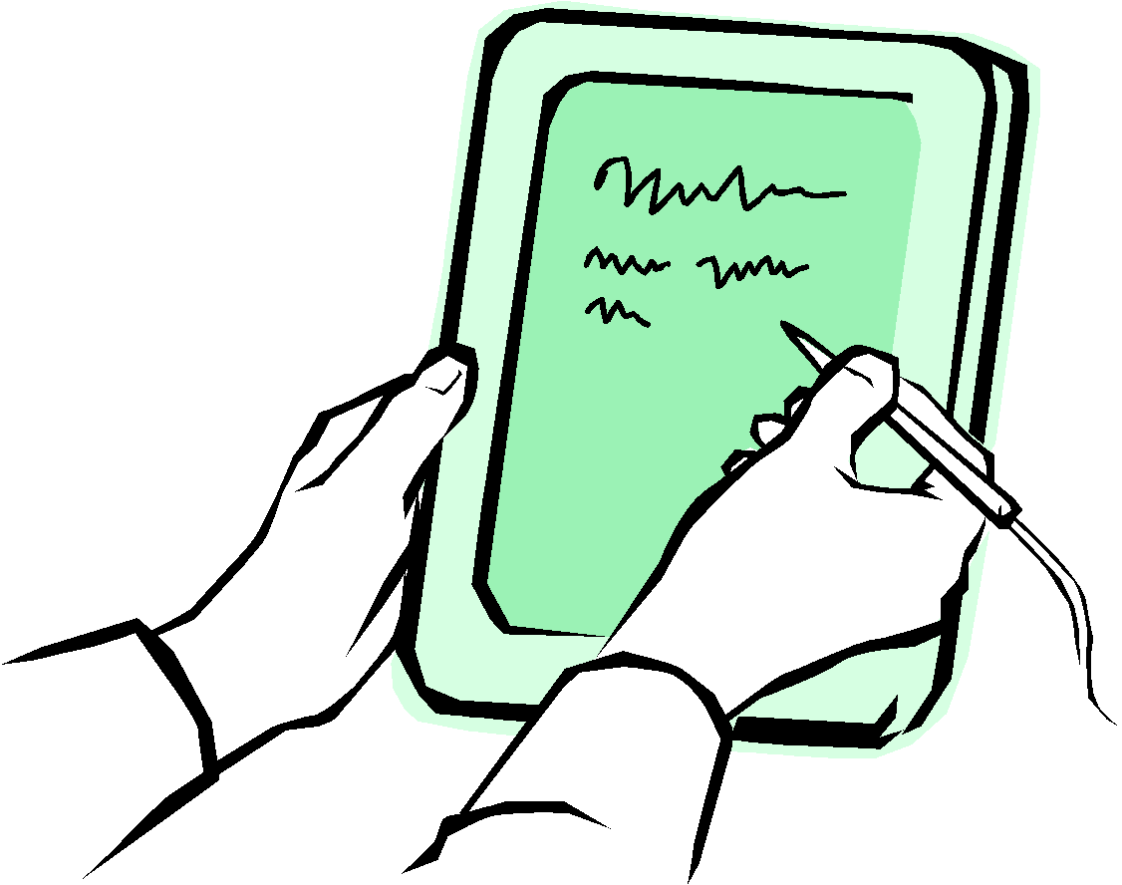
Tablets
Smaller than a laptop
Keyboard is on screen or separate
Use touch screen or type for input
Lightweight, easy to carry
Notes:
Most tablets have limitations on what programs can be used on that particular device.

Slide 9
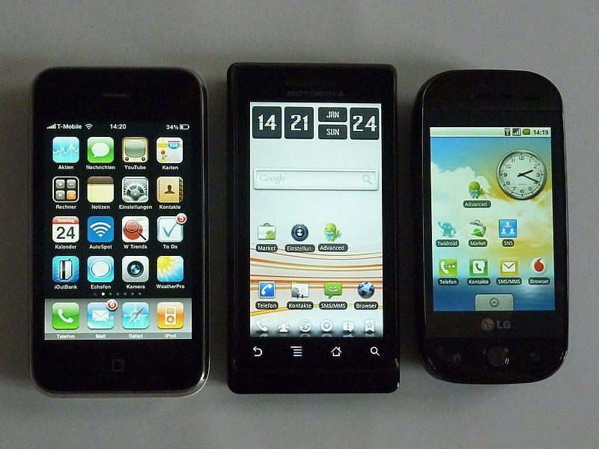
Smartphone
A cell phone with a built in computer
Very small and portable
Have fewer functions than a full sized laptop or desktop computer or Tablet
Notes:
Elicit who has a Smart phone? Do they use it like a computer? What do they do on their phone?

Slide 10
Hardware
Physical parts of the computer
Computers can be updated with new hardware
Many types of hardware
Mouse
Monitor
System Unit
Keyboard

Slide 11
Central Processing Unit
CPU
Box that contains the computer’s processor and memory
Brain of the computer
Most other computer parts are connected into the CPU
Notes:
Also known as Systems Unit.

Slide 12
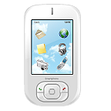
Monitor = Screen
Where information is displayed
Has a power button

Slide 13
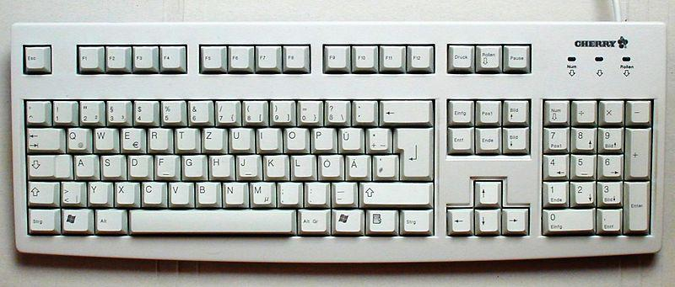
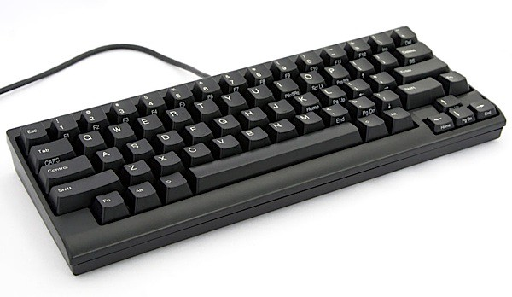
Keyboard
Used to type letters and numbers
Used to give the computer instructions
Like a typewriter with some special keys
Notes:
Keyboards have 3 groups of keys: letters, numbers and function keys. Locate the 3 different groups on the keyboard in front of you.

Slide 14
Keyboard Organization
Typing (alphanumeric) Keys
Navigation keys
Numeric Keypad
Control Keys
Function keys
Notes:
Northstar keyboard handout

Slide 15
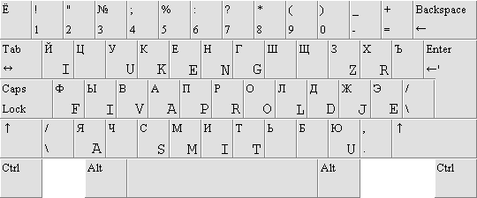
Types of Keyboards
Keyboards come in different styles
Can be set up differently for different languages
Notes:
Can also be wireless or bluetooth

Slide 16
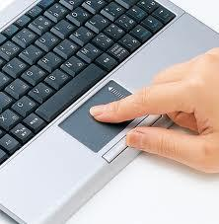
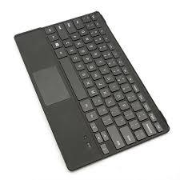
Mouse, Touchpad, Trackpad
Used to point at and select items on the screen
Used to give the computer instructions
Notes:
Ask: “Who has used a mouse before? What sound does the mouse make?” “Which do you have for your computer today?” Ask: “How do you hold a mouse?” - distribute Northstar Mouse handout

Slide 17
Touch Screen
Tap the screen to click
Often used on ATMs, grocery store check outs, smart phones and tablet computers
Notes:
Elicit: Where do they use touch screens? (banks, stores )

Slide 18
CD/DVD Drive
Used to play CDs and DVDs
Blank CDs and DVDs can be used to save information
Often located on the system unit
Notes:
Newer laptops do not have this drive.

Slide 19
Power
Power buttons often have this symbol
Monitor and the system unit have a power button
Notes:
Microsoft Surfaces Tablets have a different Power button

Slide 20
Audio Ports
Used to plug in headphones and microphones
Located on the system unit
Notes:
Ask: “What are these symbols?” Surfaces only have a headphone port, the microphone is “built into” the Tablet?”
Ask students to locate these ports. Headphones and microphones jacks have the same pictures on them to help identify where they should be plugged in on the computer.

Slide 21
USB Ports
Rectangular hole for hardware to connect to the computer
Very common type of connection
Examples of hardware that uses a USB port
Printers
Keyboards
Digital Cameras
Flash Drives
Notes:
Show students flash drives

Slide 22
Information In or Out?
Input
Output
keyboard
mouse
printer
Microphone
Scanner
Camera
monitor/screen
CD/DVD
headphones
Notes:
Word list is animated on click . Elicit which hardware puts information into a computer and which ones allow information to come out of the computer. A few can do both.

Slide 23
Practice mouse skills and typing
Click on the blue text to go to practice mouse skills or typing.
Mouse Practice 1 – Mouse Exercises
www.seniornet.org/howto/mouseexercises/mousepractice.html
Mouse Practice 2 – Mousercise
www.pbclibrary.org/mousing/mousercise.htm
Mouse Practice 3 – Mouse Games
www.pbclibrary.org/mousing/games.htm
Typing Practice 1 – Sense Lang Typing
www.sense-lang.org/typing/tutor/keyboarding.php
Typing Practice 2 – Doorway Online
www.doorwayonline.org.uk/
Notes:
“Now, you can practice using the mouse and typing.” Demo mouse hover and “Ctrl/Click” to open links. Show how each site works. Circulate, assist students

Slide 24
Questions??
1. The lesson today was:
Too difficult
Too easy
Just right
What was the most useful thing you learned today?
Will you come to the next class?
Comments, suggestions???
Notes:
For #1 - Ask for a raise hands on each bullet

Slide 25
Homework and Practice
1. Complete handout with computer parts and bring it to the next class.
2. Practice typing and/or using the mouse.
3. Watch the 4 videos at this link for
GETTING STARTED ON THE COMPUTER – 15 MINUTES
digitallearn.org/learn/getting-started-computer
Notes:
Number 1 for homework is the final 3 slides copied from an MS Word document. You could print these three slides to give to the students or print the “Hardware Matching” document from the RIFLI “Find Resources” web page.

Slide 26
Bye and see you next class!
orevwa
до свидания
លា
再见

Slide 27
Notes:
This is designed to be a tactile activity where students match the picture with the name and the function. Right click on the link and select “open hyperlink” for hard copies of the matching activity for homework. These pages should be printed and cut up for students to match at home. Beginner students can match pictures with words. More advanced students can math pictures with words and with definitions.

