Slide 1
Rectifiers and Filters
Sarika Yadav
Lecturer, Industrial Electronics Dept
VPM’s Polytechnic, Thane.

Slide 2
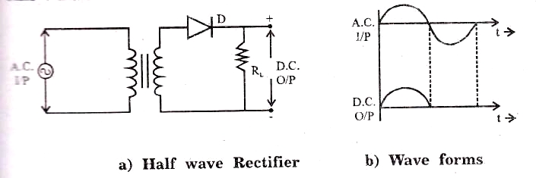
Half wave Rectifier

Slide 3
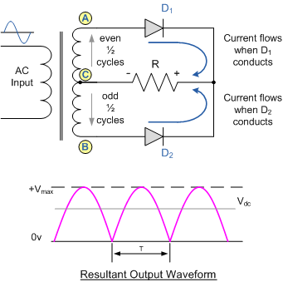
Full wave Rectifier (Center tap)

Slide 4
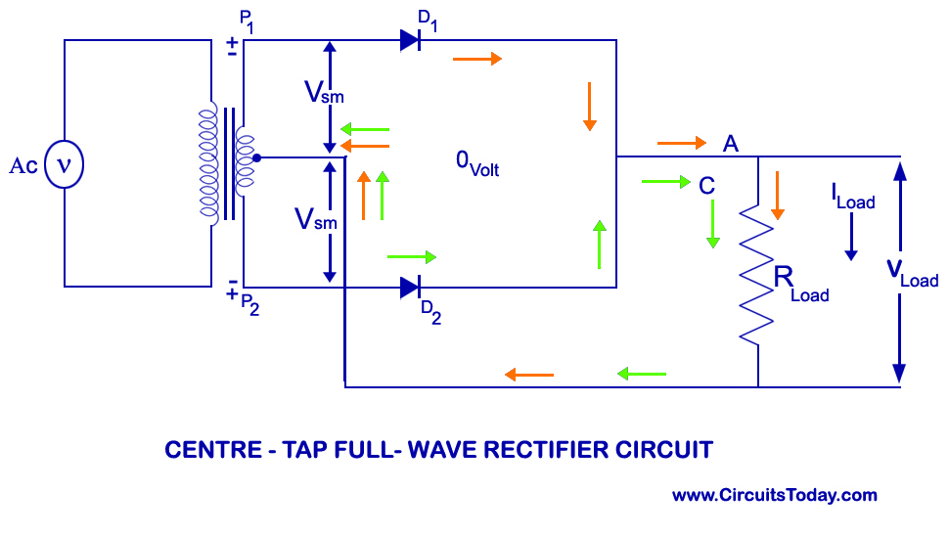

Slide 5
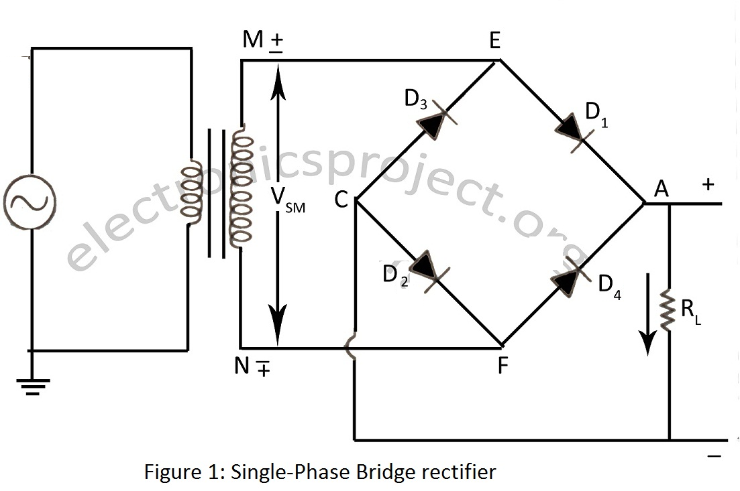
Full wave Rectifier (Bridge)

Slide 6
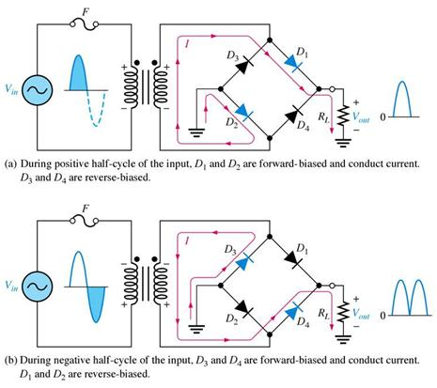

Slide 7
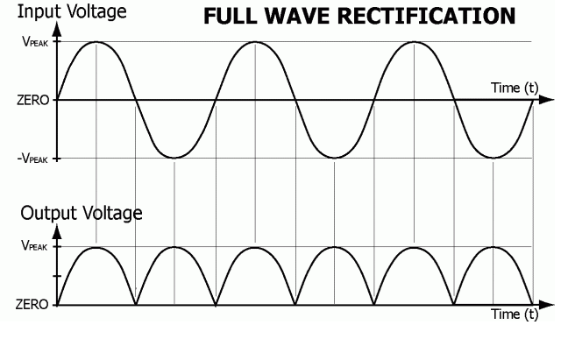
Full wave Rectifier waveforms

Slide 8
Thank you!!

Slide 9
Filters
Shunt C
Series L
LC filter
CLC filter (π)

Slide 10
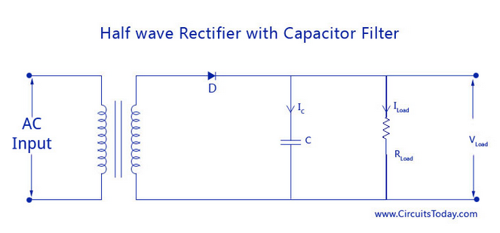
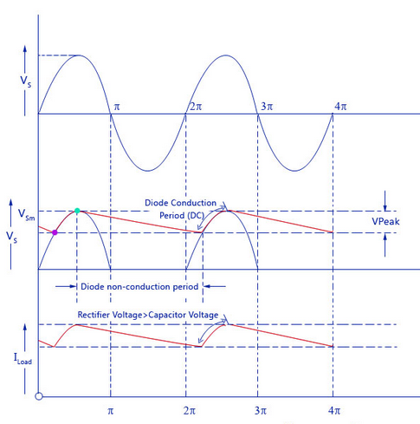

Slide 11
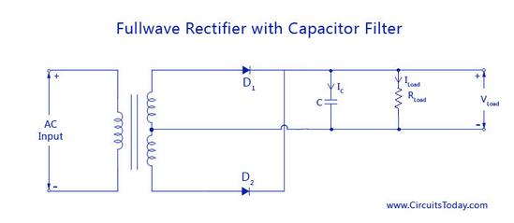
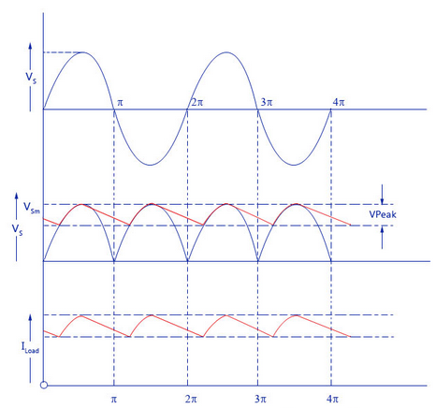

Slide 12
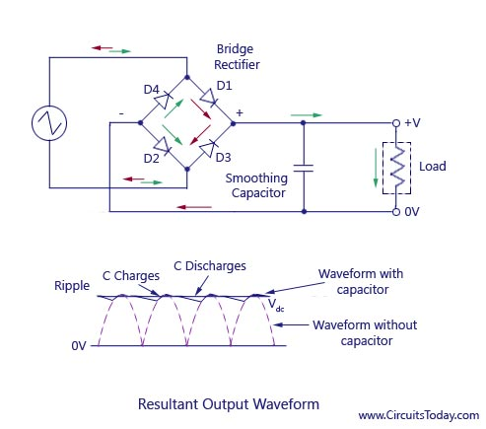

Slide 13
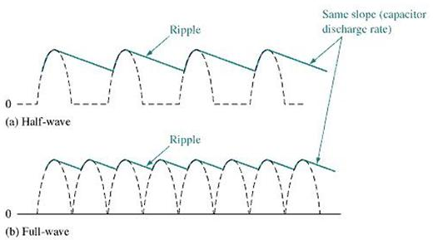
Comparison between HWR & FWR with Shunt Capacitor Filter

Slide 14
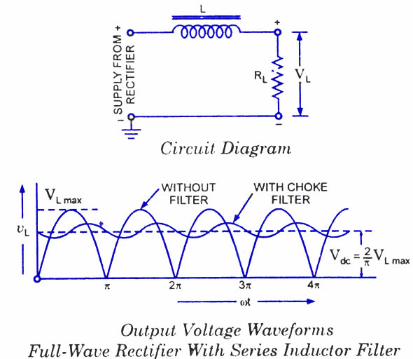
Series Inductor Filter

Slide 15
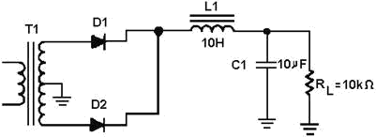
Center-tap full wave Rectifier with LC Filter

Slide 16
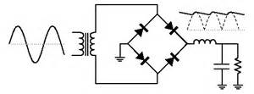
Bridge rectifier with LC filter

Slide 17
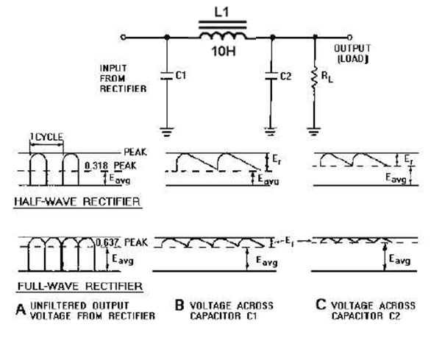
Pi Filter (π) CLC fliter

Slide 19
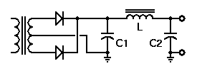
Center tap FWR with Pi filter

