Slide 1
Semiconductor Devices
By,
Mitali Ambekar

Slide 2
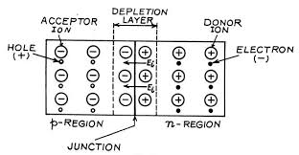
P-N junction diode
When half part of semiconductor is doped with trivalent impurity and half with pentavalent impurity, we get P-N junction diode.
The border where p- region meets n- region is called the Junction.
The region near the junction is depleted of free charges, hence called depletion layer.

Slide 3
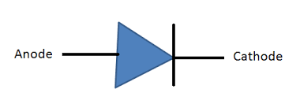
The crossing of carriers creates a wall of ions, which creates p.d. across a junction.
This p.d. prevents diffusion of electrons and holes across the junction, hence called barrier potential.
This potential is 0.7v for Si and 0.3v for Ge atom.
When no external source is connected to diode it is said to be unbiased diode.

Slide 4
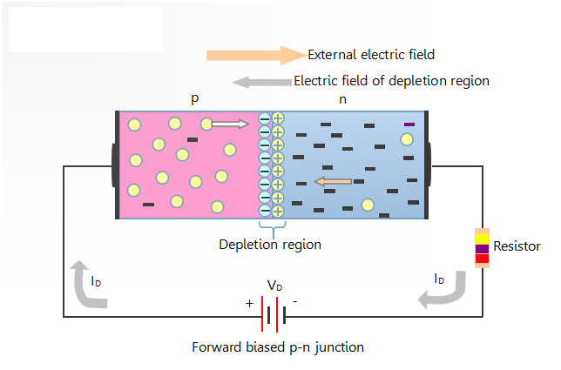
Forward biasing
When the positive terminal of the battery is connected to the p-type material and the negative terminal of the battery is connected to the n-type material, such a connection is called forward bias.
Electrons from the n-region crosses the junction and enters the p-region, the holes can flow into the n-region.
As the holes pass through the depletion region, the number of negative ions also decreases. Hence the the width of depletion region decreases due to reduction in the number of positive and negative ions.

Slide 5
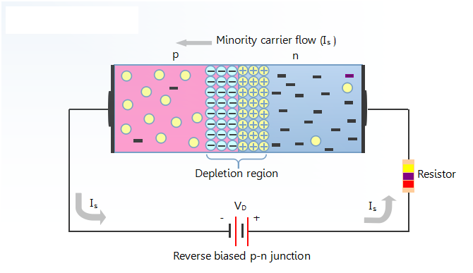
Reverse biasing
When the positive terminal of the battery is connected to n-type material and the negative terminal of the battery is connected to p-type material, such a connection is called reverse bias.
The electrons from the n-type material faces a stronger electric field and it becomes even more difficult for them to move towards the p-type material. Same discussion also applies to holes.
as the number of positive and negative ions increases, the width of the depletion region increases.

Slide 6
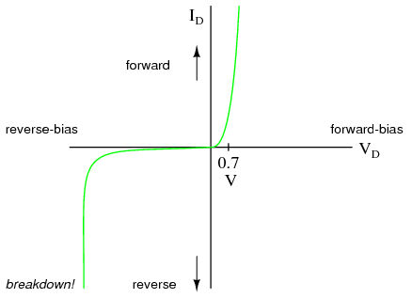
Characteristics of Diode

Slide 7
Thank you…

