Slide 1
Basics of Semiconductors
By,
Mitali Ambekar

Slide 2
Introduction
Semiconductors are materials whose electrical properties lie between Conductors and Insulators.
Ex : Silicon and Germanium
Semiconductors are materials that essentially can be conditioned to act as good conductors, or good insulators, or any thing in between.
They have 4 electrons in their outermost orbit

Slide 3
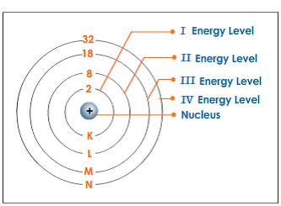
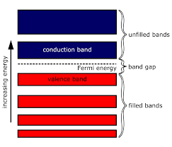
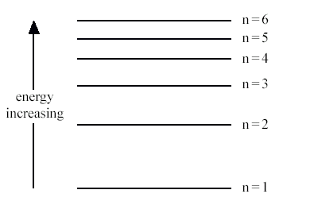
Energy Band
For a given solid, closely spaced energy levels of all electrons in a particular orbit is known as energy band.

Slide 4
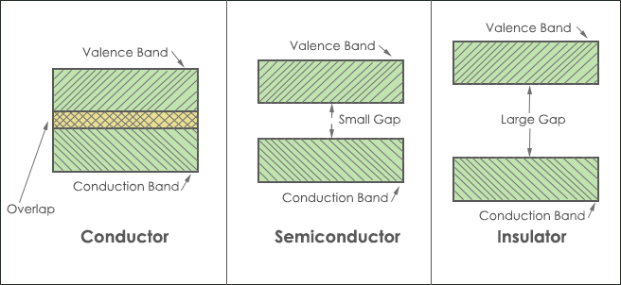
Energy bands in different materials:

Slide 5
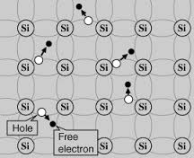
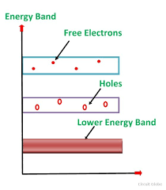
Types of semiconductors
Intrinsic semiconductors:
Extremely pure semiconductor is known as Intrinsic semiconductors.
At absolute zero temperature no electron is available for conduction.
Ne=Nh

Slide 6
Extrinsic semiconductors:
They are known as impure semiconductors.
Conductivity of pure semiconductors can be increased by adding impurity, the process of adding impurity is known as doping.
Depending upon the added impurity extrinsic semiconductors are divided into two categories:
N-type semiconductor
P-type semiconductor

Slide 7
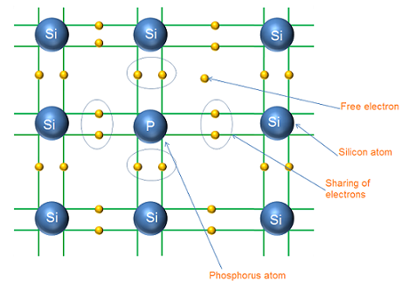
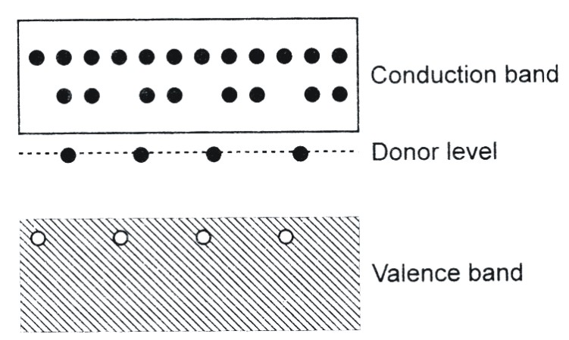
N-type semiconductor
When pure semiconductor is doped with pentavalent impurity such as arsenic (As), phosphorus(P), we get N-type semiconductor.
Pentavalent dopants donate 1 electron hence it is known as donor impurity.
Ne>> Nh

Slide 8
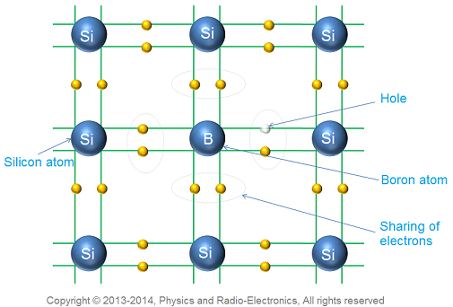
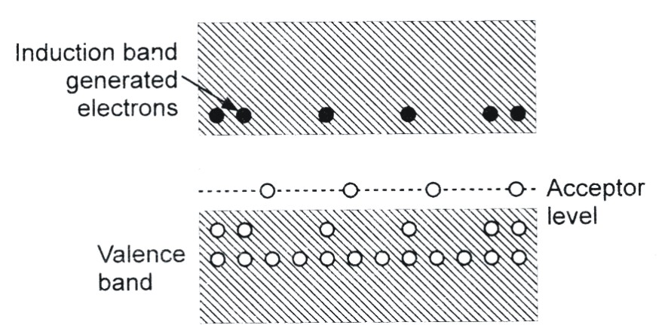
P-type semiconductor
When pure semiconductor is doped with trivalent impurity such as Indium (In), boron (B), we get N-type semiconductor.
Trivalent impurity shares their 3 electrons with neighbors but 4th neighbor has vacancy, this vacancy of electron is known as a hole.
This vacancy has tendency to accept an electron hence it is known as acceptor impurity.
Ne<< Nh

Slide 9
Thank you…

