Slide 1
Electromagnetic Induction
Mrs.Sushama S. Kulkarni

Slide 2
Concept of Magnetic Flux
Magnetic flux (Φ_{B}) is the number of magnetic field lines(also called "magnetic flux density") passing through a closed surface (such as a conducting coil).
The SI unit of magnetic flux is the weber (Wb) (in derived units: volt-seconds).
The CGS unit is the maxwell. (For example, it is used by electrical engineers trying to design systems with electromagnets)

Slide 3
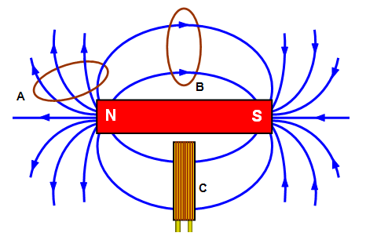
Magnetic Flux Lines

Slide 4
History of Faraday’s Laws
In 1831, Michael Faraday, an English physicist gave one of the most basic laws of electromagnetism called Faraday's law of electromagnetic induction.
This law shows the relationship between electric circuit and magnetic field.
Faraday performs an experiment with a magnet and coil. During this experiment, he found how emf is induced in the coil when flux linked with it changes

Slide 5
Faraday's First Law
Any change in the magnetic field of a coil of wire will cause an emf to be induced in the coil. This emf induced is called induced emf and if the conductor circuit is closed, the current will also circulate through the circuit and this current is called induced current.

Slide 6
Faraday's Second Law
It states that the magnitude of emf induced in the coil is equal to the rate of change of flux that links with the coil. The flux linkage of the coil is the product of number of turns in the coil and flux associated with the coil.
According to Faraday's law of electromagnetic induction, the rate of change of flux linkage is equal to induced emf.
(Refer: https://www.youtube.com/watch?v=tKmQ9T8R1Yw)

Slide 7
Lenz Law of Electromagnetic Induction
It states that the polarity of Induced emf is such that it opposes the cause which produces it.
Lenz's law obeys Newton's third law of motion (i.e to every action there is always an equal and opposite reaction) and the conservation of energy (i.e. energy can neither be created nor destroyed and therefore the sum of all the energies in the system is a constant).

Slide 8
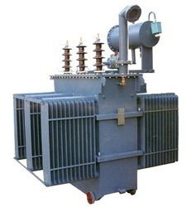
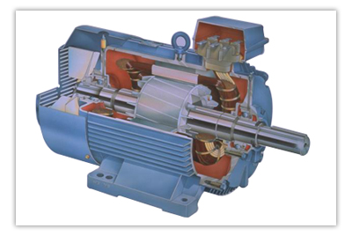
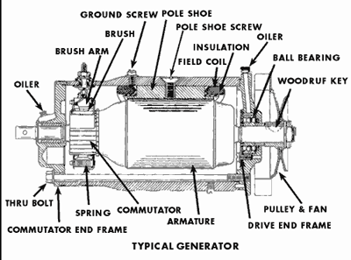
Applications of Faraday’s Laws
Transformers
Induction Motors
Generators

