Slide 1
Electromagnetic Induction -Types Of Induced EMF
Mrs R.U.Patil
Sr.Lecturer,EPS Dept.
V.P.M’s Polytechnic,Thane

Slide 2
Faraday's laws of of electromagnetic induction explains the relationship between electric circuit and magnetic field.
This law is the basic working principle of the most of the electrical motors, generators, transformers, inductors etc.

Slide 3
Faraday's First Law:
Whenever a conductor is placed in a varying magnetic field an EMF gets induced across the conductor (called as induced emf), and if the conductor is a closed circuit then induced current flows through it.
Magnetic field can be varied by various methods - 1. By moving magnet 2. By moving the coil 3. By rotating the coil relative to magnetic field
So in simple way --
Whenever the magnetic flux linked with a circuit changes, an e.m.f. is always induced in it.
or
Whenever a conductor cuts magnetic flux, an e.m.f. is induced in that conductor.

Slide 4
Faraday's Second Law:
Faraday's second law of electromagnetic induction states that,
the magnitude of induced emf is equal to the rate of change of flux linkages with the coil. The flux linkages is the product of number of turns and the flux associated with the coil.
i.e.
The magnitude of the induced e.m.f. is equal to the rate of change of flux linkages.

Slide 5
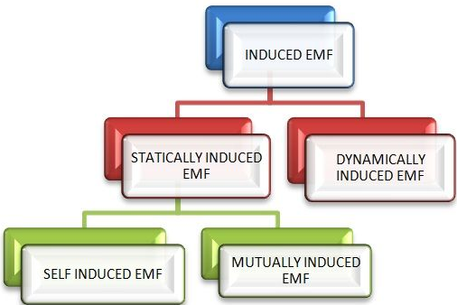
Types of Induced EMF
Conductor in motion
Field stationary
Conductor in stationary
Field varying

Slide 6
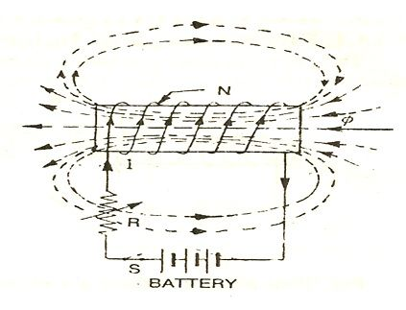
Self induced EMF
Self-induced emf is the e.m.f induced in the coil due to the change of flux produced by linking it with its own turns.

Slide 7
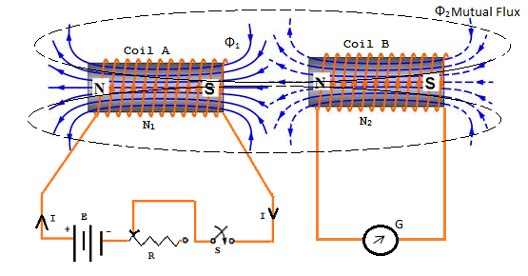
Mutual induced EMF
Phenomenon Of Mutual Induction
Alternating current flowing in a coil produces alternating magnetic field around it. When two or more coils are magnetically linked to each other, then an alternating current flowing through one coil causes an induced emf across the other linked coils. This phenomenon is called as mutual induction.
If the flux created by one coil is obtaining joined with another coil and as a result of change during this flux created by initial coil, there's induced e.m.f.in the second coil, then such an e.m.f is named mutually induced e.m.f.

Slide 8
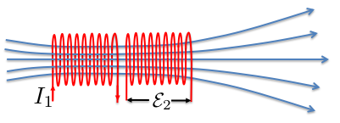
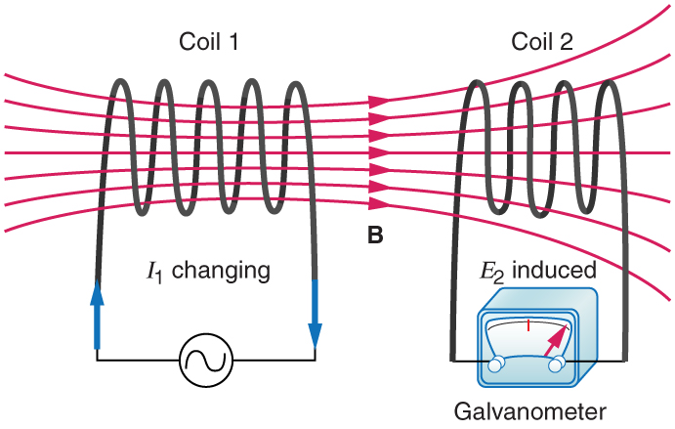
If 2 coils are placed near
each other (in the same plane),
a changing current in one coil will induce an EMF in the other coil
From Faraday’s law, the EMF E₂ induced in coil 2, is proportional to the rate of change of the magnetic flux passing through it

Slide 9
Transformer
3 phase induction motor
Works on This Mutual induction Principle

