Slide 1
3 Phase Induction Motor
Mrs R.U.Patil
Sr.Lecturer,EPS Dept.
V.P.M’s Polytechnic,Thane

Slide 2
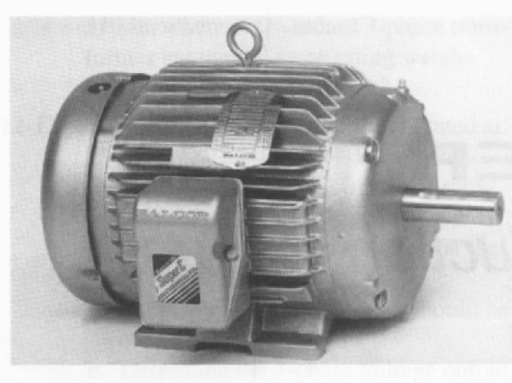
Electrical Machines
An electric motor uses electrical energy to produce mechanical energy,
Through ----- the interaction of magnetic fields and current-carrying conductors.
Basic Applications of Electric motors
industrial fans blowers and pumps
machine tools household appliances
power tools disk drives.
Motor
electrical energy
mechanical energy

Slide 3
Classifications of motors

Slide 4
Induction motors are now the preferred choice for industrial motors due to
Their Simple rugged construction
Low cost & reliability
High efficiency
absence of brushes (which are required in most DC motors)
Low maintenance
Simple starting arrangements
and—thanks to modern power electronics—the ability to control the speed of the motor.

Slide 5
Basic principle Operation of IM
A Rotating Magnetic field (RMF) is set up in the stator when a 3- Phase supply is given.
The stationary rotor cut the revolving field and due to electromagnetic induction an e.m.f. is induced in the rotor conductor.
As the rotor conductor is short circuited current flows through them.
It becomes a current carrying conductor in magnetic field and start rotating.
Slip of an Induction Motor----Induction motor rotor always rotate at a speed less than synchronous speed.
The difference between the flux (Ns) and the rotor speed (N) is called slip. ➢% Slip (s) = (Ns – N /Ns) *100
Where Ns=Synchronous Speed N= Actual Speed of rotor slip speed = Ns – N

Slide 6
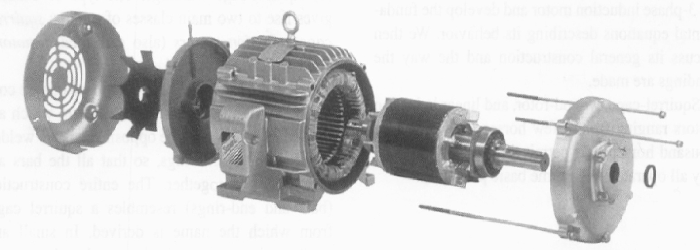
Principal components
Induction motor -- two main parts:
a stationary stator ---
a revolving rotor.
The rotor is separated from the stator by a small air gap that ranges from 0.4 mm to 4 mm, depending on the power of the motor.
Fig showing the stator, rotor, end-bells, cooling fan, ball bearings, and terminal box.

Slide 7
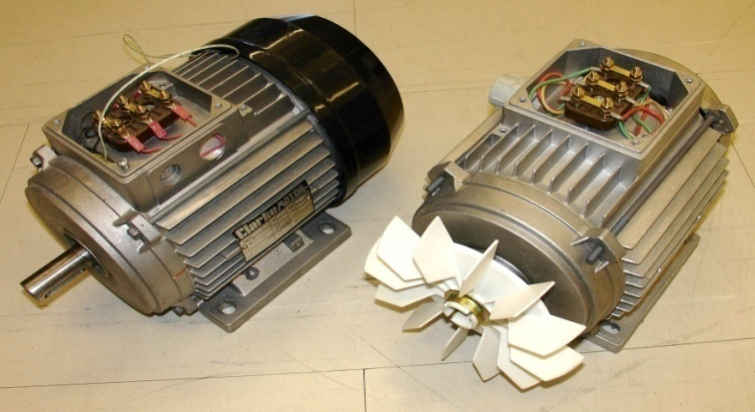
Construction of IM
1) STATOR
The stator consists of wound 'poles' that carry the supply current to induce a magnetic field
The number of 'poles' can vary between motor types but the poles are always in pairs (i.e. 2, 4, 6, etc.).
2) ROTOR
Induction Motor can be Classified in two category according to rotor Construction:-
Squirrel cage induction motor
Slip ring induction motor/ phase wound rotor
Rotor may be of Solid core rotor also

Slide 8
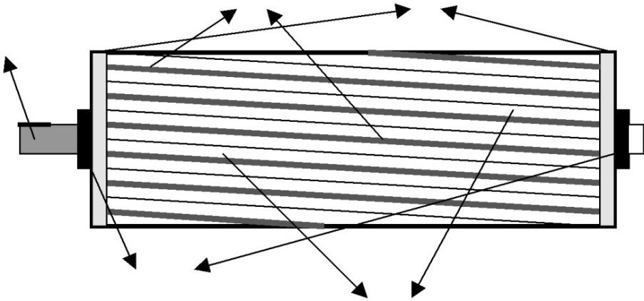
Squirrel cage rotor
The most common type of rotor
made up of solid bars of either copper (most common) or aluminum
those solid copper or aluminium strips can be shorted or connected by a ring
The rotor bars are not straight, but have some skew to reduce noise and harmonics.
The 3-phase squirrel cage motor is rugged and reliable, so it is most common type of motor used in industry
These motors drive lathes pumps, blowers and fans, compressors, conveyers, textile mills and production lines.

Slide 9
Wound Rotor (Slip Ring Induction Motors)
specially constructed motor to accomplish speed control.
rotor is constructed with windings which are brought out of the motor through slip rings on the motor shaft.
These windings are connected to a controller which places variable resistors in series with the windings.
The torque performance of the motor can be controlled using these variable resistors.
Suitable for High starting T & smooth speed control ----, rolling mills Lift, crane
Wound rotor motors are most common in the range of 300 HP and above
.

Slide 10
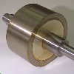
Solid core rotor
A rotor can be made from a solid mild steel. The induced current causes the rotation.

