Slide 1
Augmentative and Alternative Communication
…A comparison of Augmentative and Alternative Communication devices for a non-verbal student
Lauren McClintock
Creative Commons Attribution-NonCommercial 4.0 International

Slide 2
Alternative and Augmentative Communication (AAC) Devices
AAC devices use picture symbols, word processing features, apps on iPads, and hundreds of other means as a way to allow individuals with significant communication needs the ability to express their wants, needs, and ideas to peers and adults (Asha, 2013).

Slide 3
Types of AAC
Unaided communication systems – rely on the user's body to convey messages. Examples include gestures, body language, and/or sign language (Asha, 2013).
Aided communication systems – require the use of tools or equipment in addition to the user's body. Aided communication methods can range from paper and pencil to communication books or boards to devices that produce voice output (speech generating devices or SGD's)and/or written output (Asha, 2013).

Slide 4
Why AAC?
Increase self-worth of individuals
Increase communication skills for non-verbal students
Enhance communication skills for students with significant speech-language impairments
Build social relationships
Promote inclusion into settings with non-disabled peers

Slide 5
More about AAC devices in Classrooms
https://www.youtube.com/watch?v=wmbOmMfhd5k

Slide 6
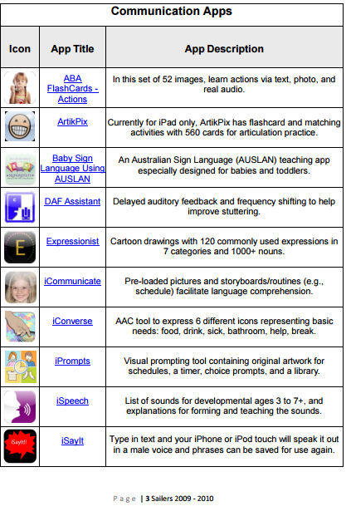
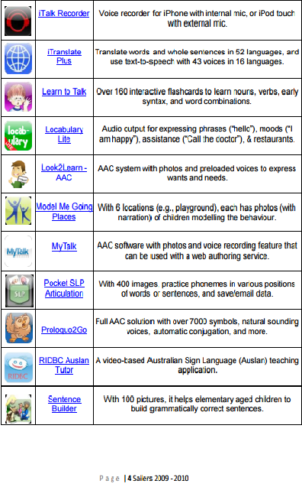
AAC Apps for iPads and other Apple Devices
Retrieved from http://www.spectronics.com.au/downloads/general/iPhone%20iPad%20and%20iPod%20touch%20Apps%20AUS.pdf

Slide 7
A Case Study
The purpose of my study is to determine the effectiveness of using a picture based symbol approach verses an app on the Apple iPad to measure the frequency of communicative exchanges between a nonverbal student with an intellectual disability and her peers and teachers.

Slide 8
Participant
The single participant for this case study was a five year old girl, Ava. Ava was diagnosed with Down Syndrome after an ultrasound revealed abnormalities with her heart and limb measurements. Prior to her first birthday Ava underwent open heart surgery, received a tracheotomy, and also a feeding port into her stomach. Ava has received services through BabyNet since birth including speech and language, physical, and occupational therapies.
Ava is currently in a self-contained special education classroom for kindergarten through third grade students with moderate to severe intellectual disabilities. Ava receives physical, occupational, and speech language services twice weekly in a school setting and is taught all core academic areas using a modified curriculum to meet her unique needs.

Slide 9
Participant
Academic and adaptive weaknesses include her limited ability to make vocalizations (able to vocalize less than five words), her ability to follow multi-step directions, unable to recognize letters, numbers, colors, and shapes, and delays in all gross and fine motor domains.
Academic and adaptive strengths include the ability to complete inset puzzles, make marks on paper using writing utensils, select named pictures and items, and match pictures of items.
Interest include watching cartoons, playing with baby dolls, using markers to color, dancing, and eating snack.

Slide 10
Setting
Data was collected at Ava’s elementary school in a rural community of South Carolina. Teachers and classroom paraprofessionals collected data of her in her natural environment, her classroom, during daily activities.

Slide 11
Procedures
During the ten day data collection period, Ava was introduced to a category of requested items—needs. Included in this category were the following four request: bathroom, help, open, and glasses clean.
Ava was introduced to these four request using two types of AAC devices—the previously established use of a Velcro picture based system and an app on the Apple iPad.

Slide 12
Procedures
Ava had access to the Velcro based picture system for the first five days of the study and frequency data was collected to monitor the request being made. During days six thru ten of the study, Ava was only given access to an app on the iPad to make the four request from the needs category. Frequency data was collected by both teacher and paraprofessionals during a seven hour school day over a period of two weeks.

Slide 13
Results
Ava made fourteen independent requests using the Velcro picture based system and twenty-eight total independent request using the iPad during the ten day study.
Communication Book | Number of Independent Request During 5 Day Period
Bathroom | 0
Glasses Clean | 10
Help | 4
Open | 0
 | Total: 14
App on iPad | Number of Independent Request During 5 Day Period
Bathroom | 0
Glasses Clean | 16
Help | 6
Open | 6
 | Total: 28

Slide 14
Implications for Practice
Being in my classroom in excess of seven hours a day provides countless opportunities to promote language in my students. There are truly hundreds of AAC devices out there and finding the right one for each child could open up so many doors for them. In this case it seems that even students with significant cognitive and speech language impairments have a preference and should be given choices about how they prefer to communicate.

Slide 15
Resources
Asha, A. (2013, June). Augmentative and alternative communication (AAC). Retrieved June 15, 2016, from http://www.asha.org/public/speech/disorders/AAC/
Augmentative and Alternative Communication (AAC) in the Preschool Classroom -- CIRCA-Part 1. (2014). Retrieved June 15, 2016, from https://www.youtube.com/watch?v=wmbOmMfhd5k
Sailors, E., Sennott, S., & Niemeijer, D. (2009). IPhone, iPod, and iPad Apps for Special Education. Retrieved June 15, 2016, from http://www.spectronics.com.au/downloads/general/iPhone%20iPad%20and %20iPod%20touch%20Apps%20AUS.pdf

