Slide 1
Unit 8: People Among Us
Notes:
.

Slide 2
Unit 8: People Among Us
Unit 8.1: People
Unit 8.2: Physical Descriptions
Unit 8.3: Clothing
Notes:
.

Slide 3
Review: Snapshots
Describing Others
Present and Not Present
KNOW
Commenting on Appearances
POTBELLY and PREGNANT
Tattoos
Decades
Notes:
.

Slide 4
Heights
Notes:
height

Slide 5
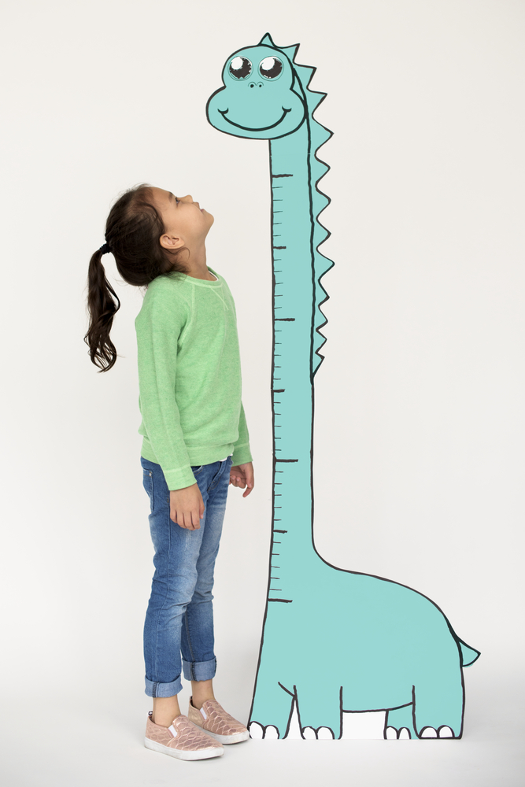
Notes:
Little People (LP)
Short
Average
Tall
Growing up
Image credit:
Rawpizel.com/Shutterstock

Slide 6
Body Types
Notes:
.

Slide 7
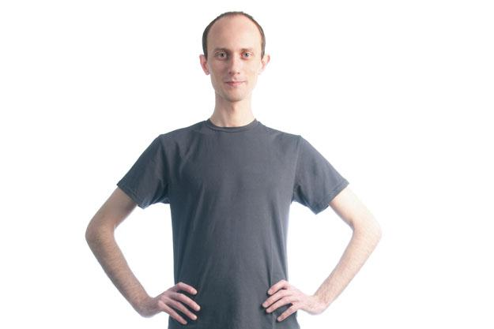
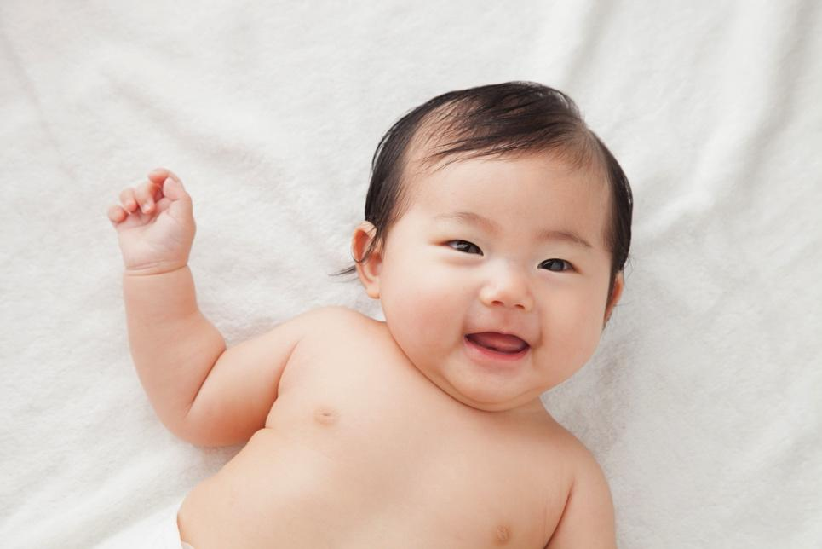
Notes:
Image 1: Skinny/Thin/Slim/Slender
Image 2: Average
Image 3: Chubby and cute!
Image 4: Muscular
Image Credits:
nanka/Shutterstock
Aila+Images/Shutterstock
ucchie79/Shutterstock
FXQuadro/Shutterstock

Slide 8
Hair Colors
Notes:
.

Slide 9
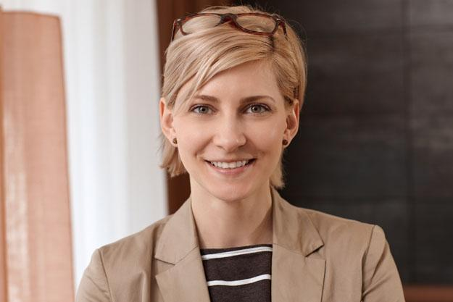
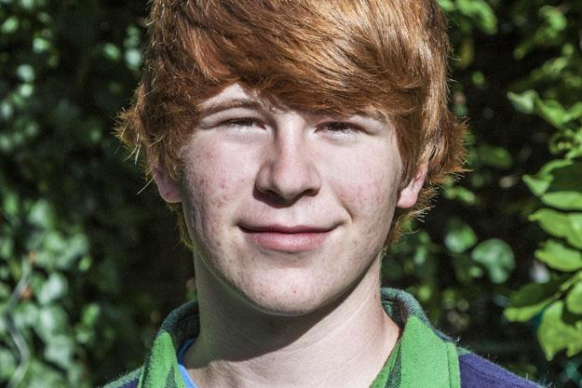
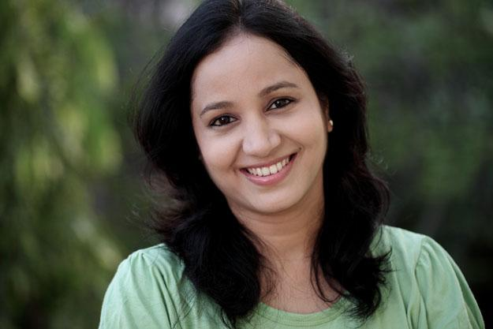
Notes:
Image 1: Blonde
Image 2: Red Hair
Image 3: Black Hair
Image Credits:
StockLite/Shutterstock
Jorg+Hackemann/Shutterstock
SnowWhiteimages/Shutterstock

Slide 10
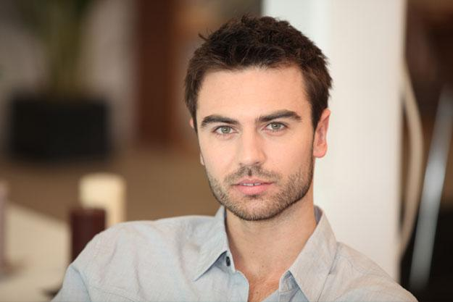
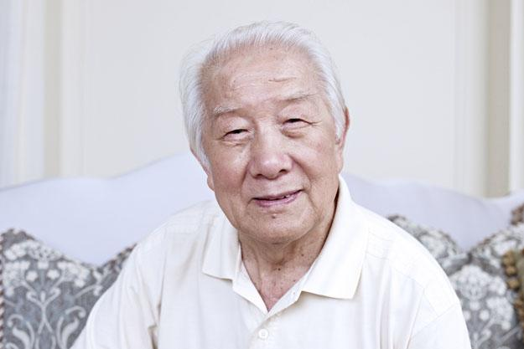
Notes:
Image 1: Brown Hair
Image 2: Grey Hair or Salt & Pepper Hair
Image 3: White Hair
Image Credits:
Phovoir/Shutterstock
Monkey+Business+Images/Shutterstock
imtmphoto/Shutterstock

Slide 11
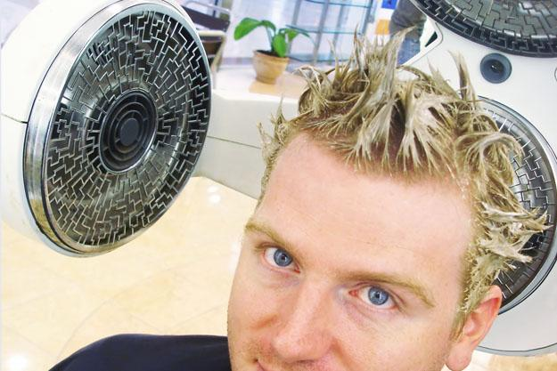
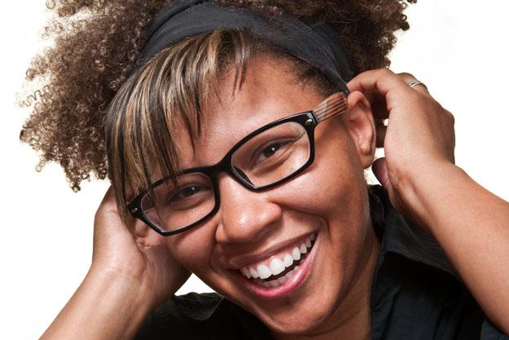
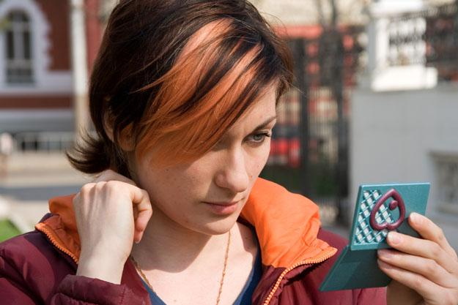
Notes:
Image 1: Dye/Color
Image 2: Highlight
Image 3: Streak
Image Credits:
Gina+Smith/Shutterstock
ESphotography/Shutterstock
Irina+Kodentseva/Shutterstock

Slide 12
Hair Types
Notes:
.

Slide 13
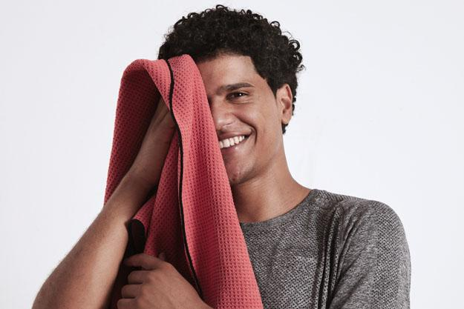
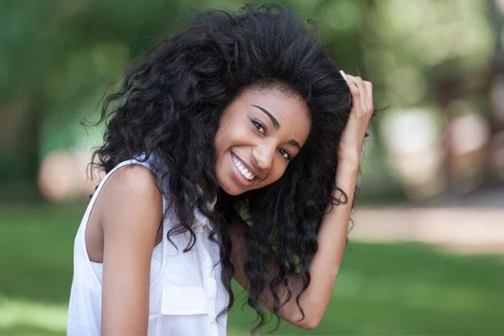
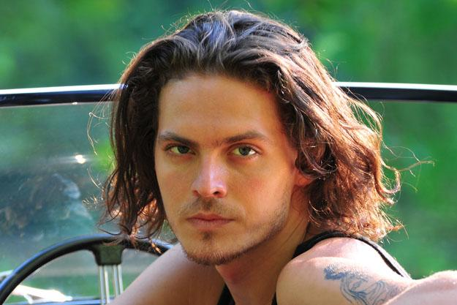
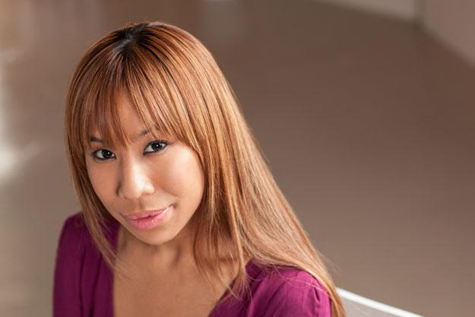
Notes:
Use non-manual markers to show hair types [“OO” with eyes squinted = tight curls or very curly; “MM” or pursed lips = relaxed/loose curls or wavy; “OO” = straight]
Image 1: Tight Curls
Image 2: Curly
Image 3: Wavy
Image 4: Straight
Image Credits:
De+Repente/Shutterstock
Samuel+Borges+Photography/Shutterstock
ChristianKieffer/Shutterstock
Cheryl+Savan/Shutterstock

Slide 14
Hair Lengths
Notes:
.

Slide 15
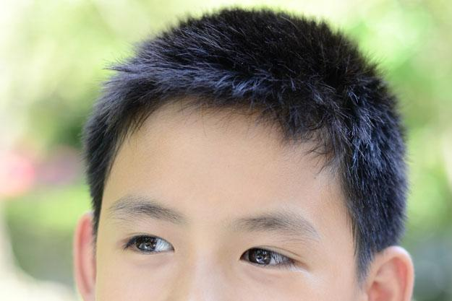
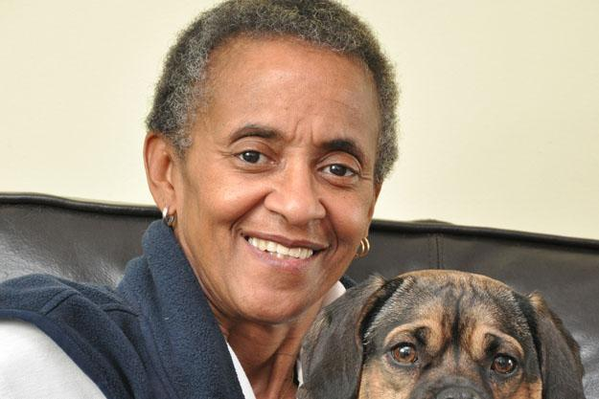
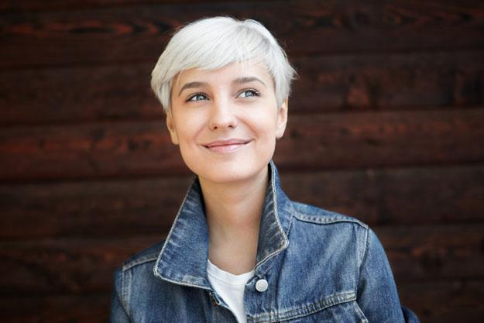
Notes:
Use mouth morphemes to show hair length (“OO” = short; chin/shoulder length = “MM” or pursed lips; long hair = “AHH”)
Image Credits:
Sanmongkhol/Shutterstock
Kuzma/Shutterstock
rSnapshotPhotos/Shutterstock

Slide 16
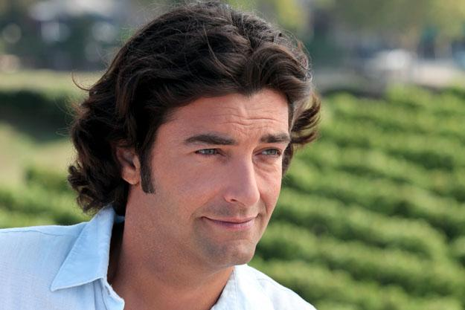
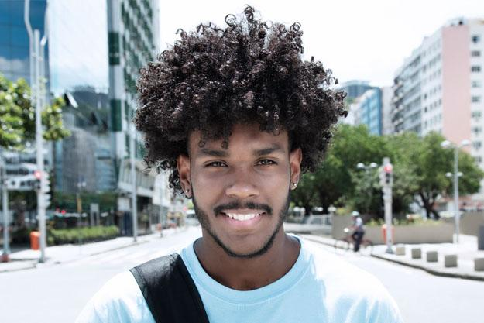
Notes:
Use mouth morphemes to show hair length [“OO” = short; chin/shoulder length = “MM” or pursed lips; long hair = “AHH”]
Image Credits:
tylerolson/Shutterstock
Phovoir/Shutterstock
Daniel+M+Ernst/Shutterstock

Slide 17
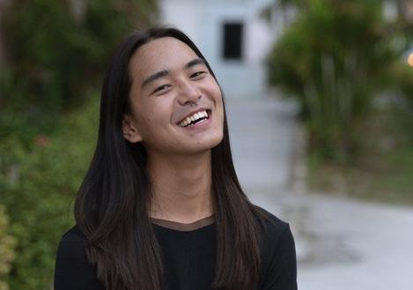
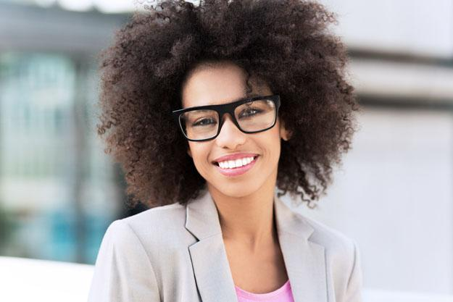
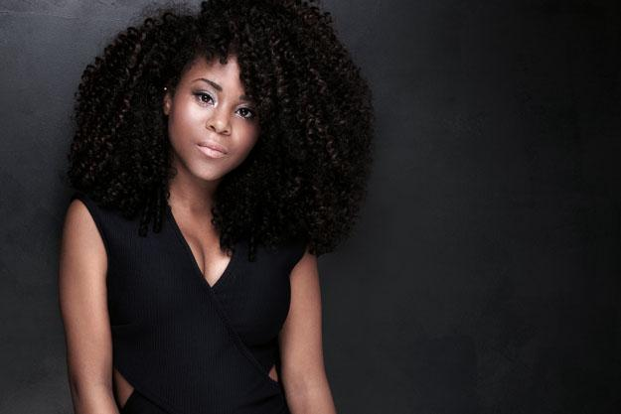
Notes:
Use mouth morphemes to show hair length [“OO” = short; chin/shoulder length = “MM” or pursed lips; long hair = “AHH”]
Image Credits:
Amazingmikael/Shutterstock
pikselstock/Shutterstock
NeonShot/Shutterstock

Slide 18
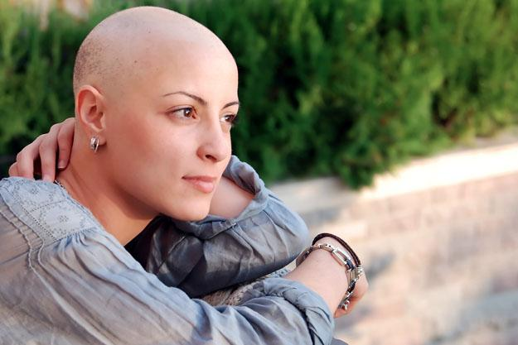
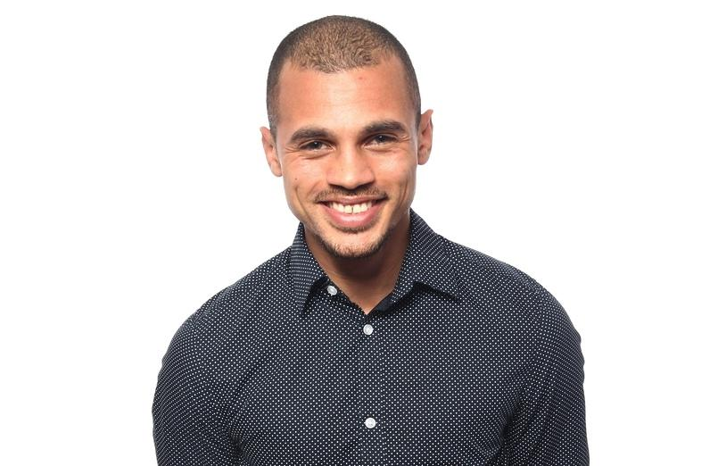
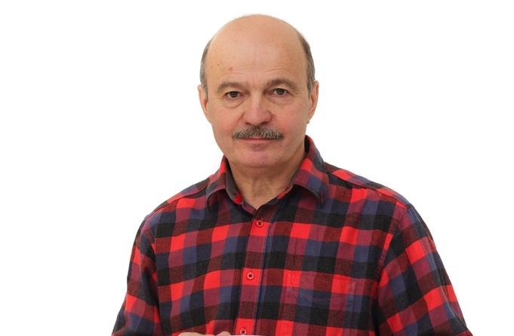
Notes:
Different types of balding areas.
Show where the bald spots are.
Image Credits:
Cleomiu/Shutterstock
Djomas/Shutterstock
Koldunov/Shutterstock

Slide 19
Facial Hair
Notes:
.

Slide 20
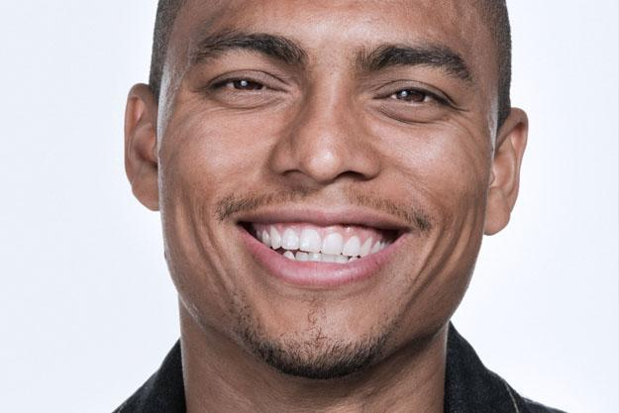
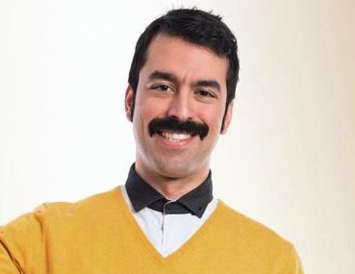
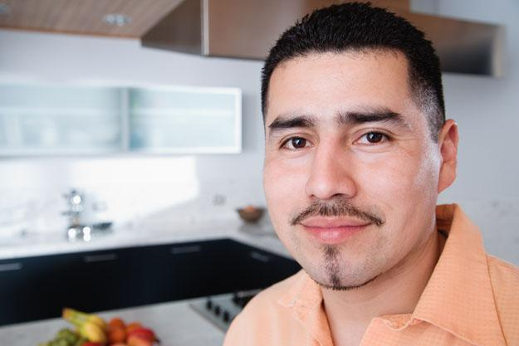
Notes:
Use non-manual markers to describe thickness of moustache/beard, facial hair (“OO” = thin; “MM” or pursed lips = regular/typical; “puffed cheek” or “SHHH” = thick)
Image Credits:
XiXinXing/Shutterstock
LuisMolinero/Shutterstock
LuisMolinero/Shutterstock

Slide 21
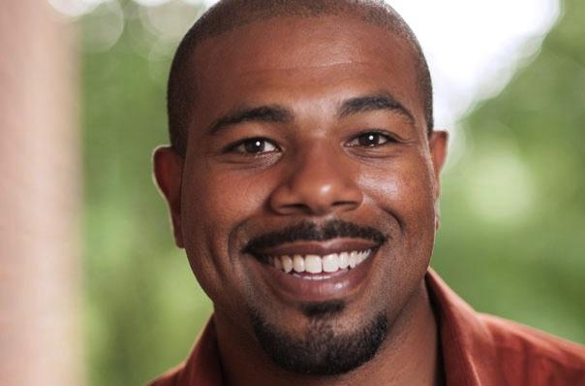
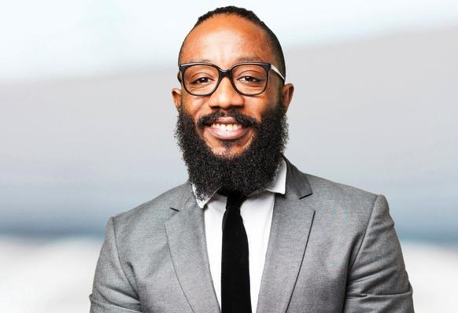
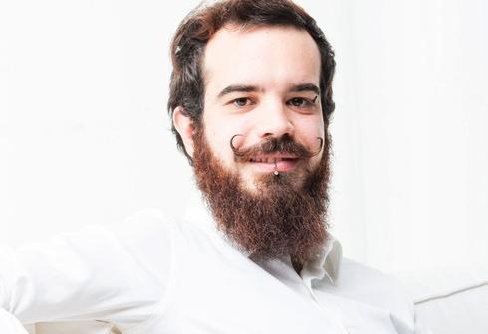
Notes:
Use non-manual markers to describe thickness of moustache/beard, facial hair (“OO” = thin; “MM” or pursed lips = regular/typical; “puffed cheek” or “SHHH” = thick)
Image Credits:
HANA/Shutterstock
Asier Romero/Shutterstock
Eugenio Maroungiu

Slide 22
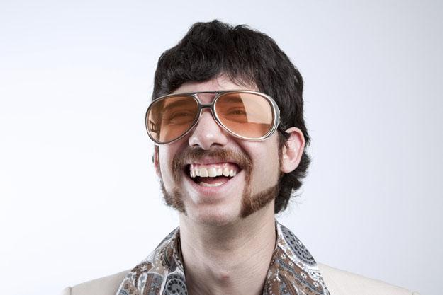
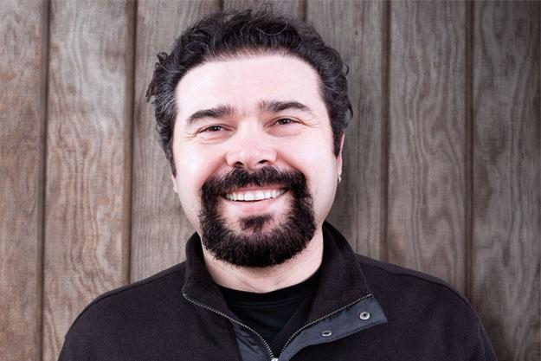
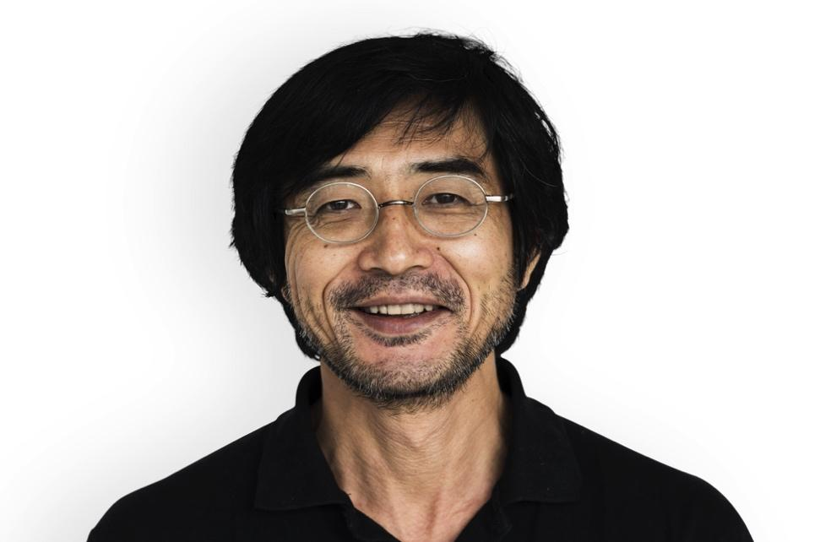
Notes:
Use non-manual markers to describe thickness of moustache/beard, facial hair (“OO” = thin; “MM” or pursed lips = regular/typical; “puffed cheek” or “SHHH” = thick)
Image 3: 5 o’clock Shadow/Scruffy (NMM showing roughness)
Image Credits:
Willrow+Hood/Shutterstock
Ozgur+Coskun/Shutterstock
Rawpixel.com/Shutterstock
70’s Willrow+Hood/Shutterstock

Slide 23
Eyebrows
Notes:
.

Slide 24
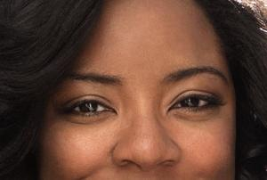
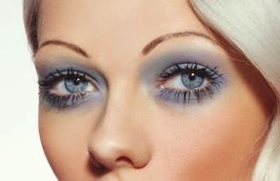
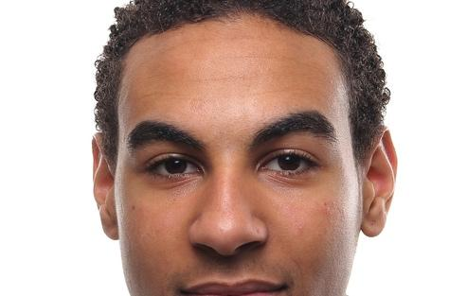
Notes:
Use non-manual markers to describe thickness of eyebrows/facial hair (“OO” = thin; “MM” or pursed lips = regular/typical; “puffed cheek” or “SHHH” = thick)
Image Credits:
Olga Ekaterincheva/shutterstock
pixelheadphoto+digitalskillet/Shutterstock
Djomas/Shutterstock

Slide 25
Facial Features
Notes:
.

Slide 26
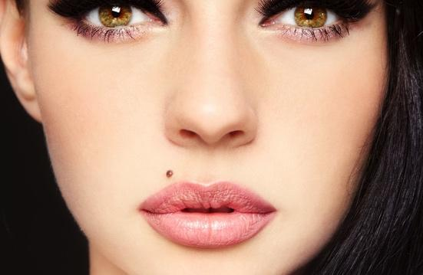
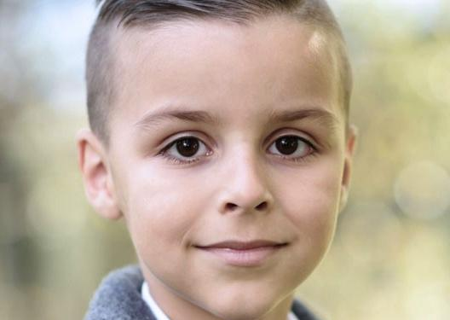
Notes:
Image 1: Long Eyelashes
Image 2: Beauty Mark
Image 3: Big Eyes
Image Credits:
Puhhha/Shutterstock
Olga EkaterinchevaShutterstock
Bajrich/Shutterstock

Slide 27
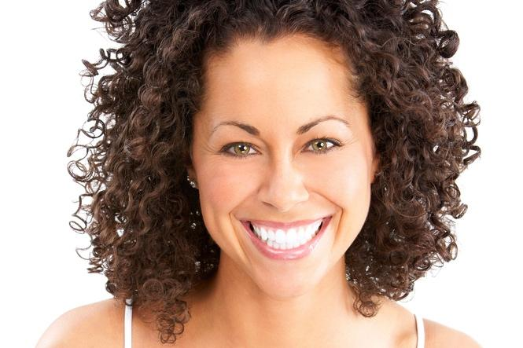
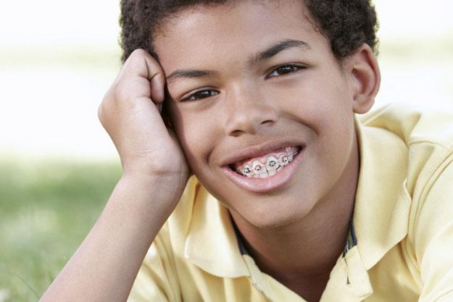
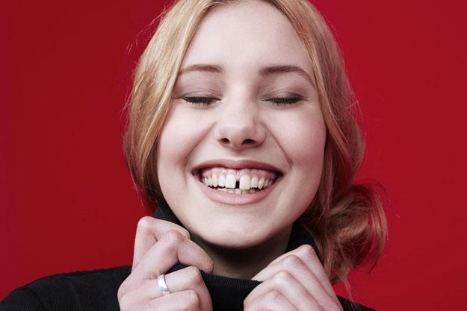
Notes:
Image 1: White Teeth
Image 2: Braces
Image 3: Gap
Image Credits:
kurhan/Shutterstock
Monkey+Business+Images/Shutterstock
sanneberg/Shutterstock

Slide 28
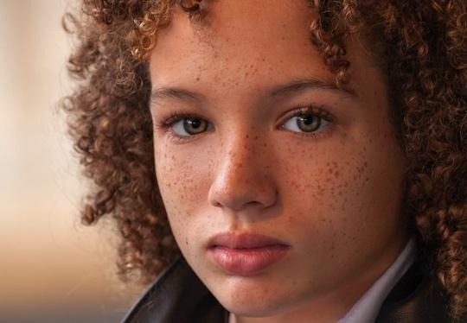
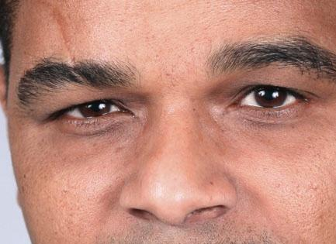
Notes:
Image 1: Freckles
Image 2: Scar on face
Image Credits:
William Moss/Shutterstock
Hriana/Shutterstock

Slide 29
More Features
Notes:
.

Slide 30
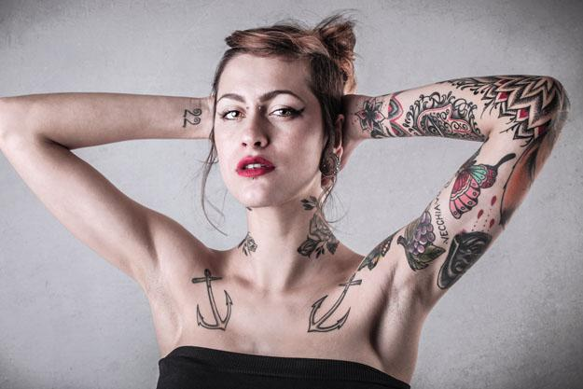
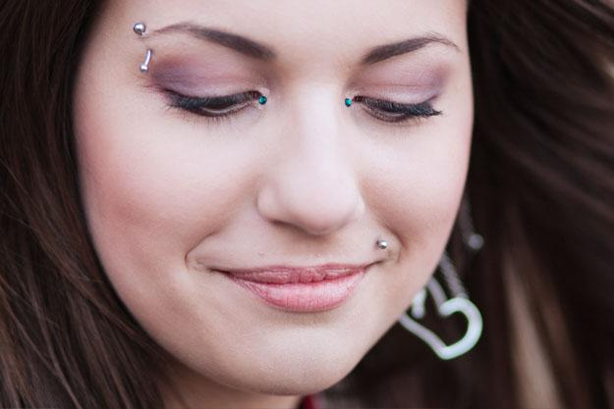
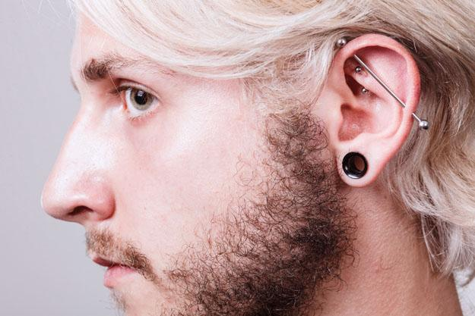
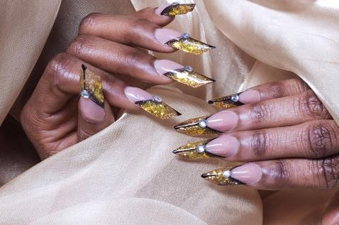
Notes:
*Sign generic TATTOO, and then indicate its location
Body piercing (show where it is)
Earlobe stretching / Plugs
Image 1: Tattoo
Image 2: Body Piercings
Image 3: Earlobe stretching / Plug
Image 4: Long Fake Nails
Image Credits:
Ollyy/Shutterstock
Tanee/Shutterstock
Anetlanda/Shutterstock
SHYPULIA+TATSIANA/Shutterstock

Slide 31
Group Discussion
Do you have a tattoo or several? What’s the story behind them?
If you were offered free plastic surgery, which area you would like to change? Why or why not?
Notes:
.

Slide 32
SO-FAR YOU LEARN WHAT?
Notes:
.

Slide 33
An instructor is only authorized to use these files if s/he has current students who have purchased subscription access to the digital product and are authorized users of TRUE+WAY ASL. An instructor who qualifies under this definition may make limited modifications to a single locally downloaded copy of lecture files and worksheets in order to provide guidance to students who are authorized users regarding additional instructions or specific assignments. The instructor is prohibited from copying, altering, or transferring to a new location any image contained within the digital product, including images contained within the lecture files and worksheets.
Image(s) used under license from Shutterstock, www.shutterstock.com/
Notes:
.

