Slide 1
Sorting Out My Career Options!
Unit 2:
Session 8

Slide 2
Dimensions of Work
Some careers work with Data.
Working with information and facts in the form of words and/or numbers
Careers that work with data include:
Bankers
Computer Programmers
Advertising Agents
Realtors
UNIT 2: Session 8: Sorting Out My Career Options

Slide 3
Dimensions of Work
Some careers work with Ideas.
Applying a concept to solve a problem
Usually involves imagination and creativity
Careers that work with ideas include:
Psychologists
Artists
Teachers
UNIT 2: Session 8: Sorting Out My Career Options

Slide 4
Dimensions of Work
Some careers work with Things.
Using tools, materials, plants and animals to do work
Careers that work with things include:
Farmers
Builders
Car Technicians
Electricians
UNIT 2: Session 8: Sorting Out My Career Options

Slide 5
Dimensions of Work
Some careers work with People.
Working to serve, sell, care for or help others
Careers that work with people include:
Extension Agents
Nurses
Elected Officials
Sales Associates
UNIT 2: Session 8: Sorting Out My Career Options

Slide 6
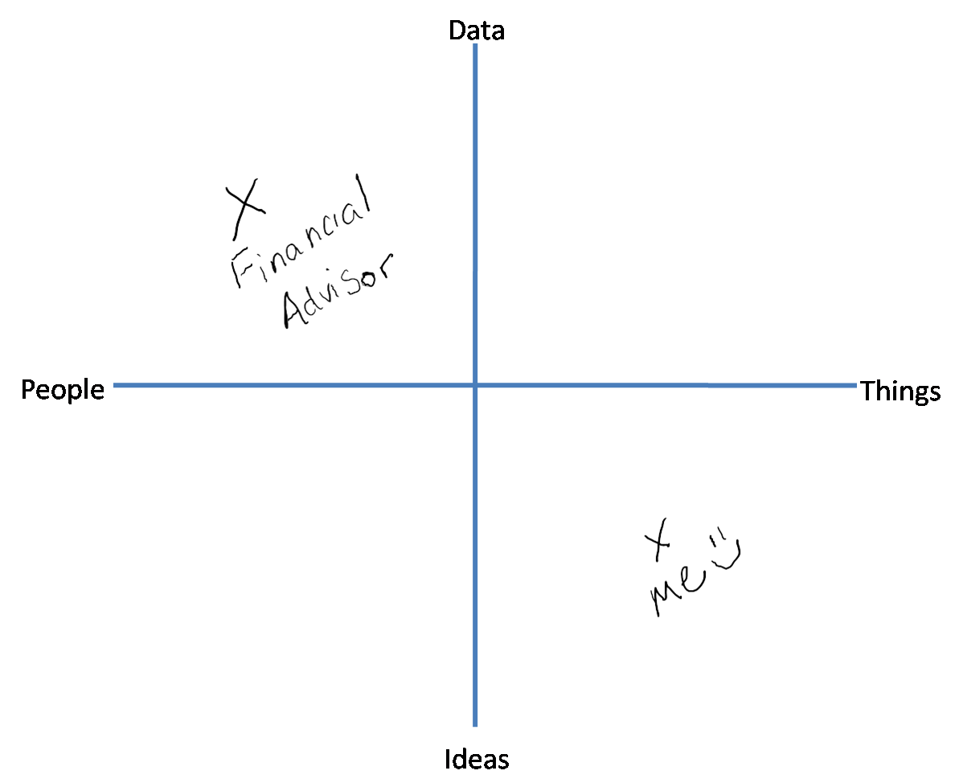
Dimensions of Work
Use the diagram to identify your interests.
UNIT 2: Session 8: Sorting Out My Career Options

Slide 7
Dimensions of Work
Use the diagram to evaluate career options.
UNIT 2: Session 8: Sorting Out My Career Options

Slide 8
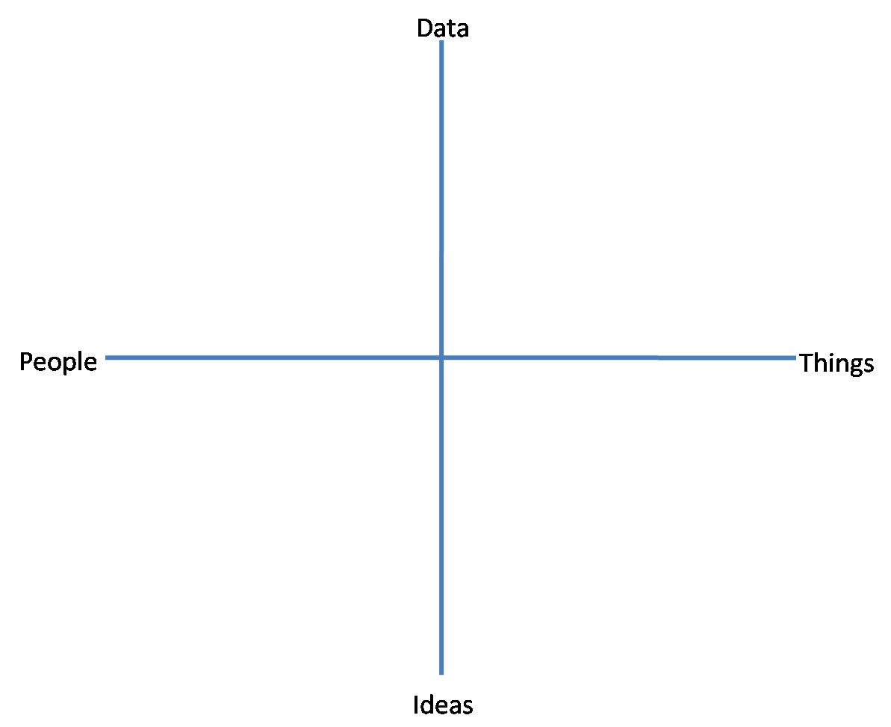
Try It Out!
Identify your interests.
Map these four careers:
Teacher
Pilot
Architect
Salesperson
Evaluate which of the options may be a good fit for you.
UNIT 2: Session 8: Sorting Out My Career Options

Slide 9
Other Factors to Consider
What is the work environment like?
Where is this kind of work located?
What level of education will I need?
What will a typical day at work look like?
UNIT 2: Session 8: Sorting Out My Career Options

