Slide 1
Career Path Development!
Unit 2:
Session 4

Slide 2
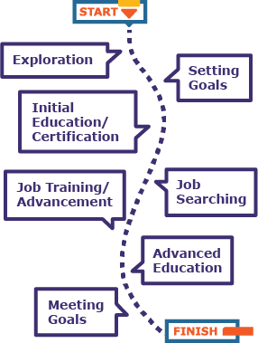
Career Exploration
Exploring My Options
Setting Career Goals
Job Specific Training
Meeting My Career Goals
Initial Education/Certification
Advancement Opportunities
Job Searching
Advancd Training/Education
??
??
??
??
??
??
??
UNIT 2: Session 4: Career Path Development

Slide 3
Career Path Development
Exploring My Options
Setting Career Goals
Initial Education/Certification
Job Searching
Job Specific Training
Advancement Opportunities
Advanced Training/Education
Meeting My Career Goals
UNIT 2: Session 4: Career Path Development

Slide 4
Step 1: Exploring My Options
Identify one or two clusters
Explore career pathways
Consider interests, lifestyle, goals and talents
UNIT 2: Session 4: Career Path Development

Slide 5
Step 2: Setting Career Goals
Establish initial career goals
These will be updated many times
For now, these may be general
UNIT 2: Session 4: Career Path Development

Slide 6
Step 3: Initial Education/Certification
Learn about the education required for dream career
Education requirements
High School Diploma
Two-year Degree/Certificate
Four-year Degree
Advanced Degree
Learn about certification required in career area
UNIT 2: Session 4: Career Path Development

Slide 7
Step 4: Job Searching
Entry level positions are a place to begin in your career
Job searching involves:
Completing an application
Sending a resume
Interviewing
Choosing a job from the offers
Start exploring careers with after-school employment
UNIT 2: Session 4: Career Path Development

Slide 8
Step 5: Take Advantage of Job Specific Training and Advancement Opportunities
This happens after you are hired for a job
In this you will learn about the tasks and tools the group uses to do your job
Take advantage of opportunities to take on more responsibility or new jobs in the same organization
UNIT 2: Session 4: Career Path Development

Slide 9
Step 6: Complete Advanced or Continuing Training/Education
Set goals for advanced education
Advancement may also mean that you learn something new
You may get an advanced degree in many ways
Continuing education keeps a license or certificate current
UNIT 2: Session 4: Career Path Development

Slide 10
Step 7: Meeting My Career Goals
Requires effort
Re-evaluate goals once they are met
Focus on continuous improvement
Achieve your dreams!
UNIT 2: Session 4: Career Path Development

