Slide 1
A World of Options!
Unit 2:
Session 1

Slide 2
A World of Options!
After this unit you will be ready to…
tell someone else about your options for a future career;
show someone a group of careers that interest you;
discuss how careers will be different in 10 years.
UNIT 2: Session 1: A World of Options!

Slide 3
Unit 2: Essential Questions
What are my options in the world of careers?
How are trends, issues and innovations influencing the world of careers?
UNIT 2: Session 1: A World of Options!

Slide 4
UNIT 2: Session 1: A World of Options!

Slide 5
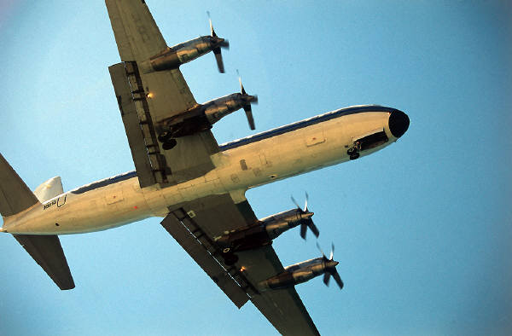
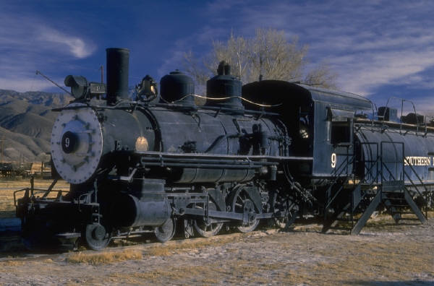
UNIT 2: Session 1: A World of Options!

Slide 6
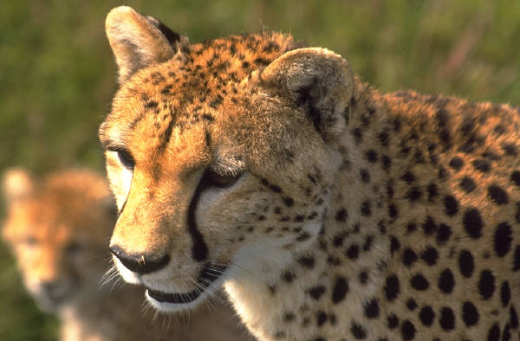
UNIT 2: Session 1: A World of Options!

Slide 7
Six Career Fields
FIELD: Business, Marketing and Management Budget Analyst Sales Manager Doctor Banker | FIELD: Agriculture, Food and Natural Resources Aerospace Engineer Fish Hatchery Manager Turf Grass Manager Agricultural Engineer | FIELD: Communication and Information Systems A/V Technology Manager Software Developer Website Designer Police Officer
FIELD: Human Services and Education Video Game Designer Teacher Family Counselor School Psychologist | FIELD: Health Sciences Nurses Accountant Dental Assistant Personal Wellness Trainer | FIELD: Skilled and Technical Sciences Architect Electrician Livestock Breeder Welder
UNIT 2: Session 1: A World of Options!

