Slide 1
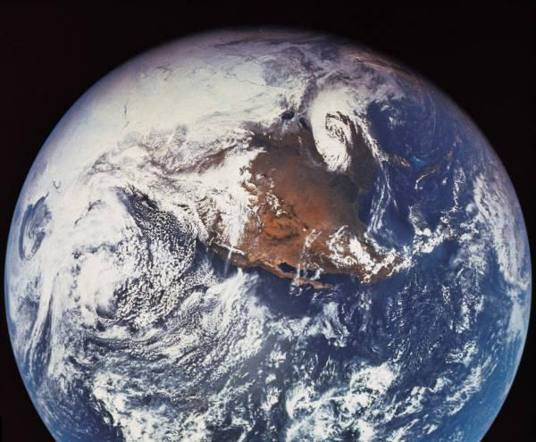
Around the world
© Food – a fact of life 2008
Notes:
*

Slide 2
Why do we eat different types of food?
© Food – a fact of life 2008
Notes:
*

Slide 3
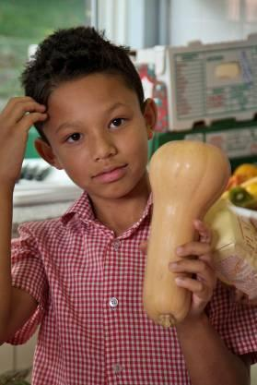
Food preferences
People choose lots of different types of food to eat.
The type they choose depends on:
the food available
their likes and dislikes
time
culture and religion
whether they can cook
© Food – a fact of life 2008
Notes:
*

Slide 4
Food around the world
There are many different types of foods from around the world.
People eat different foods depending on their culture.
Their culture might decide the foods that are commonly or normally eaten. This is different in different countries.
© Food – a fact of life 2008
Notes:
*

Slide 5
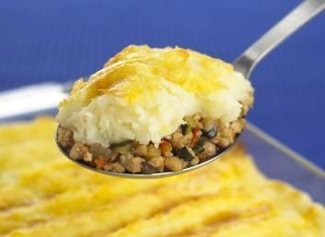
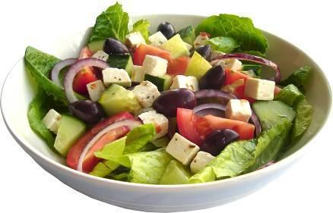
Where in the world?
© Food – a fact of life 2008
Notes:
*

Slide 6
Where in the world?
Shepherd's Pie, UK
Greek salad, Greece
© Food – a fact of life 2008
Notes:
*

Slide 7
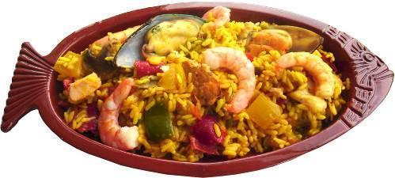
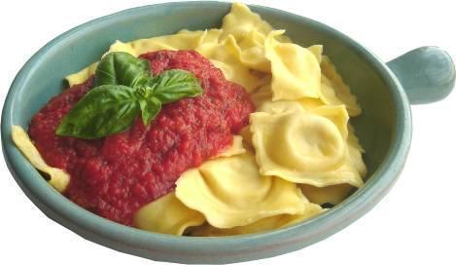
Where in the world?
© Food – a fact of life 2008
Notes:
*

Slide 8
Where in the world?
Paella, Spain
Ravioli, Italy
© Food – a fact of life 2008
Notes:
*

Slide 9
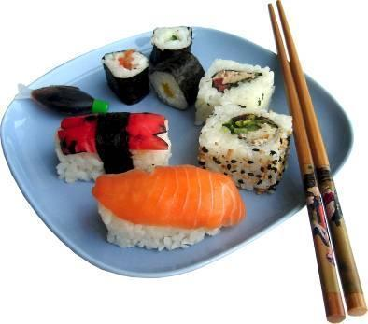
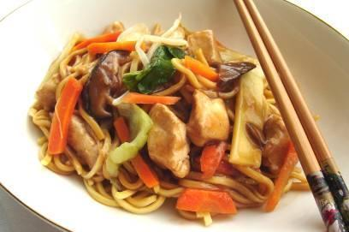
Where in the world?
© Food – a fact of life 2008
Notes:
*

Slide 10
Where in the world?
Sushi, Japan
Stir-fry, China
© Food – a fact of life 2008
Notes:
*

Slide 11
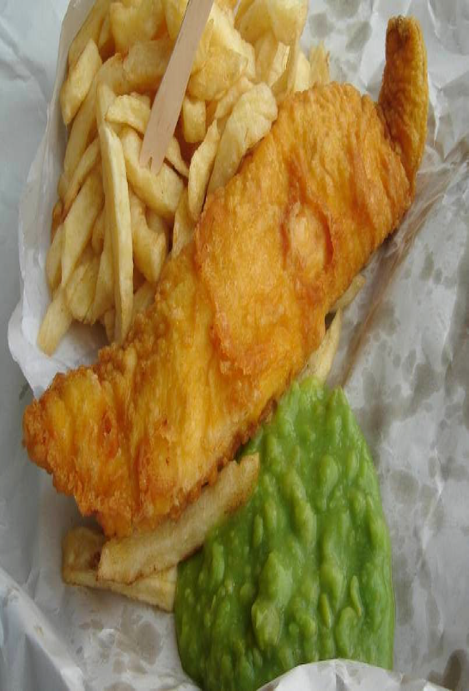
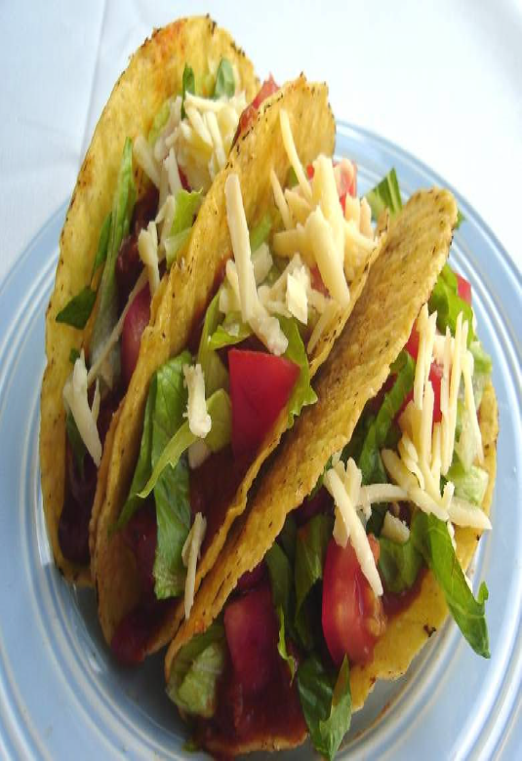
© Food – a fact of life 2008

Slide 12
UK
Mexico
© Food – a fact of life 2008

Slide 13
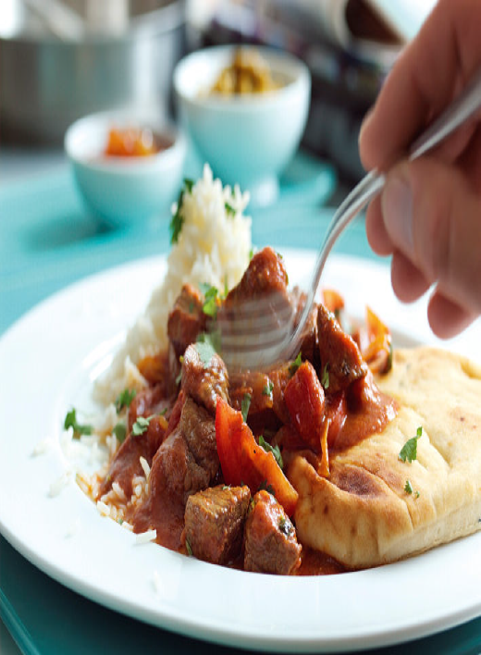
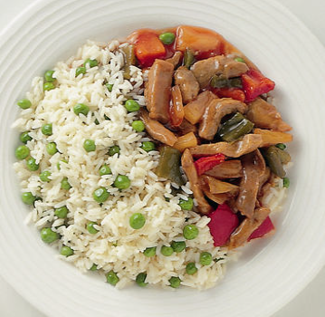
© Food – a fact of life 2008

Slide 14
India
China
© Food – a fact of life 2008

Slide 15
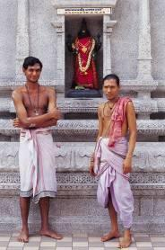
Religion
People also eat different things depending on their religion.
Their religion might dictate which foods can or cannot be eaten, or what types of foods can be served at special celebrations.
What examples do you know?
© Food – a fact of life 2008
Notes:
*

