Slide 1
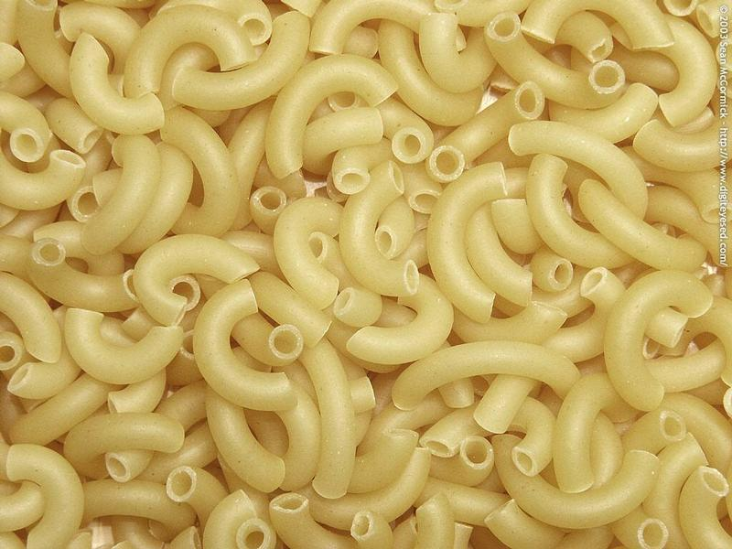
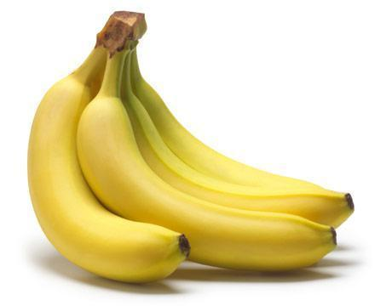
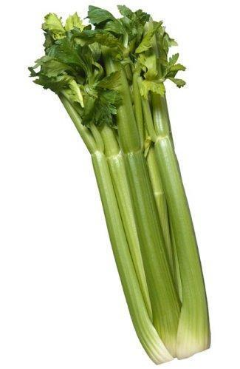
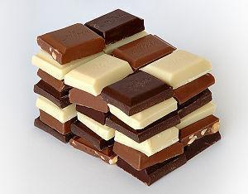
Food Word Origins
Where do words for these items come from?

Slide 2
Food Word | Language of origin
Barbeque | Haitin
Macaroni | Italian
Pretzel | German
Omelette | French
Okra | West African
Chocolate | Aztec
Pasta | Italian
Croissant | French
Mousse | French
Pita | Greek
Shish Kebab | Arabic
Hamburger | German
Paella | Spanish
Tortilla | Mexican Spanish
Banana | Spanish or Portuguese
Caramel | Spanish
Celery | French
Chilli | Aztec
Can you guess the language that each of these words comes from?

Slide 3
Food Word | Language of origin
Barbeque | Haitin
Macaroni | Italian
Pretzel | German
Omelette | French
Okra | West African
Chocolate | Aztec
Pasta | Italian
Croissant | French
Mousse | French
Pita | Greek
Shish Kebab | Arabic
Hamburger | German
Paella | Spanish
Tortilla | Mexican Spanish
Banana | Spanish or Portuguese
Caramel | Spanish
Celery | French
Chilli | Aztec
Can you guess the language tht each of these words comes from?

