Slide 1
Internet Searches
Selecting appropriate sources

Slide 2
Introduction
This presentation will help guide you through a process of choosing the most appropriate sources when completing an internet search.
You will use a PDF template to complete the following tasks:
defining your topic and keywords
questioning if the source matches your criteria, and
saving the location of the source

Slide 3
Purpose
Do you remember the last time you searched for something on the internet? Did you notice how many search results it produced?
How do you pick the best sources?
This demonstration will help you learn to select the most appropriate sources.

Slide 4
The PDF Template
Here is the template you will use to complete your search.

Slide 5
Using the PDF template

Slide 6
Defining your topic
Think of words you would use to describe the topic.
Ask yourself:
Are there simple or more complex words which have the same meaning?
Is this a technical term or the generally- accepted term?
Identify as many keywords or phrases as you can.
Type your list of keywords in the text field of the PDF.

Slide 7
Defining your criteria
Scope:
Is this information too general?
Is this information too specific?

Slide 8
Defining your criteria
Timeframe:
Is this information current?
Is this information out-of-date?
Is the information old but still relevant?

Slide 9
Credible sources
Reliable websites tend to have .edu, .gov, or .org as part of their domain name.
A credible site displays the author's name and credentials, is professional in appearance, and contains no errors in spelling or grammar.
Websites that are written by anonymous or unqualified authors require the content be confirmed by a credible source.

Slide 10
Selecting your sources
Choose the sources which make the most sense to you.
Copy and paste the website URL into the text field on the PDF.

Slide 11
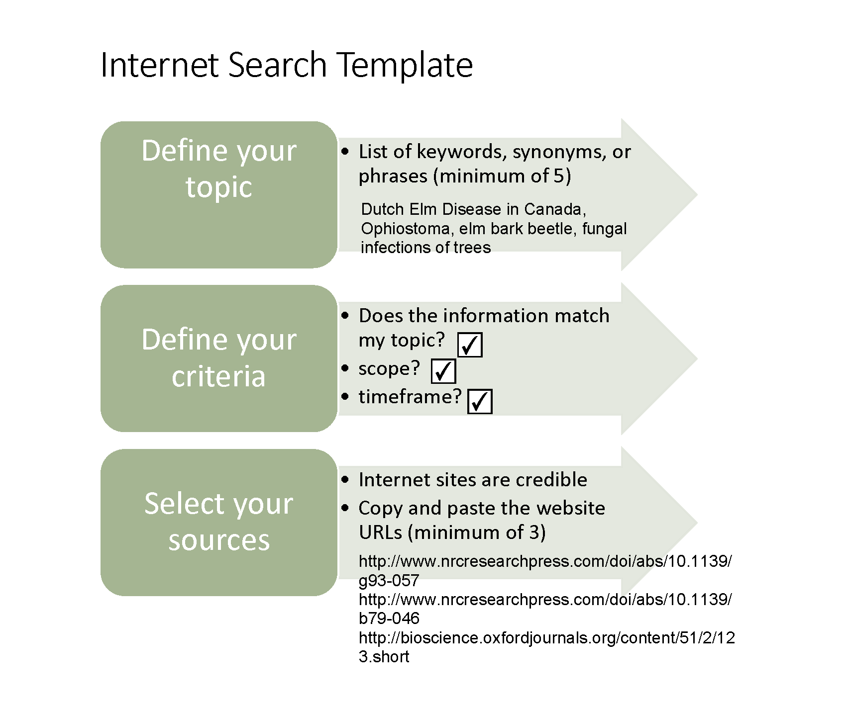
Your completed PDF template

Slide 12
Congratulations! Your template is complete.

Slide 13
Share with a Creative Commons 4.0 International license

