Slide 1
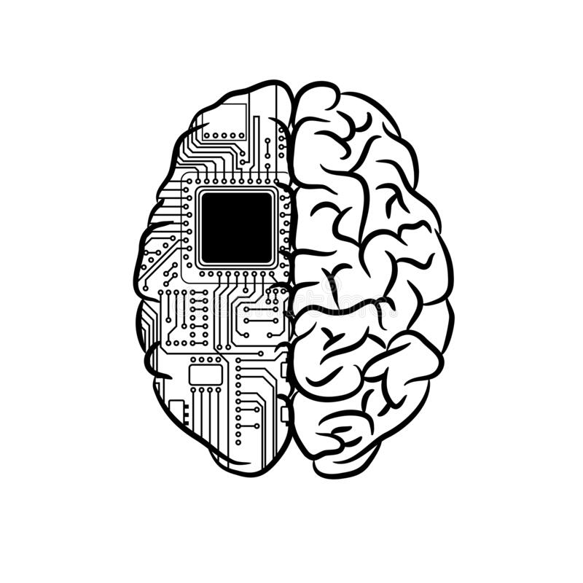
Is the Mind Material? "Can Computers Think" by John Searle
By:
Cierra Barnard
Natasha Holloway
Jose Villicana
Katelyn McMoore

Slide 2
Is Mind Material?
Katelyn: The mind-body problem – my interpretation: the mind is separate from the body in that each is a separate piece of existence, the body has limbs, skin, organs while the mind has thoughts, feelings, and understanding. Together, they create one's existence but when one is taken away, the other can't operate/exist.
Natasha: My interpretation of the mind-body problem is that while muscle contractions and digestion can be broken down and explained how/why it happens, the brain is much more complex therefore making it hard to fit it in the material world. The brain is like a machine, except in place of moving parts there are chemical and electrical signals that interact with each other. However, without our mind our bodies would simply be empty vessels.

Slide 3
Is Mind Material?
Jose: When it comes to behaviorism, the overall idea and conception of it is, people are typically inclined to perform certain actions and or behave a certain way simply because of our humane bodily movements that are generally guiding us and steering us into the direction we often turn to (behavioral wise). It is all simply “muscle memory” when we are reacting to certain events, such as: someone smacking you, tickling you, or even you feel like you’re falling, are all things that can instantly trigger a muscle memory that immediately makes us perform in a certain way. Which is why, behaviorism is to behave in certain ways or are inclined to behave in certain ways.
Cierra: My interpretation of this is that the mind-body problem is one that is extremely difficult to identify and has many different aspects. It can be very human of us to believe that we are “more than our body”, but is the mind just a material thing made of neurons firing different signals? This can be difficult to identify and prove because exactly what these signals fire off can not be observed in real time. We can see signals firing in the brain, but we can not immediately identify that the specific signal is signaling hunger or pain. Functionalism compares our brains’ mental state to functional states. Meaning there is a function for everything.

Slide 4
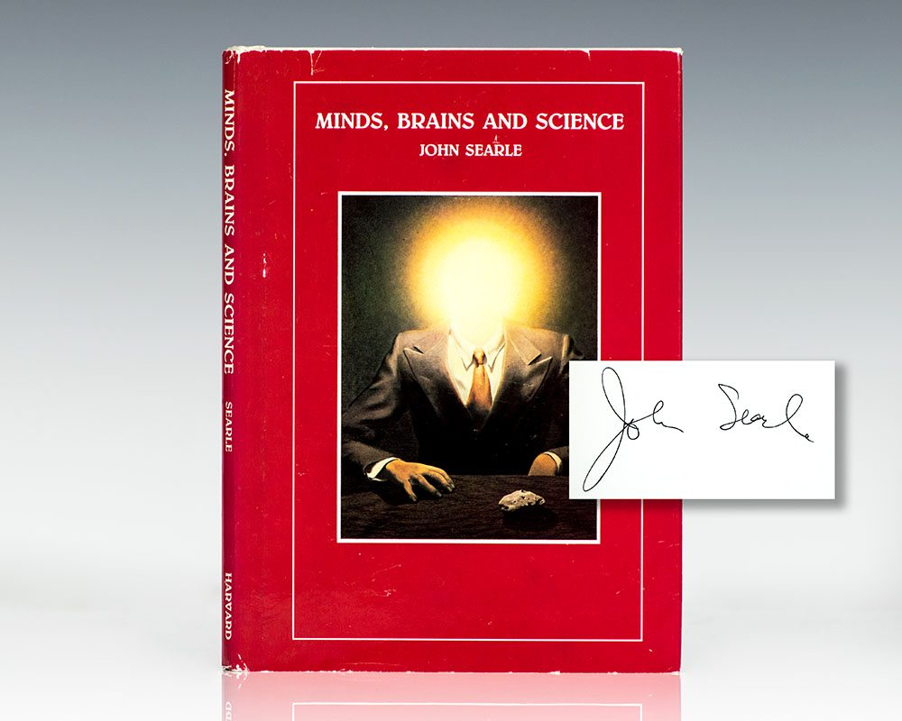
U.C. Berkeley philosopher John Searle introduced an extensively discussed argument in 1980. This argument was meant to show that it is impossible for digital computers to think or understand language.
The Chinese Room Argument was published by John Searle, and it has become one of the best-known arguments in recent philosophy on the topic of “Can Computers Think?”
“The narrow conclusion of the argument is that programming a digital computer may make it appear to understand language but could not produce real understanding.” (Cole)
Image of the cover of a book written by John Searle.

Slide 5
Can Computers Think?
Katelyn: the brain represents a digital computer while the mind represents a computer program- the difference between the mind and a machine is that we have an active conscience while a computer operates on a syntactical basis- simulating what is programed into it. Quote: "the mind is to the body, as the program is to the computer hardware" (Searle, p. 342)
Natasha: Brains are semantical, which means they can understand the meanings and differences of words. Computers are syntactical, meaning they just follow the rules of grammar. Computers do not understand the material they produce, they simply follow what they are programmed to do but our minds understand what we produce and what it means. Computers cannot think, have feelings or emotions like a human brain can.

Slide 6
Can Computers Think?
Jose: As Searle said, its not about if a machine can think, its not about if an artifact can think, its whether a Computer can think. And this narrows down what is truly being asked and what makes it unique is the overall component of how the programming inside of a computer is what makes this different from anything else. When Searle mentions about the program telling it to “stay there” it does give it some meaning and some reason to believe maybe computers can think. If the program was made to do more than just that, then maybe it can think. Searle says, in the end though, no for the reason the program is defined purely syntactically.
Cierra: When reading this, I interpreted that Searle is attempting to show the relationship between the knowledge to solve problems and understanding them. He uses the Chinese Room example which I feel really helped me to understand this more. Just because a computer can decipher Chinese and respond to it, it does not prove that the computer understands the Chinese. Just like if a human were put in a room and given a set of directions to put this symbol with this symbol if this specific symbol is shown. I believe that’s what computers are really doing. The computer is also not able to detect emotion when it comes to what is saying. Even if they are, it would just be a computer program like the Chinese Room example “If this is expressed, then respond in this way”, but are they really processing what the emotion is and being able to express genuine sympathy? I don’t believe so.

Slide 7
Discussion: Is Mind Material?
Q: What can be said on how to determine what is a "material" thing? For example, a virus (an example stated on page 307) can be argued to be nothing more than a complex molecular structure while the brain (example on page 308) can be argued to be nothing more than a combination of cells and biological wiring.
Q: Were your (the readers) interpretations the same as ours or different? How? Functionalism says mental states are identical to functional states, if this is true, what would the function for mental illnesses be? One example being depression.
Q: If one day they can stimulate human behavior on computers, could you then compare them to a human brain/mind? Why or why not?
Q: Could the nerves in our bodies be manipulated in to removing that muscle memory effect? And can the behaviorism of people be used to show how they can or might react to certain events?

Slide 8
Discussion: Can Computers Think?
Q: If a computer is programed to interact with empathy and emotion, how can we differentiate real authentic thoughts with simulated thoughts?
Q: In a way, are humans like machines?
Q: Could something else other than computers be capable of “thinking” or having some sort of way to interact on their own terms?
Q: Do you think computers would be able to recognize emotion and process it the way humans do? Or do you see it as comparable to the human in the Chinese room example? If we could program computers to respond to emotion, then what would differentiate our minds from the computer programs?

Slide 9
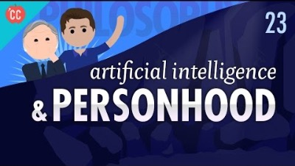
Additional Resource

Slide 10
References
Cole, David. 2020. “The Chinese Room Argument” https://plato.stanford.edu/entries/chinese-room/#:~:text=In%201980%20U.C.,to%20understand%20language%20or%20think.
Rosen, Byrne, Cohen, Harman, and Shiffrin. “The Norton Introduction to Philosophy, second edition” London. W. W. Norton & Company, Inc. 2018.

