Slide 1
BIOL 1010 Module 10
OpenStax
Concepts of Biology
Chapter 10: Biotechnology

Slide 2
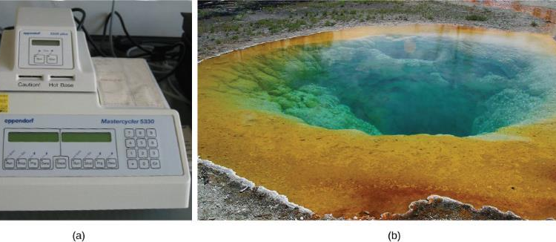
Figure 10.1 10.1 Cloning and genetic engineering
Learning Outcomes:
Explain the basic techniques used to manipulate genetic material
Explain molecular and reproductive cloning
(a) A thermal cycler, such as the one shown here, is a basic tool used to study DNA in a process called the polymerase chain reaction (PCR). The polymerase enzyme most often used with PCR comes from a strain of bacteria that lives in (b) the hot springs of Yellowstone National Park. (credit a: modification of work by Magnus Manske; credit b: modification of work by Jon Sullivan)

Slide 3
10.1 Cloning and genetic engineering
Biotechnology - the use of artificial methods to modify the genetic material of living organisms or cells to produce novel compounds or to perform new functions
First example: selective breeding of plants and animals in agriculture
In 1970s, development of tools and methods to manipulate DNA expanded the realm of biotechnology
Must be able to extract, manipulate, and analyze nucleic acids

Slide 4
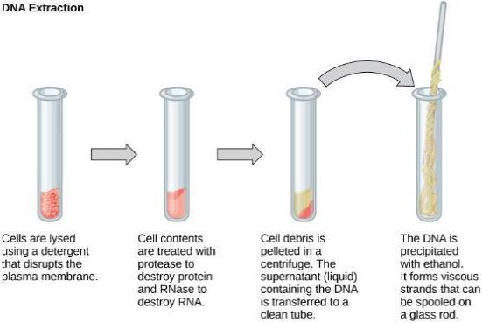
Figure 10.2
DNA Extraction:
Steps:
Break open cells (detergent)
Use enzymes to destroy unwanted components
Precipitate DNA (alcohol)
This diagram shows the basic method used for the extraction of DNA.

Slide 5
10.1 Cloning and genetic engineering
Visualization and Analysis
Nucleic acids have a negative charge (except in acidic environments)
Can make use of this to analyze
Gel electrophoresis - a technique used to separate molecules on the basis of their ability to migrate through a semisolid gel in response to an electric current
Load nucleic acids into gel, then apply a current from loaded end (negative) to end of gel (positive)
Gel has different sized pores, so smaller fragments of DNA move faster through it
Must then stain with a dye to visualize fragment bands

Slide 6
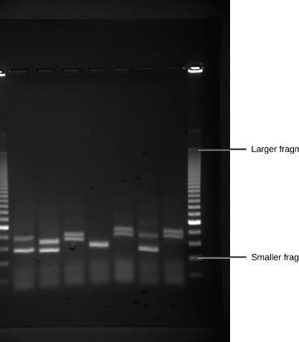
Figure 10.3
Shown are DNA fragments from six samples run on a gel, stained with a fluorescent dye and viewed under UV light. (credit: modification of work by James Jacob, Tompkins Cortland Community College)

Slide 7
10.1 Cloning and genetic engineering
PCR (Polymerase Chain Reaction) - a technique used to make multiple copies of DNA
Most DNA samples too small lfor analysis, must be amplified first
Uses a special DNA polymerase and nucleotide sequences called primers to specifically replicate regions of DNA
Many applications:
Crime scene investigation
Paternity analysis
Evolutionary comparison
Sequencing
etc…

Slide 8
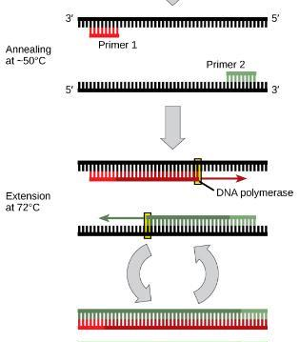
Figure 10.4
Polymerase chain reaction, or PCR, is used to produce many copies of a specific sequence of DNA using a special form of DNA polymerase.

Slide 9
10.1 Cloning and genetic engineering
Cloning - the production of an exact copy—specifically, an exact genetic copy—of a gene, cell, or organism
Whole organisms – reproductive cloning
Specific DNA sequences – molecular cloning
Allows synthesis of multiple copies, expression of genes, and study of genes and gene products
Plasmid - a small circular molecule of DNA found in bacteria that replicates independently of the main bacterial chromosome; plasmids code for some important traits for bacteria and can be used as vectors to transport DNA into bacteria in genetic engineering applications
Can carry fragments of DNA that can then be put in cells

Slide 10
10.1 Cloning and genetic engineering
Plasmids are naturally occurring, carrying genes that contribute favorable traits, such as antibiotic resistance or heavy metal tolerance
Can insert DNA into them using molecular “scissors”
Then can be put in cells
Bacteria – DNA replication and protein synthesis for analysis
Eukaryotic cells – functional studies
Restriction enzymes - an enzyme that recognizes a specific nucleotide sequence in DNA and cuts the DNA double strand at that recognition site, often with a staggered cut leaving short single strands or “sticky” ends

Slide 11
10.1 Cloning and genetic engineering
Restriction enzymes cut at a specific DNA sequence, a palindrome, that reads the same in the 5’ to 3’ direction on both strands
Can cut either in the same place in the palindrome (blunt ends) or at offset places (sticky ends)
Can insert a fragment of DNA into a plasmid if ends are cut with the same enzyme(s)
Annealing - in molecular biology, the process by which two single strands of DNA hydrogen bond at complementary nucleotides to form a double-stranded molecule
Add DNA ligase to seal the fragments together

Slide 12
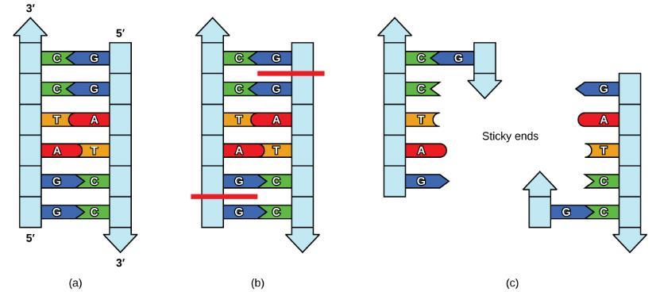
Figure 10.5
In this (a) six-nucleotide restriction enzyme recognition site, notice that the sequence of six nucleotides reads the same in the 5' to 3' direction on one strand as it does in the 5' to 3' direction on the complementary strand. This is known as a palindrome. (b) The restriction enzyme makes breaks in the DNA strands, and (c) the cut in the DNA results in “sticky ends”. Another piece of DNA cut on either end by the same restriction enzyme could attach to these sticky ends and be inserted into the gap made by this cut.

Slide 13
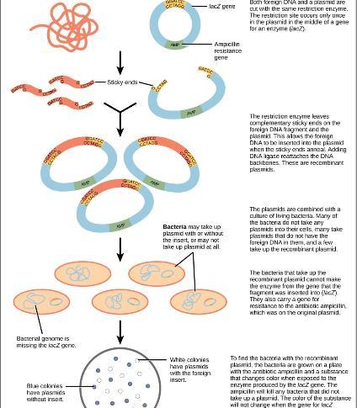
Figure 10.6
This diagram shows the steps involved in molecular cloning.

Slide 14
10.1 Cloning and genetic engineering
Recombinant DNA - a combination of DNA fragments generated by molecular cloning that does not exist in nature
Recombinant protein - a protein that is expressed from recombinant DNA molecules
Can engineer plasmids to not express protein, or to only express it under certain environmental conditions

Slide 15
10.1 Cloning and genetic engineering
Reproductive cloning - cloning of entire organisms
Requires egg cell (cytoplasmic components) and a diploid somatic cell (nuclear components)
First remove nucleus from egg cell, then inject diploid nucleus and implant egg cell or stimulate it to divide
Dolly – first cloned agricultural animal (sheep) 1996
Genetic engineering - alteration of the genetic makeup of an organism using the molecular methods of biotechnology
Organisms with modified DNA are called genetically modified organisms, or transgenic organisms

Slide 16
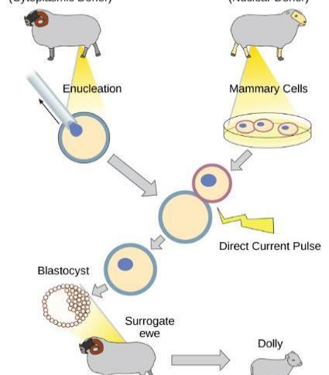
Figure 10.7
Dolly the sheep was the first agricultural animal to be cloned. To create Dolly, the nucleus was removed from a donor egg cell. The enucleated egg was placed next to the other cell, then they were shocked to fuse. They were shocked again to start division. The cells were allowed to divide for several days until an early embryonic stage was reached, before being implanted in a surrogate mother.

Slide 17
10.2 biotechnology in medicine and agricutlure
Learning Outcomes
Describe uses of biotechnology in medicine
Describe uses of biotechnology in agriculture

Slide 18
10.2 biotechnology in medicine and agricutlure
Genetic diagnosis is the process of using genetic testing to identify genetic defects and inform treatment
Example – BRCA genes in breast cancer
Mutations in these genes increase the likelihood for aggressive breast cancer
Gene therapy - the technique used to cure heritable diseases by replacing mutant genes with good genes
Theoretically involves introduction of non-mutant gene into diseased cells using an avirulent virus to deliver genetic material
Still highly experimental

Slide 19
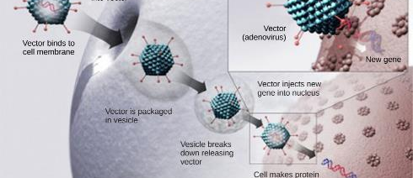
Figure 10.8
This diagram shows the steps involved in curing disease with gene therapy using an adenovirus vector. (credit: modification of work by NIH)

Slide 20
10.2 biotechnology in medicine and agricutlure
Used to produce vaccines, antibiotics, and hormones
Can grow human insulin in E. coli cheaply and efficiently
Some proteins require processing only found in eukaryotic cells, so must make transgenic animals

Slide 21
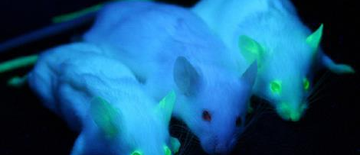
Figure 10.9
It can be seen that two of these mice are transgenic because they have a gene that causes them to fluoresce under a UV light. The non-transgenic mouse does not have the gene that causes fluorescence. (credit: Ingrid Moen et al.)

Slide 22
10.2 biotechnology in medicine and agricutlure
Transgenic plants – can modify DNA to make more disease resistant, herbicide resistant, pest resistant, or to increase nutritional value
Use a bacterium, Agrobacterium tumefaciens, that normally causes tumors in plants to transfer recombinant DNA into plants
Example: introduction of Bt toxin
Bacillus thuringiensis produces crystals that are toxic to insects
Introduced genes for Bt toxin into crops to make insect resistant
Is safe for humans and environment

Slide 23
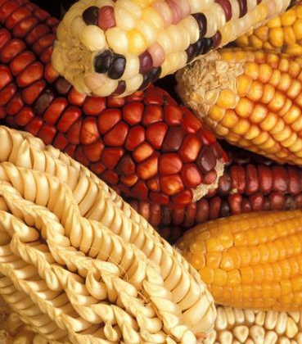
Figure 10.10
Corn, a major agricultural crop used to create products for a variety of industries, is often modified through plant biotechnology. (credit: Keith Weller, USDA)

Slide 24
10.3 Genomics and Proteomics
Learning Outcomes:
Define genomics and proteomics
Define whole genome sequencing
Explain different applications of genomics and proteomics

Slide 25
10.3 Genomics and Proteomics
Genomics - the study of entire genomes, including the complete set of genes, their nucleotide sequence and organization, and their interactions within a species and with other species
Requires the ability to read entire DNA sequence (genome) of an organism
Genetic map - an outline of genes and their location on a chromosome that is based on recombination frequencies between markers
Physical map - a representation of the physical distance between genes or genetic markers
Helps with identifying human disease-causing genes or identifying organisms with beneficial traits

Slide 26
Figure 10.11
This is a physical map of the human X chromosome. (credit: modification of work by NCBI, NIH)

Slide 27
10.3 Genomics and Proteomics
Whole genome sequencing - a process that determines the nucleotide sequence of an entire genome
First human map in 2010, in boy with intestinal abcesses
Had a disease in pathway causing programmed cell death (apoptosis); was cured with a bone marrow transplant
Used at St. Jude to treat pediatric cancer
Used in simpler organisms with smaller genomes that are commonly used in research
Model organism - a species that is studied and used as a model to understand the biological processes in other species represented by the model organism

Slide 28
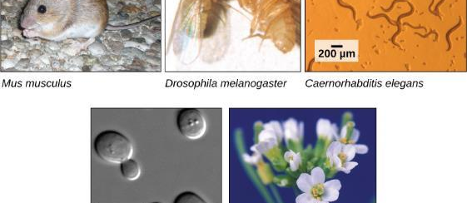
Figure 10.12
Much basic research is done with model organisms, such as the mouse, Mus musculus; the fruit fly, Drosophila melanogaster; the nematode Caenorhabditis elegans; the yeast Saccharomyces cerevisiae; and the common weed, Arabidopsis thaliana. (credit “mouse”: modification of work by Florean Fortescue; credit “nematodes”: modification of work by “snickclunk”/Flickr; credit “common weed”: modification of work by Peggy Greb, USDA; scale-bar data from Matt Russell)

Slide 29
10.3 Genomics and Proteomics
Many genetic diseases involve defects in more than one gene
Genome Wide Association Studies (GWAS) are used to identify differences between individuals in single nucleotides (single nucleotide polymorphisms, SNPs) that may be involve in disease
Help link SNPs to specific diseases
Pharmacogenomics – using personal genome information to inform prescription of drugs to treat disorders
Metagenomics - the study of the collective genomes of multiple species that grow and interact in an environmental niche

Slide 30
Figure 10.13
Metagenomics involves isolating DNA from multiple species within an environmental niche. The DNA is cut up and sequenced, allowing entire genome sequences of multiple species to be reconstructed from the sequences of overlapping pieces.

Slide 31
10.3 Genomics and Proteomics
Biofuel creation – using microorganisms to produce fules
Mitochondrial genomics – used to trace genealogy because inherited from mother; used to study evolutionary relationships
Forensic analysis
2001 – first use of genomics to identify cases of anthrax being transported by mail in US
Caused 5 deaths and 17 illnesses
News media and 2 US senators were targeted, but sickened anyone who handled
Eventually tracked culprit using genomics
Genomics in agriculture – allows identification of beneficial traits and genes responsible that can be used to make GMOs

Slide 32
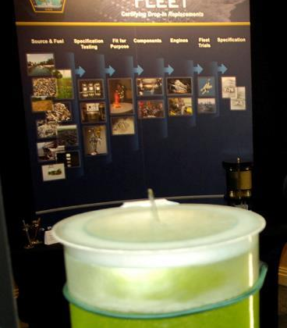
Figure 10.14
Renewable fuels were tested in Navy ships and aircraft at the first Naval Energy Forum. (credit: modification of work by John F. Williams, US Navy)

Slide 33
Figure 10.15
Bacillus anthracis is the organism that causes anthrax. (credit: modification of work by CDC; scale-bar data from Matt Russell)

Slide 34
10.3 Genomics and Proteomics
Proteomics
Proteins perform most functions in cells
Proteomics - study of the function of proteomes
More dynamic than genomics, because genome is constant in an organism but the proteome changes
Allows identification of proteins involved in diseases
Biomarker - an individual protein that is uniquely produced in a diseased state
Protein signature - a set of over- or under-expressed proteins characteristic of cells in a particular diseased tissue

Slide 35
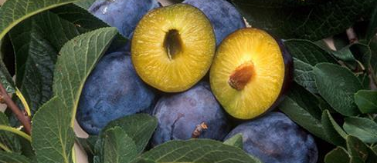
Figure 10.16
Transgenic agricultural plants can be made to resist disease. These transgenic plums are resistant to the plum pox virus. (credit: Scott Bauer, USDA ARS)

Slide 36
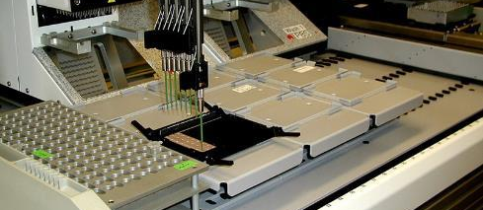
Figure 10.17
This machine is preparing to do a proteomic pattern analysis to identify specific cancers so that an accurate cancer prognosis can be made. (credit: Dorie Hightower, NCI, NIH)

Slide 37
10.3 Genomics and Proteomics
Current affairs –
https://www.sciencefocus.com/science/who-really-discovered-crispr-emmanuelle-charpentier-and-jennifer-doudna-or-the-broad-institute/
Critical thinking - Identify a possible advantage and a possible disadvantage of a genetic test that would identify genes in individuals that increase their probability of having Alzheimer's disease later in life.

