Slide 1
BIOL 1010 Module 8
OpenStax
Concepts of Biology
Chapter 8: Patterns of Inheritance

Slide 2
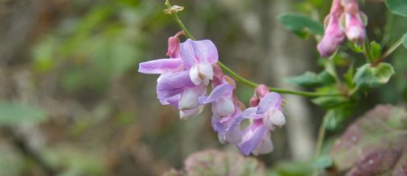
Figure 8.1 8.1 Mendel’s experiments
Learning Outcomes:
Explain the scientific reasons for the success of Mendel’s experimental work
Describe the expected outcomes of monohybrid crosses involving dominant and recessive alleles
Experimenting with thousands of garden peas, Mendel uncovered the fundamentals of genetics. (credit: modification of work by Jerry Kirkhart)

Slide 3
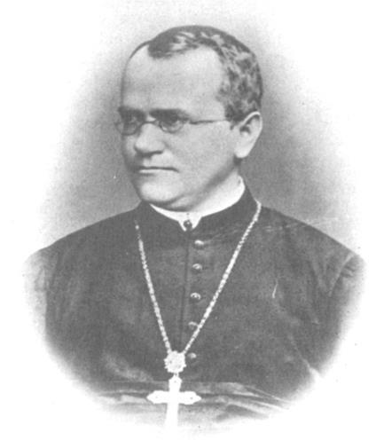
Figure 8.2
Johann Gregor Mendel (1822-1884)
Austrian monk
Taught physics, botany, and natural science at the secondary and university levels
1856 Began his work on heredity
Used pea plants to study inheritance patterns
Model system - a species or biological system used to study a specific biological phenomenon to gain understanding that will be applied to other species
Published in 1866
Johann Gregor Mendel set the framework for the study of genetics.

Slide 4
8.1 Mendel’s experiments
Mendel’s work went unnoticed due to the contemporary hypothesis that inheritance was a blending of parental traits giving an intermediate physical appearance in offspring due to continuous variation
Continuous variation - a variation in a characteristic in which individuals show a range of traits with small differences between them
Mendel worked with traits that exhibit discontinuous variation
Discontinuous variation - a variation in a characteristic in which individuals show two, or a few, traits with large differences between them
Allowed Mendel to easily distinguish between “blended” hypothesis and inheritance of distinct traits

Slide 5
8.1 Mendel’s experiments
Advantages of pea plants
Self fertilizing, allowing extablishment of “true-breeding” lines of plants
Grow to maturity in 1 season
Large quantities can be cultivated simultaneously
Mendel crossed true-breeding plants by manually pollinating flowers to create “hybrids”
Hybridization - the process of mating two individuals that differ, with the goal of achieving a certain characteristic in their offspring

Slide 6
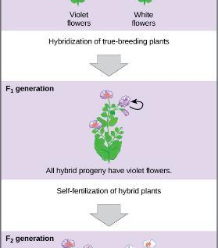
Mendel’s experiments
Mendel’s Pea Plants
P = parental generation
F1 = first filial generation; offspring resulting from crossing P generation
F2 = second filial generation; offspring resulting from self-pollination of F1 generation
Mendel’s process for performing crosses included examining flower color.

Slide 7
8.1 Mendel’s experiments
Mendel studied 7 traits
Trait - a variation in an inherited characteristic
Examined:
Plant height
Seed texture
Seed color
Flower color
Flower position
Pea-pod size
Pea-pod color
Generated large numbers of plants to give results statistical power
Confirmed true-breeding by allowing self pollination for several generations before performing crosses

Slide 8
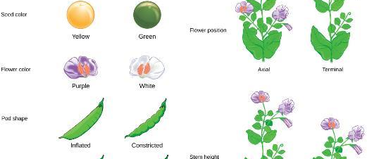
Figure 8.4
Mendel identified seven pea plant characteristics.

Slide 9
8.1 Mendel’s experiments
Mendel was able to characterize his traits based on his results
Dominant - describes a trait that masks the expression of another trait when both versions of the gene are present in an individual
Recessive - describes a trait whose expression is masked by another trait when the alleles for both traits are present in an individual
Demonstrated that traits were not blended
Hypothesized that this was due to plants inheriting 2 copies of trait, or “factors” that govern trait
A plant with a dominant trait could have 2 copies of dominant factor, on one dominant copy and one recessive copy
A plant with a recessive trait could only have 2 copies of recessive factor

Slide 10
8.2 Laws of inheritance
Learning Outcomes:
Explain the relationship between genotypes and phenotypes in dominant and recessive gene systems
Use a Punnett square to calculate the expected proportions of genotypes and phenotypes in a monohybrid cross
Explain Mendel’s law of segregation and independent assortment in terms of genetics and the events of meiosis
Explain the purpose and methods of a test cross

Slide 11
8.2 Laws of inheritance
In a diploid organism, for traits controlled by a single gene, there are two copies of each gene
Allele - one of two or more variants of a gene that determines a particular trait for a characteristic
Phenotype - the observable traits expressed by an organism
Genotype - the underlying genetic makeup, consisting of both physically visible and non-expressed alleles, of an organism
One copy of gene is dominant over the other
Example: seed color – in P generation, one parent plant had yellow (dominant) and one had green (recessive)
In the F1, all had one of each allele, but seed were all yellow b/c it is the dominant allele
Crossing F1 revealed that they had 2 copies, because the recessive reappears

Slide 12
8.2 Laws of inheritance
P generation is homozygous for each trait
Homozygous - having two identical alleles for a given gene on the homologous chromosomes
Heterozygous - having two different alleles for a given gene on the homologous chromosomes
Dominant allele is represented as a capital letter, recessive as a lower-case letter
Law of Dominance - in a heterozygote, one trait will conceal the presence of another trait for the same characteristic

Slide 13
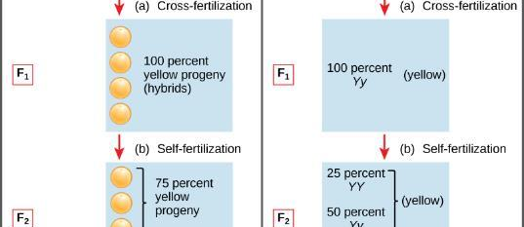
Figure 8.5
Phenotypes are physical expressions of traits that are transmitted by alleles. Capital letters represent dominant alleles and lowercase letters represent recessive alleles. The phenotypic ratios are the ratios of visible characteristics. The genotypic ratios are the ratios of gene combinations in the offspring, and these are not always distinguishable in the phenotypes.

Slide 14
8.2 Laws of inheritance Table 8.1
Correspondence between Genotype and Phenotype for a Dominant-Recessive Characteristic.
 | Homozygous | Heterozygous | Homozygous
Genotype | YY | Yy | yy
Phenotype | Yellow | Yellow | Green

Slide 15
8.2 Laws of inheritance
Monohybrid cross - the result of a cross between two true-breeding parents that express different traits for only one characteristic
Mendel’s crosses involved 1 trait governed by Law of Dominance
P generation were homozygous, F1 were heterozygous, and F2 were homozygous dominant, heterozygous, and homozygous recessive with a 1:2:1 genotypic ratio and a 3:1 phenotypic ratio of dominant:recessive

Slide 16
8.2 Laws of inheritance
Punnet square - a visual representation of a cross between two individuals in which the gametes of each individual are denoted along the top and side of a grid, respectively, and the possible zygotic genotypes are recombined at each box in the grid
Example: Cross two organisms that are heterozygous for purple flowers (Pp)
 | P | p
P | PP | Pp
p | Pp | pp
One parent
Other parent

Slide 17
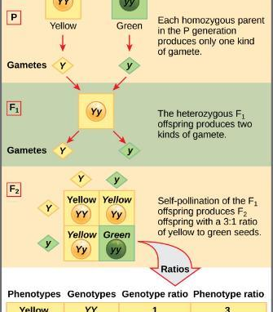
Figure 8.9
This Punnett square shows the cross between plants with yellow seeds and green seeds. The cross between the true-breeding P plants produces F₁ heterozygotes that can be self-fertilized. The self-cross of the F₁ generation can be analyzed with a Punnett square to predict the genotypes of the F₂ generation. Given an inheritance pattern of dominant–recessive, the genotypic and phenotypic ratios can then be determined.

Slide 18
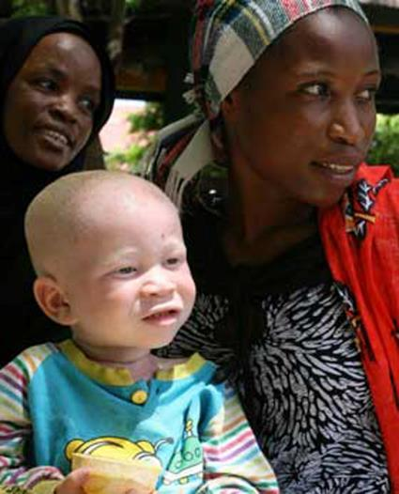
Figure 8.6
The allele for albinism, expressed here in humans, is recessive. Both of this child’s parents carried the recessive allele.

Slide 19
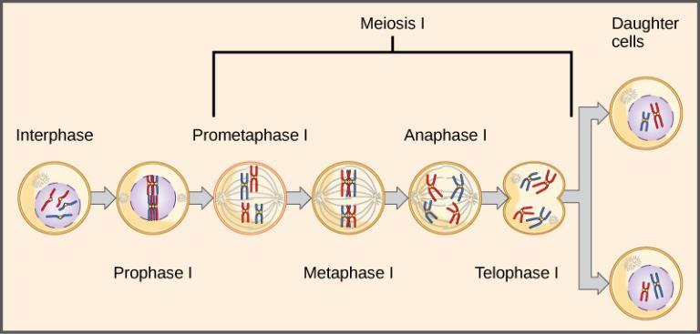
Figure 8.7
The first division in meiosis is shown.
Law of Segregation - paired unit factors (i.e., genes) segregate equally into gametes such that offspring have an equal likelihood of inheriting any combination of factors

Slide 20
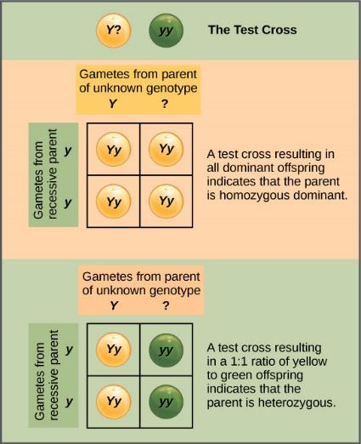
Figure 8.8
To determine whether a parent is homozygous or heterozygous, perform a test cross
Test cross - a cross between a dominant expressing individual with an unknown genotype and a homozygous recessive individual; the offspring phenotypes indicate whether the unknown parent is heterozygous or homozygous for the dominant trait
A test cross can be performed to determine whether an organism expressing a dominant trait is a homozygote or a heterozygote.

Slide 21
8.2 Laws of inheritance
Law of Independent Assortment - genes do not influence each other with regard to sorting of alleles into gametes; every possible combination of alleles is equally likely to occur
Dihybrid - the result of a cross between two true-breeding parents that express different traits for two characteristics
Inheritance of one allele doesn’t affect inheritance of another allele

Slide 22
Figure 8.10
A dihybrid cross in pea plants involves the genes for seed color and texture. The P cross produces F₁ offspring that are all heterozygous for both characteristics. The resulting 9:3:3:1 F₂ phenotypic ratio is obtained using a Punnett square.

Slide 23
Figure 8.11
The random segregation into daughter nuclei that happens during the first division in meiosis can lead to a variety of possible genetic arrangements.

Slide 24
8.3 Extensions of the Laws of Inheritance
Learning Outcomes
Identify non-Mendelian inheritance patterns such as incomplete dominance, codominance, multiple alleles, and sex linkage from the results of crosses
Explain the effect of linkage and recombination on gamete genotypes
Explain the phenotypic outcomes of epistatic effects among genes

Slide 25
8.3 Extensions of the Laws of Inheritance
Not all traits are governed by a recessive/dominant allele pair
Mendel’s work suggested that:
Two types of “units” or alleles exist for every gene
Alleles maintain integrity in each generation
In the presence of the dominant allele, the recessive allele is hidden, with no contribution to the phenotype
Heterozygotes are sometimes called “carriers” because they carry the unexpressed recessive allele

Slide 26
8.3 Extensions of the Laws of Inheritance
Incomplete dominance - in a heterozygote, expression of two contrasting alleles such that the individual displays an intermediate phenotype
Heterozygote has a phenotype where both alleles are expressed
Genotypic ratio and phenotypic ratio are the same
Example: snapdragons – red flowers (C^{R}C^{R}) are incompletely dominant to white flowers (C^{W}C^{W})
Heterozygote (C^{R}C^{W}) is pink
Genotypic and phenotypic ratio from cross of 2 heterozygotes is 1:2:1 C^{R}C^{R}: C^{R}C^{W}: C^{W}C^{W} or red:pink:white

Slide 27
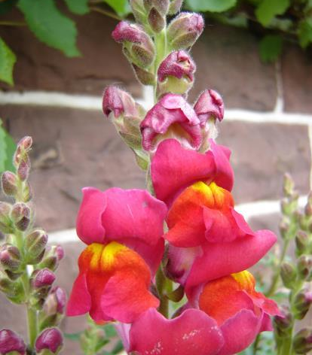
Figure 8.12
These pink flowers of a heterozygote snapdragon result from incomplete dominance. (credit: “storebukkebruse”/Flickr)

Slide 28
8.3 Extensions of the Laws of Inheritance
Codominance - in a heterozygote, complete and simultaneous expression of both alleles for the same characteristic
Both alleles are expressed in the heterozygote
Example: human blood group types

Slide 29
Figure 8.13
This Punnet square shows an AB/AB blood type cross

Slide 30
8.3 Extensions of the Laws of Inheritance
Multiple alleles – can have more than 2 variants of a gene in a population
Wild type - the most commonly occurring genotype or phenotype for a given characteristic found in a population
Example: ABO blood types
3 alleles in the population
IA = A antigen on red blood cells
IB = B antigen on red blood cells
i = no antigen - recessive
Codominant

Slide 31
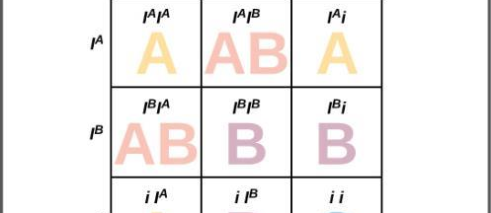
Figure 8.14
Inheritance of the ABO blood system in humans is shown.
.

Slide 32
8.3 Extensions of the Laws of Inheritance
Sex-linked traits – alleles found on X-chromosome
X-linked - a gene present on the X chromosome, but not the Y chromosome
Women are XX, so 2 alleles for each trait
Men are XY, so only have 1 allele for each trait
Hemizygous - the presence of only one allele for a characteristic, as in X-linkage; hemizygosity makes descriptions of dominance and recessiveness irrelevant

Slide 33
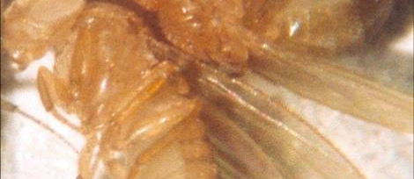
Figure 8.15
In Drosophila, the gene for eye color is located on the X chromosome. Red eye color is wild-type and is dominant to white eye color.

Slide 34
Figure 8.16
Crosses involving sex-linked traits often give rise to different phenotypes for the different sexes of offspring, as is the case for this cross involving red and white eye color in Drosophila. In the diagram, w is the white-eye mutant allele and W is the wild-type, red-eye allele.

Slide 35
8.3 Extensions of the Laws of Inheritance
Linkage - a phenomenon in which alleles that are located in close proximity to each other on the same chromosome are more likely to be inherited together
Not all alleles are inherited independently
Crossing over can disrupt linkage, but genes that are physically close together on a chromosome tend to be inherited together
Recombination - the process during meiosis in which homologous chromosomes exchange linear segments of genetic material, thereby dramatically increasing genetic variation in the offspring and separating linked genes

Slide 36
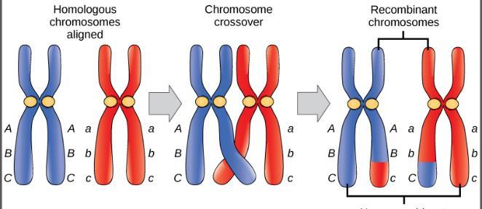
Figure 8.17
The process of crossover, or recombination, occurs when two homologous chromosomes align and exchange a segment of genetic material.

Slide 37
8.3 Extensions of the Laws of Inheritance
Most physical characteristics are controlled by multipe genes
Example: eye color – 8 genes involved
Many may act sequentially, or function in a complementary or synergistic fashion
Can also oppose one another to cancel out a given effect
Epistasis - an interaction between genes such that one gene masks or interferes with the expression of another
Example – pigmentation in mice
WT (agouti, AA) is dominant to solid color (aa)
Gene C, when homozygous recessive (cc) negates A, so mice are albino

Slide 38
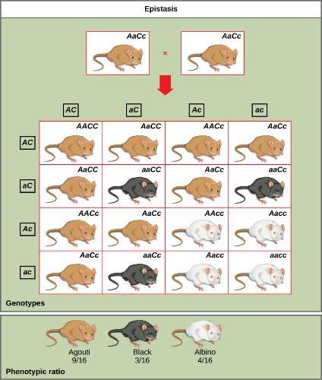
Figure 8.18
Aacc, Aacc, and aacc are all albino as well
Crossing AaCc to AaCc gives 9 agouti, 3 black, 4 albino
C is epistatic to A
In this example of epistasis, one gene (C) masks the expression of another (A) for coat color. When the C allele is present, coat color is expressed; when it is absent (cc), no coat color is expressed. Coat color depends on the A gene, which shows dominance, with the recessive homozygote showing a different phenotype than the heterozygote or dominant homozygote.

Slide 39
8.3 Extensions of the Laws of Inheritance
Historical Perspective –
https://en.wikipedia.org/wiki/Gregor_Mendel
Critical Thinking - Could an individual with blood type O (genotype ii) be a legitimate child of parents in which one parent had blood type A and the other parent had blood type B?

