Slide 1
BIOL 1010 Module 6
OpenStax
Concepts of Biology
Chapter 6: Reproduction at the Cellular Level

Slide 2
Figure 6.1
Section 6.1 The Genome
Learning Outcomes:
Describe the prokaryotic and eukaryotic genome
Distinguish between chromosomes, genes, and traits
A sea urchin begins life as a single cell that (a) divides to form two cells, visible by scanning electron microscopy. After four rounds of cell division, (b) there are 16 cells, as seen in this SEM image. After many rounds of cell division, the individual develops into a complex, multicellular organism, as seen in this (c) mature sea urchin. (credit a: modification of work by Evelyn Spiegel, Louisa Howard; credit b: modification of work by Evelyn Spiegel, Louisa Howard; credit c: modification of work by Marco Busdraghi; scale-bar data from Matt Russell)

Slide 3
6.1 The Genome
Genome – a cell’s complete complement of DNA
Prokaryotes – single, circular DNA molecule
No nucleus, but found in an area known as the nucleoid
Eukaryotes – 2 or more linear DNA molecules with associated proteins
Chromosomes – DNA molceules and associated proteins organized into compacted structures
Humans have 46

Slide 4
6.1 The Genome
Chromosomes
Exist in matched pairs
Diploid – 2n – where each cell has a pair of chromosomes carrying information about the same genetic traits
Haploid – n – a single set of chromosomes
Somatic cells – cells of the body that are diploid
Gametes – sex cells that are haploid (egg and sperm in humans)

Slide 5
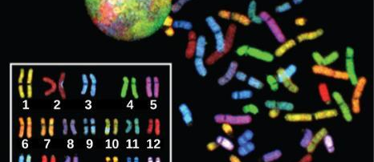
Figure 6.2 – human karyotype
There are 23 pairs of homologous chromosomes in a female human somatic cell. These chromosomes are viewed within the nucleus (top), removed from a cell in mitosis (right), and arranged according to length (left) in an arrangement called a karyotype. In this image, the chromosomes were exposed to fluorescent stains to distinguish them. (credit: “718 Bot”/Wikimedia Commons, National Human Genome Research)

Slide 6
6.1 The Genome
Chromosomes
Homologous chromosomes – chromosomes similar in size and position of centromere carrying information about the same genetic traits
Genes – functional units of chromosomes that code for specific proteins
Locus – the location of a gene on a chromosome
Traits – characteristics
One of each of the homologous chromosomes comes from each parent, so information on the chromosomes is not identical

Slide 7
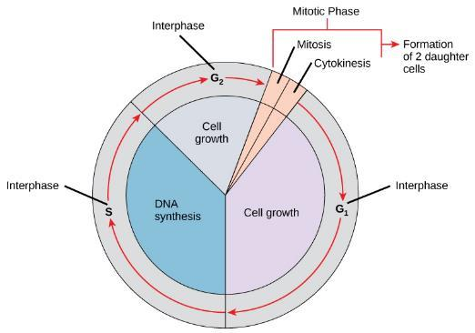
6.2 The cell cycle Figure 6.3
Learning Outcomes:
Describe the three stages of interphase
Discuss the behavior of chromosomes during mitosis and how the cytoplasmic content divides during cytokinesis
Define the quiescent G₀ phase
Explain how the three internal control checkpoints occur at the end of G₁, at the G₂–M transition, and during metaphase
A cell moves through a series of phases in an orderly manner. During interphase, G₁ involves cell growth and protein synthesis, the S phase involves DNA replication and the replication of the centrosome, and G₂ involves further growth and protein synthesis. The mitotic phase follows interphase. Mitosis is nuclear division during which duplicated chromosomes are segregated and distributed into daughter nuclei. Usually the cell will divide after mitosis in a process called cytokinesis in which the cytoplasm is divided and two daughter cells are formed.

Slide 8
6.2 The cell cycle
Cell cycle – the ordered sequence of events that a cell passes through between one cell division and the next
Carefully regulated series of events involving DNA replication and production of 2 genetically identical daughter cells from a single cells
2 phases:
Interphase – cell growth and DNA replication
M phase – mitotic phase – division of chromosomes (mitosis) and cell contents (cytokinesis)

Slide 9
6.2 The cell cycle
Interphase
G1 (Gap 1) – cell is biochemically active, synthesizing molecules needed for DNA replication and storing energy
S (synthesis) – production of 2 identical copies of chromosomes, joined at a condensed region (centromere)
Sister chromatids – identical copies of chromosomes
Also have duplication of centrosome and structures involved in separating chromosomes during mitosis
G2 (Gap 2) – synthesis of proteins for chromosome and cell division, replenish energy stores, duplication of organelles, disassembly of cytoskeleton

Slide 10
6.2 The cell cycle
M phase
2 parts
Mitosis – division of nuclear contents involving alignment and equal division of chromosomes
Cytokinesis – division of cytoplasm
Mitosis - the period of the cell cycle at which the duplicated chromosomes are separated into identical nuclei; includes prophase, prometaphase, metaphase, anaphase, and telophase
5 phases – Prophase, Prometaphase, Metaphase, Anaphase, Telophase

Slide 11
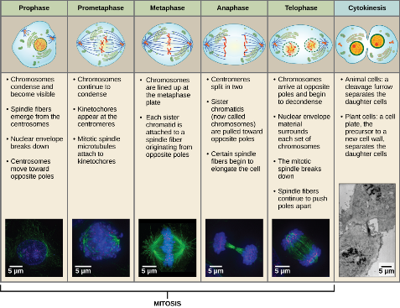
Figure 6.4
Animal cell mitosis is divided into five stages—prophase, prometaphase, metaphase, anaphase, and telophase—visualized here by light microscopy with fluorescence. Mitosis is usually accompanied by cytokinesis, shown here by a transmission electron microscope. (credit “diagrams”: modification of work by Mariana Ruiz Villareal; credit “mitosis micrographs”: modification of work by Roy van Heesbeen; credit “cytokinesis micrograph”: modification of work by the Wadsworth Center, NY State Department of Health; donated to the Wikimedia foundation; scale-bar data from Matt Russell)

Slide 12
6.2 The cell cycle
Mitosis
Prophase - the stage of mitosis during which chromosomes condense and the mitotic spindle begins to form
Nuclear envelope breaks down
Golgi and Endoplasmic Reticulum fragment
Nucleolus disappears
Chromosomes condense to visible structures under light miscroscope
Centrosomes move to opposite poles of cell
sources.

Slide 13
6.2 The cell cycle
Mitosis
Prometaphase - the stage of mitosis during which mitotic spindle fibers attach to kinetochores
Nuclear envelop breaks down
Spindle fibers (microtubules) extend from centrosome and attach to each chromosome at the centromere via the kinetochore
Kinetochore - a protein structure in the centromere of each sister chromatid that attracts and binds spindle microtubules during prometaphase

Slide 14
6.2 The cell cycle
Mitosis
Metaphase - the stage of mitosis during which chromosomes are lined up at the metaphase plate
Chromosomes align at cell equator, or metaphase plate
Metaphase plate - the equatorial plane midway between two poles of a cell where the chromosomes align during metaphase

Slide 15
6.2 The cell cycle
Mitosis
Anaphase - the stage of mitosis during which sister chromatids are separated from each other
Chromosomes are pushed and pulled apart by kinetochore microtubules at the centromere and travel to opposite poles of the cell
Cell elongates as spindle microtubules push centrosomes apart

Slide 16
6.2 The cell cycle
Mitosis
Telophase - the stage of mitosis during which chromosomes arrive at opposite poles, decondense, and are surrounded by new nuclear envelopes
Chromosomes arrive at opposite poles of the cell and decondense
Mitotic spindle breaks down
New nuclear envelope forms

Slide 17
6.2 The cell cycle
Mitosis
http://labs.bio.unc.edu/Salmon/mitosis/mitosismovies.html

Slide 18
6.2 The cell cycle
Cytokinesis - the division of the cytoplasm following mitosis to form two daughter cells
Different in eukaryotes depending on the presence of a cell wall
In cells with no cell walls:
Begins during anaphase
A contractile ring of actin forms around the cell at the metaphase plate
As the ring contracts, it forms an indentiation that eventually pinches off to form 2 new cells
Cleavage furrow - a constriction formed by the actin ring during animal-cell cytokinesis that leads to cytoplasmic division

Slide 19
Figure 6.5
In part (a), a cleavage furrow forms at the former metaphase plate in the animal cell. The plasma membrane is drawn in by a ring of actin fibers contracting just inside the membrane. The cleavage furrow deepens until the cells are pinched in two. In part (b), Golgi vesicles coalesce at the former metaphase plate in a plant cell. The vesicles fuse and form the cell plate. The cell plate grows from the center toward the cell walls. New cell walls are made from the vesicle contents.

Slide 20
6.2 The cell cycle
In cells with cell walls (plant cells), a cleavage furrow cannot form because of the rigidity of the cell wall
In interphase, the Golgi fragments and vesicles move to the sides of the cell
In telophase, Golgi vesicles collect at the metaphase plate and fuse from the center of the cell to the cell walls, forming the cell plate
Cell plate - a structure formed during plant-cell cytokinesis by Golgi vesicles fusing at the metaphase plate; will ultimately lead to formation of a cell wall to separate the two daughter cells
New cell wall is formed from glucose accumulated during interphase (cellulose) and membranes form new cell wall

Slide 21
6.2 The cell cycle
Not all cells divide
Most somatic cells do not divide
Arrest in G1, exiting the cell cycle
Termed G0
G0 - a cell-cycle phase distinct from the G₁ phase of interphase; a cell in G₀ is not preparing to divide

Slide 22
Figure 6.6
Cells that are not actively preparing to divide enter an alternate phase called G₀. In some cases, this is a temporary condition until triggered to enter G₁. In other cases, the cell will remain in G₀ permanently.

Slide 23
6.2 The cell cycle
Control of the cell cycle
Rate varies with developmental stage and cell type
Embryonic cells ≈ 2 hours
Epithelial cells ≈ 2 – 5 days
Some never
Also varies in length of time spent in cell cycle

Slide 24
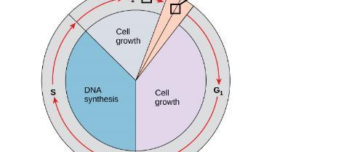
Figure 6.7
The cell cycle is controlled at three checkpoints. Integrity of the DNA is assessed at the G₁ checkpoint. Proper chromosome duplication is assessed at the G₂ checkpoint. Attachment of each kinetochore to a spindle fiber is assessed at the M checkpoint.

Slide 25
6.2 The cell cycle
Regulation of the cell cycle
In order to ensure exact genetic copies and identical cells, the cycle must be regulated
Cell cycle checkpoints - mechanisms that monitor the preparedness of a eukaryotic cell to advance through the various cell cycle stages

Slide 26
6.2 The cell cycle
Cell Cycle Checkpoints
G1 checkpoint (restriction point) – determines whether a cell can progress to S phase
After passing, a cell is committed to division
Assesses energy reserves, cell size, and DNA damage
G2-M checkpoint – stops entry into M phase
Assesses cell size and protein reserves
Ensures replication of chromosomes and no damage to DNA
M checkpoint – at the end of metaphase (spindle checkpoint)
Assesses whether chromosomes are correctly attached to spindle
https://www.youtube.com/watch?v=f-ldPgEfAHI

Slide 27
6.3 Cancer and the cell cycle
Learning Outcomes:
Explain how cancer is caused by uncontrolled cell division
Understand how proto-oncogenes are normal cell genes that, when mutated, become oncogenes
Describe how tumor suppressors function to stop the cell cycle until certain events are completed
Explain how mutant tumor suppressors cause cancer

Slide 28
6.3 Cancer and the cell cycle
Cancer – a set of diseases caused by uncontrolled cell division
Despite checkpoints, some replication errors (mutations) occur and are passed on
Mutations that occur in genes can lead to mutant proteins that may cause cancer
Can have a snowball effect, where one mutation can affect checkpoints leading to more mutations being perpetuated
Can affect pace of cell cycle and overcome regulation

Slide 29
6.3 Cancer and the cell cycle
Proto-oncogenes
Proto-oncogenes - a normal gene that controls cell division by regulating the cell cycle that becomes an oncogene if it is mutated
Oncogene - a mutated version of a proto-oncogene, which allows for uncontrolled progression of the cell cycle, or uncontrolled cell reproduction
Mutation usually results in less functional protein that may not be perpetuated (cell cannot divide)
If gene increases activity of a positive regulator of the cell cycle, it can overcome checkpoints
.

Slide 30
6.3 Cancer and the cell cycle
Tumor Suppressor Genes
Tumor Suppressor Gene - a gene that codes for regulator proteins that prevent the cell from undergoing uncontrolled division
Stop progression through the cell cycle
Example: p53
This regulator is mutated in more than half of all human tumors
Plays a role in the G1 checkpoint, initiating the process to halt the cell cycle, allowing time for DNA repair or to initiate cell death if DNA cannot be repaired

Slide 31
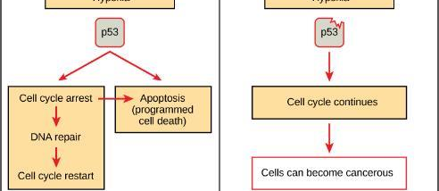
Figure 6.8
The role of p53 is to monitor DNA. If damage is detected, p53 triggers repair mechanisms. If repairs are unsuccessful, p53 signals apoptosis.
A cell with an abnormal p53 protein cannot repair damaged DNA and cannot signal apoptosis. Cells with abnormal p53 can become cancerous. (credit: modification of work by Thierry Soussi)

Slide 32
6.4 The Prokaryotic cell cycle
Learning Outcomes:
Describe the process of binary fission in prokaryotes
Explain how FtsZ and tubulin proteins are examples of homology

Slide 33
6.4 The Prokaryotic cell cycle
Binary fission - the process of prokaryotic cell division
Prokaryotes have a single circular chromosome, so mitosis is not required
Process is much less complicated and quicker, allowing bacteria to grow more quickly than eukaryotic cells
]

Slide 34
6.4 The Prokaryotic cell cycle
DNA replication begins at a single point in the chromosome
Origin (of replication) - the region of the prokaryotic chromosome at which replication begins
Replication occurs in both directions simultaneously and new chrromosomes are separated via attachments to the cell wall in enlongating cell
After chromosomes clear the midpoint, division of cytoplasm begins with septum formation
Septum - a wall formed between bacterial daughter cells as a precursor to cell separation
]

Slide 35
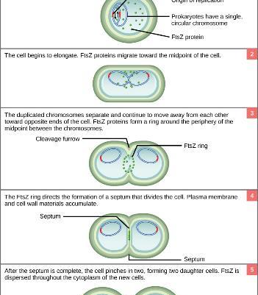
Figure 6.9
The binary fission of a bacterium is outlined in five steps. (credit: modification of work by “Mcstrother”/Wikimedia Commons)
]

Slide 36
6.4 The Prokaryotic cell cycle Table 6.1
Structure of genetic material
Division of nuclear material
Separation of daughter cells
Prokaryotes | There is no nucleus. The single, circular chromosome exists in a region of cytoplasm called the nucleoid. | Occurs through binary fission. As the chromosome is replicated, the two copies move to opposite ends of the cell by an unknown mechanism. | FtsZ proteins assemble into a ring that pinches the cell in two.
Some protists | Linear chromosomes exist in the nucleus. | Chromosomes attach to the nuclear envelope, which remains intact. The mitotic spindle passes through the envelope and elongates the cell. No centrioles exist. | Microfilaments form a cleavage furrow that pinches the cell in two.
Other protists | Linear chromosomes exist in the nucleus. | A mitotic spindle forms from the centrioles and passes through the nuclear membrane, which remains intact. Chromosomes attach to the mitotic spindle. The mitotic spindle separates the chromosomes and elongates the cell. | Microfilaments form a cleavage furrow that pinches the cell in two.
Animal cells | Linear chromosomes exist in the nucleus. | A mitotic spindle forms from the centrioles. The nuclear envelope dissolves. Chromosomes attach to the mitotic spindle, which separates them and elongates the cell. | Microfilaments form a cleavage furrow that pinches the cell in two.

Slide 37
6.4 The Prokaryotic cell cycle
Historical Perspectives
https://en.wikipedia.org/wiki/Walther_Flemming
Critical thinking - Describe the similarities and differences between the cytokinesis mechanisms found in animal cells versus those in plant cells.

