Slide 1
BIOL 1010 Module 5
OpenStax
Biology 2e
Chapter 5: Structure and Function of Plasma Membranes

Slide 2
Fluid Mosaic Model
The fluid mosaic model describes the plasma membrane structure as a mosaic of components—including phospholipids, cholesterol, proteins, and carbohydrates—that gives the membrane a fluid character.
Plasma membranes range from 5 to 10 nm in thickness.
A plasma membrane's principal components are lipids (phospholipids and cholesterol), proteins, and carbohydrates attached to some of the lipids and proteins.
Protein, lipid, and carbohydrate proportions in the plasma membrane vary with cell type, but for a typical human cell, protein accounts for about 50 percent of the composition by mass, lipids (of all types) account for about 40 percent, and carbohydrates comprise the remaining 10 percent.
Carbohydrates are present only on the plasma membrane's exterior surface and are attached to proteins, forming glycoproteins, or attached to lipids, forming glycolipids.

Slide 3
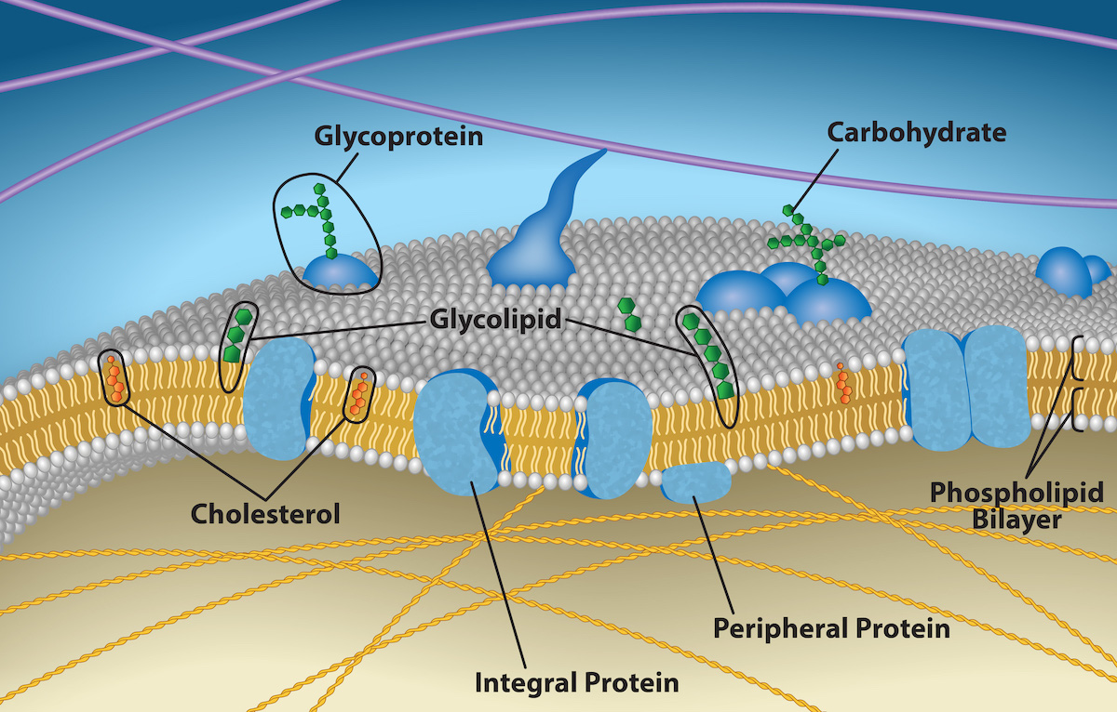

Slide 4
Membrane Proteins
Integral proteins, or integrins, as their name suggests, integrate completely into the membrane structure, and their hydrophobic membrane-spanning regions interact with the phospholipid bilayer's hydrophobic region.
Single-pass integral membrane proteins usually have a hydrophobic transmembrane segment that consists of 20–25 amino acids and span only part of the membrane—associating with a single layer—while others stretch from one side to the other.
Multiple-pass protein types have hydrophilic regions oriented protein's hydrophobic region adjacent to the phospholipids' tails and the protein's hydrophilic region or regions protruding from the membrane and in contact with the cytosol or extracellular fluid.
Peripheral proteins are on the membranes' exterior and interior surfaces, attached either to integral proteins or to phospholipids.
Peripheral proteins, along with integral proteins, may serve as enzymes, as structural attachments for the cytoskeleton's fibers, or as part of the cell’s recognition sites.

Slide 5
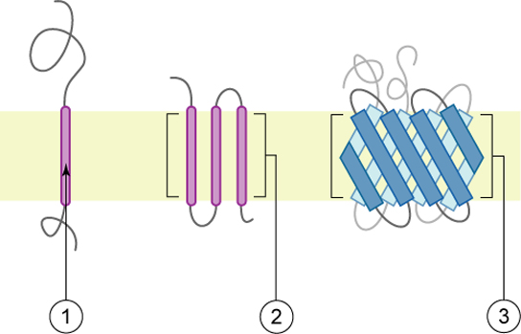

Slide 6
Carbohydrates
Carbohydrates are are always present on the cells' exterior surface and are bound either to proteins (forming glycoproteins) or to lipids (forming glycolipids).
These carbohydrate chains may consist of 2–60 monosaccharide units and can be either straight or branched.
Carbohydrates form specialized sites on the cell surface that allow cells to recognize each other by forming unique patterns that allow for cell recognition, much the way that the facial features unique to each person allow individuals to recognize him or her.
Carbohydrates allow the immune system to differentiate between body cells (“self”) and foreign cells or tissues (“non-self”).
Glycoprotein and glycolipid types are on the surfaces of viruses and may change frequently, preventing immune cells from recognizing and attacking them.
We collectively refer to these carbohydrates on the cell's exterior surface as the glycocalyx (meaning “sugar coating”).
The glycocalyx is highly hydrophilic and attracts large amounts of water to the cell's surface.
The glycocalyx aids in the cell's interaction with its watery environment and in the cell’s ability to obtain substances dissolved in the water.

Slide 7
Membrane Fluidity
Integral proteins and lipids exist in the membrane as separate but loosely attached molecules.
These resemble the separate, multicolored tiles of a mosaic picture, and they float, moving somewhat with respect to one another.
The membrane is fairly rigid and can burst if penetrated or if a cell takes in too much water.
A very fine needle can easily penetrate a plasma membrane without causing it to burst, and the membrane will flow and self-seal when one extracts the needle.

Slide 8
Membrane Fluidity
Saturated fatty acids with straight tails make a dense and fairly rigid membrane.
Unsaturated fatty acids with “kinks” in their tails elbow adjacent phospholipid molecules away, maintaining some space between the phospholipid molecules creating a less compact membrane environment.
Cholesterol (in animals) intercalates alongside the phospholipids in the membrane and tends to dampen temperature effects on the membrane.
Cholesterol extends the temperature range in which the membrane is appropriately fluid and consequently functional.
Cholesterol also serves other functions, such as organizing clusters of transmembrane proteins into lipid rafts.

Slide 9
Membrane Permeability
Plasma membranes are selectively permeable—they allow some substances to pass through, but not others. If they were to lose this selectivity, the cell would no longer be able to sustain itself, and it would be destroyed.
Important substances require hydrolyzing adenosine triphosphate (ATP) to transport these materials.
Most cells spend most of their energy maintaining an imbalance of sodium and potassium ions between the cell's interior and exterior and protein synthesis.
Passive transport is a naturally occurring phenomenon and does not require the cell to exert any of its energy to accomplish the movement.
In passive transport, substances move from an area of higher concentration to an area of lower concentration moving down their concentration gradient.

Slide 10
Selective Permeability
The hydrophilic and hydrophobic regions helps move some materials through the membrane and hinders the movement of others.
Non-polar and lipid-soluble material with a low molecular weight can easily slip through the membrane's hydrophobic lipid core.
Substances such as the fat-soluble vitamins A, D, E, and K readily pass through the plasma membranes in the digestive tract and other tissues. Fat-soluble drugs and hormones also gain easy entry into cells and readily transport themselves into the body’s tissues and organs.
Oxygen and carbon dioxide molecules have no charge and pass through membranes by simple diffusion.

Slide 11
Selective Permeability
Polar substances present problems for the membrane.
Some polar molecules connect easily with the cell's outside but cannot readily pass through the plasma membrane's lipid core.
Small ions could easily slip through the spaces in the membrane's mosaic, their charge prevents them from doing so.
Ions such as sodium, potassium, calcium, and chloride must have special means of penetrating plasma membranes.
Simple sugars and amino acids also need the help of various transmembrane proteins (channels) to transport themselves across plasma membranes.

Slide 12
Diffusion
Diffusion is a passive process of solute transport.
A single substance moves from a high concentration to a low concentration area until the concentration is equal across a space.
Diffusion expends no energy.
Concentration gradients are a form of potential energy, which dissipates as the gradient is eliminated.
Each separate substance in a medium has its own concentration gradient, independent of another material’s concentration gradient.

Slide 13
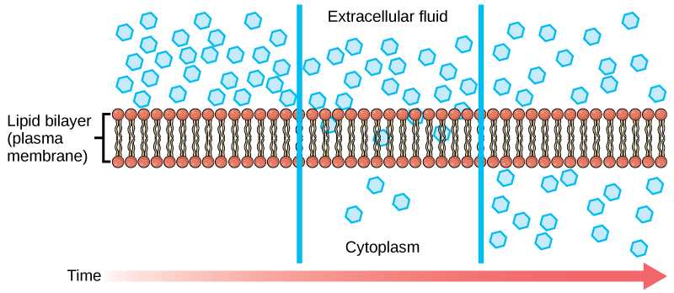

Slide 14
Factors Affecting Diffusion
Extent of the concentration gradient
Mass of the molecules diffusing
Temperature
Solvent density
Solubility
Surface area and plasma membrane thickness
Distance travelled

Slide 15
Facilitated Transport
In facilitated transport, or facilitated diffusion, materials diffuse across the plasma membrane with the help of membrane proteins.
A concentration gradient exists that would allow these materials to diffuse into the cell without expending cellular energy.
Facilitated transport proteins shield polar molecules from the membrane’s repulsive hydrophobic force, allowing them to diffuse into the cell.
The transported material first attaches to protein or glycoprotein receptors on the plasma membrane's exterior surface.
The substances then pass to specific integral proteins that facilitate their passage.

Slide 16
Channel Proteins
Some integral proteins are collections of beta-pleated sheets that form a pore or channel through the phospholipid bilayer.
Channels are specific for the transported substance and have a hydrophilic channel through their core that provides a hydrated opening through the membrane layers.
Passage through the channel allows polar compounds to avoid the plasma membrane's nonpolar central layer that would otherwise slow or prevent their entry into the cell.
Aquaporins are channel proteins that allow water to pass through the membrane at a very high rate.
Channel proteins are either open at all times or they are “gated,” which controls the channel's opening.
When a particular ion attaches to the channel protein it may control the opening, or other mechanisms or substances may be involved.

Slide 17
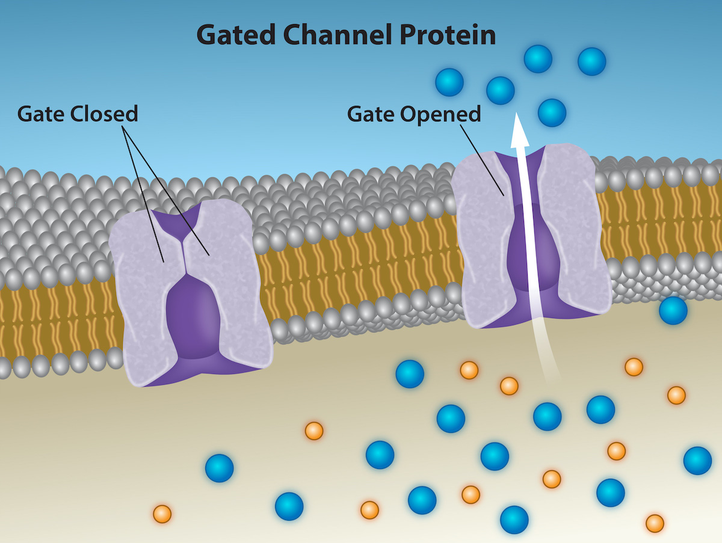

Slide 18
Carrier Proteins
A Carrier protein binds a substance and triggers a change of its own shape, moving the bound molecule from the cell's outside to its interior.
Depending on the gradient, the material may move in the opposite direction.
Carrier proteins are typically specific for a single substance.
When all of the proteins are bound to their ligands, they are saturated and the rate of transport is at its maximum. Increasing the concentration gradient at this point will not result in an increased transport rate.
Channel and carrier proteins transport material at different rates.
Channel proteins transport much more quickly than carrier proteins.

Slide 19
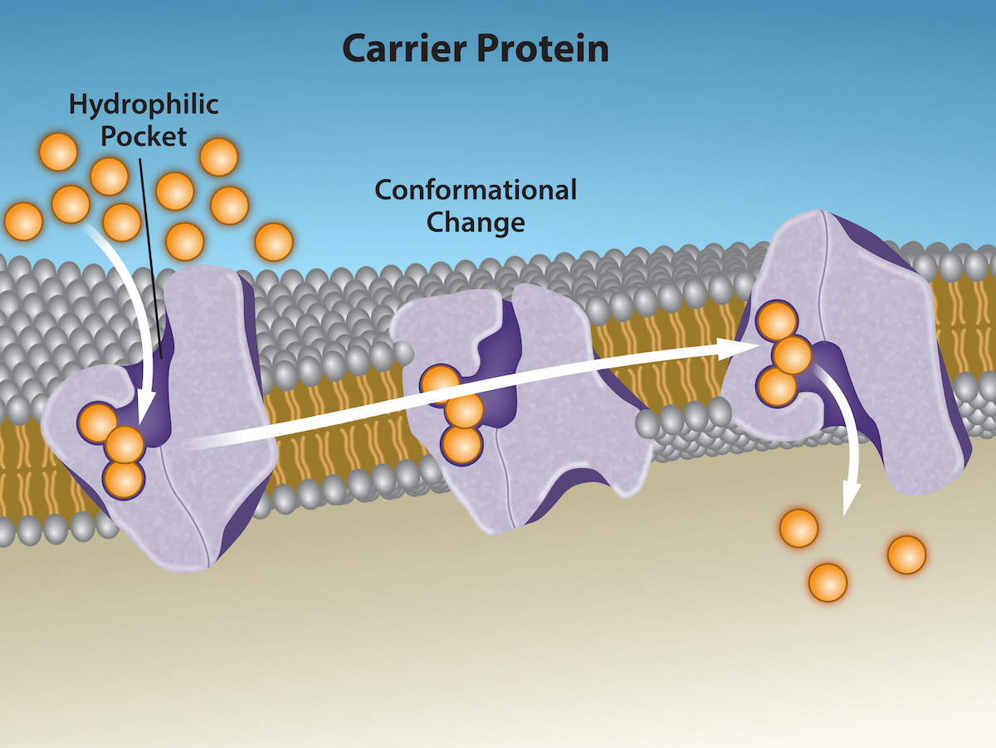

Slide 20
Osmosis
Osmosis is the movement of free water molecules through a semipermeable membrane according to the water's concentration gradient across the membrane, which is inversely proportional to the solutes' concentration.
Osmosis transports only water across a membrane and the membrane limits the solutes' diffusion in the water.
Osmosis is a special case of diffusion.
Water, like other substances, moves from an area of high concentration of free water molecules to one of low free water molecule concentration.

Slide 21
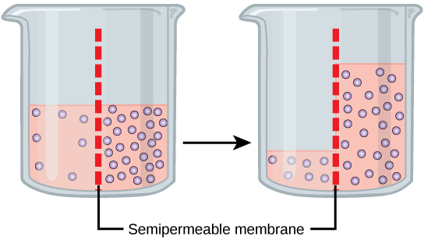

Slide 22
Tonicity
Tonicity describes how an extracellular solution can change a cell's volume by affecting osmosis.
Osmolarity describes the solution's total solute concentration.
A solution with low osmolarity has a greater number of water molecules relative to the number of solute particles.
A solution with high osmolarity has fewer water molecules with respect to solute particles.
For a membrane permeable to water only, watermolecules will move from the membrane's side with lower osmolarity (and more water) to the side with higher osmolarity (and less water).

Slide 23
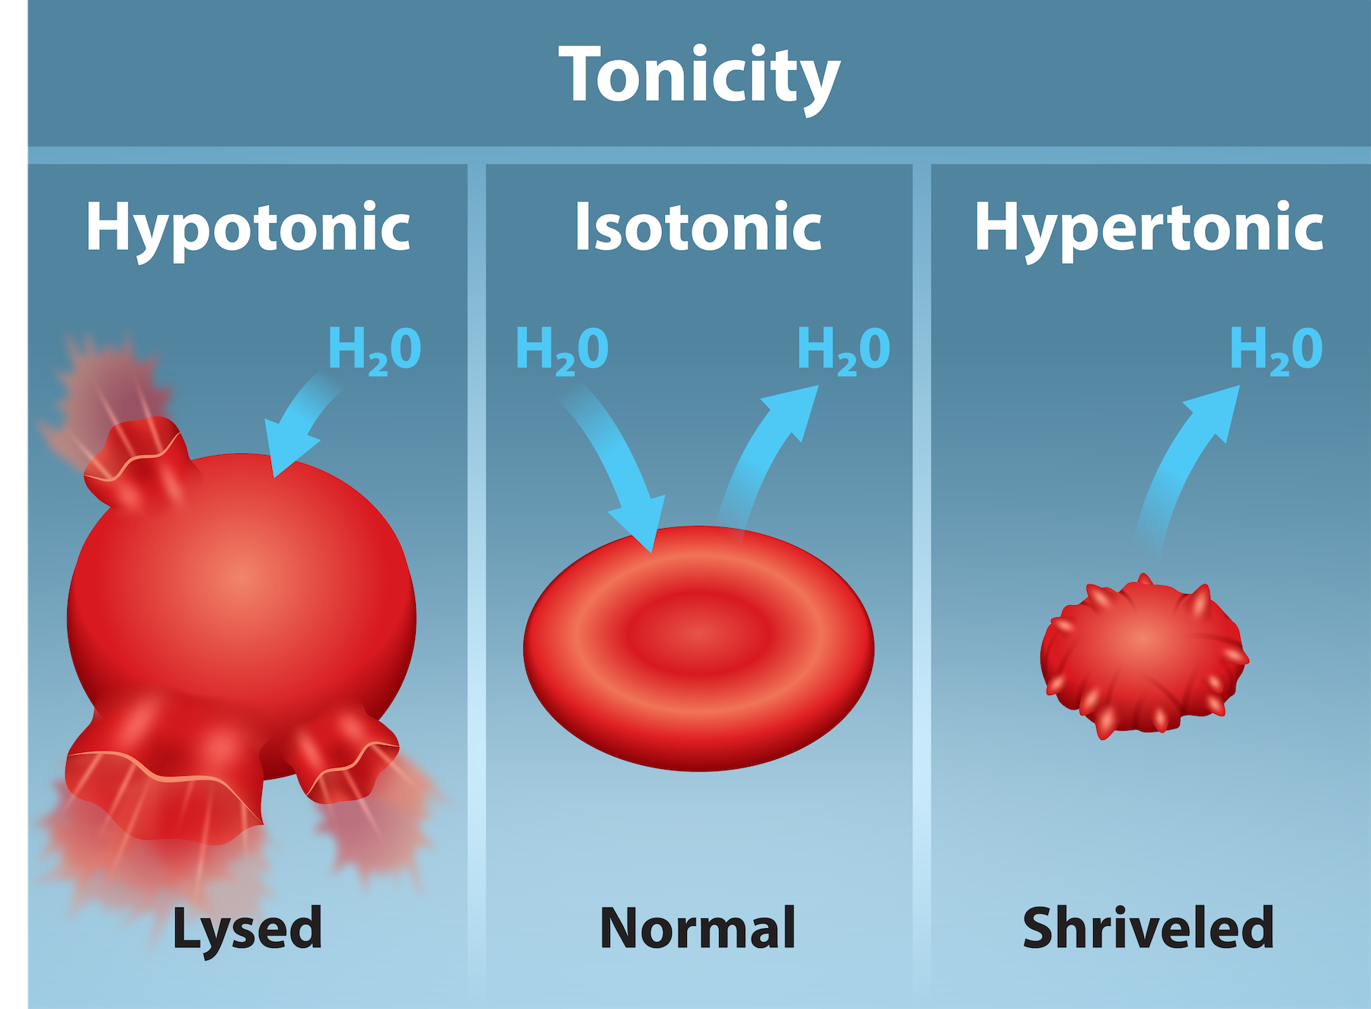
Tonicity
Hypotonic solutions – the extracellular fluid has lower osmolarity than the fluid inside the cell, and water enters the cell.
Hypertonic solution - the extracellular fluid having a higher osmolarity than the cell’s cytoplasm, and water will leave the cell.
Isotonic solution - the extracellular fluid has the same osmolarity as the cell, and there will be no net movement of water into or out of the cell.

Slide 24
Tonicity in Living Systems
A red blood cell will burst, or lyse, when it swells beyond the plasma membrane’s capability to expand.
When excessive water leaves a red blood cell, the cell shrinks, or crenates.
Various living things have ways of controlling the effects of osmosis—a mechanism we call osmoregulation.
Some organisms, such as plants, fungi, bacteria, and some protists, have cell walls that surround the plasma membrane and prevent cell lysis in a hypotonic solution.
The cytoplasm in plants is always slightly hypertonic to the cellular environment, and water will always enter a cell if water is available. This water inflow produces turgor pressure, which stiffens the plant's cell walls.

Slide 25
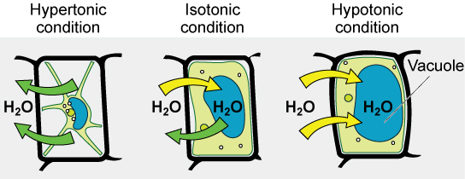

Slide 26
Tonicity
Paramecia and amoebas, which are protists that lack cell walls, have contractile vacuoles that collect excess water from the cell and pumps it out, keeping the cell from lysing as it takes on water from its environment.
Many marine invertebrates have internal salt levels matched to their environments, making them isotonic with the water in which they live.
In vertebrates, the kidneys regulate the water amount in the body. Osmoreceptors are specialized cells in the brain that monitor solute concentration in the blood.

Slide 27
Active Transport
Active transport mechanisms require the cell’s energy, usually in the form of adenosine triphosphate (ATP).
If a substance must move into the cell against its concentration gradient—that is, if the substance's concentration inside the cell is greater than its concentration in the extracellular fluid (and vice versa)—the cell must use energy to move the substance.
Some active transport mechanisms move small-molecular weight materials, such as ions, through the membrane.
Other mechanisms transport much larger molecules.

Slide 28
Electrochemical Gradient
In living systems, concentration gradients are complex.
Because ions move into and out of cells and because cells contain proteins that do not move across the membrane and are mostly negatively charged, there is also an electrical gradient, a difference of charge, across the plasma membrane.
The interior of living cells is electrically negative with respect to the extracellular fluid in which they are bathed, and at the same time, cells have higher concentrations of potassium (K⁺) and lower concentrations of sodium (Na⁺) than the extracellular fluid.
Thus in a living cell, the concentration gradient of Na⁺ tends to drive it into the cell, and its electrical gradient (a positive ion) also drives it inward to the negatively charged interior.
The electrical gradient of K⁺, a positive ion, also drives it into the cell, but the concentration gradient of K⁺ drives K⁺ out of the cell.
We call the combined concentration gradient and electrical charge that affects an ion its electrochemical gradient.

Slide 29
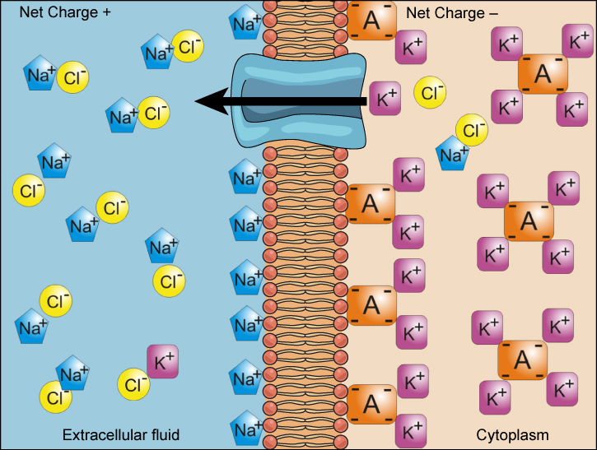

Slide 30
Moving Against a Gradient
To move substances against a concentration or electrochemical gradient, the cell must use energy using ATP for energy.
Active transport mechanisms, or pumps, work against electrochemical gradients.
Small substances constantly pass through plasma membranes.
Active transport maintains concentrations of ions and other substances that living cells require in the face of these passive movements.

Slide 31
Carrier Proteins for Active Transport
Uniporter carries one specific ion or molecule.
Symporter carries two different ions or molecules, both in the same direction
An antiporter also carries two different ions or molecules, but in different directions.
All of these transporters can also transport small, uncharged organic molecules like glucose.
These three types of carrier proteins are also in facilitated diffusion, but they do not require ATP to work in that process.

Slide 32
Primary Active Transport
One of the most important pumps in animal cells is the sodium-potassium pump (Na⁺-K⁺ ATPase), which maintains the electrochemical gradient (and the correct concentrations of Na⁺ and K⁺) in living cells.
The sodium-potassium pump moves K⁺ into the cell while moving Na⁺ out at the same time, at a ratio of three Na⁺ for every two K⁺ ions moved in.
The Na⁺-K⁺ ATPase exists in two forms, depending on its orientation to the cell's interior or exterior and its affinity for either sodium or potassium ions.
The sodium-potassium pump is an electrogenic pump (a pump that creates a charge imbalance), creating an electrical imbalance across the membrane and contributing to the membrane potential.

Slide 33
Primary Active Transport Steps
With the enzyme oriented towards the cell's interior, the carrier has a high affinity for sodium ions. Three ions bind to the protein.
The protein carrier hydrolyzes ATP and a low-energy phosphate group attaches to it.
As a result, the carrier changes shape and reorients itself towards the membrane's exterior. The protein’s affinity for sodium decreases and the three sodium ions leave the carrier.
The shape change increases the carrier’s affinity for potassium ions, and two such ions attach to the protein. Subsequently, the low-energy phosphate group detaches from the carrier.
With the phosphate group removed and potassium ions attached, the carrier protein repositions itself towards the cell's interior.
The carrier protein, in its new configuration, has a decreased affinity for potassium, and the two ions moves into the cytoplasm. The protein now has a higher affinity for sodium ions, and the process starts again.

Slide 34
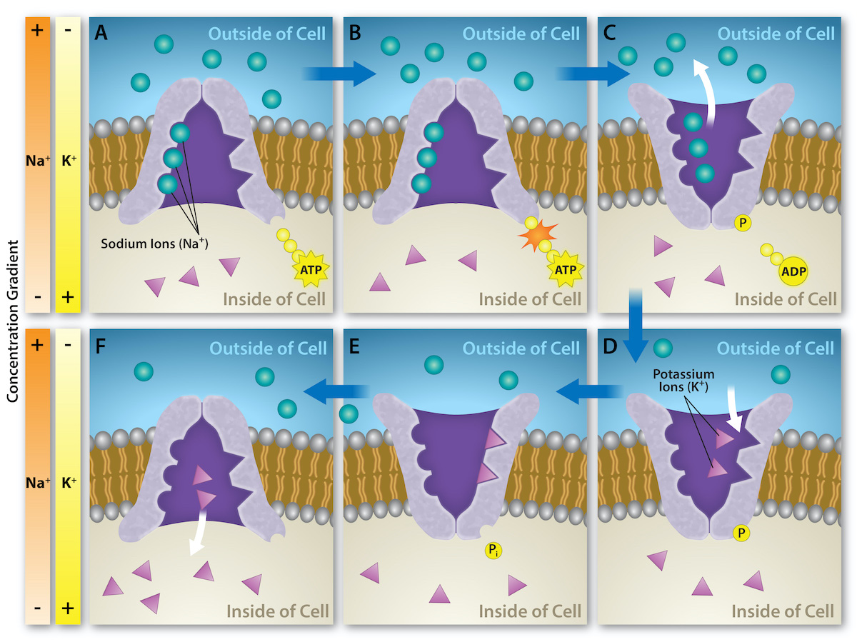

Slide 35
Secondary Active Transport (Co-Trasnport)
Secondary active transport uses the kinetic energy of sodium ions to bring other compounds, against their concentration gradient into the cell.
As sodium ion concentrations build outside of the plasma membrane because of the primary active transport process, this creates an electrochemical gradient.
If a channel protein exists and is open, the sodium ions will move down its concentration gradient across the membrane.
This movement transports other substances that must be attached to the same transport protein in order for the sodium ions to move across the membrane.
Many amino acids, as well as glucose, enter a cell this way.
This secondary process also stores high-energy hydrogen ions in the mitochondria of plant and animal cells in order to produce ATP. The potential energy that accumulates in the stored hydrogen ions translates into kinetic energy as the ions surge through the channel protein ATP synthase, and that energy then converts ADP into ATP.

Slide 36
Endocytosis
Endocytosis is a type of active transport that moves particles, such as large molecules, parts of cells, and even whole cells, into a cell
Indocytosis variations share a common characteristic: the cell's plasma membrane invaginates, forming a pocket around the target particle.
The pocket pinches off, resulting in the particle containing itself in a newly created intracellular vesicle formed from the plasma membrane.

Slide 37
Phagocytosis
A portion of the plasma membrane's inward-facing surface becomes coated with the protein clathrin, which stabilizes this membrane's section.
The membrane's coated portion then extends from the cell's body and surrounds the particle, eventually enclosing it.
Once inside the cell, the clathrin disengages from the membrane and the vesicle merges with a lysosome forming an endosome.

Slide 38
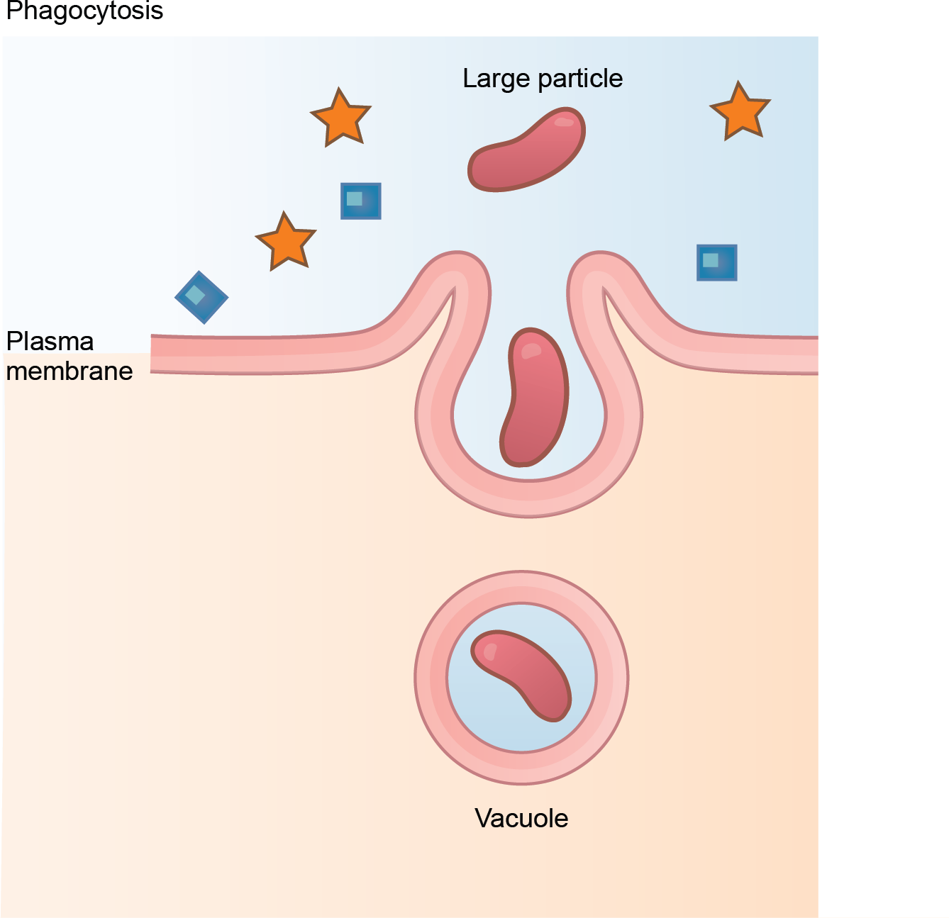

Slide 39
Pinocyctosis
Pinocytosis results in a much smaller vesicle than phagocytosis.
The vesicle does not merge with a lysosome.
Potocytosis uses a coating protein, caveolin, on the plasma membrane's cytoplasmic side, which performs a similar function to clathrin.
Potocytosis brings small molecules into the cell and transports them through the cell for their release on the other side, a process we call transcytosis.

Slide 40
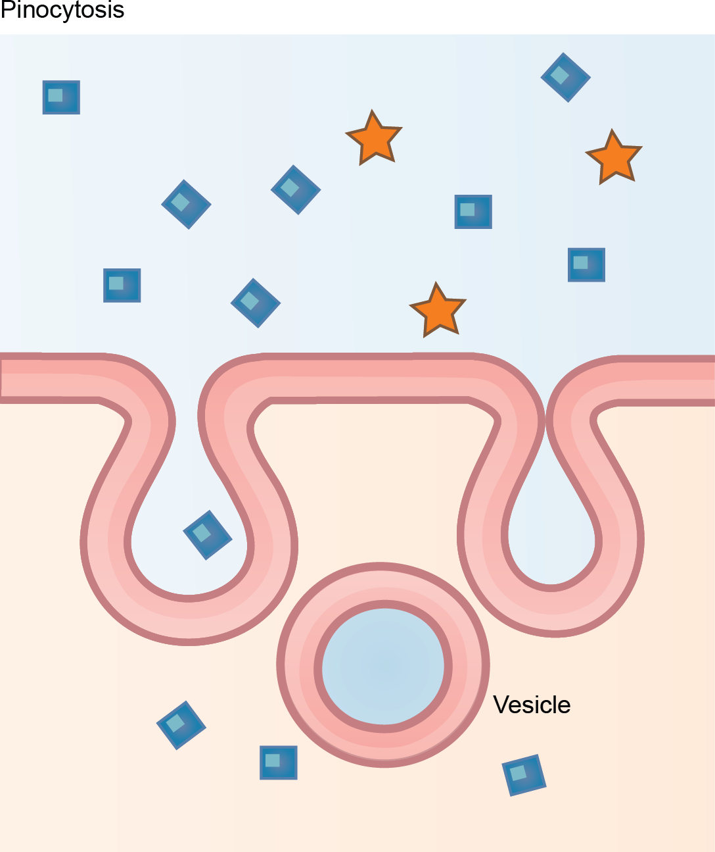

Slide 41
Receptor-Mediated Endocytosis
A targeted variation of endocytosis employs receptor proteins in the plasma membrane that have a specific binding affinity for certain substances.
In receptor-mediated endocytosis, clathrin attaches to the plasma membrane's cytoplasmic side.
The failure of receptor-mediated endocytosis causes some human diseases. For example, receptor mediated endocytosis removes low density lipoprotein or LDL (or "bad" cholesterol) from the blood.
In the human genetic disease familial hypercholesterolemia, the LDL receptors are defective or missing entirely. People with this condition have life-threatening levels of cholesterol in their blood, because their cells cannot clear LDL particles.
Although receptor-mediated endocytosis is designed to bring specific substances that are normally in the extracellular fluid into the cell, other substances may gain entry into the cell at the same site.
Flu viruses, diphtheria, and cholera toxin all have sites that cross-react with normal receptor-binding sites and gain entry into cells.

Slide 42
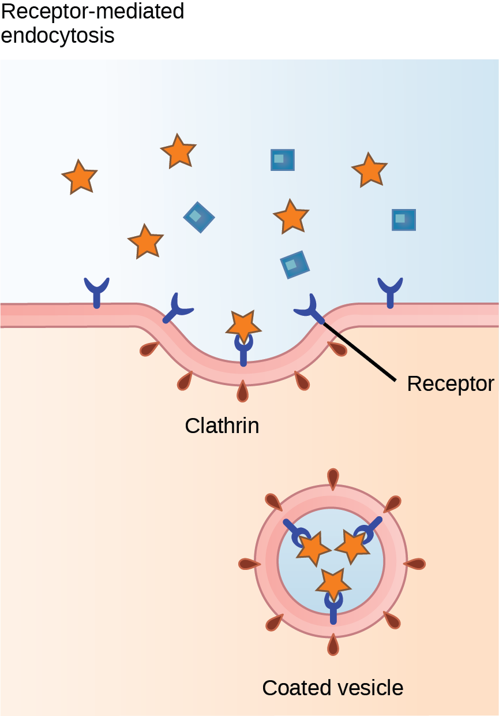

Slide 43
Exocytosis
Exocytosis is the opposite of the endocytosis.
Waste material is enveloped in a membrane and fuses with the plasma membrane's interior.
This fusion opens the membranous envelope on the cell's exterior, and the waste material expels into the extracellular space.
Examples of exocytosis include extracellular matrix protein secretion and neurotransmitter secretion into the synaptic cleft by synaptic vesicles.

Slide 44
