Slide 1
BIOL 1010 Module 4
OpenStax
Biology 2e
Chapter 4: The Cell

Slide 2
Light Microscopy
Microscopes magnify objects we cannot see with the naked eye, which includes nearly all cells.
Visible light passes through light microscopes and bends through the lens system to enable the user to see the specimen.
Light microscopes are advantageous for viewing living organisms, but since individual cells are generally transparent, their components are not distinguishable unless they are colored with special stains.
Two important parameters: magnification and resolving power.
Magnification is the process of enlarging an object in appearance.
Resolving power is the microscope's ability to distinguish two adjacent structures as separate.
The higher the resolution, the better the image's clarity and detail.

Slide 3
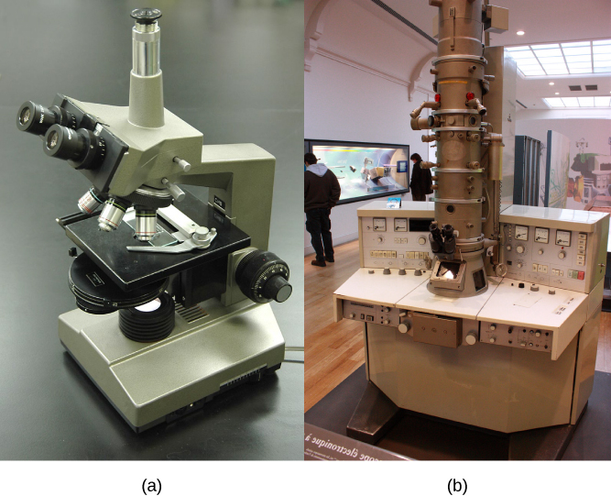
Electron Microscopes
Electron microscopy (EM) uses a beam of electrons instead of a beam of light.
Th higher magnification and resolution of EM results in higher resolving power.
Electrons have short wavelengths (shorter than photons) that move best in a vacuum, so we cannot view living cells with an electron microscope.
Scanning electron microscopy (SEM) uses a beam of electrons moving back and forth across a cell’s surface, creating details of cell surface characteristics.
Transmission electron microscopy beam electrons through the cell and provides details of a cell’s internal structures.

Slide 4
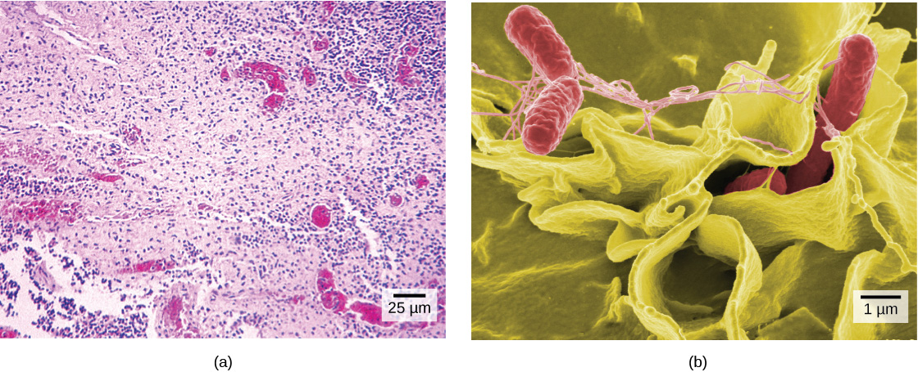
Cell Theory
Antony van Leeuwenhoek was the first to observe movements of single-celled organisms in the first microscopes with highly polished lenses he created in the late 16th century.
Robert Hooke coined the term “cell” for the box-like structures he observed when viewing cork tissue.
In the 1670s, van Leeuwenhoek discovered bacteria and protozoa.
By the late 1830s, botanist Matthias Schleiden and zoologist Theodor Schwann were studying tissues and proposed the unified cell theory, which states that one or more cells comprise all living things, the cell is the basic unit of life, and new cells arise from existing cells.

Slide 5
Prokaryotic Cells
All cells share four common components: 1) a plasma membrane, an outer covering that separates the cell’s interior from its surrounding environment; 2) cytoplasm, consisting of a jelly-like cytosol within the cell in which there are other cellular components; 3) DNA, the cell's genetic material; and 4) ribosomes, which synthesize proteins.
Prokaryotes differ from eukaryotic cells in several ways.
A prokaryote is a simple, mostly single-celled (unicellular) organism that lacks a nucleus, or any other membrane-bound organelle.
Prokaryotic DNA is in the cell's central part: the nucleoid.

Slide 6
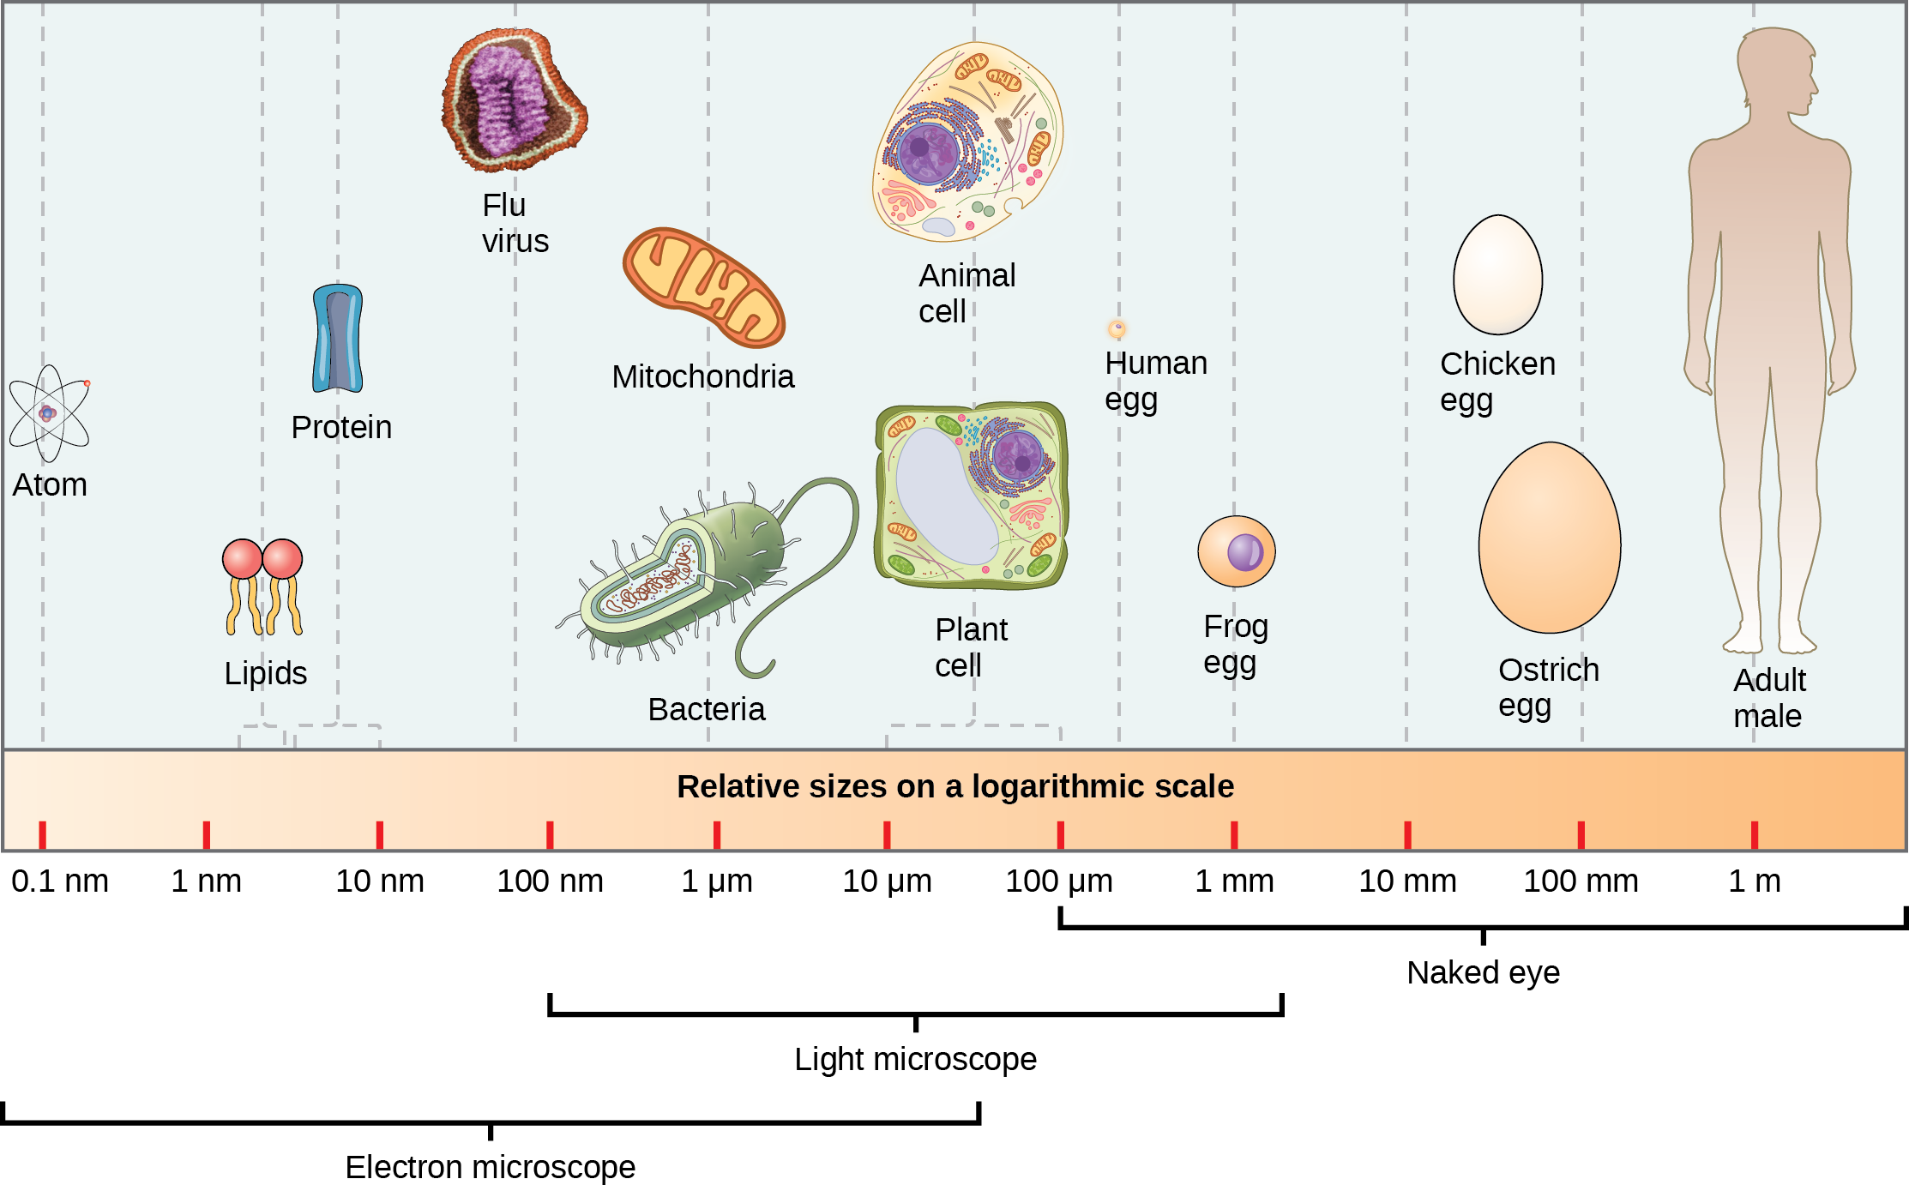
Cell Size
Prokaryotic cells are significantly smaller than eukaryotic cells - 0.1 to 5.0 μm in diameter.
Eukaryotic cells have diameters ranging from 10 to 100 μm.
The prokaryotes' small size allows ions and organic molecules that enter them to quickly diffuse to other parts of the cell.
Wastes produced within a prokaryotic cell can quickly diffuse. This is not the case in eukaryotic cells, which have developed different structural adaptations to enhance intracellular transport.

Slide 7
Eukaryotic Cells
Eukaryotic cells have: 1) a membrane-bound nucleus; 2) numerous membrane-bound organelles such as the endoplasmic reticulum, Golgi apparatus, chloroplasts, mitochondria, and others; and 3) several, rod-shaped chromosomes.
Because a membrane surrounds eukaryotic cell’s nucleus, it has a “true nucleus.”
The word “organelle” means “little organ.”
Organelles have specialized cellular functions, just as your body's organs have specialized functions.
Organelles allow different functions to be compartmentalized in different areas of the cell.

Slide 8
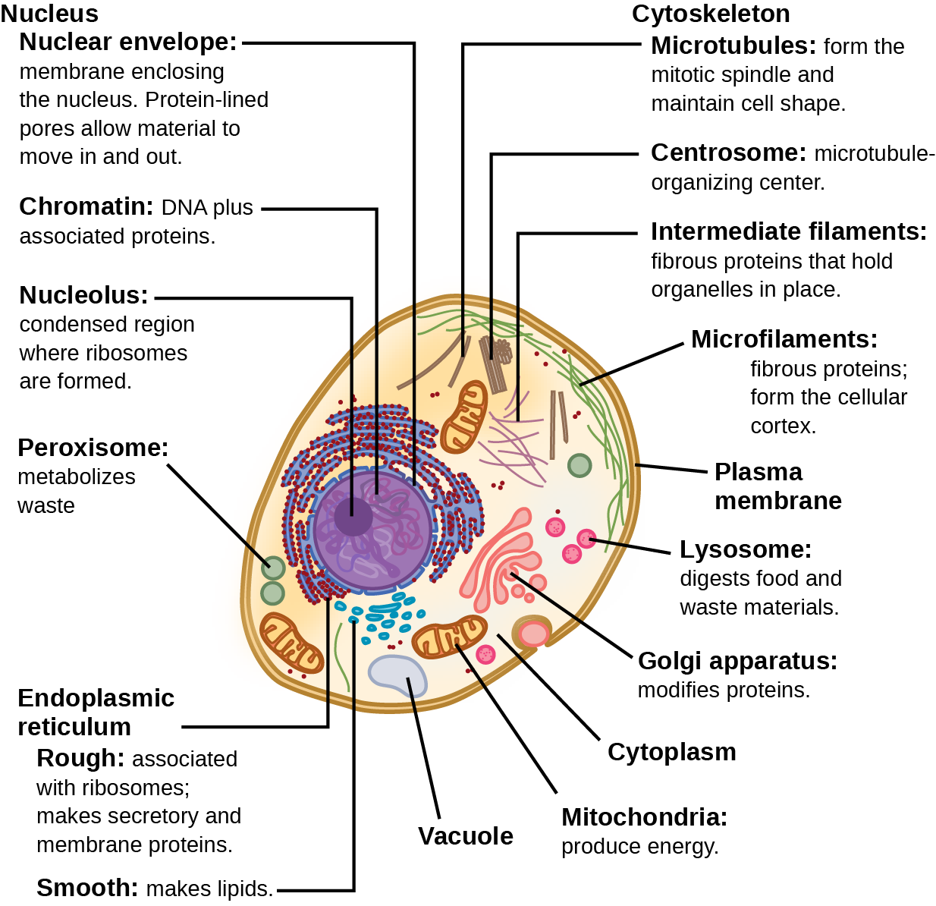

Slide 9
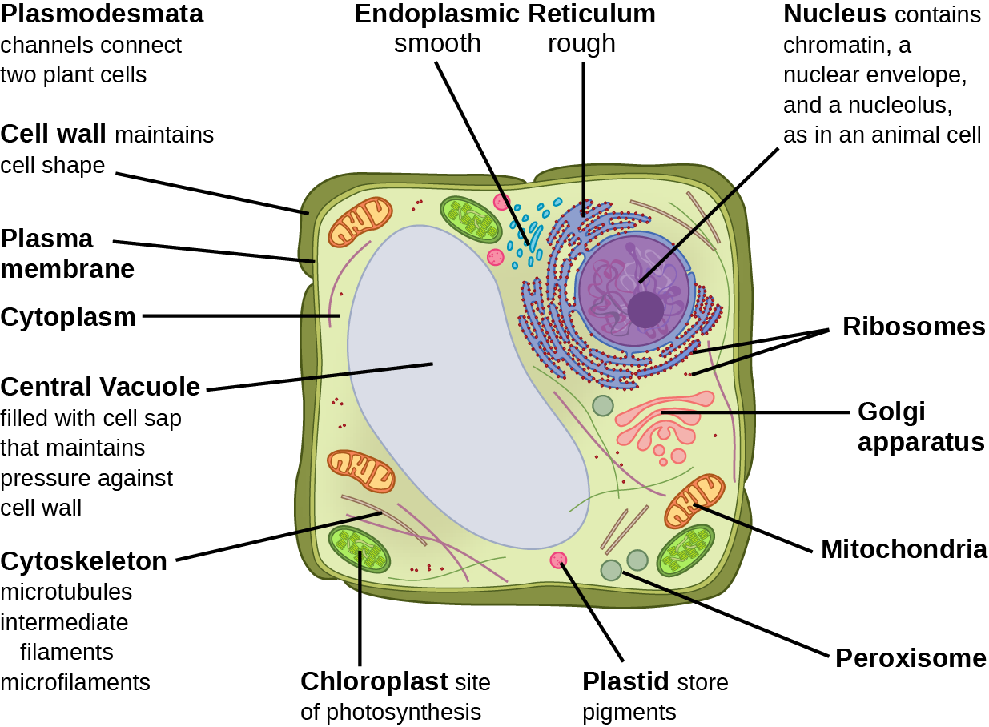

Slide 10
The Plasma Membrane
Prokaryotic and eukaryotic cells have a plasma membrane - a phospholipid bilayer with embedded proteins that separates the internal contents of the cell from its surrounding environment.
Recall – a phospholipid is a lipid molecule with two fatty acid chains and a phosphate-containing group
Plasma membranes control the passage of organic molecules, ions, water, and oxygen into and out of the cell.
Wastes (such as carbon dioxide and ammonia) also leave the cell by passing through the plasma membrane.
The plasma membranes of cells that specialize in absorption fold into fingerlike projections that we call microvilli (singular = microvillus). Such cells typically line the small intestine, the organ that absorbs nutrients from digested food.

Slide 11
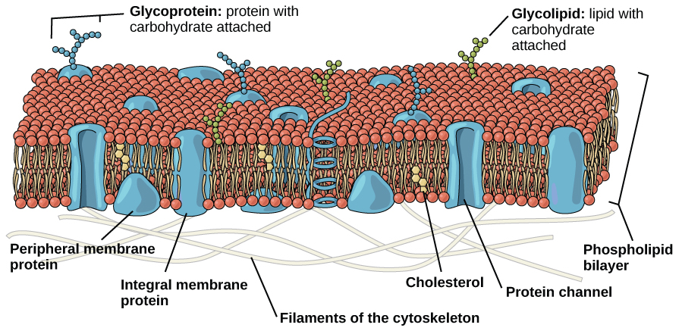

Slide 12
Cytoplasm
The cytoplasm is the cell's entire region between the plasma membrane and the nuclear envelope (a structure we will discuss shortly).
Organelles are suspended in a gel-like cytosol and the cytoskeleton.
The cytoplasm consists of 70 to 80 percent water but has a semi-solid consistency, which comes from the proteins within it.
Many metabolic reactions, including protein synthesis, take place in the cytoplasm.

Slide 13
The Nucleus
The nucleus houses the cell’s DNA and directs the synthesis of ribosomes and proteins.
The nuclear envelope is a phospholipid bilayer.
The nuclear envelope's inner and outer membranes are phospholipid bilayers.
The nuclear envelope is punctuated with pores that control the passage of ions, molecules, and RNA between the nucleoplasm and cytoplasm.
Nucleoplasm is the semi-solid fluid inside the nucleus, where we find chromatin and the nucleolus.
Some chromosomes have sections of DNA that encode ribosomal RNA.
The darkly staining area within the nucleus called the nucleolus aggregates the ribosomal RNA with associated proteins to assemble the ribosomal subunits that are then transported out through the pores in the nuclear envelope to the cytoplasm.

Slide 14
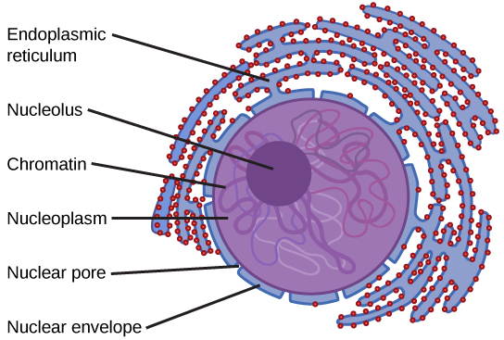

Slide 15
Ribosomes
Ribosomes are the cellular structures responsible for protein synthesis.
Ribosomes are large protein and RNA complexes, consist of two subunits, large and small.
Ribosomes translate mRNA into proteins guided by complimentary matching tRNA at the ribosome’s enzyme active site.
Ribosomes are particularly abundant in cells that synthesize large amounts of protein.

Slide 16
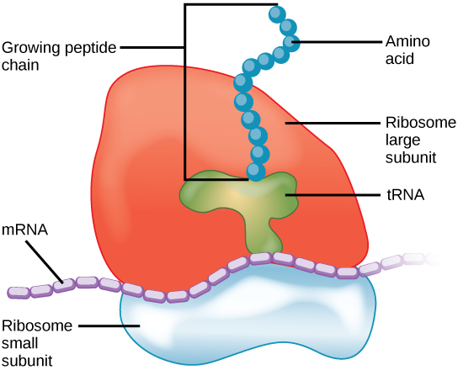

Slide 17
Mitochondria
Often called “powerhouses” or “energy factories” of both plant and animal cells because they are responsible for making adenosine triphosphate (ATP), the cell’s main energy-carrying molecule.
ATP represents the cell's short-term stored energy.
Cellular respiration is the process of making ATP using the chemical energy in glucose and other nutrients.
In mitochondria, this process uses oxygen and produces carbon dioxide as a waste product.
Muscle cells have a very high concentration of mitochondria that produce ATP because they need considerable energy.

Slide 18
Mitochondria
Mitochondria are oval-shaped, double membrane organelles that have their own ribosomes and DNA.
Each membrane is a phospholipid bilayer embedded with proteins. The inner layer has folds called cristae.
We call the area surrounded by the folds the mitochondrial matrix.
The cristae and the matrix have different roles in cellular respiration.

Slide 19
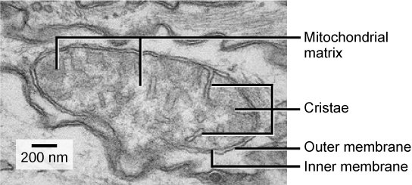

Slide 20
Peroxisomes, Vesicles and Vacuoles
Peroxisomes are small, round organelles enclosed by single membranes that carry out oxidation reactions that break down fatty acids and amino acids.
Peroxisomes also detoxify.
Oxidation reactions of peroxisomes release hydrogen peroxide (H₂O₂), which damages cells.
When these reactions are confined to peroxisomes, enzymes safely break down the H₂O₂ into oxygen and water.
Vesicles and vacuoles are membrane-bound sacs that function in storage and transport.
Vesicle membranes can fuse with either the plasma membrane or other membrane systems within the cell.
Enzymes within plant vacuoles break down macromolecules.

Slide 21
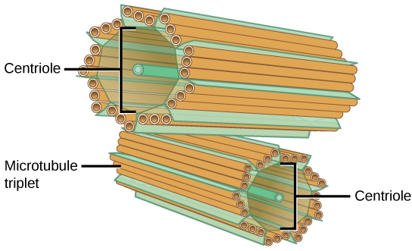
Centrosomes
The centrosome is a microtubule-organizing center found near the nuclei of animal cells.
Contains a pair of centrioles, two microtubule structures that lie perpendicular to each other.
The entrosome replicates itself before a cell divides.
Centrioles appear to have some role in pulling the duplicated chromosomes to opposite ends of the dividing cell..

Slide 22
Lysosomes
Lysosomes are the animal cell’s “garbage disposal.”
Enzymes within the lysosomes aid in breaking down proteins, polysaccharides, lipids, nucleic acids, and even worn-out organelles.
Enzyme activity is compartmentalized in lysosomes, where the pH is much lower than the cell’s cytoplasm.
Animal cells have another set of organelles that most plant cells do not: lysosomes.
In plant cells, the digestive processes take place in vacuoles.

Slide 23
Lysosomes and Phagocytosis
Lysosomes also use their hydrolytic enzymes to destroy pathogens (disease-causing organisms) that might enter the cell.
Macrophages (a group of immune system white blood cells) process phagocytize pathogens by invaginating its plasma membrane.
The invaginated section, with the pathogen inside, pinches itself off from the plasma membrane and becomes a vesicle.
The vesicle fuses with a lysosome which releases enzymes to destroy the pathogen.

Slide 24
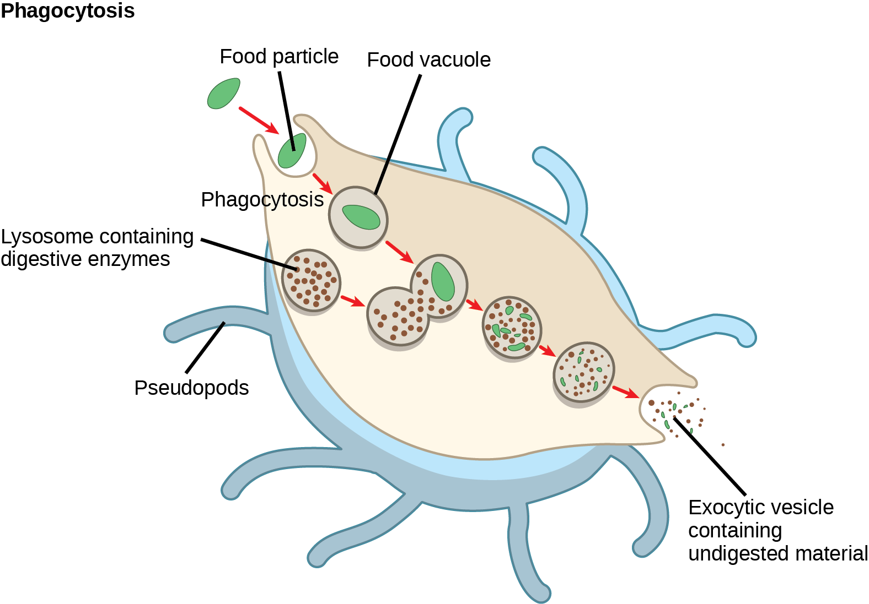

Slide 25
The Cell Wall
The cell wall is a rigid covering that protects the cell of plants and some prokayotes, protists and fungi.
It provides structural support, and gives shape to the cell. Fungal and some protistan cells also have cell walls.
The prokaryotic cell wall’s chief component is peptidoglycan and the major organic molecule in the plant (and some protists') cell wall is cellulose.

Slide 26
Chloroplasts
Chloroplasts have their own DNA and ribosomes, but chloroplasts have an entirely different function.
Chloroplasts are plant cell organelles that carry out photosynthesis.
Photosynthesis is the series of reactions that use carbon dioxide, water, and light energy to make glucose and oxygen.
Plants (autotrophs) are able to make their own food, like sugars used in cellular respiration to provide ATP energy generated in the plant mitochondria.
Animals (heterotrophs) must ingest their food.

Slide 27
Chloroplasts
Like mitochondria, chloroplasts have outer and inner membranes.
The space enclosed by a chloroplast’s inner membrane is a set of interconnected and stacked fluid-filled membrane sacs we call thylakoids.
Each thylakoid stack is a granum (plural = grana).
Chloroplasts contain a green pigment, chlorophyll, which captures the light energy that drives the reactions of photosynthesis.
Photosynthetic protists also have chloroplasts.
Some bacteria perform photosynthesis, but their chlorophyll is not relegated to an organelle.

Slide 28
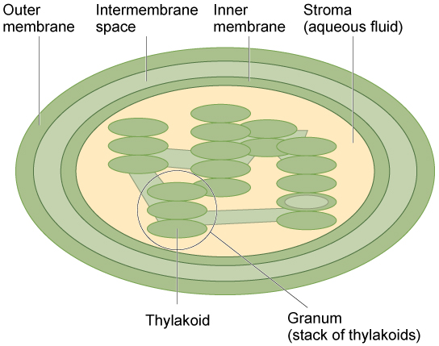

Slide 29
The Central Vacuole
Plant cells each have a large central vacuole that occupies most of the cell's area.
The central vacuole plays a key role in regulating the cell’s concentration of water in changing environmental conditions.
When the water concentration in the soil becomes lower than the water concentration in the plant, water moves out of the central vacuoles and cytoplasm, leaving the cell wall unsupported.
When the central vacuole holds more water, the cell becomes larger without having to invest considerable energy in synthesizing new cytoplasm.

Slide 30
Endoplasmic Reticulum
The endoplasmic reticulum (ER) is a series of interconnected membranous sacs and tubules that collectively modifies proteins and synthesizes lipids.
These two functions take place in separate areas of the ER: the rough ER and the smooth ER, respectively.
We call the ER tubules' hollow portion the lumen or cisternal space.
The ER's membrane, which is a phospholipid bilayer embedded with proteins, is continuous with the nuclear envelope.

Slide 31
Endoplasmic Reticulum
Rough endoplasmic reticulum (RER) was named because the ribosomes attached to its cytoplasmic surface give it a studded appearance when viewing it through an electron microscope.
Ribosomes transfer their newly synthesized proteins into the RER's lumen where they undergo structural modifications, such as folding or acquiring side chains.
Secreting cells, like liver cells, are abundant in RER.
smooth endoplasmic reticulum (SER) is continuous with the RER but has few or no ribosomes on its cytoplasmic surface.
SER functions include synthesis of carbohydrates, lipids, and steroid hormones; detoxification of medications and poisons; and storing calcium ions.
In muscle cells, a specialized SER, the sarcoplasmic reticulum, is responsible for storing calcium ions that are needed to trigger the muscle cells' coordinated contractions.

Slide 32
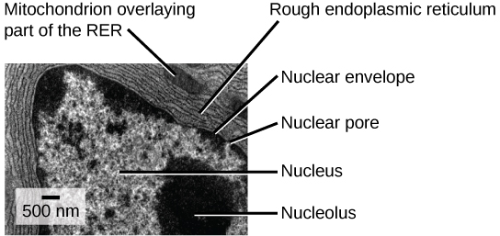

Slide 33
The Golgi Apparatus
Sorting, tagging, packaging, and distributing lipids and proteins takes place in a series of flattened membranous sacs called the Golgi apparatus (Golgi body).
The side of the Golgi apparatus that is closer to the ER is called the cis face. The opposite side is the trans face.
Transport vesicles that formed from the ER travel to the cis face, fuse with it, and empty their contents into the Golgi apparatus' lumen.
Proteins and lipids travel through the Golgi undergoing further modifications that allow them to be sorted.
Finally, the modified and tagged proteins are packaged into secretory vesicles that bud from the Golgi's trans face.

Slide 34
The Golgi Apparatus
Some vesicles deposit their contents into other cell parts where they will be used, other secretory vesicles fuse with the plasma membrane and release their contents outside the cell.
Cells engaged in secretory activity (such as salivary gland cells that secrete digestive enzymes or immune system cells that secrete antibodies) have an abundance of Golgi.
In plant cells, the Golgi apparatus has the additional role of synthesizing polysaccharides, some of which are incorporated into the cell wall or used elsewhere in the cell.

Slide 35
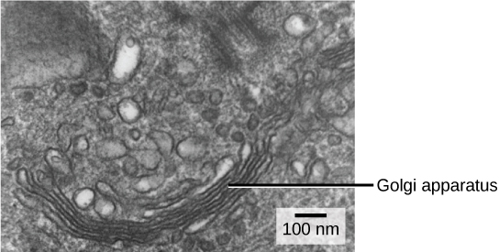

Slide 36
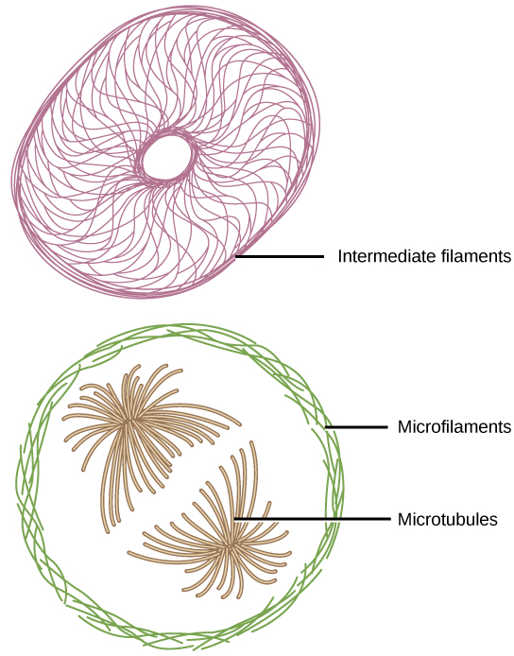
Cytoskeleton
Three types of fibers within the cytoskeleton: microfilaments, intermediate filaments, and microtubules

Slide 37
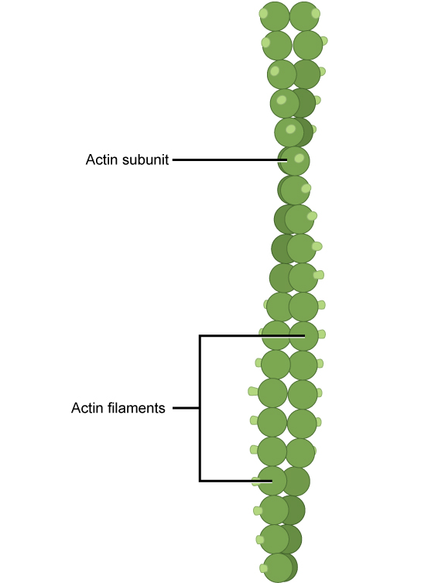
Microfilaments
Of the three types of protein fibers in the cytoskeleton, microfilaments are the narrowest.
They function in cellular movement and have a diameter of about 7 nm, and are comprised of two globular protein intertwined strands of actin proteins.
We also call microfilaments actin filaments.
ATP powers actin to assemble its filamentous form, which serves as a track for the movement of a motor protein we call myosin.
Actin is engaged in cellular events requiring motion, such as cell division in eukaryotic cells and cytoplasmic streaming,
Actin and myosin are plentiful in muscle cells. When your actin and myosin filaments slide past each other, your muscles contract.
Microfilaments also provide some rigidity and shape to the cell.
Actin filaments depolymerize (disassemble) and reform quickly, thus enabling a cell to change its shape and move.
White blood cells (your body’s infection-fighting cells) make good use of this ability. They can move to an infection site and phagocytize the pathogen.

Slide 38
Intermediate Filaments
Fibrous proteins wound together comprise intermediate filaments.
Their diameter, 8 to 10 nm, is between those of microfilaments and microtubules.
Intermediate filaments are purely structural.
They maintain the cell's shape and anchor the nucleus and other organelles in place.
Keratin is a fibrous protein composed of intermediate fialments that strengthens your hair, nails, and the skin's epidermis.

Slide 39
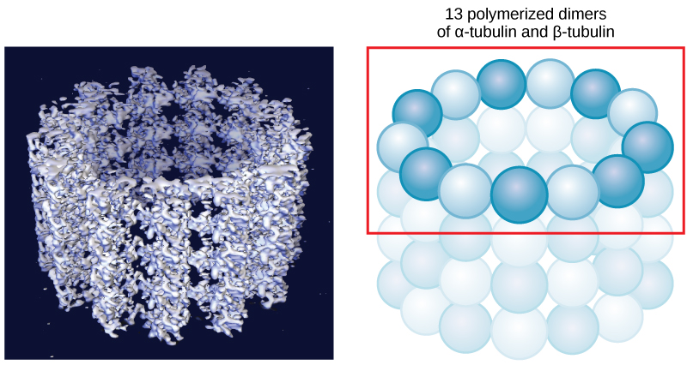
Microtubules
Microtubules are small hollow tubes of polymerized dimers of α-tubulin and β-tubulin.
α-tubulin and β-tubulin are globular proteins that comprise the microtubule's walls.
With a diameter of about 25 nm, microtubules are cytoskeletons' widest components.
They resist compression, provide a track along which vesicles move through the cell, and pull replicated chromosomes to opposite ends of a dividing cell.
Microfilaments, microtubules can disassemble and reform quickly.
Microtubules are also the structural elements of flagella, cilia, and centrioles.
In animal cells, the centrosome is the microtubule-organizing center.

Slide 40
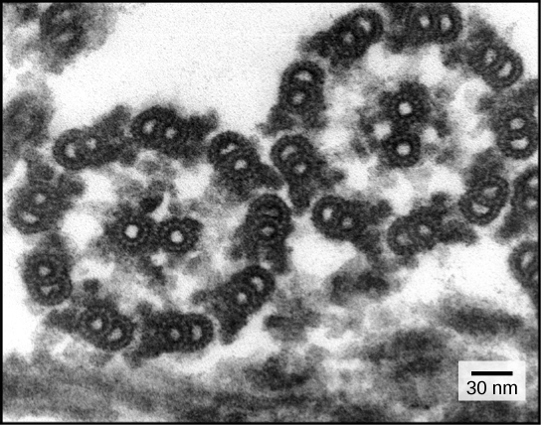
Flagella and Cilia
Flagella are long, hair-like structures that extend from the plasma membrane and enable an entire cell to move.
Sperm, Euglena, and some prokaryotes are examples.
Cilia along the plasma membrane's entire surface when present.
Cilia are short, hair-like structures that move entire cells (such as paramecia) or substances along the cell's outer surface.
Cilia of cells lining the Fallopian tubes move an ovum toward the uterus, or cilia lining the cells of the respiratory tract trap particulate matter and move it toward your nostrils.
Flagella and cilia share a common structural arrangement of microtubules called a “9 + 2 array.”

Slide 41
What components are common to plant and animal cells?

