Slide 1
BIOL 1010 Module 3
OpenStax
Biology 2e
Chapter 3: Biological Macromolecules

Slide 2
Dehydration Synthesis
Single subunit (monomer) macromolecules combine to form larger polymer molecules by a chemical reaction called dehydration synthesis.
Hydrogen of one monomer combines with the hydroxyl group of another monomer, releasing a water molecule. At the same time, the monomers share electrons and form covalent bonds. As additional monomers join, this chain of repeating monomers forms a polymer.

Slide 3
Hydrolysis
Hydrolysis occurs by inserting a water molecule across a polymer bond, breaking a covalent bond with the water molecule.
During these reactions, the polymer breaks into two components: one part gains a hydrogen atom (H+) and the other gains a hydroxyl molecule (OH–) from a split water molecule.
Dehydration and hydrolysis reactions are catalyzed, or “sped up,” by specific enzymes; dehydration reactions involve the formation of new bonds, requiring energy, while hydrolysis reactions break bonds and release energy.

Slide 4
Carbohydrates
Carbohydrates are classified into three subtypes: monosaccharides, disaccharides, and polysaccharides.
Grains, fruits, and vegetables are all natural carbohydrate sources that provide energy to the body, particularly through glucose, a simple sugar that is a component of starch and an ingredient in many staple foods.
The stoichiometric formula (CH₂O)_{n}, where n is the number of carbons in the molecule represents carbohydrates. In

Slide 5
Monosaccharides
Monosaccharides are simple sugars, the most common of which is glucose.
The chemical formula for glucose is C₆H₁₂O₆.
In humans, glucose is an important source of energy. During cellular respiration, energy releases from glucose, and that energy helps make adenosine triphosphate (ATP).
Plants synthesize glucose using carbon dioxide and water, and glucose in turn provides energy requirements for the plant.
Humans and other animals that feed on plants often obtain glucose from catabolized (cell breakdown of larger molecules) starch.

Slide 6
Monosaccharides
Galactose (part of lactose, or milk sugar) and fructose (found in sucrose, in fruit) are other common monosaccharides.
Although glucose, galactose, and fructose all have the same chemical formula (C₆H₁₂O₆), they differ structurally and chemically (and are isomers) because of the different arrangement of functional groups around the asymmetric carbon.

Slide 7
Monosaccharides can exist as a linear chain or as ring-shaped molecules. In aqueous solutions they are usually in ring forms.

Slide 8
Disaccharides
Disaccharides form when two monosaccharides undergo a dehydration reaction (or a condensation reaction or dehydration synthesis).
One monosaccharide's hydroxyl group combines with another monosaccharide's hydrogen, releasing a water molecule and forming a covalent bond.
A covalent (glycosidic linkage) bond forms between a carbohydrate molecule and another molecule.

Slide 9
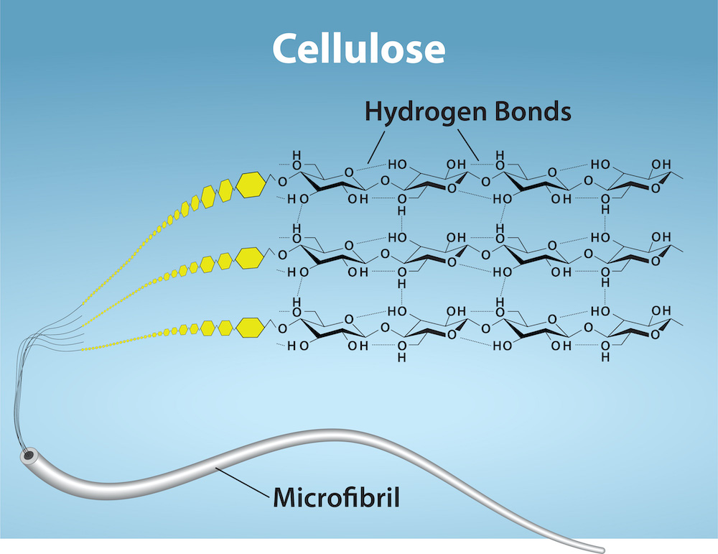
Glycogen and Cellulose
A polysaccharides is a long chain of monosaccharides linked by glycosidic bonds.
Glycogen is the storage form of glucose in humans and other vertebrates and is a polymer of glucose.
Glycogen is the animal equivalent of starch and is a highly branched molecule usually stored in liver and muscle cells.
Glycogen breaks down to release glucose in a process scientists call glycogenolysis when blood glucose levels are decreased.
Cellulose is the most abundant natural biopolymer.
Glucose monomers comprise cellulose, which mostly comprises a plant's cell wall and provides the cell structural support.
Wood and paper are mostly cellulose.

Slide 10
Discussion
Are carbohydrates beneficial?

Slide 11
Lipids
Fats and Oils
Trans Fats
Omega Fatty Acids
Phospholipids
Steroids

Slide 12
Lipids Defined
Lipids are generally nonpolar hydrocarbons insoluble in water (hydrophobic) mostly composed of carbon-carbon and carbon-hydrogen bonds.
Cells store energy for long-term use in the form of fats.
Lipids also provide insulation from the environment for plants and animals.
They help keep aquatic birds and mammals dry by forming a protective layer over fur or feathers because of their water-repellant hydrophobic nature.
Lipids are also the building blocks of many hormones and are an important constituent of all cellular membranes.

Slide 13
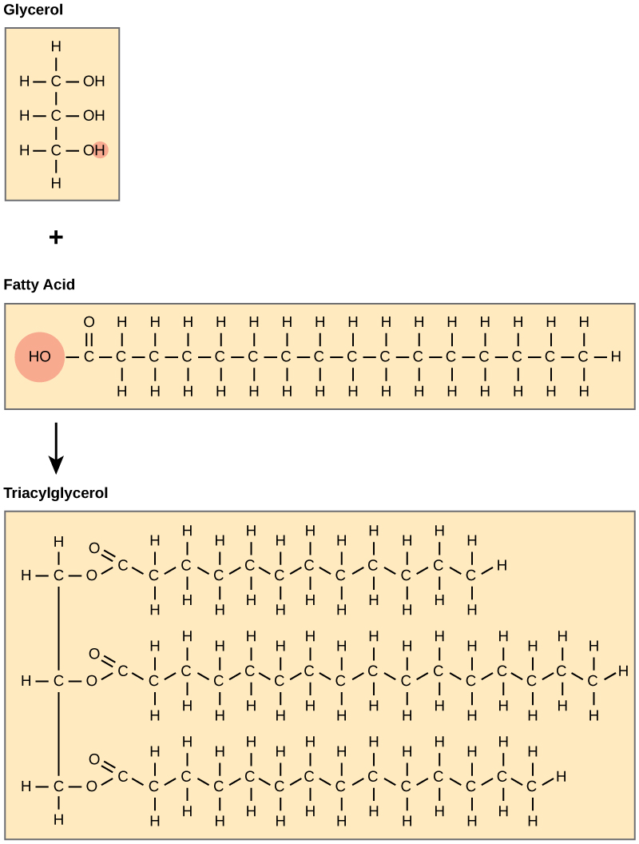
Fats and Oils
A fat molecule consists of two main components—glycerol and fatty acids.
Fatty acids have a long chain of hydrocarbons to which a carboxyl group is attached, hence the name “fatty acid.”
The number of carbons in a fatty acid may range from 4 to 36.
In a fatty acid molecule, the fatty acids attach to each of the glycerol molecule's three carbons with an ester bond through an oxygen atom.
We also call fats triacylglycerols or triglycerides because of their chemical structure.

Slide 14
Saturated Fatty Acids
Fatty acids may be saturated or unsaturated.
If there are only single bonds between neighboring carbons in the hydrocarbon chain, the fatty acid is saturated.
Saturated fatty acids are saturated with hydrogen. In other words, the number of hydrogen atoms attached to the carbon skeleton is maximized.
Stearic acid is an example of a saturated fatty acid

Slide 15
Unsaturated Fatty Acids
When the hydrocarbon chain contains a double bond, the fatty acid is unsaturated. Oleic acid is an example of an unsaturated fatty acid.
Most unsaturated fats are liquid at room temperature. We call these oils.
If there is one double bond in the molecule, then it is a monounsaturated fat (e.g., olive oil), and if there is more than one double bond, then it is a polyunsaturated fat (e.g., canola oil).

Slide 16
Cis and Trans Fatty Acids
Long straight fatty acids with single bonds generally pack tightly and are solid at room temperature.
Animal fats with stearic acid and palmitic acid (common in meat) and the fat with butyric acid (common in butter) are examples of saturated fats.
Unsaturated fats or oils are usually of plant origin and contain cis unsaturated fatty acids.
Cis and trans indicate the configuration of the molecule around the double bond.
If hydrogens are present in the same plane, it is a cis fat. The cis double bond causes a bend or a “kink” that prevents the fatty acids from packing tightly, keeping them liquid at room temperature
If the hydrogen atoms are on two different planes, it is a trans fat. Olive oil, corn oil, canola oil, and cod liver oil are examples of unsaturated fats.
Unsaturated fats help to lower blood cholesterol levels; saturated fats contribute to plaque formation in the arteries.

Slide 17
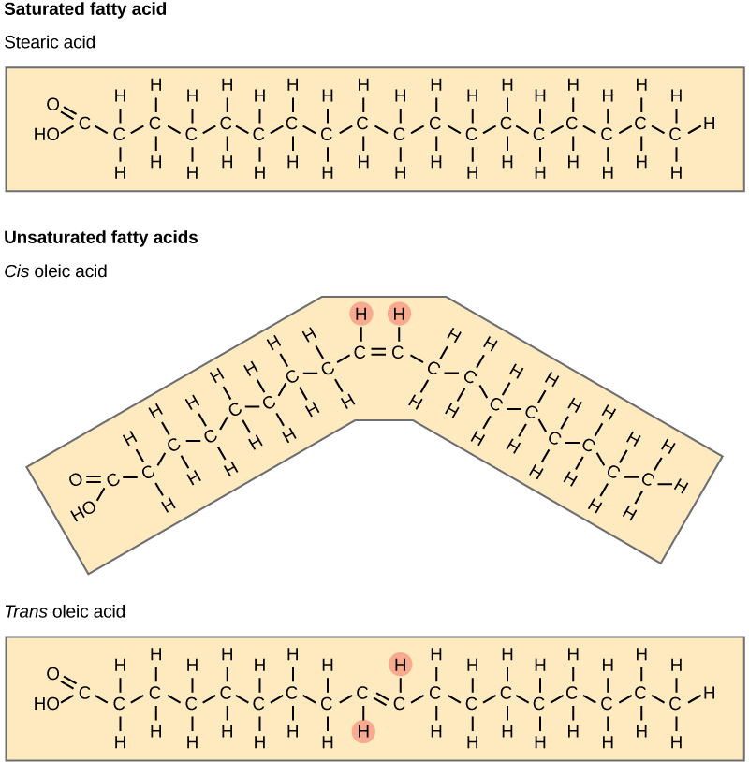

Slide 18
Discussion
Omega-3 Fatty Acids

Slide 19
Phospolipids
Phospholipids are major plasma membrane constituents that comprise cells' outermost layer.
They are comprised of fatty acid chains attached to a glycerol or sphingosine backbone with two fatty acids forming diacylglycerol, and a modified phosphate group eventually forming molecules like phosphatidylcholine and phosphatidylserine.
A phospholipid is an amphipathic molecule, meaning it has a hydrophobic and a hydrophilic part.
The fatty acid chains are hydrophobic (tails) and cannot interact with water; the phosphate-containing group is a hydrophilic (head) and interacts with water.
In a membrane, a bilayer of phospholipids forms the structure's matrix. Phospholipid fatty acid tails face inside, away from water; the phosphate group faces the outside, aqueous side
Phospholipids are responsible for the plasma membrane's dynamic nature.
If a drop of phospholipids is placed in water, it spontaneously forms a structure that scientists call a micelle, where the hydrophilic phosphate heads face the outside and the fatty acids face the structure's interior.

Slide 20
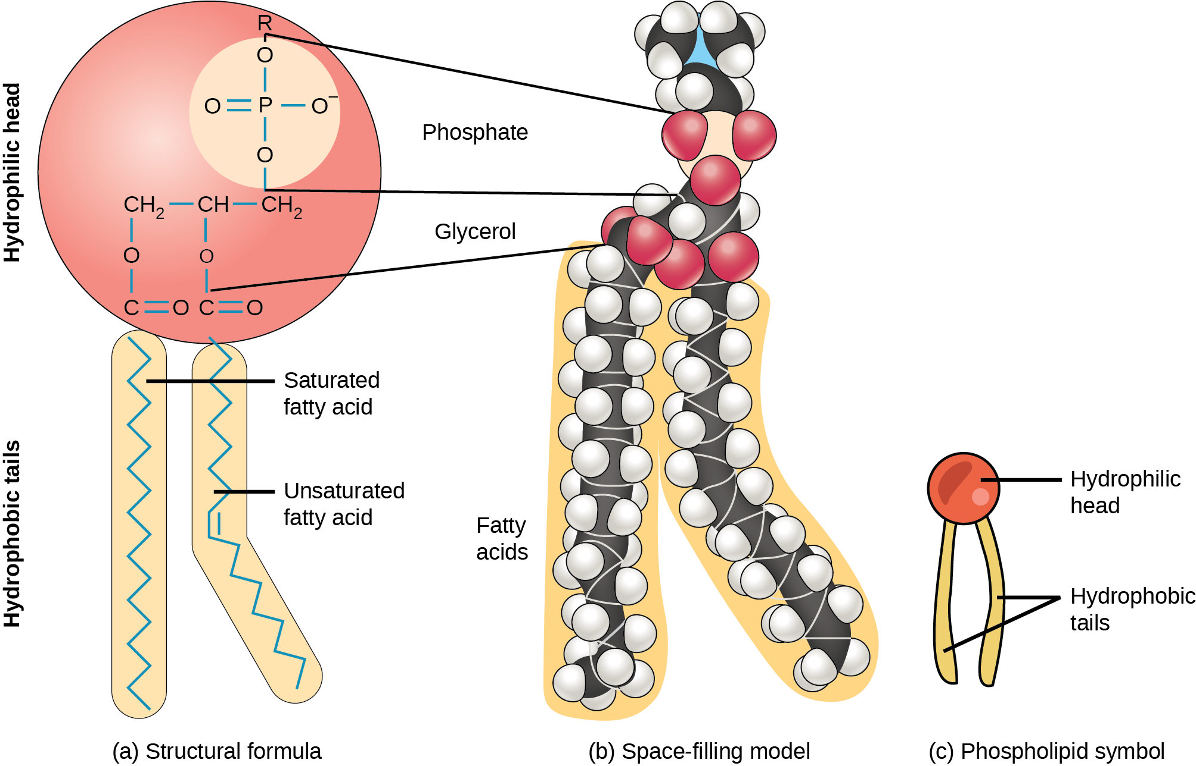
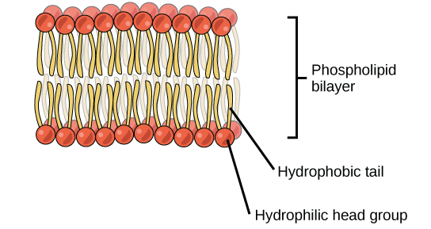

Slide 21
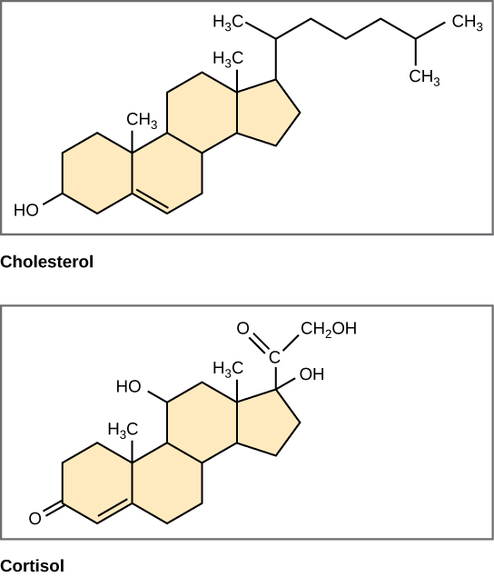
Steroids
Steroids are lipids with a fused ring structure.
They are hydrophobic and insoluble in water.
All steroids have four linked carbon rings and several of them, like cholesterol, have a short tail.
Cholesterol is the most common steroid. The liver synthesizes cholesterol and is the precursor to many steroid hormones such as testosterone and estradiol, which gonads and endocrine glands secrete. It is also the precursor to Vitamin D. Cholesterol is also the precursor of bile salts, which help emulsifying fats and their subsequent absorption by cells.
Sterols (cholesterol in animal cells, phytosterol in plants) are components of the plasma membrane of cells and are found within the phospholipid bilayer.

Slide 22
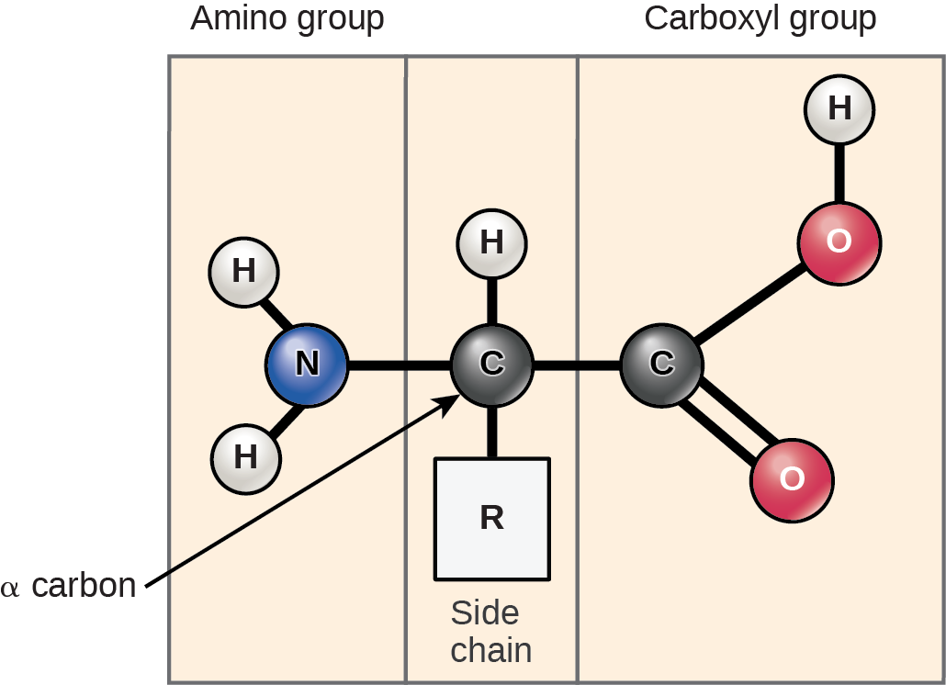
Proteins
Composed of amino acids.
Each amino acid has the same fundamental structure, which consists of a central carbon atom, or the alpha (α) carbon, bonded to an amino group (NH₂), a carboxyl group (COOH), and to a hydrogen atom.
Every amino acid also has another atom or group of atoms bonded to the central atom known as the R group.

Slide 23
Amino Acids
Amino acids contain both amino group and carboxyl-acid-group in their basic structure.
There are 20 common amino acids present in proteins.
Nine of these are essential amino acids in humans because the human body cannot produce them and we obtain them from our diet.
The chemical nature of the side chain determines the amino acid's nature (that is, whether it is acidic, basic, polar, or nonpolar).

Slide 24
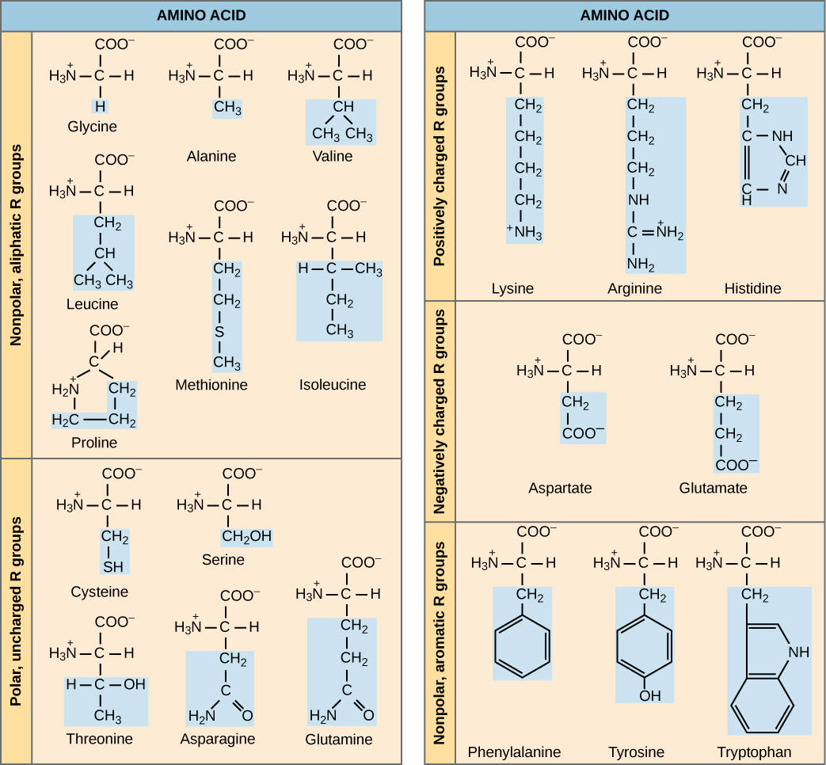

Slide 25
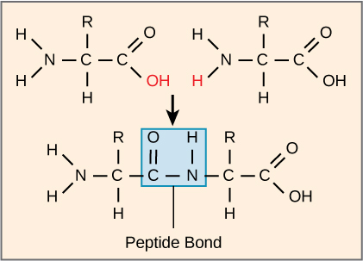
Protein Structure
The sequence and the number of amino acids ultimately determine the protein's shape, size, and function.
A covalent peptide bond forms when one amino acid's carboxyl group and the incoming amino acid's amino group combine, releasing a water molecule.
As more amino acids join to this growing chain, the resulting chain is a polypeptide.
A polypeptide is a polymer of amino acids.
A protein is a polypeptide or group of polypeptides that have combined together, often have bound non-peptide prosthetic groups, have a distinct shape, and have a unique function.

Slide 26
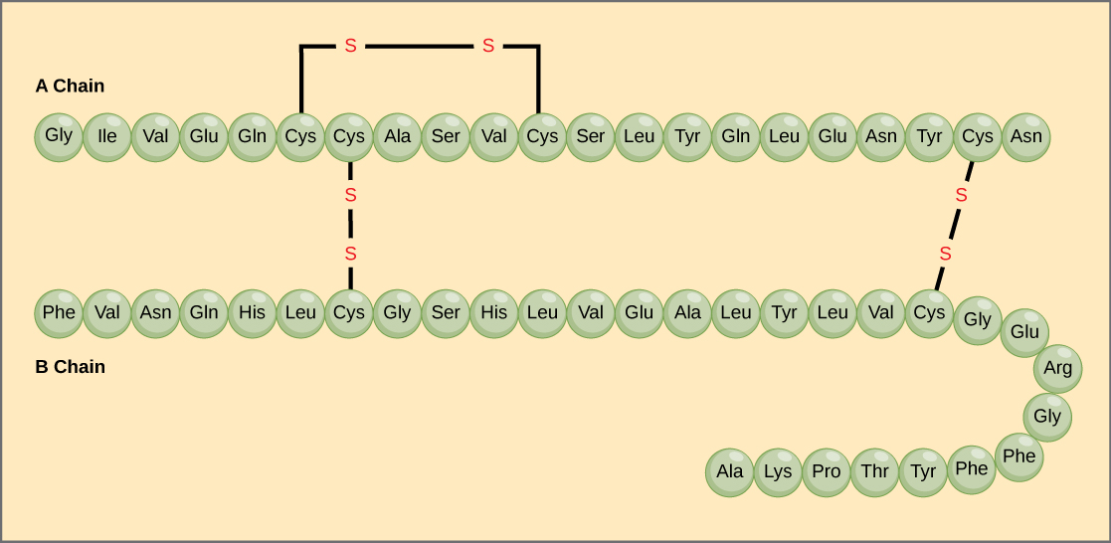
Primary Structure
Amino acids' unique sequence in a polypeptide chain is its primary structure.
Insulin has two polypeptide chains, A and B, linked together by disulfide bonds.
The N terminal amino acid of the A chain is glycine; the C terminal amino acid is asparagine

Slide 27
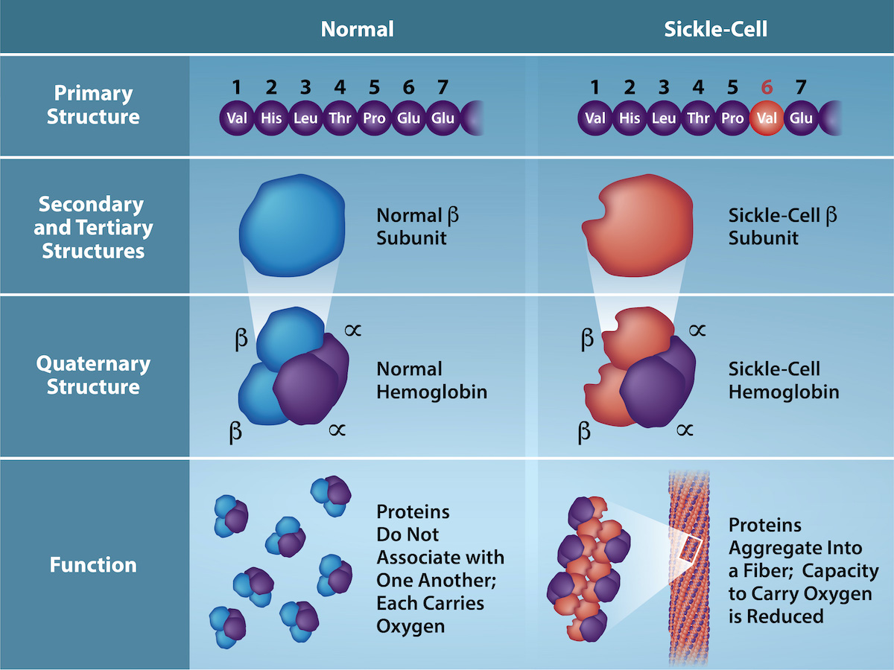
Sickle Cell
In sickle cell anemia, the hemoglobin β chain has a single amino acid substitution, causing a change in protein structure and function.
Specifically, valine in the β chain substitutes the amino acid glutamic. The structural difference between a normal hemoglobin molecule and a sickle cell molecule—which dramatically decreases life expectancy—is a single amino acid of the 600.
Because of this change of one amino acid in the chain, hemoglobin molecules form long fibers that distort the biconcave, or disc-shaped, red blood cells and causes them to assume a crescent or “sickle” shape, which clogs blood vessels.

Slide 28
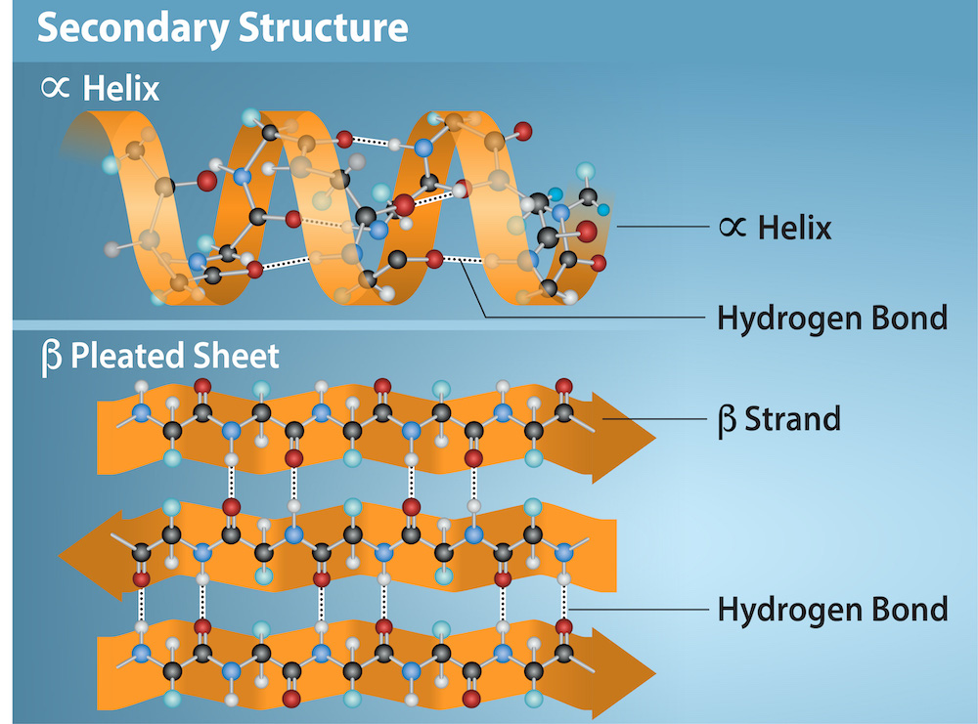
Secondary Structure
Folding of a polypeptide in some regions gives rise to the secondary structure of a protein.
α-helix and β-pleated sheet structures are held in shape by hydrogen bonds. The hydrogen bonds form between the oxygen atom in the carbonyl group in one amino acid and another amino acid that is four amino acids farther along the chain.
In the β-pleated sheet, hydrogen bonding between atoms on the polypeptide chain's backbone form the "pleats".
α-helix and β-pleated sheet structures are in most globular and fibrous proteins and they play an important structural role.

Slide 29
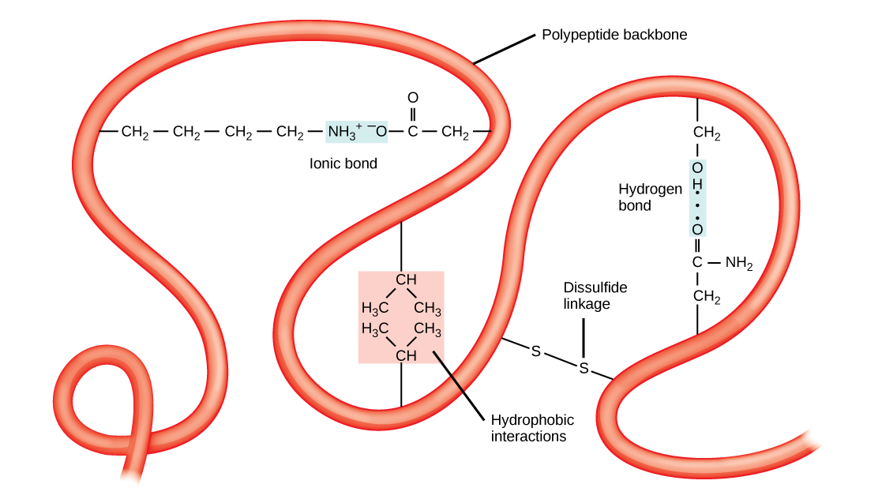
Tertiary Structure
The polypeptide's unique three-dimensional structure is its tertiary structure.
Interactions among R groups create the protein's complex three-dimensional tertiary structure.
When protein folding takes place, the nonpolar amino acids' hydrophobic R groups lie in the protein's interior; the hydrophilic R groups lie on the outside.
Interaction between cysteine side chains forms disulfide linkages in the presence of oxygen, the only covalent bond that forms during protein folding.

Slide 30
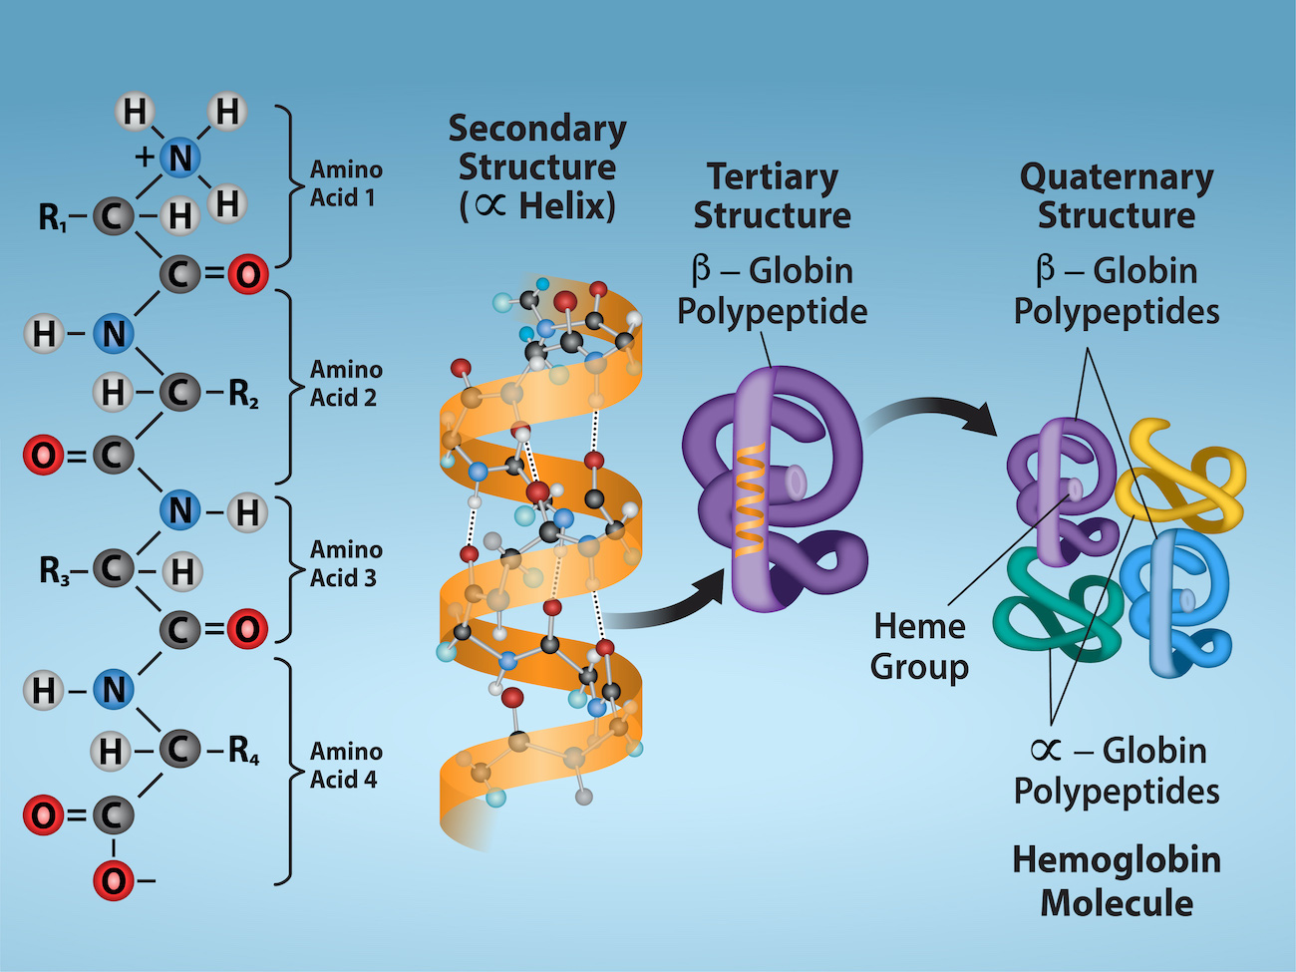
Qauternary Structure
Some proteins form from several polypeptides, or subunits, and the interaction of these subunits forms the quaternary structure.
Weak interactions between the subunits help to stabilize the overall structure.
Insulin (a globular protein) has a combination of hydrogen and disulfide bonds that cause it to mostly clump into a ball shape.

Slide 31
Denaturation and Protein Folding
If the protein is subject to changes in temperature, pH, or exposure to chemicals, the protein structure may change, losing its shape without losing its primary sequence in what scientists call denaturation.
Denaturation is often reversible because the polypeptide's primary structure is conserved in the process if the denaturing agent is removed, allowing the protein to resume its function.
Sometimes denaturation is irreversible, leading to loss of function.
One example of irreversible protein denaturation is frying an egg.

Slide 32
DNA and RNA
Deoxyribonucleic acid (DNA) and ribonucleic acid (RNA) are nucleic acids responsible for instructing protein synthesis.
DNA is the genetic material in all living organisms.
Many genes contain the information to make protein products. Other genes code for RNA products.
RNA is mostly involved in protein synthesis.
Messneger RNA (mRNA) is an intermediate nucleotide used to translate the DNA code into protein.
Other types of RNA—like rRNA, tRNA, and microRNA—are involved in protein synthesis and its regulation.

Slide 33
DNA and RNA
DNA and RNA are comprised of monomers that scientists call nucleotides.
Nucleotides combine with each other to form a polynucleotide, DNA or RNA.
Three components comprise each nucleotide: a nitrogenous base, a pentose (five-carbon) sugar, and a phosphate group.
Each nucleotide in DNA contains one of four possible nitrogenous bases: adenine (A), guanine (G) cytosine (C), and thymine (T).

Slide 34
DNA and RNA
Adenine and guanine as purines.
Apurine's primary structure is two carbon-nitrogen rings.
Cytosine, thymine, and uracil are pyrimidines which have a single carbon-nitrogen ring as their primary structure.
Each of these basic carbon-nitrogen rings has different functional groups attached to it.
In molecular biology shorthand, we know the nitrogenous bases by their symbols A, T, G, C, and U.
DNA contains A, T, G, and C; RNA contains A, U, G, and C.
The pentose sugar in DNA is deoxyribose, and in RNA, the sugar is ribose.
The difference between the sugars is the presence of the hydroxyl group on the ribose's second carbon and hydrogen on the deoxyribose's second carbon.

Slide 35
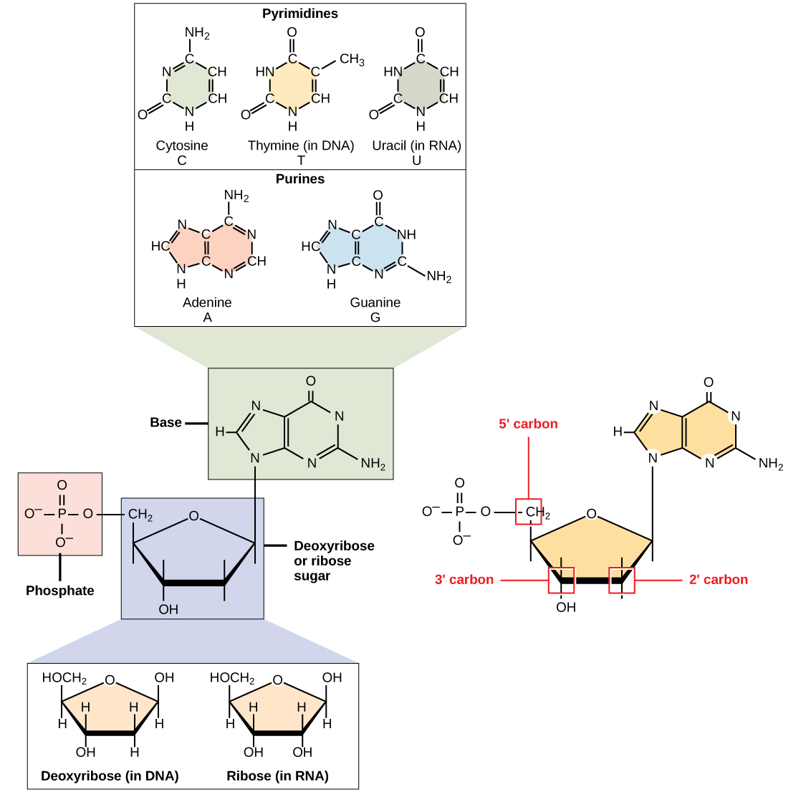

Slide 36
DNA Double-Helix Structure
DNA has a double-helix structure.
The sugar and phosphate backbone lie on the outside of the helix.
The nitrogenous bases are stacked in the interior, like a pair of staircase steps.
Hydrogen bonds bind the pairs to each other.
The helix's two strands run in opposite directions, meaning that the 5′ carbon end of one strand will face the 3′ carbon end of its matching strand. (Scientists call this an antiparallel orientation and is important to DNA replication and in many nucleic acid interactions.)
Only certain types of base pairing are allowed: A can pair with T, and G can pair with C. This is the base complementary rule.
DNA strands are complementary to each other. If the sequence of one strand is AATTGGCC, the complementary strand would have the sequence TTAACCGG.
During DNA replication, each strand copies itself, resulting in a daughter DNA double helix containing one parental DNA strand and a newly synthesized strand.

Slide 37
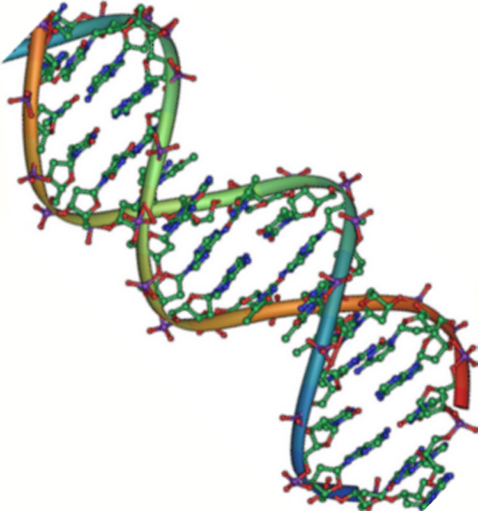

Slide 38
RNA
Ribonucleic acid, or RNA, is nucleic acid polymer used to direct protein synthesis.
RNA is usually single-stranded and is comprised of ribonucleotides that are linked by phosphodiester bonds.
A ribonucleotide in the RNA chain contains ribose (the pentose sugar), one of the four nitrogenous bases (A, U, G, and C), and the phosphate group.
There are four major types of RNA: messenger RNA (mRNA), ribosomal RNA (rRNA), transfer RNA (tRNA), and microRNA (miRNA).

Slide 39
RNA
mRNA, carries the message from DNA, which controls all of the cellular activities in a cell.
An mRNA base sequence is complementary to the DNA's coding sequence (gene) from which it has been copied in a process called transcription.
In mRNA, the base T is absent and U is present instead. If the DNA strand has a sequence AATTGCGC, the sequence of the complementary RNA is UUAACGCG.
In the cytoplasm, the mRNA interacts with ribosomes and other cellular machinery to synthesize protein by translating the mRNA.

Slide 40
RNA and Codons
The mRNA is read in sets of three bases known as codons.
Each codon codes for a single amino acid.
Ribosomal RNA (rRNA) is a major constituent of ribosomes on which the mRNA binds.
rRNA ensures the proper alignment of the mRNA and the Ribosomes.
The ribosome's rRNA also has an enzymatic activity. Transfer RNA (tRNA) carries the correct amino acid to the protein synthesis site.
Base pairing between the tRNA and mRNA that allows for the correct amino acid to insert itself in the polypeptide chain.

Slide 41
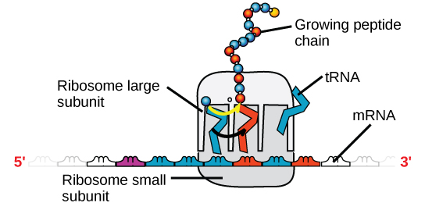
 | DNA | RNA
Function | Carries genetic information | Involved in protein synthesis
Location | Remains in the nucleus | Leaves the nucleus
Structure | Double helix | Usually single-stranded
Sugar | Deoxyribose | Ribose
Pyrimidines | Cytosine, thymine | Cytosine, uracil
Purines | Adenine, guanine | Adenine, guanine

