Slide 1
BIOL 1010 Module 2
OepnStax
Biology 2e
Chapter 2: The Chemical Foundation of Life

Slide 2
The Fundamental Units of Life
Matter – any substance that occupies space and has mass
Elements – unique forms of matter with specific chemical and physical properties that cannot break down into smaller substances by ordinary chemical reactions.
Elements – designated by a chemical symbol
Four Elements Common to all living things:
Oxygen (O)
Carbon (C)
Hydrogen (H)
Nitrogen (N)

Slide 3
How do we begin building life?
The Atom
The smallest unit of matter that retains all of the element’s chemical properties.

Slide 4
Atoms
All atoms of an element retain the same chemical properties of the element.
For example: all carbon atoms have the same chemical properties.
Atoms are composed of a core nucleus and a series of orbital shells for electrons orbiting the nucleus
The nucleus contains a proton alone (hydrogen) or protons and neutrons (all other atoms).
Protons and neutrons have an atomic mass of one (1) or (1 Dalton).
Electron mass does not contribute significantly to the mass of an atom and is ignored in any mass calculation.

Slide 5
Atomic Structure
Protons are positively charged with an atomic mass of one (1).
Neutrons are uncharged and have an atomic mass of one (1).
Electrons are negatively charged and do not carry a significant atomic mass, so we ignore the mass in calculations.

Slide 6
Atomic Number and Mass
Atomic Number = Number of Protons
Mass Number = Number of Protons + Number of Neutrons
Elemental Isotopes – Vary in the number of neutrons. (Isotopes behave the same chemically.)
Electrons – Ignore the mass of these subatomic particles.
Most of an atom is empty space.
Atoms have a charge balance between electrons and protons leading to no net charge.
Isotope mass is averaged (mean) to give an atom’s atomic mass.

Slide 7
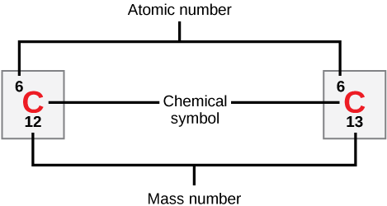

Slide 8
Isotopes
Isotopes – atoms from the same element with the same number of protons and different number of neutrons.
Carbon-12 and Carbon-13 are stable isotopes with six and seven neutrons respectively.
Carbon-14 is an unstable isotope with two extra (eight) neutrons.
Carbon-14 is a radioactive isotope (radioisotope) that decays to Nitrogen-14 by gaining a proton and an electron.
Energy loss (beta decay) occurs in this process.
Carbon-14 decay is used to date the age of artifacts.

Slide 9
The Periodic Table of Elements
Organizes elements based on their atomic properties.
Elements are organized by periods and groups.
Periods (rows across) have the same number of electron shells.
Groups (columns) have the same number of valence electrons.
Periodic table display atomic mass and atomic number.
The table helps us understand how elements can react and bond to form molecules.
Molecules are tow or more atoms bonded together chemically.

Slide 10
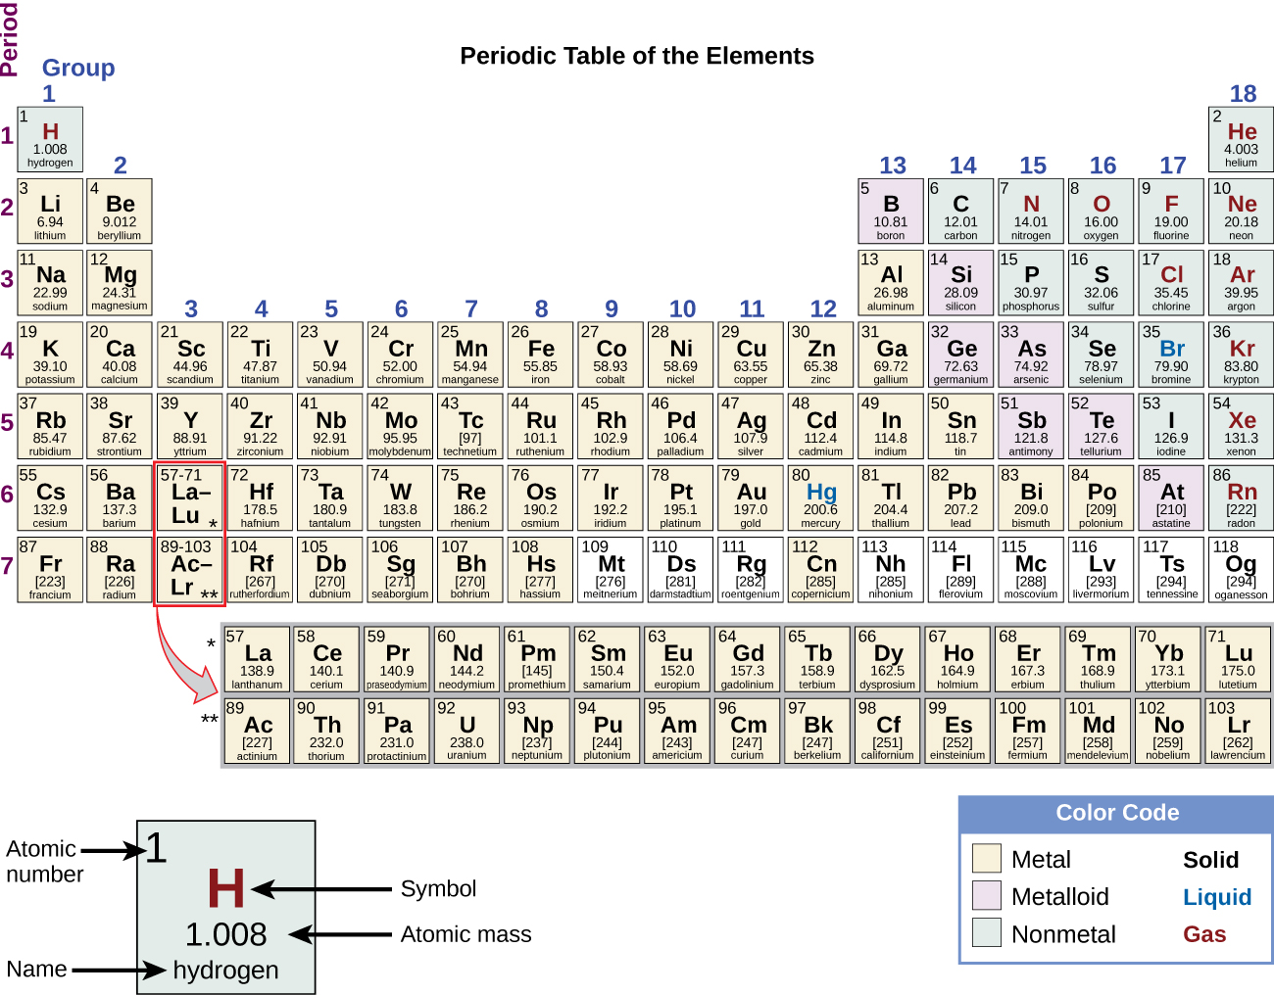

Slide 11
The Electron– Proton Connection
Neutrally charged atoms have the same number of protons and neutrons.
The number of electrons equals the number of protons.
Electrons exist in orbitals around the protons and neutrons in the nucleus.
Niels Bohr created an atomic model with circular shells demonstrating electrons orbiting the nucleus at specific distances.
Electrons do not move in smooth orbits around a nucleus, but the shell structure of the Bohr atom helps us understand how electrons play a role in bonding.

Slide 12
The Bohr Atom
Electrons form electron shells or energy levels around a nucleus.
Shells are designated by “n.”
Allows us to visualize electrons and their position in the outermost shell around the atom.
Electrons in the outermost shell of an atom form chemical bonds with electrons in the outermost shell of another atoms.

Slide 13
Electron Filling and The Octet Rule
Electrons move to their lowest energy state and fill shells beginning with the shell closest to the nucleus.
Shells are filled successively until the number of electrons equals the number of protons to form an uncharged (stable) atom.
The first shell holds two electrons. Subsequent shells hold eight electrons – an octet of electrons in each shell.

Slide 14
Atomic Bonding – A Beginning
Atoms with eight electrons in their outermost shell, like neon (Ne), are stable and don’t react with other atoms under standard conditions.
Atoms like Carbon (C), Sodium (Na), Fluorine (F) and Chlorine (Cl) have unfilled outer electron shells and can bind with other atoms to form molecules.
Atoms donate, accept or share electrons with another atom to fill their outermost (valence) electron shells.

Slide 15
Electron Orbitals
Electrons exist in orbitals created by the combined particle and wave properties of electron behavior.
Each orbital holds up to two electrons.
Electron orbitals more closely describe the position of electrons as they move around the nucleus.

Slide 16
Chemical Reactions and Molecules
All elements are most stable when their outermost shell is filled with electrons according to the octet rule.
It is energetically favorable for the outer shell of atoms to be full.
When two or more atoms chemically bond with each other, the resultant chemical structure is a molecule.
Atoms form chemical bonds with other atoms thereby obtaining the electrons they need to attain a stable electron configuration.
Chemical reactions occur when two or more atoms bond together to form molecules or when bonded atoms break apart.

Slide 17
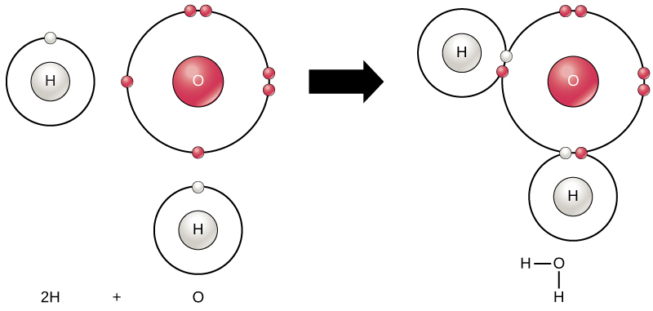

Slide 18
Reactants to Products
Reactants – substances used at the beginning of a reaction.
Products – substances at the end reaction.
Balanced Equation - number of atoms of reactants equals the number of product atoms.
Compounds – contain more than one kind of element.
2H + O H₂O
Reactants Products

Slide 19
Ions and Ionic Bonds
Electron transfer between atoms creates ions.
Cations are created when an atom loses an electron.
Anions are created when an atom gains an electron.
Ionic bonds form between cations and anions.

Slide 20
Sodium Chloride (NaCl)
The chlorine (Cl) nucleus is more electronegative and strips an electron from sodium (Na), which is less electronegative and loses an electron.
Chlorine becomes negatively charged (anion).
We call the negatively charged atom chloride.

Slide 21
Sodium Chloride (NaCl)
The sodium atom becomes positively charged (cation).
The negatively charged chloride and positively charged sodium are attracted to each other and are held together by their opposite charges as a compound.

Slide 22
Covalent Bonds
Atoms can share electrons to complete or partially complete their valence shells.
Carbon has four electrons in its valence shell. It can bond with four atoms by sharing one of each of its electrons with an electron from another atom.
Carbon covalent bonds are the backbone for many biological molecules.
Water is a covalently bonded molecule. Let’s revisit how hydrogen bonds to oxygen in the water molecule.

Slide 24
Covalent Bonding in Water
The oxygen atom and the hydrogen atoms have filled valence shells.
Oxygen shares one electron with each hydrogen atom.
Each hydrogen atom shares one electron with oxygen.
Covalent bonds are stronger than ionic bonds and require more energy to create or break.
The more electrons shared between two atoms the stronger the bond.

Slide 25
Nonpolar Covalent Bonds
Polar covalent bonds create a charge separation when the more electronegative atom attracts electrons from the less electronegative atom.
Water is a polar covalent bond.
Nonpolar covalent bonds do not create regions of attraction. Electrons are shared evenly in these molecules.

Slide 26
Hydrogen Bonds and Van Der Waals Interactions
The partial positive charge on a hydrogen atom of a polar covalent bond can attract the partial positive charge of a nearby polar molecule atom.
This is a weak interaction alone, but in large enough numbers these interactions can relatively strong forces.
Hydrogen bonds are weaker than ionic bonds.
Van der Waals interactions occur when the momentary fluctuations in electron location in a moelcule creates attractive forces between those molecules.
Van der Waals interactions are the weakest interactions.

Slide 27
Water
Without it, life as we know it would not exist.

Slide 28
Properties of Water
Remember, water is a polar molecule.
Water’s partial charges give it unique properties.
Water is attracted to polar molecules and ions.
Substances that interact readily with (or dissolves in) water are called hydrophilic.
Nonpolar substances do not interact readily with water. They are called hydrophobic.

Slide 29
The Capacity of Water
Exists in three states: solid, liquid and gas.
Water has the highest specific heat capacity of all liquids.
Specific heat is the amount of heat one gram of a substance must absorb or lose to change its temperature by one degree Celsius.
For water this equals one calorie.
Water absorbs and loses heat more slowly.
Water allows even heat distribution warm blooded animals.
Water has a high heat of vaporization.
It is defined as the amount of energy required to change one gram of a liquid substance to a gas.

Slide 30
Water as a Solvent
Water is a solvent, a substance capable of dissolving other polar molecules and ionic compounds.
charges associated with these molecules will form hydrogen bonds with water, surrounding the particle with water molecules.
A sphere of hydration, or a hydration shell, serves to keep the particles separated or dispersed in the water.

Slide 31
Water’s Cohesive and Adhesive Properties
Hydrogen bonds formed by water molecules keep the molecules together at the water-air interface.
Cohesion creates surface tension, the capacity of a substance to withstand rupturing when placed under tension or stress.

Slide 32
Water’s Cohesive and Adhesive Properties
Cohesive forces are related to water’s property of adhesion, or the attraction between water molecules and other molecules.
We observe adhesion when water climbs up the tube placed in a glass of water.
We call this type of adhesion capillary action.

Slide 33
Water’s Cohesive and Adhesive Properties
Insects such as the water strider use the water's surface tension to stay afloat on the water's surface layer and even mate there.
Cohesive and adhesive forces are important for transporting water from the roots to the leaves in plants.

Slide 34
pH, Buffers, Acids, and Bases
Hydrogen ions spontaneously generate in pure water by the dissociation (ionization) of a small percentage of water molecules into equal numbers of hydrogen (H⁺) ions and hydroxide (OH⁻) ions.
H₂O (I) H⁺ (aq) + OH⁻ (aq)
The concentration of dissociated hydrogen ions in pure water is expressed on the pH scale. Water has neutral pH of seven (7).

Slide 35
pH Scale
The pH scale is an inverse logarithm and ranging from 0 to 14.
0.0 to 6.9 is acidic.
7.1 to 14.0 is alkaline.
Extremes in pH in either direction from 7.0 are usually inhospitable to life.
The pH inside cells (6.8) and the pH in the blood (7.4) are both very close to neutral.

Slide 36
Acids and Bases
Non-neutral pH readings result from dissolving acids or bases in water.
Using the negative logarithm to generate positive integers, high concentrations of hydrogen ions yield a low pH number; whereas, low levels of hydrogen ions result in a high pH.
An acid is a substance that increases hydrogen ions' (H⁺) concentration in a solution, usually by having one of its hydrogen atoms dissociate.
A base provides either hydroxide ions (OH–) or other negatively charged ions that combine with hydrogen ions, reducing their concentration in the solution and thereby raising the pH.
In cases where the base releases hydroxide ions, these ions bind to free hydrogen ions, generating new water molecules.

Slide 37
Acids and Bases
The stronger the acid, the more readily it donates H⁺.
Hydrochloric acid (HCl) completely dissociates into hydrogen and chloride ions and is highly acidic; whereas the acids in tomato juice or vinegar do not completely dissociate and are weak acids.
Strong bases are those substances that readily donate OH– or take up hydrogen ions.
Sodium hydroxide (NaOH) and many household cleaners are highly alkaline and give up OH– rapidly when we place them in water, thereby raising the pH. An example of a weak basic solution is seawater, which has a pH near 8.0 This is close enough to a neutral pH that marine organisms have adapted in order to live and thrive in a saline environment.

Slide 38
Buffers
Buffers readily absorb excess H⁺ or OH–, keeping the body's pH carefully maintained in the narrow range required for survival.
Maintaining a constant blood pH is critical to a person’s well-being.
The buffer maintaining the pH of human blood involves carbonic acid (H₂CO₃), bicarbonate ion (HCO₃–), and carbon dioxide (CO₂).
When bicarbonate ions combine with free hydrogen ions and become carbonic acid, it removes hydrogen ions and moderates pH changes.
Excess carbonic acid can convert to carbon dioxide gas which we exhale through the lungs. This prevents too many free hydrogen ions from building up in the blood and dangerously reducing the blood’s pH.

Slide 39
Macromolecules
Hydrocarbons
Isomers
Enantiomers
Functional Groups

Slide 40
Hydrocarbons
Organic molecules - any carbon-containing liquid, solid, or gas.
Remember, carbon has only four electrons in its valence shell, making it capable of sharing four electrons with other atoms or a singular atom.
Hydrocarbons are organic molecules consisting entirely of carbon and hydrogen, such as methane (CH₄)

Slide 41
Hydrocarbon Chains
Successive bonds between carbon atoms form branched or unbranched hydrocarbon chains.
The hydrocarbons ethane, ethene, and ethyne serve as examples of how different carbon-to-carbon bonds affect the molecule's geometry.
The names of all three molecules start with the prefix “eth-,” which is the prefix for two carbon hydrocarbons. The suffixes “-ane,” “-ene,” and “-yne” refer to the presence of single, double, or triple carbon-carbon bonds.

Slide 42
Hydrocarbon Rings
Aromatic hydrocarbons consist of closed rings of carbon atoms with alternating single and double bonds.
Biological molecules that incorporate a benzene ring include some amino acids and cholesterol and its derivatives, including the hormones estrogen and testosterone.

Slide 43
Isomers
Molecules that share the same chemical formula but differ in the placement (structure) of their atoms and/or chemical bonds are called isomers.
Structural isomers differ in the placement of their covalent bonds: both molecules have four carbons and ten hydrogens (C₄H₁₀), but the different atom arrangement within the molecules leads to differences in their chemical properties.

Slide 44
Isomers
Geometric isomers have similar placements of their covalent bonds but differ in how these bonds are made to the surrounding atoms.
Butene (C₄H₈), the two methyl groups (CH₃) can be on either side of the double covalent bond central to the molecule.
When the carbons are bound on the same side of the double bond, this is the cis configuration.
If they are on opposite sides of the double bond, it is a trans configuration.
In the trans configuration, the carbons form a more or less linear structure; whereas, the carbons in the cis configuration make a bend (change in direction) of the carbon backbone.

Slide 45
Biological Isomers
In triglycerides (fats and oils), long carbon chains known as fatty acids may contain double bonds, which can be in either the cis or trans configuration.
Fats with at least one double bond between carbon atoms are unsaturated fats. When some of these bonds are in the cis configuration, the resulting bend in the chain's carbon backbone means that triglyceride molecules cannot pack tightly, so they remain liquid (oil) at room temperature.
Triglycerides with trans double bonds (popularly called trans fats), have relatively linear fatty acids that can pack tightly together at room temperature and form solid fats.

Slide 46
Enantiomers
Enantiomers are molecules that share the same chemical structure and chemical bonds but differ in the three-dimensional placement of atoms so that they are non-superimposable mirror images.
In nature, the L-forms of amino acids are predominant in proteins. Some D forms of amino acids are seen in the cell walls of bacteria and polypeptides in other organisms.
Similarly, the D-form of glucose is the main product of photosynthesis and we rarely see the molecule's L-form in nature.

Slide 47
Functional Groups
Functional groups are groups of atoms that occur within molecules and confer specific chemical properties to those molecules.
Functional groups participate in chemical reactions.
Functional grouus play an important role in forming molecules like DNA, proteins, carbohydrates, and lipids.
We classify functional groups as hydrophobic or hydrophilic depending on their charge or polarity characteristics.

Slide 48
Functional Groups
Hydrogen bonds between functional groups (within the same molecule or between different molecules) are important to the function of many macromolecules and help them to fold properly into and maintain the appropriate shape for functioning.
Hydrogen bonds are also involved in various recognition processes, such as DNA complementary base pairing and the binding of an enzyme to its substrate.

