Slide 1
BIOL 1010 Module 1
OpenStax
Biology 2e
Chapter 1: The Study of Life

Slide 2
What is biology?
Why should we study it?

Slide 3
A Brief History of Life
Life started as microorganisms
Higher organisms originated 130-250 million years ago
Genus Homo originated in the last 2.5 million years
Modern humans emerged 300,00 years ago

Slide 4
Biology As A Science
We can define science (from the Latin scientia, meaning “knowledge”) as knowledge that covers general truths or the operation of general laws, especially when acquired and tested by the scientific method. (Biology 2e)
The foundation of science is testing of hypotheses through experimentation.
The scientific method is a method of research with defined steps that include experiments and careful observation. (Biology 2e)
A hypothesis is a suggested explanation for an event, which one can test. (Biology 2e)

Slide 5
Biology As A Science
A hypothesis is a suggested explanation for an event, which one can test. (Biology 2e)
A theory is a tested and confirmed explanation for observations or phenomena. (Biology 2e)

Slide 6
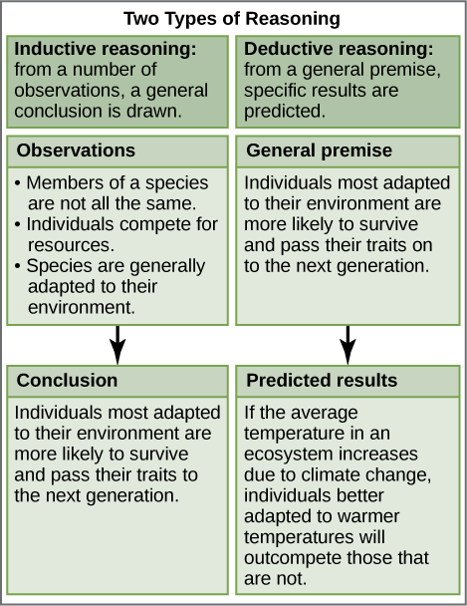
Scientific Reasoning
Inductive Reasoning – logical thinking using descriptive science or observations lead to general conclusions.
Deductive Reasoning – logical thinking used to create hypotheses to predict results.

Slide 7
The Scientific Method
1. Observation | a. There is something wrong with the electrical outlet.
2. Question | b. If something is wrong with the outlet, my coffeemaker also won’t work when plugged into it.
3. Hypothesis (answer) | c. My toaster doesn’t toast my bread.
4. Prediction | d. I plug my coffee maker into the outlet.
5. Experiment | e. My coffeemaker works.
6. Result | f. Why doesn’t my toaster work?

Slide 8
Testing a Hypothesis
A valid hypothesis must be testable
A testable hypothesis must be falsifiable – experimental results can disprove the hypothesis
An experiment requires variables – dependent and independent
An experiments requires a control group – no manipulation
Dependent Variable – a measured variable in the experiment, which leads to experimental results
Independent Variable – a measure changed or manipulated in the experiment

Slide 9
Two Types of Science
Basic Science
Expands scientific knowledge regardless of real work application.
Basic science is the foundation of applied science.
Applied Science
Applies basic science to solve real world problems.
Applied science generates immediately applicable results.

Slide 10
Reporting Scientific Work
Scientists share work through peer-reviewed publications.
Peer-reviewed articles are a foundation of scientific work.
Lay articles (online or print), television news stories and opinion are not peer-reviewed and are not scientific.

Slide 11
Properties of Life
Order
Response to Stimuli
Reproduction
Adaptation
Growth and Development
Regulation/Homeostasis
Energy Processing
Evolution

Slide 12
Organizing Living Things
What are the building blocks of living things?
Atoms
Molecules
Macromolecules
Cells
Tissues
Organs
Figure 1.15 All molecules, including this DNA molecule, are comprised of atoms. (credit: “brian0918”/Wikimedia Commons)

Slide 13
Cells
The cell is the smallest functional unit of life.
Cells are formed by the cohesion or chemical bonding of macromolecules or atoms including membranes.
Membrane formation was necessary for life as we know it.
Membrane-bound organelles form functional components of eukaryotic cells.
Eukaryotic cells are the building blocks of more complex organisms and house their DNA in membrane-bound nuclei.
Prokaryotic cells lack membrane-bound organelles or nulcei.

Slide 14
From Cells to Organs
Cells with common or complementary functions combine to form tissues.
Organs are collections of tissues grouped together performing a common function.
An organ system is an organization of tissues forming higher organisms.
Humans are an example of organisms composed of organ systems.

Slide 16
Branches of Biological Study
Molecular biology and biochemistry study biological processes at the molecular and chemical level, including interactions among molecules such as DNA, RNA, and proteins, as well as the way they are regulated.
Microbiology, the study of microorganisms, is the study of the structure and function of single-celled organisms.
Neurobiologists study the biology of the nervous system, and although it is a branch of biology, it is also an interdisciplinary field of study known as neuroscience.
Paleontology, another branch of biology, uses fossils to study life’s history.
Zoology and botany are the study of animals and plants, respectively.

Slide 17
Diversity of Life
Evolution is the source of life’s diversity on Earth.
Evolution is the process of gradual change in a population or species over time.
Evolutionary biologists study the evolution of living things in everything from the microscopic world to ecosystems.
A phylogenetic tree can summarize the evolution of various life forms on Earth.
It is a diagram showing the evolutionary relationships among biological species based on similarities and differences in genetic or physical traits or both.
The internal nodes represent ancestors and are points in evolution when, based on scientific evidence, researchers believe an ancestor has diverged to form two new species.
The length of each branch is proportional to the time elapsed since the split.

Slide 18
Diversity of Life
Figure 1.17 Microbiologist Carl Woese constructed this phylogenetic tree using data that he obtained from sequencing ribosomal RNA genes. The tree shows the separation of living organisms into three domains: Bacteria, Archaea, and Eukarya. Bacteria and Archaea are prokaryotes, single-celled organisms lacking intracellular organelles. (credit: Eric Gaba; NASA Astrobiology Institute)

