Slide 1
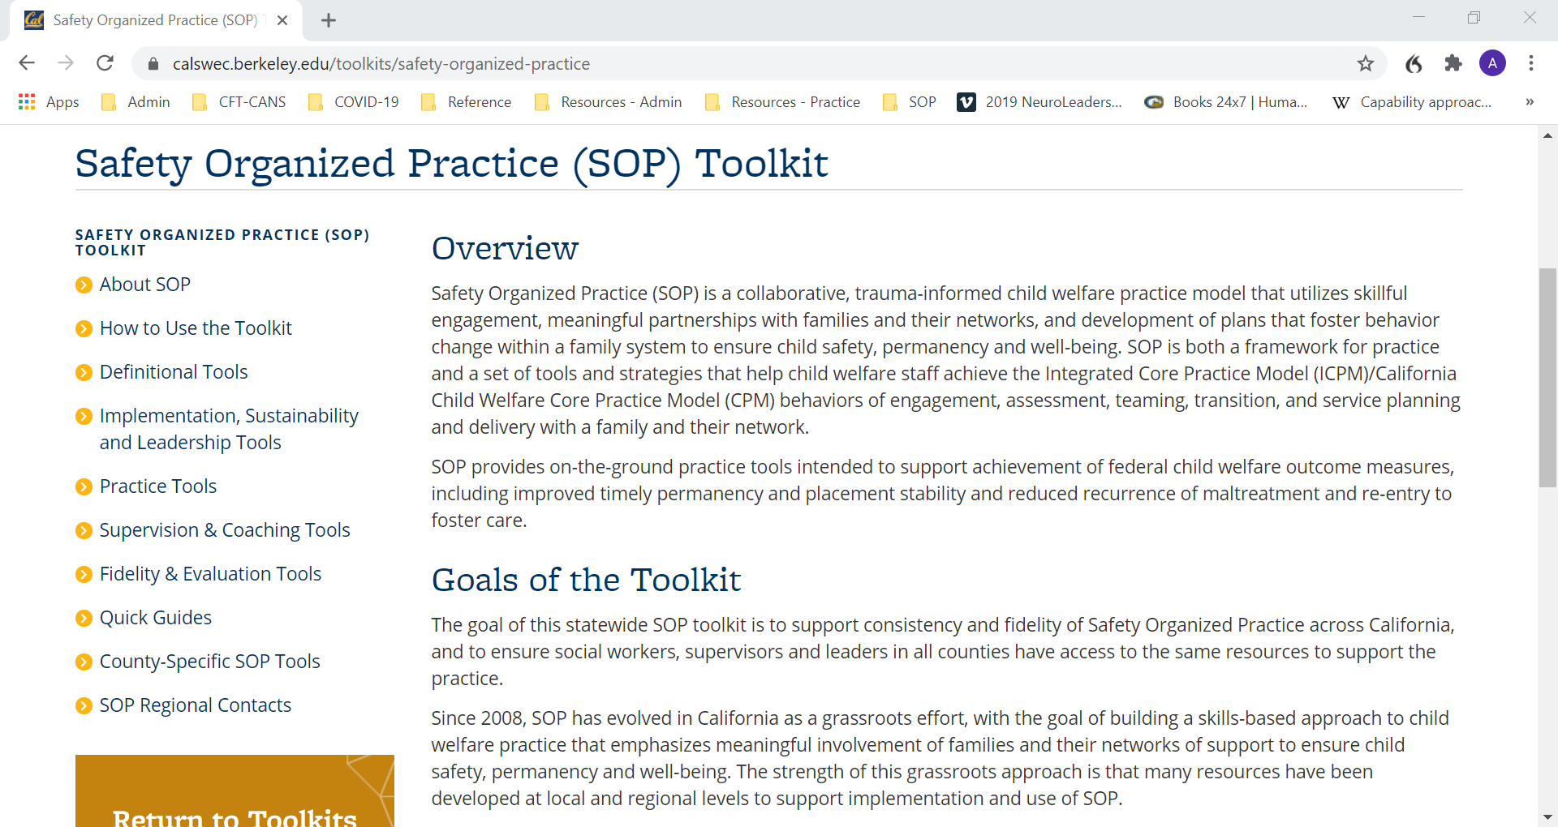
SOP Toolkit
Your complete resource for SOP implementation, leadership and practice supports!
Definitional Tools
Implementation, Sustainability & Leadership Tools
Practice Tools
Supervision & Coaching Tools
Fidelity & Evaluation Tools
Quick Guides
County-Specific Tools
SOP Regional Contacts
Contact your Regional Training Academy for more information
https://calswec.berkeley.edu/toolkits/safety-organized-practice
Notes:
NOTE: VERSION 1: THIS SLIDE CAN BE USED FOR TRAININGS DELIVERED BY THE REGIONAL TRAINING ACADEMY.
The SOP toolkit contains a comprehensive range of tools to support agencies in implementing SOP and practicing to fidelity.
The toolkit was developed by California’s SOP Backbone Committee, which is made up of members from the Regional Training Academies (RTAs; Northern, Southern, Bay and Central), CDSS, Casey Family Programs, CalSWEC and county representatives from each region. The RTAs provide SOP training, coaching and technical assistance in their geographic areas, including supporting counties in implementing the toolkit. If you would like more information, check out the website at the URL listed here, go to the main CalSWEC website and click on Quick Links – Toolkits – SOP Toolkit, or contact your local RTA.

Slide 2
SOP Toolkit
Your complete resource for SOP implementation, leadership and practice supports!
Definitional Tools
Implementation, Sustainability & Leadership Tools
Practice Tools
Supervision & Coaching Tools
Fidelity & Evaluation Tools
Quick Guides
County-Specific Tools
SOP Regional Contacts
Contact your county’s training coordinator for more information
https://calswec.berkeley.edu/toolkits/safety-organized-practice
Notes:
NOTE: VERSION 2: THIS SLIDE CAN BE USED FOR TRAININGS DELIVERED BY COUNTIES.
The SOP toolkit contains a comprehensive range of tools to support agencies in implementing SOP and practicing to fidelity.
The toolkit was developed by California’s SOP Backbone Committee, which is made up of members from the Regional Training Academies (RTAs; Northern, Southern, Bay and Central), CDSS, Casey Family Programs, CalSWEC and county representatives from each region. The RTAs provide SOP training, coaching and technical assistance in their geographic areas, including supporting counties in implementing the toolkit. If you would like more information, check out the website at the URL listed here, go to the main CalSWEC website and click on Quick Links – Toolkits – SOP Toolkit, or contact your training coordinator or staff development officer.

