Slide 1
IT Grade 10 Flowchart and pseudocode Algorithms

Slide 2
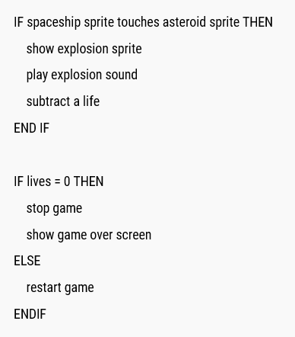
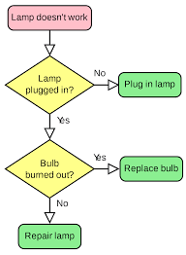
Representing algorithms
Pseudocode
A detailed description of what a computer program or algorithm must do, expressed in natural language rather than in a programming language.
Flow chart
A flowchart is the graphical representation of an algorithm using different symbols, shapes and arrows in order to demonstrate a process or program.

Slide 3
Pseudocode
Limit pseudocode statements to one per line.
Use initial capitalization for all keywords.
Do not write source code. Write your thoughts of what the program should do.
List all steps. ...
Don't be afraid to use programming structures (IF, THEN, ELSE etc.)
Use indentation to show subordination.
Example

Slide 4
Flow chart algorithm
A flowchart is the graphical representation of an algorithm using different symbols, shapes and arrows in order to demonstrate a process or program.
Terminal Box – Start/end
Decision
Instruction/ process
Connector arrows
Input/ output

