Slide 1
The Baroque in Spanish America

Slide 2
The Baroque in Spanish America
According to the Anthology… p. 3-4, we state the following:
One European idea uniquely and powerfully changed by its incarnation in Spanish America was the Baroque. Manifest typically as a style and an aesthetic, the Baroque was in fact a distinctive worldview, one that accommodated elements that were not necessarily harmonious or congruent.
Think of examples we discussed in class to exemplify the above statement.

Slide 3
How did the Baroque emphasize the power of the senses
In architecture
- Church of the Compañía de Jesus, Quito, p. 117
-Biblioteca Miguel Lerdo de Tejada, Mexico City, p. 139 (estípite)
-Cathedral of Concepción with its imposing bell tower, p.140
-Iturbide’s Palace, Mexico City, p. 142
-Chapel of the Rosary, Santo Domingo Church, Puebla Mexico
https://www.youtube.com/watch?v=jW8gX__QTjk
In poetry, poem of Sor Juana (passing of time, can’t trust your senses, deceitful portrait) Este que ves engaño colorido

Slide 4
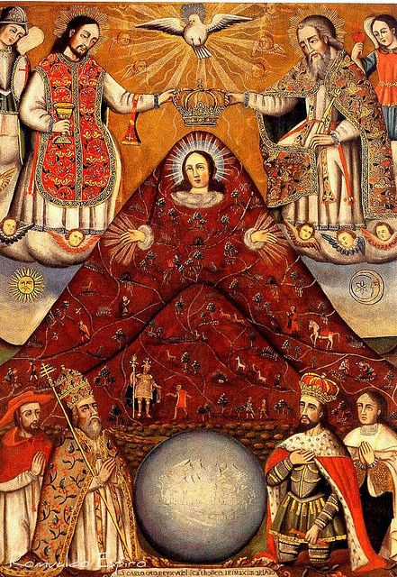
Baroque Painting
Virgen Cerro Rico
Potosí, Bolivia
Andean huaca and the Virgin

Slide 5
Baroque:
Virgen de
Guadalupe

