Slide 1
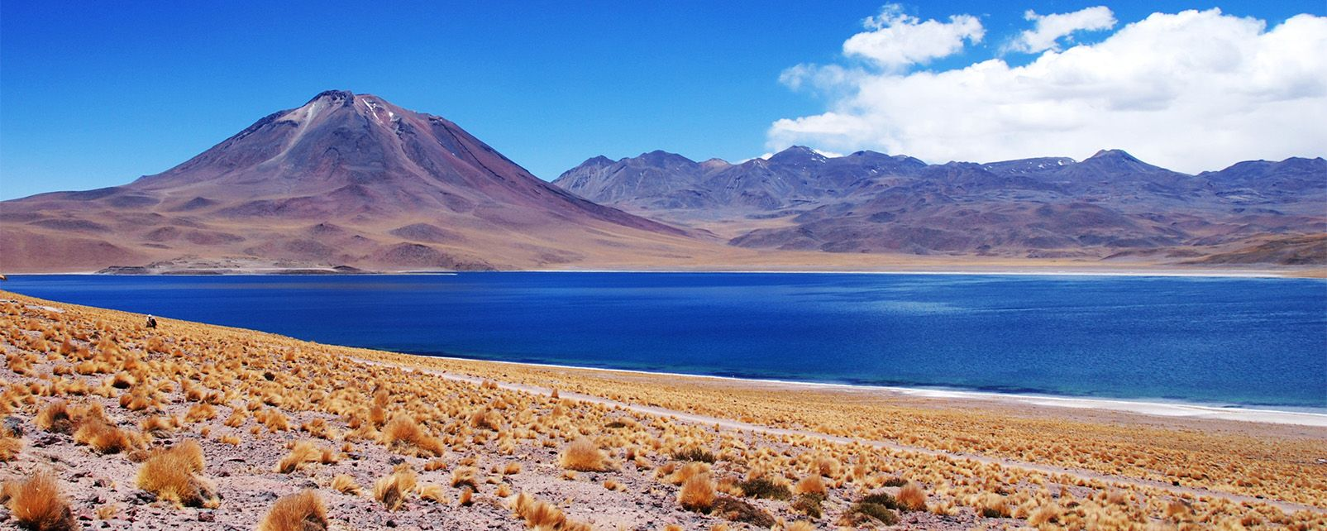
The Andes

Slide 2
The Andes

Slide 3
Agricultural terraces. Andenes

Slide 4
Coca plant

Slide 5
Chicaloma, Yungas

Slide 6
Tiwanaku

