Slide 1
Images from the Popol Vuh

Slide 2
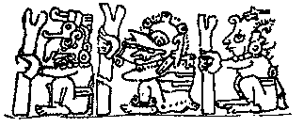
From the Madrid Codex – Maize God ©

